Slide 1
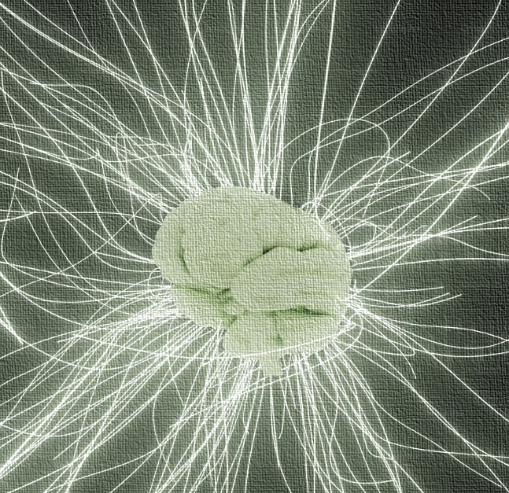
Neural Networks: The Backbone of Artificial Intelligence
Presented To: Dr. Manish Mahajan
Presented By: Tarinee
Enrollment NO: A25305223169

Slide 2
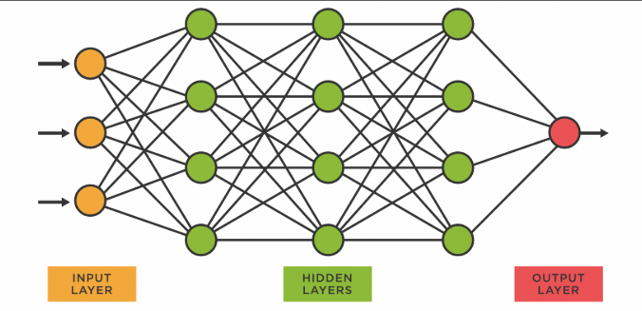
Introduction to Neural Networks
What is Neural Networks?
Neural networks are a class of machine learning algorithms inspired by the structure and functioning of the human brain. They are designed to recognize patterns and make decisions based on data. At a basic level, a neural network consists of layers of nodes (also called neurons) that work together to process input data and produce an output.
What is the key components of Neural Networks?
Neurons
Layers
Weighs and Biases
Activation Function
Learning Process
Training

Slide 3
Evolution of Neural Network
1943:First Airtificial Neuron Model by MCCulloch and Pitts
2010s- Present: Advancement in AI and Deep learning.
1958: Frank Rosenblatt develops the Perceptron.
2012: AlexNet revolutionizes image classification with deep learning.
1960s-70: AI Winter due to the limitation of early models.
1986: Inroduction to Backproagation by Rumelhalt, Hinton, and Williams.

Slide 4
How Neural Networks Works?
Input Layer: The network receives the input data (e.g., image, text, or numerical features).
Weighted Sum: Each input is multiplied by a weight and summed with a bias.
Activation: The result is passed through an activation function to introduce non-linearity.
Hidden Layers: Data is processed in hidden layers to capture complex patterns.
Output Layer: The network produces its prediction or classification result.
Loss Calculation: The prediction is compared to the true output, and the error is calculated.
Backpropagation: The error is propagated back through the network to adjust weights and biases.
Optimization: The network updates its parameters to minimize the loss using techniques like Gradient Descent.

Slide 5
Types of Neural Networks
Feedforward Neural Networks (FNNs):
Description: The most basic type of neural network where data flows in one direction—from the input layer, through hidden layers, and to the output layer. There are no loops or cycles.
Example: A binary classification task, such as predicting whether an email is spam or not, using features like the presence of certain words in the email.
Convolutional Neural Networks (CNNs):
Description: A specialized type of neural network designed for processing structured grid-like data, such as images. CNNs use convolutional layers to automatically detect patterns like edges, textures, and objects.
Example: Image classification, such as identifying objects in images (e.g., detecting whether a picture contains a cat or dog).

Slide 6
Types of Neural Networks(Cont.)
Recurrent Neural Networks (RNNs):
Description: Neural networks designed for sequential data or time-series data. RNNs have loops, allowing information to persist over time and be used for prediction tasks where context matters (i.e., the current output depends on previous inputs).
Example: Speech recognition (transcribing spoken words into text) or predicting stock prices where the model needs to understand the sequence of past events to make future predictions.
Generative Adversarial Networks (GANs):
Description: GANs consist of two neural networks—a Generator and a Discriminator—that are trained together. The generator creates fake data, while the discriminator evaluates whether the data is real or fake. They "compete" with each other to improve their performance.
Example: Image generation, where GANs can create realistic images, such as generating fake faces or artwork, or generating realistic deepfake videos.

Slide 7
Training a Neural Network
Data Preprocessing and Normalization:
Description: Preparing and scaling data (e.g., scaling features to a range) to ensure neural networks perform efficiently.
Example: Normalizing pixel values (0-255) to the range 0-1 for image classification.
Cost Functions and Loss Minimization:
Description: A function that measures the error between predicted and actual values. The goal is to minimize this loss.
Example: Mean Squared Error (MSE) in regression tasks to minimize prediction errors.
Gradient Descent and Optimization Algorithms:
Description: An iterative process used to minimize the cost function by adjusting model weights in the direction of the steepest descent.
Example: Stochastic Gradient Descent (SGD) to optimize a neural network’s weights during training.
Overfitting and Regularization Techniques:
Description: Overfitting occurs when a model learns noise, not just patterns. Regularization techniques like L2 (Ridge) prevent overfitting by penalizing large weights.
Example: Dropout is a regularization technique where random neurons are “dropped” during training to prevent overfitting.

Slide 8
Automated Grading System (based on FNN)
Problem: Traditional grading methods are time- consuming, prone to bias, and inconsistent. Teachers spend hours grading assignments, leading to delays, in feedback.

Slide 9
Methodology
Challenges
1) Understanding complex answers.
2) Training Data Dependency
3) Language Limitations
Data Collection and Preprocessing.
Neural Network Model for Automated Grading
MCQ Grading (using FNN Algorithm)
Short Answer Grading (using NLP and FNN)
Easy Grading (using RNN & Transformer Models)
Future Development
AI- Human hybrid grading models, emotion analysis in student writing, and personalized learning feedback.

Slide 10
Breast Cancer Detection and Treatment (based on CNN)
Problem: Traditional breast cancer detection methods rely on heavily on radiologists' expertise, which cause:
Delayed diagnosis due to human limitation.
Inconsistent results due to subjective interpretation.
Missed early- stage tumors, especially in dense breast tissue.

Slide 11
Methodology
1) Data Collection
DDSM (Digital Database for Screening Mamography)
INbreast (Full- field digital Mamography dataset)
BreakHis (Break Cancer Histopathological Image Dataset)
2) Image Preprocessing
Noise Reduction
Contrast Enhancement
Segmentation
Normalization
3) CNN Model Architecture
Input Layer
Convolutional Layer
Pooling Layers
Fully Connected Layers
Output Layer
Challenges
1) Data Availability
2) Interpretability
3) Generalization Issues
Future Development
Hybrid AI models
Explainable AI
3d CNNs for MRI analysis

Slide 12
VIDEO CAPTIONING (based on RNN)
Problem: Traditional video captioning methods rely on manual annotation, which is time- consuming, labor- intensive, and prone to human errors. The goal is to develop an automated deep learning model that can generate meaningful captions for video in real- time.

Slide 13
Seq2Seq model with CNN- RNN Architecture
CHALLENGES:
Video understanding complexity
Data Annotation
Language Ambiguity
Computational Cost
FUTURE ENHANCEMENTS
Transformer- Based approaches
Multimodal Learning
Few- Shot & Zero Shot Learning
Real- Time Video Captioning
Steps are:
Feature Extraction: CNN extracts visual features from video frames.
Sequence Modeling: A RNN or transformer encodes temporal dependencies between frames.
Text Generation: A decoder converts extracted features into a coherent sentence.

Slide 14
Virtual Try- On Systems (based on GAN)
Problem: Online shoppers often struggle with size, fit, appearance, when buying clothing. Traditional online shopping relies on static images, leading to uncertain purchases and high return rates.

Slide 15
TECHNOLOGY INVOLVED
CHALLENGES
Accurate body shape detection
Realistic fabric simulation
Data privacy concerns
CNN: Extract key clothing features.
GANs: Synthesis realistic clothing textures.
Pose Estimation Networks: Identify human body positions for accurate fitting.
3D Mesh Reconstruction: Maps clothing onto avatars realistically.
FUTURE ADVANCEMENTS
AR Integration
AI Generated personalized recommendation
Blockchain Based Secure Data Storage
Multi- angle try- on

Slide 16
Challenges in Neural Networks
Data Requirements: Neural networks require large amounts of labeled data to perform well, which can be hard to obtain in some fields.
Computational Power: Training deep neural networks demands significant computational resources, often requiring GPUs or specialized hardware.
Overfitting: Neural networks can memorize data instead of learning general patterns, leading to poor performance on new, unseen data.
Interpretability: Neural networks are often considered "black boxes," meaning their decision-making process is hard to understand, especially in complex models.
Training Time: Training deep networks can take a long time, especially for large datasets, and fine-tuning parameters requires trial and error.
Hyperparameter Tuning: Selecting the right architecture, learning rate, and other hyperparameters is often challenging and time-consuming.

Slide 17
Why Use Neural Networks?
Handle Complex Data: They excel at processing large and complex datasets, such as images, text, and audio, making them ideal for tasks like image recognition, natural language processing, and speech recognition.
Learn Patterns Automatically: Neural networks can automatically learn patterns and features from raw data, eliminating the need for manual feature extraction.
Adaptability: They can be trained to improve over time, adapting to new data and changing conditions.
Non-Linearity: Neural networks can model non-linear relationships, which many traditional algorithms can't handle.
Versatility: They are highly flexible and can be used for various tasks, including classification, regression, and generation of new data.

Slide 18
Applications of Neural Network
Object Detection
Face Recognition
Sentimental Analysis
Drones and UAVs
Handwriting Recognition
Medical Imaging and Diagnostics

Slide 19
Future of Neural Networks
Faster, More Efficient Models: Advancements in hardware (e.g., quantum computing, AI chips) will enable faster, more efficient neural networks.
Reduced Data Dependency: Techniques like transfer learning and few-shot learning will minimize the need for large datasets.
Better Explainability: Improved methods for explainable AI will make neural networks more transparent and trustworthy.
Ethical AI Frameworks: Stronger ethical guidelines will ensure responsible and fair use of neural networks.
Wider Industry Applications: Neural networks will continue transforming healthcare, robotics, finance, and autonomous systems.
Overcoming Biases and Challenges: Ongoing research will address issues like data bias and model interpretability.

Slide 20
Conclusion
Neural networks have revolutionized fields like computer vision, natural language processing, and autonomous systems, offering unprecedented capabilities in learning from data. Despite challenges like computational demands and ethical concerns, ongoing advancements in AI models, hardware, and explainability are shaping a promising future. As neural networks continue to evolve, they will drive innovation across industries, creating smarter, more efficient technologies while addressing societal challenges responsibly.

Slide 21
Thank You

