Slide 1

Team – 8
Kesireddy PRADEEp
HIMA BINDU TARINI
BhaGYALAKSHMI BIKKI
SARAT VENKATA

Slide 2
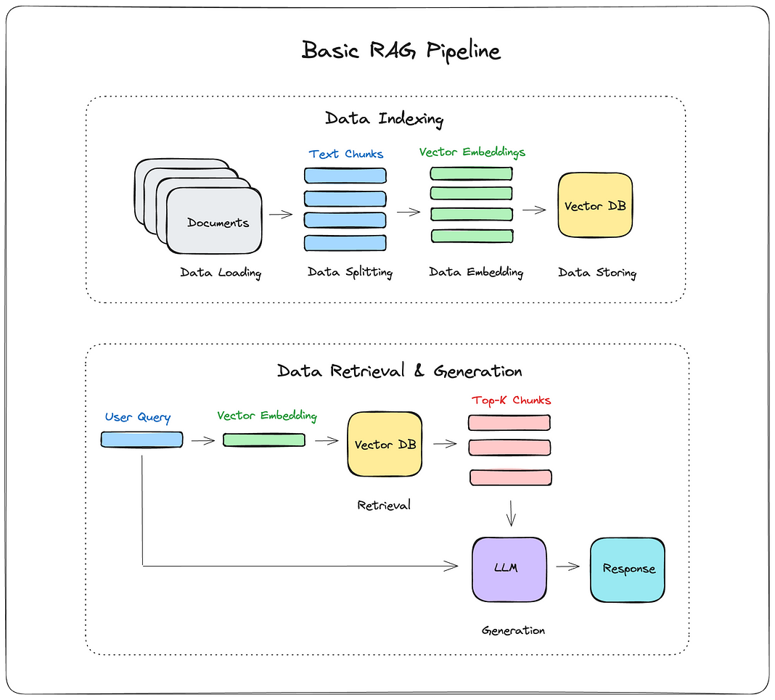
RAG Workflow

Slide 3
RAG Pipeline
The Retrieval-Augmented Generation (RAG) pipeline consists of two main phases:
Data Indexing:
Data Loading: Import documents.
Data Splitting: Break large documents into smaller chunks (e.g., 500 characters).
Data Embedding: Convert data into vector representations using an embedding model.
Data Storing: Save vector embeddings in a vector database for efficient searching.
Retrieval & Generation:
Retrieval: Convert user queries into vectors, match them against stored vectors, and retrieve the most relevant chunks.
Generation: Use an LLM to combine the user query with retrieved data to generate a response.

Slide 4
Experimental Models
Chunking | Embedding model | Vector DB | Retrieval Method | Reranking | Response LLM
Sliding window chunking with window size=4, overlap=1 | BAAI/bge-base-en | FAISS | FAISS index with cosine similarity(IP) based search |  | HugggingfaceH4/Zephyr-7b-beta
Sliding window chunking with window size=4, overlap=1 | all-MiniLM-L6-v2 | FAISS | FAISS index with cosine similarity(IP) based search + KNN(1000) |  | meta-llama/Llama-3.1-8B-Instruct
Sliding window chunking with window size=4, overlap=1 | all-MiniLM-L6-v2 | FAISS | FAISS index with cosine similarity(IP) based search + KNN(1000) | MMR | HugggingfaceH4/Zephyr-7b-beta
Sliding window chunking with window size=4, overlap=1 | all-MiniLM-L6-v2 | FAISS | FAISS with IVF(inverted file index) and ANN(1000) | MMR | meta-llama/Meta-Llama-3-70B-Instruct
Sliding window chunking with window size=4, overlap=1 | all-MiniLM-L6-v2 | MILVUS | TF-IDF vectorizer + ANN(1000) | Cosine Similarity | HugggingfaceH4/Zephyr-7b-beta

Slide 5
Explainability Attributes for Generated Response
We assess alignment between retrieved documents, the query, and the generated response using Meta-Llama3-70b-8192 with RAGBench’s predefined prompt to extract the following attributes:
Relevance Explanation – Justifies why retrieved documents match the query intent.
All Relevant Sentence Keys – Identifies key sentences supporting the response.
Overall Supported Explanation – Assesses factual grounding of the response.
Overall Supported (Binary) – Yes/No indicator of factual support.
Sentence Support Information – Maps response segments to supporting retrieved sentences.
All Utilized Sentence Keys – Identifies retrieved content used in response generation
.

Slide 6
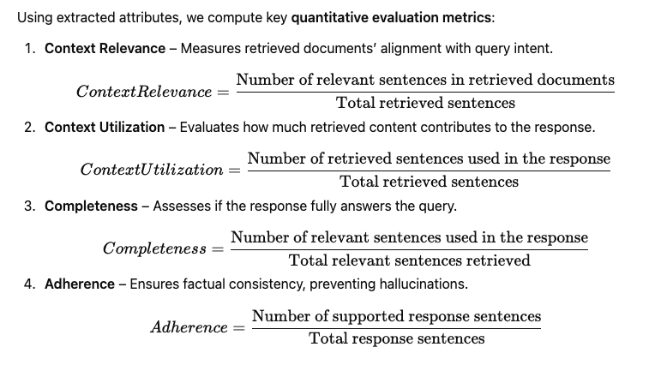
TRACE Metrics

Slide 7
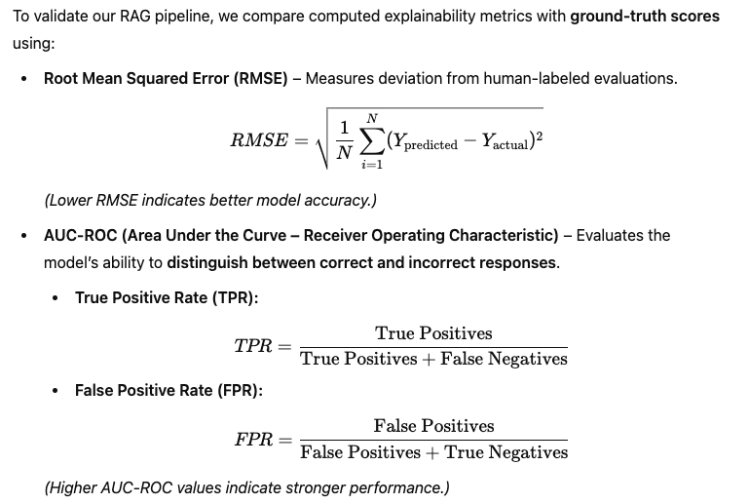
Evaluation Metrics (Llama3-70b-8192 Evaluation Model)

Slide 8
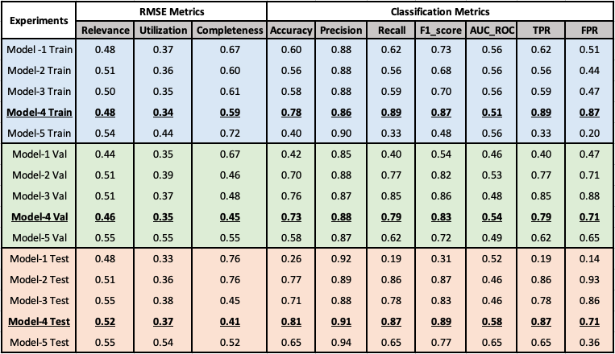
Experiment Results

Slide 9
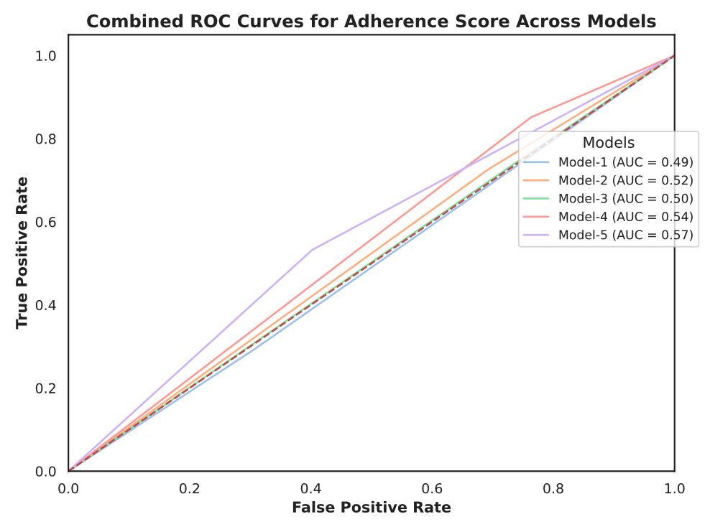
Experiment Results

Slide 10
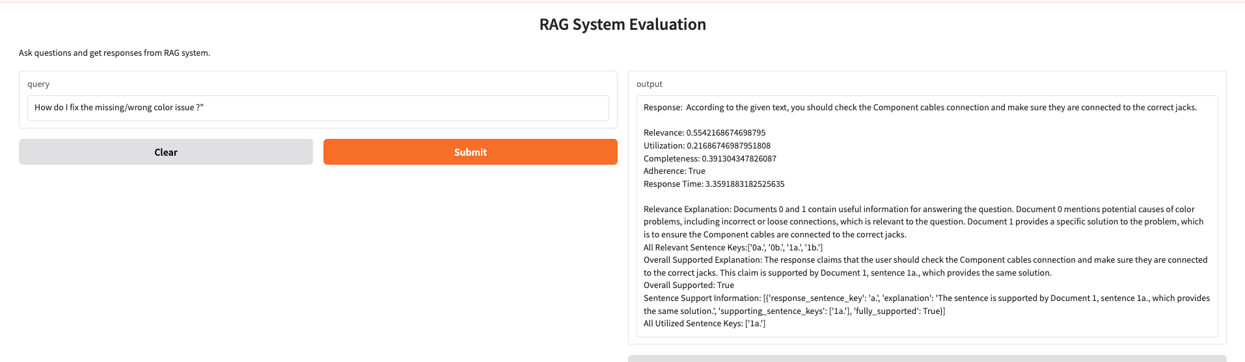
Proposed RAG Result

Slide 11
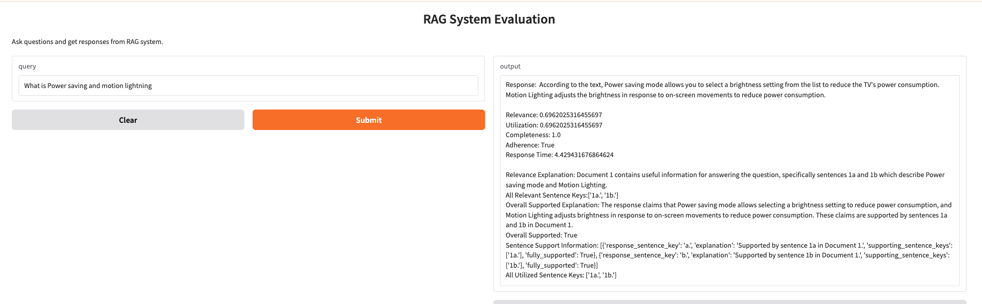
Proposed RAG Result

Slide 12
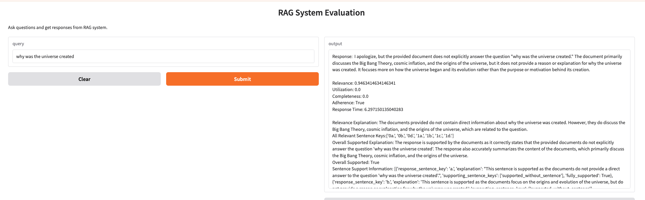
Proposed RAG Result

Slide 13
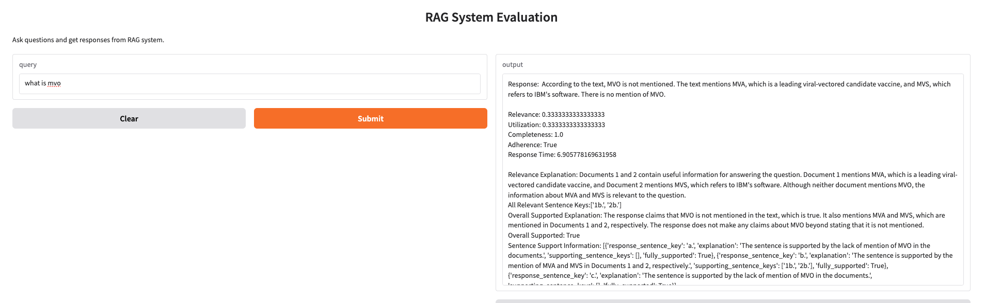
Proposed RAG Result

Slide 14
Benchmarking LLM in RAG: Noise Robustness
Noise robustness measures how well an LLM can extract useful information from noisy documents
Summary:
This shows LLMs struggle with noise Higher noise levels significantly impact all models.
DeepSeek-R1-Distill-Qwen-32B is the most robust model. This suggests it is better at handling noisy documents.
Noise significantly impacts LLM accuracy, highlighting the need for improved retrieval and reasoning mechanisms.
Noise Robustness
Noise Ratio | 0 | 0.2 | 0.4 | 0.6 | 0.8
Mistral-7B-Instruct-v0.3 | 99 | 98 | 97 | 96.77 | 90.667
Qwen2.5-72B-Instruct | 97.5 | 87.8 | 95.5 | 94 | 88
DeepSeek-R1-Distill-Qwen-32B | 99.7 | 99 | 98.3 | 93.67 | 93

Slide 15
Benchmarking LLM in RAG: Negative Rejection
Measures how well an LLM rejects answering when provided only with irrelevant (noisy) documents.
A low rejection rate suggests the model hallucinates answers instead of rejecting them.
A higher rejection rate means the model is better at recognizing when it lacks sufficient information
Summary:
Qwen2.5-72B-Instruct has the highest rejection rate (18.2%)
LLMs struggle to strictly follow instructions & Models can be misled by noisy information
Negative Rejection
Model Name | Accuracy when Noise Ratios =1 | Rejection Rate
mistralai/Mistral-7B-Instruct-v0.3 | 41 | 4.5
Qwen/Qwen2.5-72B-Instruct | 58.2 | 18.2
deepseek-ai/DeepSeek-R1-Distill-Qwen-32B | 37 | 10.3

Slide 16
Benchmarking LLM in RAG: Information Integration
Information Integration
Noise Ratio | 0 | 0.2 | 0.4
mistralai/Mistral-7B-Instruct-v0.3 | 73 | 65 | 57
Qwen/Qwen2.5-72B-Instruct | 92 | 87.8 | 85.6
deepseek-ai/DeepSeek-R1-Distill-Qwen-32B | 81 | 80 | 78
Summary:
Qwen2.5-72B-Instruct performs best (92% accuracy)
This model has the strongest ability to extract and integrate relevant information when no noise is present.
Suggests better comprehension and retrieval processing compared to the other models.
LLMs struggle to fully utilize information, even in clean data settings.
Adding noise significantly reduces performance.
Suggests that models have difficulty distinguishing relevant from irrelevant information.
Information from multiple documents can act as “noise” to each other.
This makes it difficult for the model to extract only the correct data points and integrate them into a meaningful answer.

Slide 17
Benchmarking LLM in RAG: Counterfactual Robustness
Counterfactual Robustness
Model Name | Without Doc (Accuracy ) | With Positive Doc (Accuracy ) | Error Detection Rate | Error Correction Rate
Qwen2.5-72B-Instruct | 75 | 13 | 2 | 33.66
DeepSeek-R1-Distill-Qwen-32B | 96 | 84 | 8 | 25.66
Mistral-Nemo-Instruct-2407 | 72 | 7 | 0 | 0
All models suffered drastic performance drops when presented with incorrect documents.
Error Detection is generally poor (ED is below 10% for all models).
Even when errors are detected, correction is inconsistent.
LLMs are easily misled by false information in retrieval-augmented setups

