Slide 1

MUSE
Tariq Georges, Usman Jalil, John Burke,
Ahmed Benmensour, Killian McShane

Slide 2
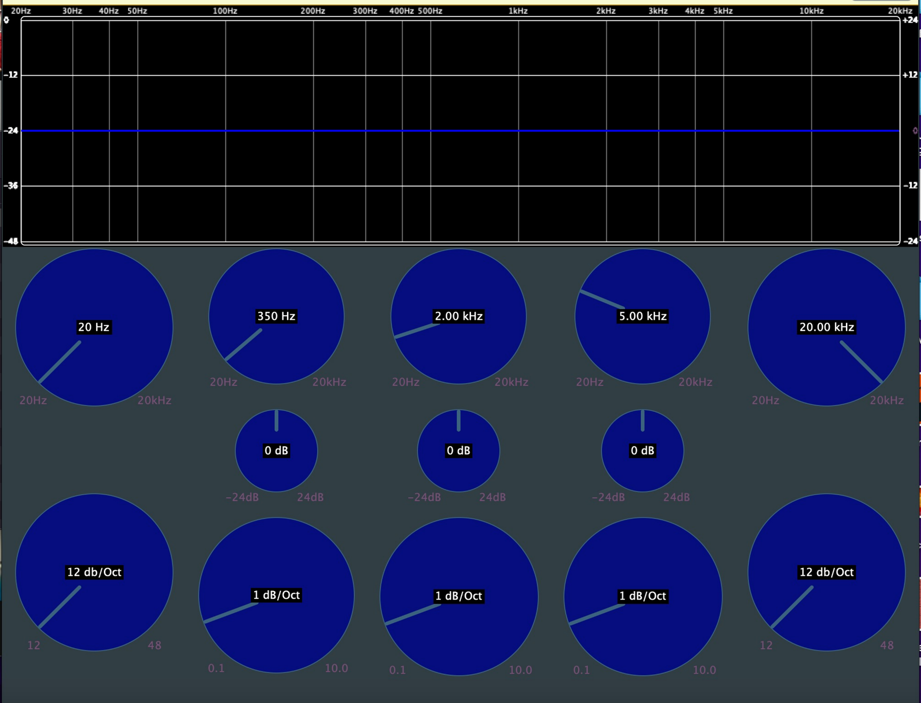
MUSE EQ:
Interface
MUSE EQ is a 5-band EQ filter that can filter and cut frequencies from 20-20,000 Hz
The Low/High cut bands can cut out frequencies by a specified slope
The parametric/middle bands can increase/decrease gain and quality
All functionality and display code is created and run in:
PluginProcessor.cpp (Functionality)
PluginProcessor.h
PluginEditor.cpp (Display)
PluginEditor.h
LOW
HIGH

Slide 3
MUSE EQ: Cut bands
The two cut bands are the Low Cut and High Cut filters
Both are established in the PluginProcessor.cpp/.h files
In these files we added parameters in the createParameterLayout() the ability to change the slope of the line (12, 24, 36, 48 decibels/octave)
These parameters start to work by the makeCutFilter() function that are based from the juce Coefficients library
Not only can you lower frequencies, but depending on the intensity, you can completely cut out audio frequencies
LOW
HIGH

Slide 4
MUSE EQ: Parametric bands
There are three parametric bands: Lo-Mid, Mid, and Hi-Mid
Each band, which are created through the makePeakFilter() functions can be adjusted by: Frequency location, Gain, and Quality
With the combination of these it allows for the user to cut out or add frequencies on the spectrum.
The JUCE framework provided support for one, but we decided to include two more to allow for more variation in adjusting and filtering sound
LOW
HIGH

Slide 5
MUSE EQ:
Response Display
The Response Curve Display represents to the user a quantifiable way in which their input is altering their audio
It is built by the ‘ResponseCurveComponent’ object.
This object is drawn through the combination of the ‘paint’ and ‘resized’ member functions.
These functions establish the borders, colors, and various text elements displayed in the response curve region.
They update every time any one of the audio bands is manipulated, this update functionality comes from the timerCallback member function.
LOW
HIGH

Slide 6
MUSE EQ: Knobs / General Display
The knobs that the user sees are generated each as an object: ‘RotarySliderWithLabels’ as a member variable of the main ‘FiveBandEQAudioProcessorEditor’
‘RotarySliderWithLabels’ is a derivative of a JUCE standard class: ‘Slider’, and is modified by the LookAndFeel struct, which is responsible for the custom colors and text location of the sliders
‘RotarySliderWithLabels’ contains the member functions ‘getTextHeight’, ‘getDisplayString’, and ‘paint’, which are responsible for determining the font size on the knobs, displaying the information described in the text, and for outputting interface respectively
LOW
HIGH

Slide 7
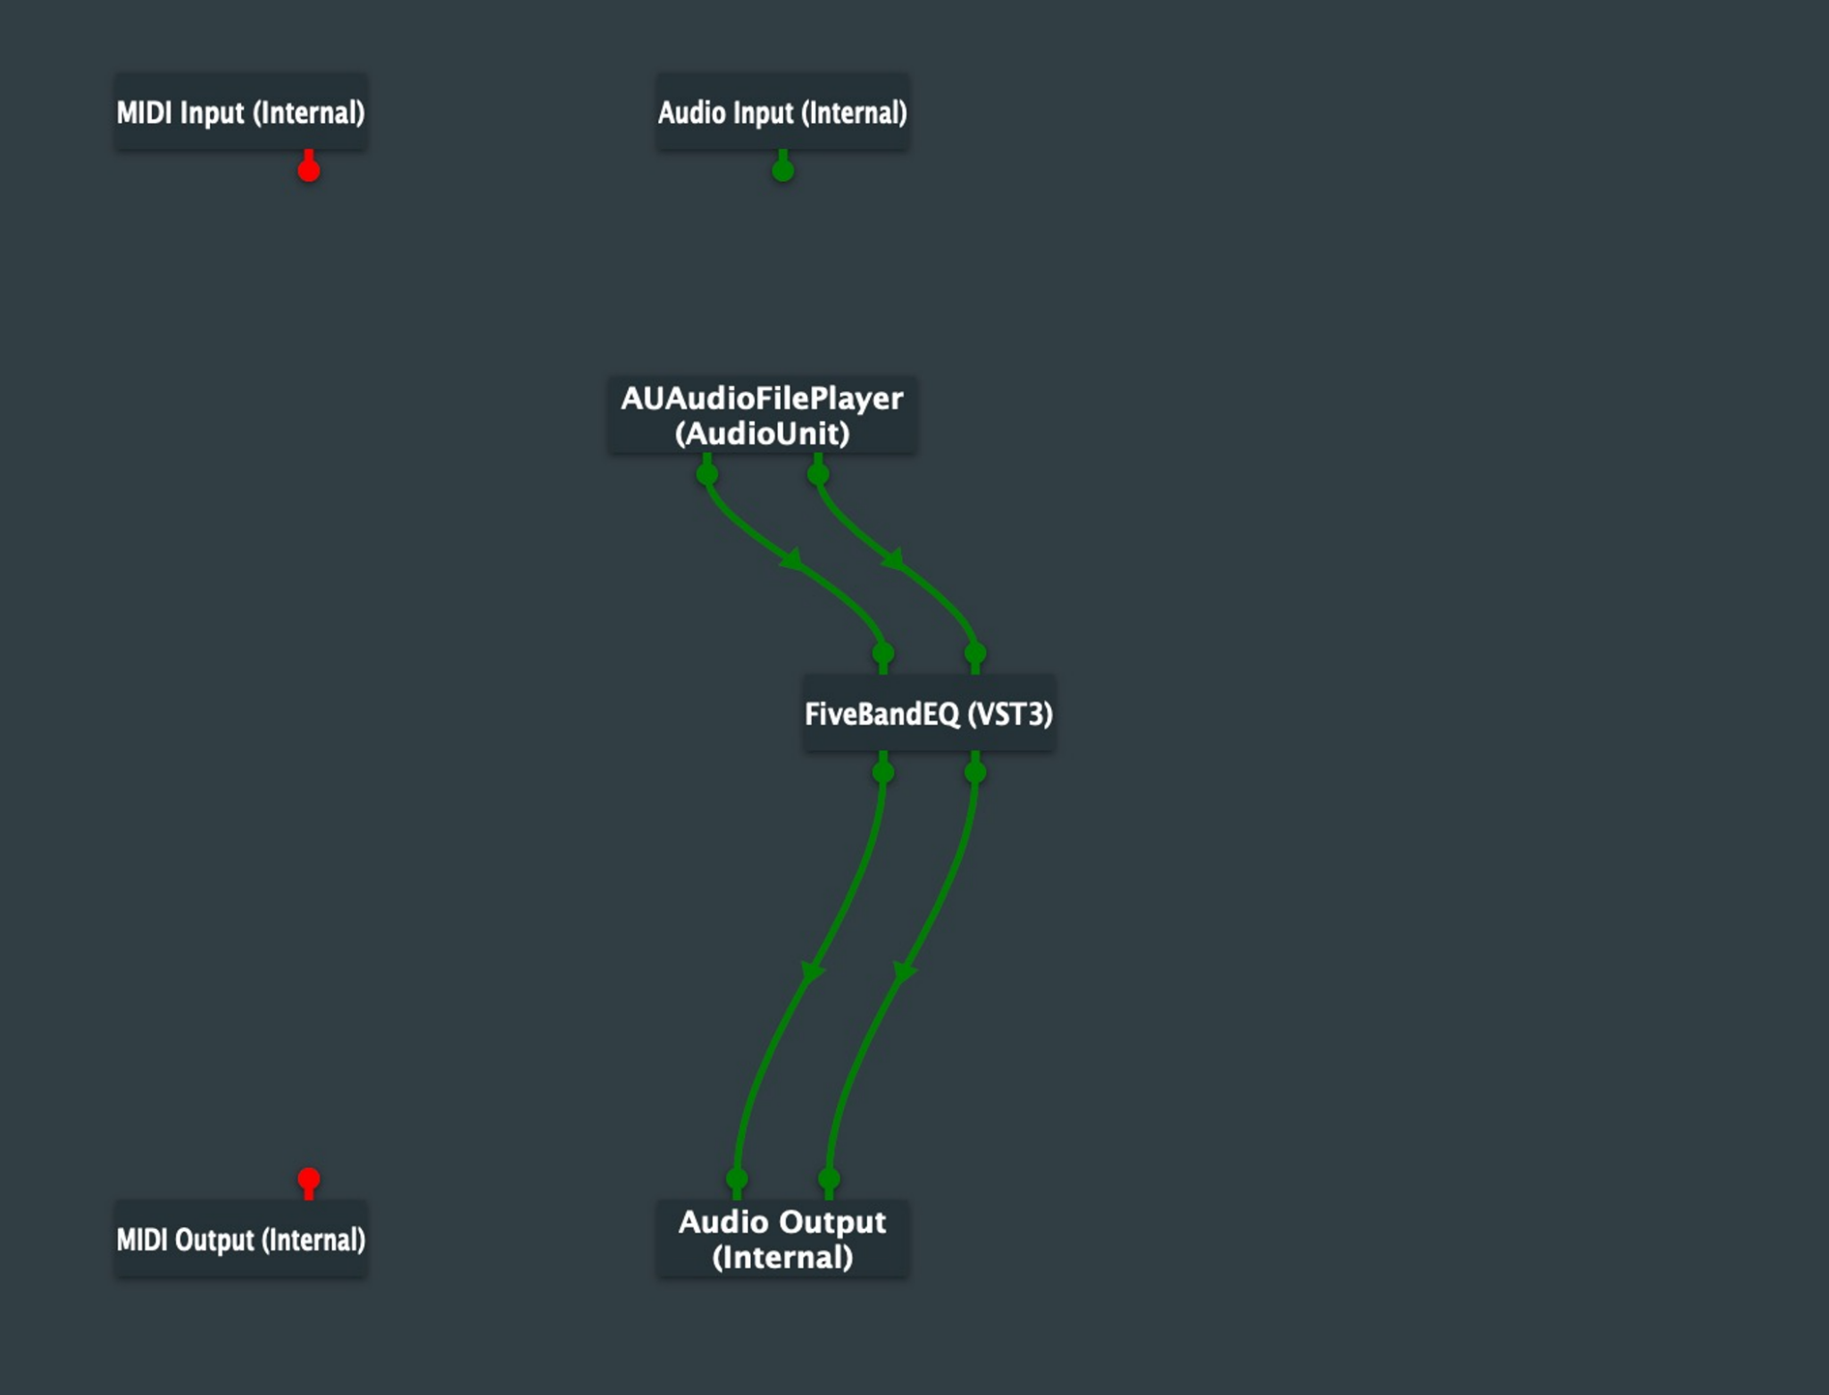
MUSE EQ: Input and Output
Through the processBlock function and the JUCE framework, the user is able to run audio in a chain of multiple different plugins without interference or latency.
This allows a user to be able to add different effects in addition to the MUSE EQ
*The picture on the left is an example of how audio would be run through the plugin*

