Slide 1
Claim Detection from middle and high school student essays
Tariq Alhindi
Debanjan Ghosh
Notes:
Take your time on this slide: Mention that those essays from the writing mentor

Slide 2
Motivation
The central component of the argument is the claim
“an assertion that deserves our attention” (Toulmin, 2003)
“a statement that is in dispute and that we are trying to support with reasons” (Govier, 2010)
Argumentation
segmentation, component (claim, premise) and relation (support, attack) detection
claim example “Parents should be limiting screen time for their children”
Argument/Claim Detection applications
Assess public opinion on political and social issues to foster public deliberation
Refine search and information retrieval
other applications: legal documents, fact-checking
Copyright © 2020 by Educational Testing Service. All rights reserved. ETS and the ETS logo are registered trademarks of Educational Testing Service (ETS). 462301852

Slide 3
Motivation
Educational Applications
Analyze students' writings for scoring (Klebanov et al. 2014, Ghosh et al. 2016)
Generate quantitative and qualitative feedbacks to help students (K-12) writings such as on the Writing Mentor app
Notes:
[ETS] # of claims associated with high scores
# of dangling (unsupported claims) with low scores

Slide 4
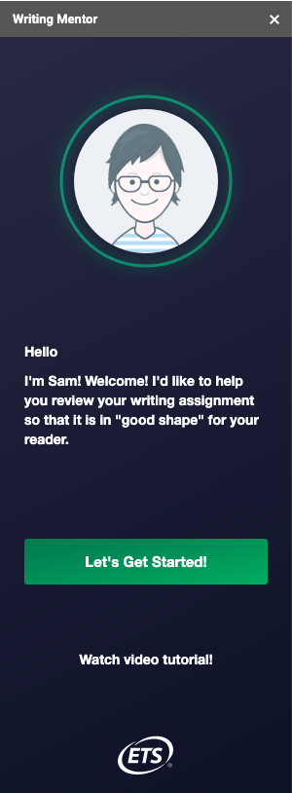
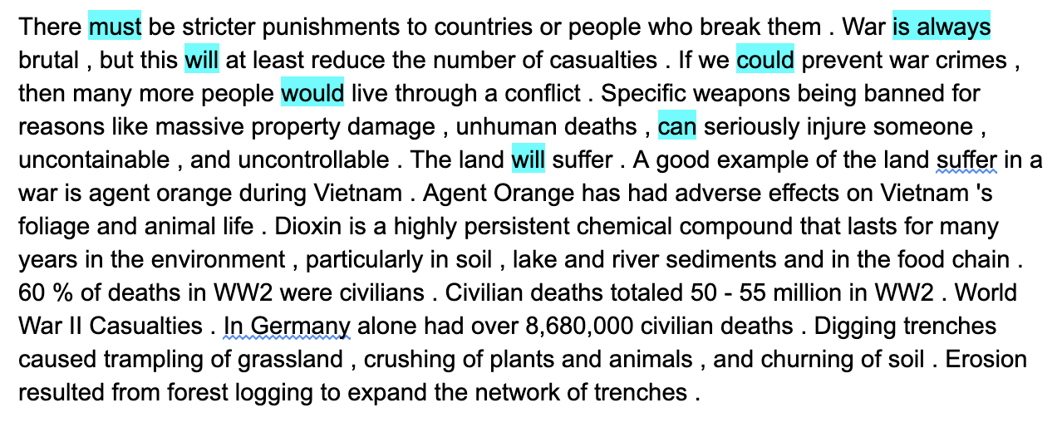
Writing Mentor App
Essay
https://mentormywriting.org/
Copyright © 2020 by Educational Testing Service. All rights reserved. ETS and the ETS logo are registered trademarks of Educational Testing Service (ETS). 462301852
Notes:
Writing Mentor is an Add-on in google docs that has a number of functionalities, one of which is showing claims in essay
This essay is written by a middle/high school student.
It talks about war and ….
When we ask the app to show the claims in the text, we get the following highlighted terms
This will be a running example that we show throughout the presentation

Slide 5
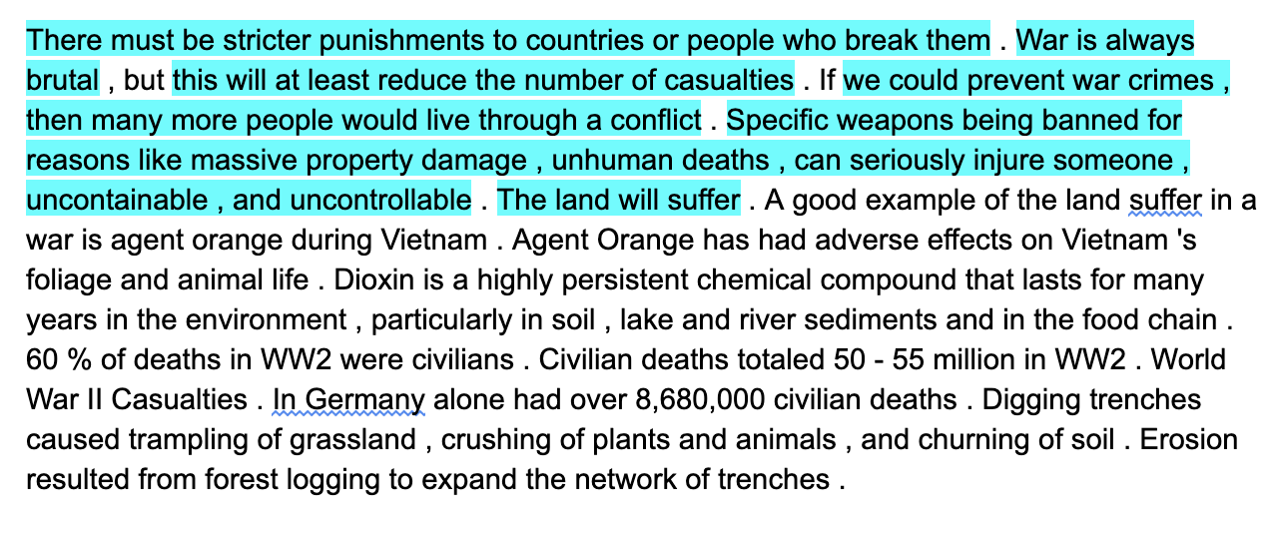
Annotations
WM App (lexicon-based)
Copyright © 2020 by Educational Testing Service. All rights reserved. ETS and the ETS logo are registered trademarks of Educational Testing Service (ETS). 462301852
Notes:
Mention: Lexicon and Rule based
We had this essay annotated for claims by our annotators
more on that later
Difference between the two: words vs segments
However, current WM app gets claim words in the almost all the annotated claims

Slide 6
Research questions
Can we detect claim boundaries at the token level from student essays?
If we could prevent war crimes , then many more people would live through a conflict .
War is always brutal , but this will at least reduce the number of casualties .
Can we develop robust claim detection models that go beyond lexicon-based matching?

Slide 7
Task
Claim Token Detection in each sentence using a B-I-O setup
B beginning of a claim
I inside a claim
O outside a claim
If we could prevent war crimes , then many more people would live through a conflict . War is always brutal , but this will at least reduce the number of casualties .
Copyright © 2020 by Educational Testing Service. All rights reserved. ETS and the ETS logo are registered trademarks of Educational Testing Service (ETS). 462301852

Slide 8
Task
Claim Token Detection in each sentence using a B-I-O setup
B beginning of a claim
I inside a claim
O outside a claim
If we could prevent war crimes , then many more people would live through a conflict . O B I I I I I I I I I I I I I I O War is always brutal , but this will at least reduce the number of casualties . B I I I O O B I I I I I I I I O
Copyright © 2020 by Educational Testing Service. All rights reserved. ETS and the ETS logo are registered trademarks of Educational Testing Service (ETS). 462301852

Slide 9
Outline of the Talk
Background and Data
Features and Models
Results
Discussions and Future Work

Slide 10
Background
Segmentation (argument token detection) Argument Type Detection (claim, premise) Argument Relation Detection (support, attack) using 400 argumentative essays (Stab & Gurevych, 2017, Eger et al. 2017))
Sentence Claim Detection (-) a sentence might have multiple claims (-) a sentence might have a claim and a premise Cross-domain claim detection in 6 datasets (Daxenberger et al. 2017) Using unlabeled data from the same domain (Chakrabarty et al. 2019)
Copyright © 2020 by Educational Testing Service. All rights reserved. ETS and the ETS logo are registered trademarks of Educational Testing Service (ETS). 462301852
Notes:
Training on multiple datasets

Slide 11
Annotation Efforts
Continuing annotation of argumentative and narrative essays with 3 annotators
Annotation of claims, arguing expressions (``I agree’’) and opinions (``music makes people feel good‘’), etc.
Several rounds of calibration to finalize the guideline
10 essays (argumentative and narrative) were triple annotated in the pilot task
65 essays are annotated by pair(s); rest are annotated by one annotator
Average pairwise agreement is in mid 80s (Wiebe et al., 2005)
Copyright © 2020 by Educational Testing Service. All rights reserved. ETS and the ETS logo are registered trademarks of Educational Testing Service (ETS). 462301852
Notes:
essay type is self-labeled in the title by the writer
This project is different; empirical and annotation are going in parallel
IAA mertic: keep one annotation as gold and measure the other based on the overlap between gold and annotator
do the opposite
get the average
more data coming:
70 narrative
25 argumentative, 15 of the old ones with premise annotations

Slide 12
Dataset
Argumentative
Narrative
Split | Essays | B-claim | I-claim | O-claim | Total
train | 45 | 951 | 10,263 | 25,332 | 36,546
test | 45 | 707 | 7,407 | 16,841 | 24,955
Split | Essays | B-claim | I-claim | O-claim | Total
test | 45 | 121 | 34,879 | 21,465 | 36,195
Copyright © 2020 by Educational Testing Service. All rights reserved. ETS and the ETS logo are registered trademarks of Educational Testing Service (ETS). 462301852
Notes:
Mention An on-going process
Now we have more narrative

Slide 13
Outline of the Talk
Background and Data
Features and Models
Results
Discussions and Future Work

Slide 14
Features
Discrete Features
Word Embeddings from Transformers (e.g. BERT)
Models
Logistic Regression (Token Classification)
Conditional Random Field (Sequence Classification)
Deep Learning Models (Transformers)
Copyright © 2020 by Educational Testing Service. All rights reserved. ETS and the ETS logo are registered trademarks of Educational Testing Service (ETS). 462301852

Slide 15
Discrete Feature Groups
Structural token position features, punctuation features position of covering sentence
Syntactic POS, Lowest common ancestor (LCA), LCA types
Lex-Syntactic Relations governing the token and its context N hops deep in retrieving relations Features: (token, previous, next): token_dependency-relation
Christian Stab, and Iryna Gurevych. "Parsing argumentation structures in persuasive essays." Computational Linguistics (2017)
Copyright © 2020 by Educational Testing Service. All rights reserved. ETS and the ETS logo are registered trademarks of Educational Testing Service (ETS). 462301852
Notes:
Mention that
we tested on SG data; and that our lexsyn features are performing better
Actual number of features is larger
We run Logistic Regression using SKLL
Structural
token position features:
Token present in introduction or conclusion
Token is first or last token in sentence
Relative and absolute token position in document, paragraph and sentence
punctuation features
Token precedes or follows any punctuation, full stop, comma and semicolon;
Token is any punctuation or full stop
position of covering sentence:
Absolute and relative position of the token’s covering sentence in the document and paragraph
Syntactic
POS: The token’s part-of-speech
Lowest common ancestor (LCA):
Normalized length of the path to the LCA with the *following* and *preceding* token in the parse tree
LCA types:
The two constituent types of the LCA of the current token and its preceding and following token
Lex-Syntactic
A modification of SG2017 LexSyn features.
We get the relations governing the token and its previous and next tokens. We also go N hops deep in retrieving those relations where N(hops) is a input to this function
Features: (token, previous, next)
dependency-relation
token_dependency-relation

Slide 16
Feature-based Models
Logistic Regression (LR)
Takes a single token as input.
Conditional Random Field (CRF)
Takes a sequence as input (sentence)
Make prediction to each element (token) in the sequence while considering other neighboring elements (tokens in the same sentence)
Copyright © 2020 by Educational Testing Service. All rights reserved. ETS and the ETS logo are registered trademarks of Educational Testing Service (ETS). 462301852

Slide 17
Deep Learning Models
Training a Neural Network, from scratch with layers such as: Dense (fully-connected) Convolutional (zonal information; filters) Recurrent (sequential)
Pretrained transformers (e.g., BERT) as feature extractors language models trained on a lot of data (wikipedia, google books) using embeddings generated by these models as features
Pretrained transformers as classifiers fine-tuning on the task (training partition) fine-tuning on a related unlabeled corpus
Copyright © 2020 by Educational Testing Service. All rights reserved. ETS and the ETS logo are registered trademarks of Educational Testing Service (ETS). 462301852

Slide 18
Fine-tuning Transformers
Training a Bert-based classifier
Fine-tuning on the training partition
model choice and hyperparameter tuning (cased vs uncased, batch size, number of epochs, etc.), weighted loss per class according to class frequencies
Copyright © 2020 by Educational Testing Service. All rights reserved. ETS and the ETS logo are registered trademarks of Educational Testing Service (ETS). 462301852

Slide 19
Fine-tuning Transformers
Training a Bert-based classifier
Fine-tuning on the training partition
model choice and hyperparameter tuning (cased vs uncased, batch size, number of epochs, etc.), weighted loss per class according to class frequencies
language model fine-tuning on argumentative corpora: IMHO: trained on argumentative subreddit (Chakrabarty et al. 2019)
GRE essays: trained on student essays (Ghosh et al. 2020)
Copyright © 2020 by Educational Testing Service. All rights reserved. ETS and the ETS logo are registered trademarks of Educational Testing Service (ETS). 462301852
Notes:
Over 5 million sentences

Slide 20
Outline of the Talk
Background and Data
Features and Models
Results
Discussions and Future Work

Slide 21
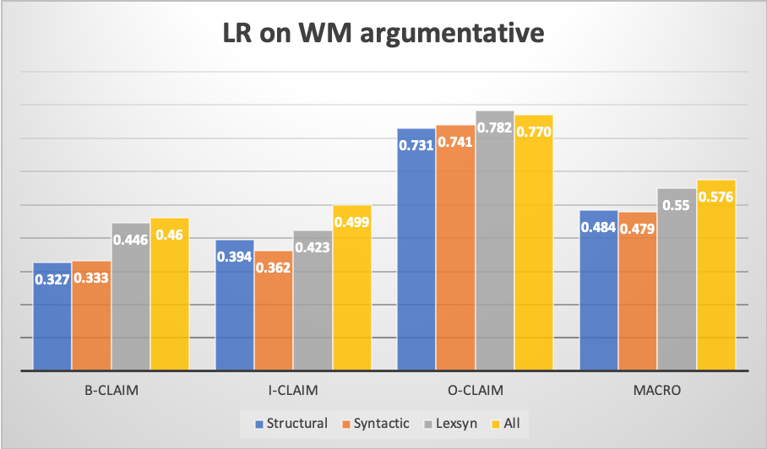
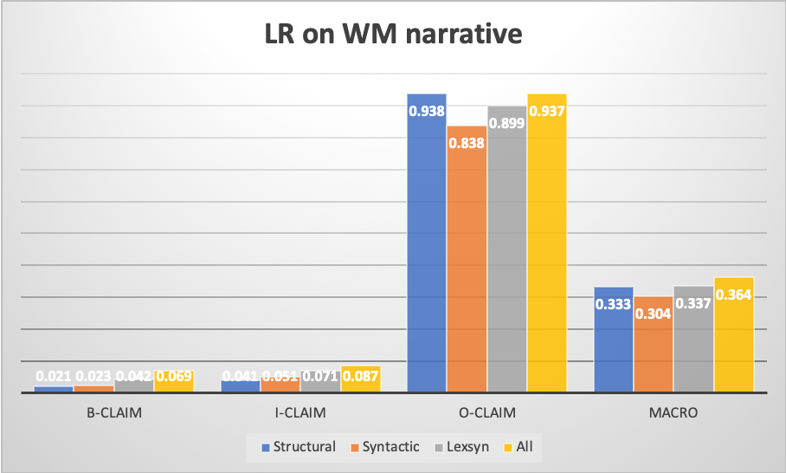
Results - LR
F1 score
Copyright © 2020 by Educational Testing Service. All rights reserved. ETS and the ETS logo are registered trademarks of Educational Testing Service (ETS). 462301852

Slide 22
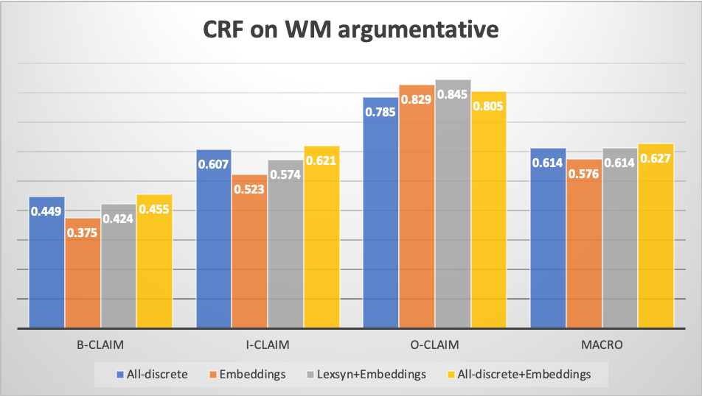
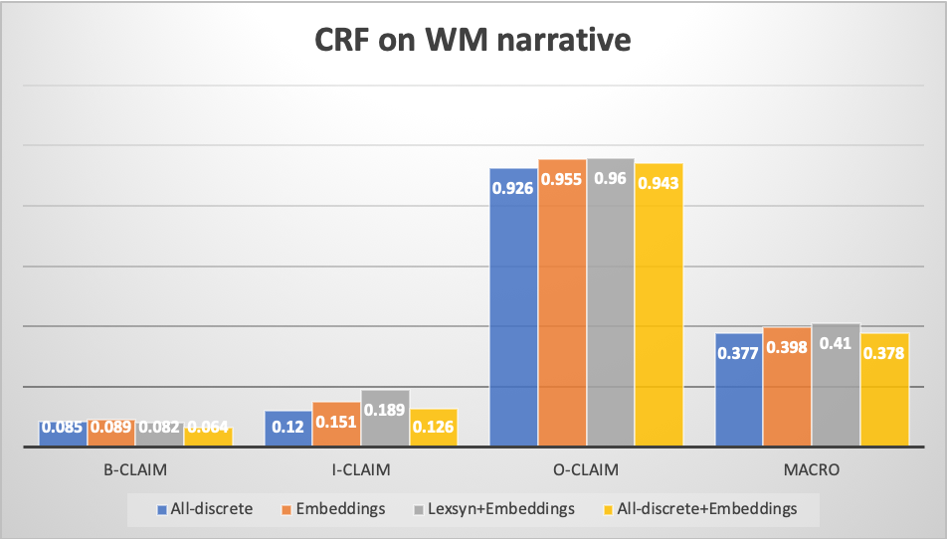
Results - CRF
F1 score
Copyright © 2020 by Educational Testing Service. All rights reserved. ETS and the ETS logo are registered trademarks of Educational Testing Service (ETS). 462301852
Notes:
Claims in narrative
1. Domain difference
2. Lower number of claims

Slide 23
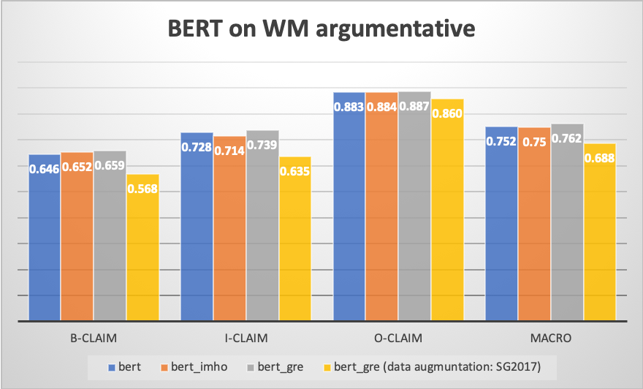
Results - BERT
F1 score
Copyright © 2020 by Educational Testing Service. All rights reserved. ETS and the ETS logo are registered trademarks of Educational Testing Service (ETS). 462301852
Notes:
Data augmentation: we also used a data from another source
more mature writers
annotation guidelines are different
Mention that we don’t run all variations of BERT on the narrative test set because we just got it

Slide 24
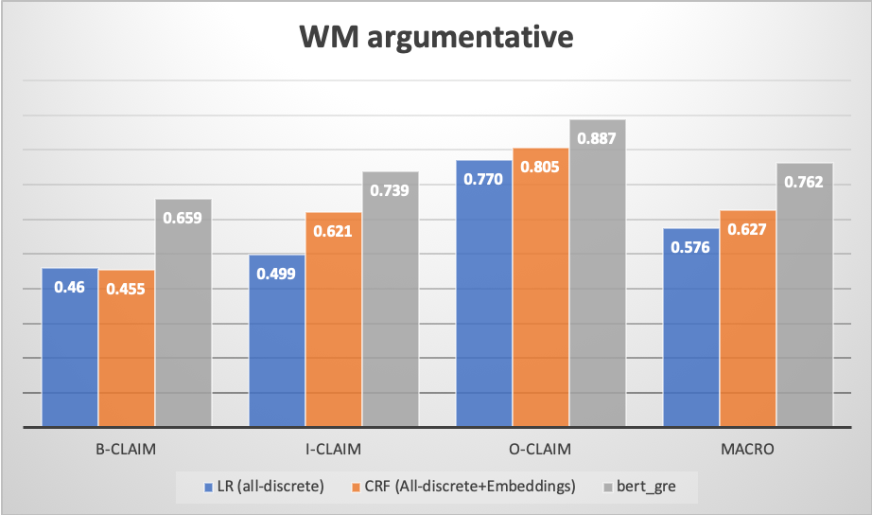
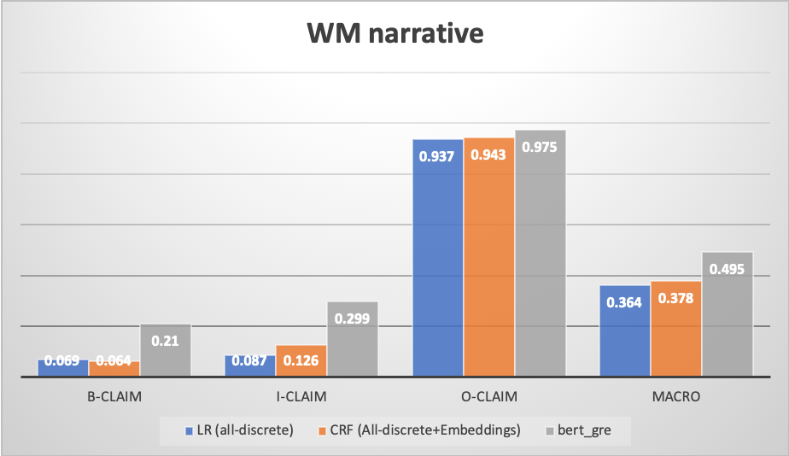
Results - summary
F1 score
Copyright © 2020 by Educational Testing Service. All rights reserved. ETS and the ETS logo are registered trademarks of Educational Testing Service (ETS). 462301852
Notes:
Mention: we did not measure statistical significance yet

Slide 25
Outline of the Talk
Background and Data
Features and Models
Results
Discussions and Future Work

Slide 26
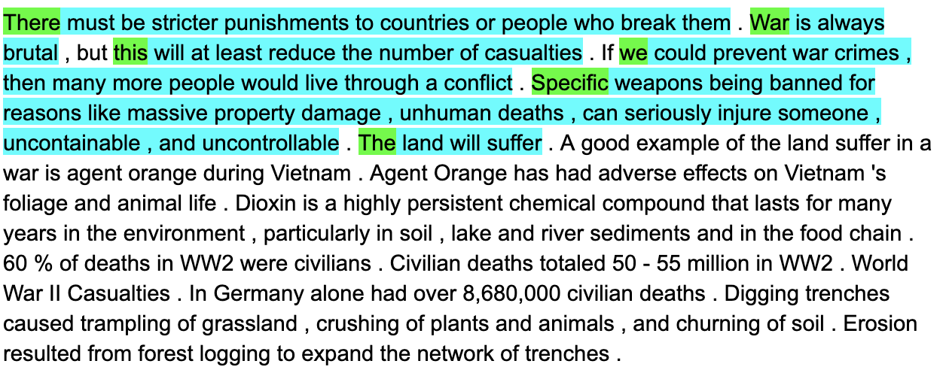
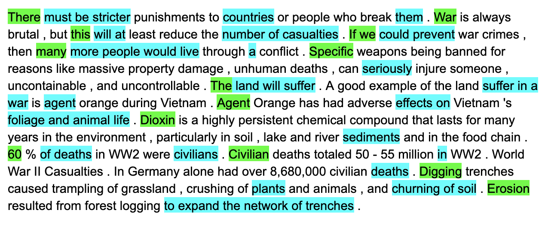
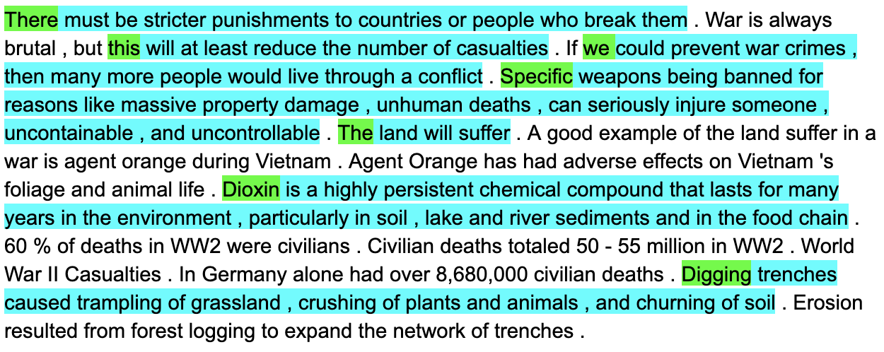
Model Output
Gold WM App
LR (all-discrete)
CRF (all-discrete + embeddings)
Copyright © 2020 by Educational Testing Service. All rights reserved. ETS and the ETS logo are registered trademarks of Educational Testing Service (ETS). 462301852
Notes:
LR scattered predictions
I-claim with no proceeding B-claim
almost all sentence beginning labeled as B-claim
gets one claim completely correct “The land will suffer”
CRF low precision

Slide 27
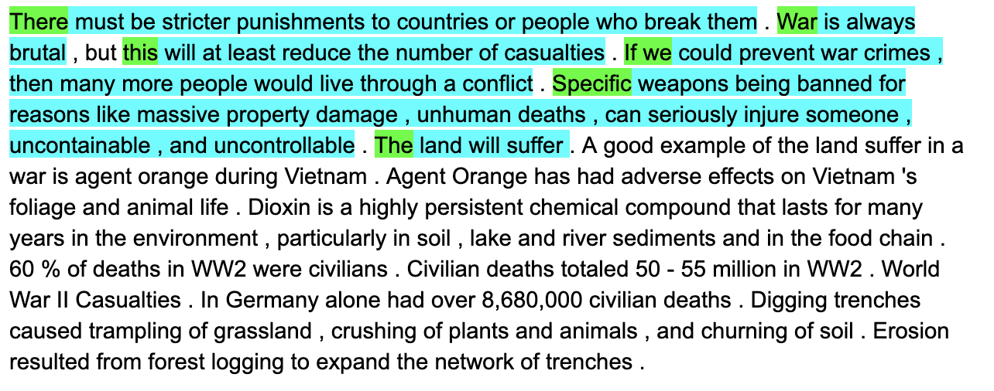
Model Output
Gold WM App
CRF (all-discrete + embeddings)
BERT (fine-tuned with GRE data)
Copyright © 2020 by Educational Testing Service. All rights reserved. ETS and the ETS logo are registered trademarks of Educational Testing Service (ETS). 462301852
Notes:
BERT almost perfect
essay example is short, could be an easy one
but still shows the difference between models' performance

Slide 28
Observations
B-claim after back B-claim
I-claim starts after O-claim
post-processing based on the possible transitions
B→ I
I →B I → I I → O
O→B O→O
Multiple claims in a sentences are sometimes merged
comma are sometimes within a claim or separate two claims
Copyright © 2020 by Educational Testing Service. All rights reserved. ETS and the ETS logo are registered trademarks of Educational Testing Service (ETS). 462301852
Notes:
compare model predictions
long vs short claims
sentence with multiple claims
sentences with all claim tokens vs some claim tokens
sentences with modal verbs (and argumentative word)s
claims in narrative vs claims in argumentative

Slide 29
Challenges
Claims often look like other type of argumentative text expressions (“I agree”) premise or opinions
Run-on sentences and other writing features specific to middle or high school students
Genre/domain differences (argumentative vs narrative) makes generalizability and data augmentation harder
Copyright © 2020 by Educational Testing Service. All rights reserved. ETS and the ETS logo are registered trademarks of Educational Testing Service (ETS). 462301852
Notes:
Claims often look like other type of argumentative text such as expressions (“I agree”), or premise or opinions
Middle or high school Students writings are weaker than college students
Run-on sentences

Slide 30
Future Work
Using RNN (+CRF) with word embeddings and discrete features
Joint Learning Argument token detection (claim+premise, claim only) Claim sentence detection Multi-dataset training
Pretraining on a relevant task SG2017 vs WM2020 Argumentative vs Narrative
Copyright © 2020 by Educational Testing Service. All rights reserved. ETS and the ETS logo are registered trademarks of Educational Testing Service (ETS). 462301852

Slide 31
Educational Applications
Correlation claims are with scores
Useful for feedback generation
Great job! Your essay have 8 supported claims

Slide 32
Thank You

Slide 34
Copyright © 2020 by Educational Testing Service. All rights reserved. ETS and the ETS logo are registered trademarks of Educational Testing Service (ETS). 462301852

Slide 35
B-claim
I-claim
I-claim
I-claim
O-claim
…….
Fine-tuned BERT
Training
Partition
…….
[CLS]
The
land
will
suffer
.
[PAD]
[PAD]
[PAD]
[SEP]
Pretrained BERT

Slide 36
B-claim
I-claim
I-claim
I-claim
O-claim
…….
Fine-tuned BERT
Training
Partition
…….
[CLS]
The
land
will
suffer
.
[PAD]
[PAD]
[PAD]
[SEP]
Fine-tuning
Unlabeled domain & task relevant data
(IMHO, GRE)
Pretrained BERT

