Slide 1
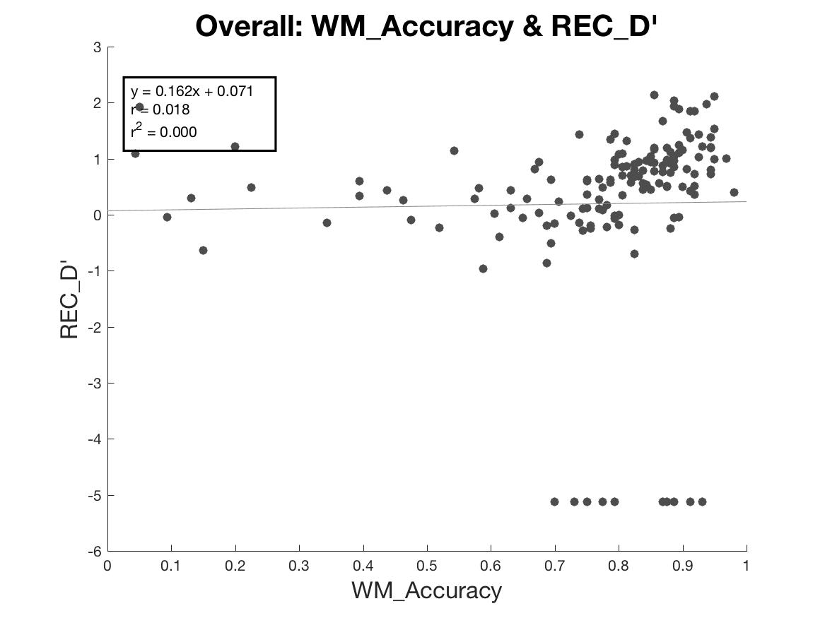
Overall: WM ACC & REC D’

Slide 2
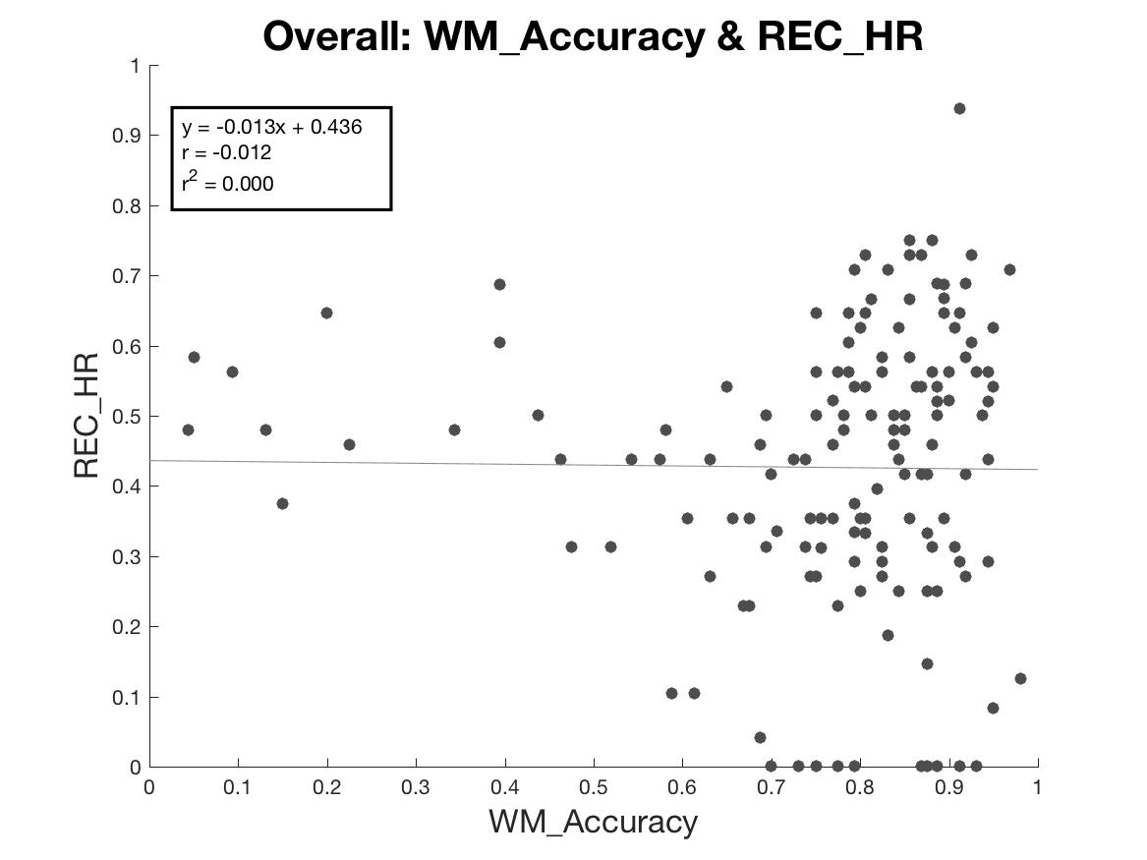
Overall: WM ACC & REC HR

Slide 3
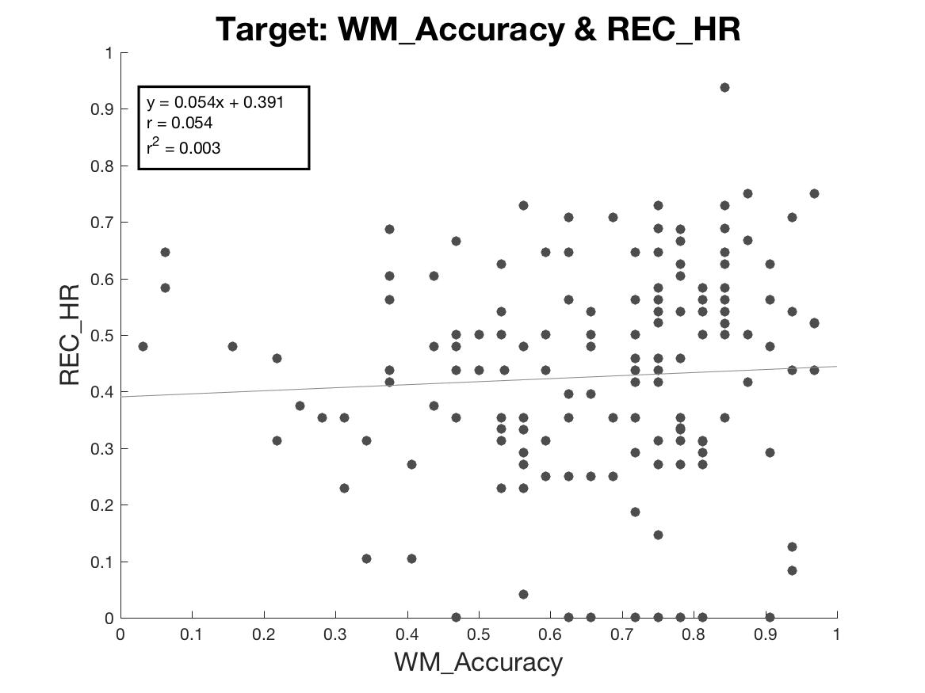
Target: WM ACC & REC HR

Slide 4
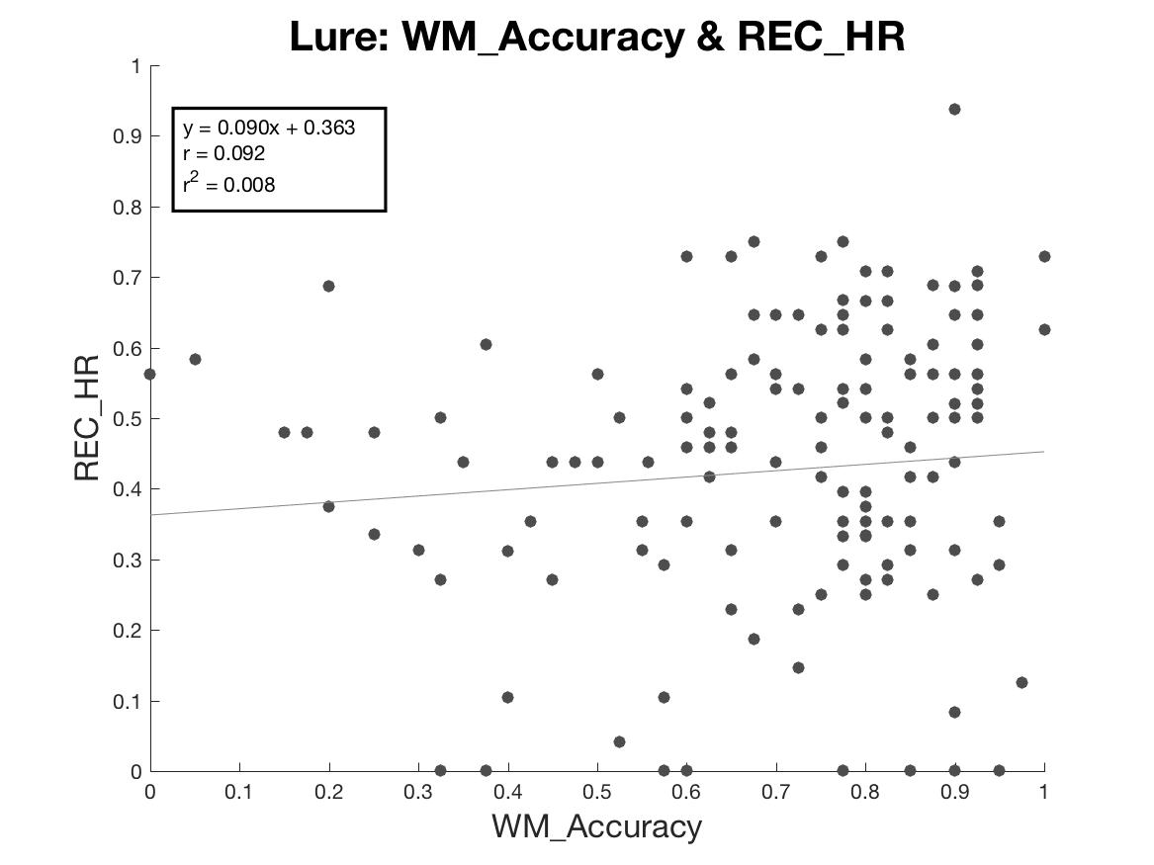
Lure: WM ACC & REC HR

Slide 5
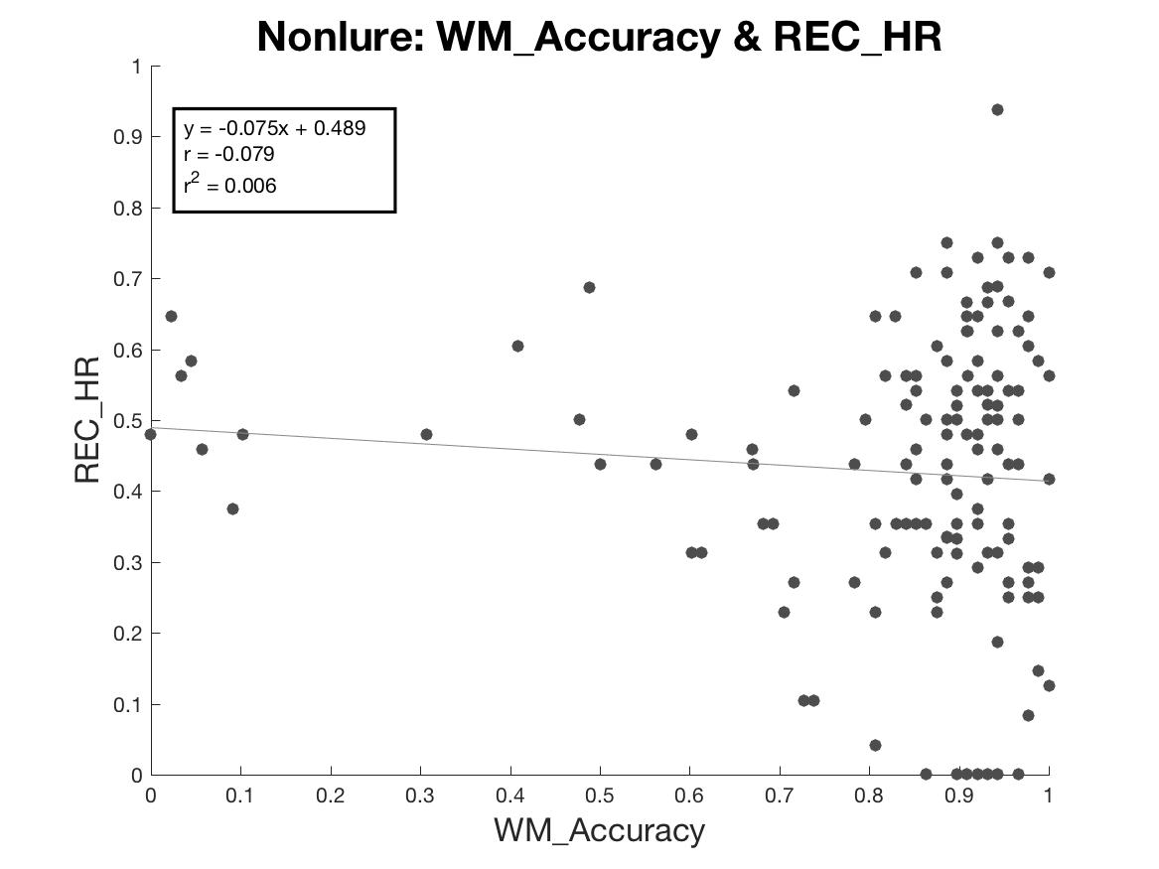
Nonlure: WM FA & REC HR

