Slide 1
Global SuperStore
Uncovering Profit Erosion & Optimizing Financial Performance
Tariq Jawad
Data Analyst Aug 2026

Slide 2
THE ASK
Why are profits declining despite massive Sales?
An in-depth analysis of the Global SuperStore dataset to uncover the underlying causes of profit erosion across product categories.
DATA CLEANING & PREPARATION
01
Large-Scale Data Analysis
Analyzed over 50,000 sales records to build a comprehensive baseline.
02
Data Isolation
Isolated raw transactional data to pinpoint exact financial performance metrics.
03
Dataset Standardization & Cleaning
Removed irrelevant columns and standardized formatting to ensure complete data integrity and analytical accuracy.

Slide 3
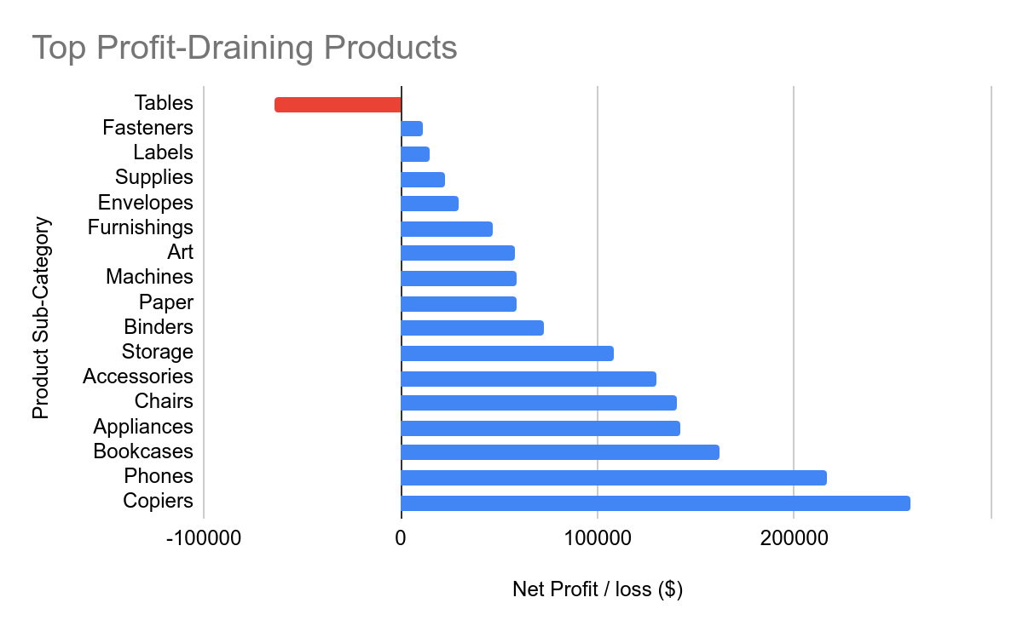
THE PROBLEM
Tables Drain Profits
The Tables category generates massive sales ($757k) but results in a severe net loss (-$64k).
CRITICAL LOSS
Tables represent the only highly negative product sub-category in the portfolio.

Slide 4
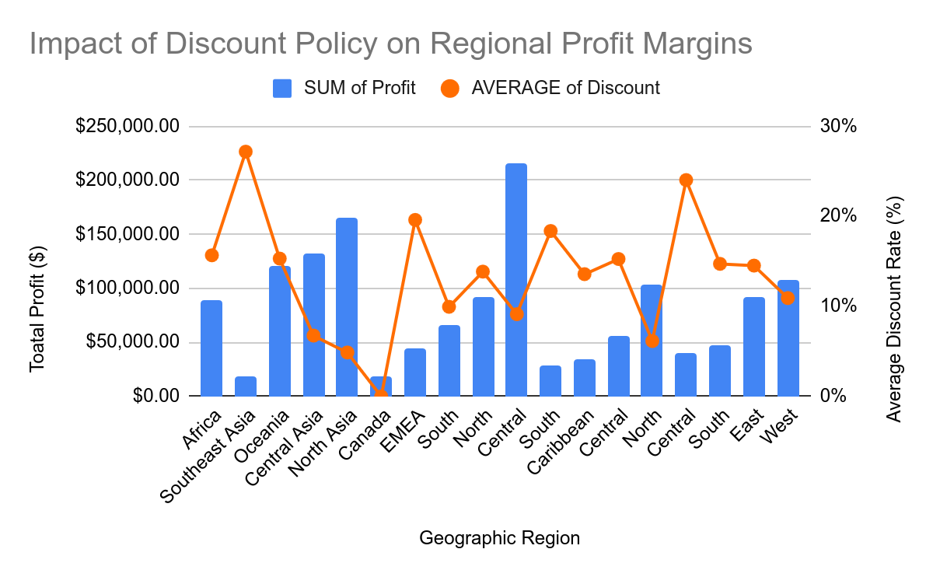
The Problem
High Discount Rates
Retail discount policies act as the silent killer of regional profit margins when left unchecked.
The Evidence
Southeast Asia averaged a 27% discount rate which led to collapsing profits, while Central Asia maintained excellent profitability with a disciplined 7% discount rate.

Slide 5
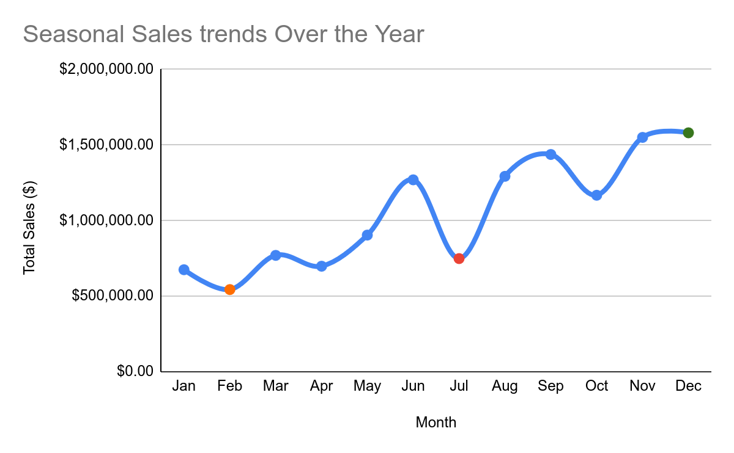
THE TREND
Seasonal Sales Trends
Sales peak dramatically in Q4 (November and December) while suffering a severe slump in mid-year (July).
Q4 PEAK November & December
SLUMPMid-Year (July)

Slide 6
Strategic Recommendations
01
Pricing & Logistics
Renegotiate international shipping contracts for heavy items like tables, or adjust their pricing to absorb the shipping costs.
02
Discount Cap
Implement a strict discount cap of 10% - 15% in underperforming regions to instantly recover profit margins.
03
Inventory Strategy
Reduce procurement orders before the July slump, and ramp up inventory stocking gradually in late summer to prepare for the Q4 peak.

Slide 7
CORE STRATEGY
Main Message
High sales volume must be paired with strategic pricing and disciplined discounting to ensure true profitability.
Identify
Uncovered hidden financial leaks in specific products (Tables) and regions (over-discounting)
01
Act
Applying a 15% discount cap and restructuring heavy-item logistics will immediately recover lost margins.
02
Grow
Leveraging Q4 seasonality will maximize revenue without tying up capital in mid-year dead stock.
03

Slide 8


