Slide 1
Project Title: An efficient deep learning framework for the recognition of house numbers in street view imagery.
Group Information
Group 19
Section: 01
NAME | STUDENT ID | Department
Md. Yasin Arafat Tamim | 20301029 | CSE
Md.Tariqul Islam | 20301044 | CSE
Nabiha Tasnim Orchi | 20301148 | CSE
Mohammad Tajwar Chowdhury | 20301080 | CSE
Zohayer Bin Osman | 20301362 | CSE

Slide 2
CONTENTS
1. Introduction
2. Literature Review
3. Proposed Methodologies
4.Model Explanation
5. Data Analysis
6. Result Analysis
7. Model Comparison
8. Future Work Plan
9. Conclusion

Slide 3
INTRODUCTION
This research introduces a deep learning framework for efficient and accurate house number recognition in street view photos. It combines CNNs, RNNs, and MLPs to address real-world challenges like scale, orientation, illumination, and occlusion. The innovative approach captures local patterns, sequential information, and end-to-end learning, delivering high accuracy while optimizing model size and training time. This contribution is vital for applications such as navigation and urban planning, advancing computer vision capabilities.

Slide 4
LITERATURE REVIEW
1. Several studies explore innovative deep learning approaches for diverse applications, from street view house number recognition to urban planning and image classification.
2. These approaches leverage convolutional neural networks (CNNs), recurrent neural networks (RNNs), and other deep learning techniques to achieve impressive accuracy rates, but some face computational challenges and data limitations.
3. Notable contributions include a unified CNN framework for multi-digit recognition, a cost-effective solution for food cultivation mapping using Google Street View, and an efficient approach for high-definition image reconstruction.
4. Challenges in data scarcity, image type differentiation, and urban architectural style identification are also addressed, highlighting the potential of deep learning in various domains.
5. While these studies advance the field of computer vision, they often come with limitations related to data availability, computational resources, and scalability, emphasizing the need for further research and improvements.

Slide 5
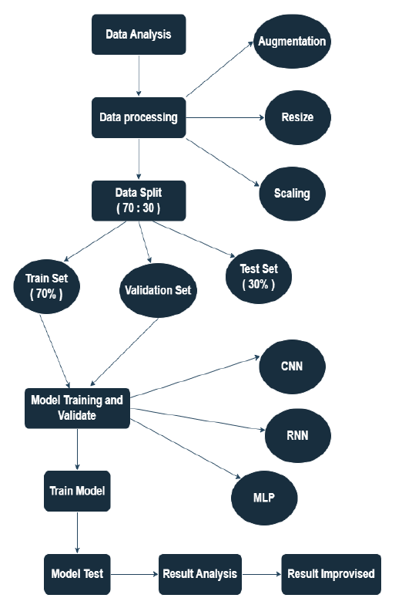
PROPOSED METHODOLOGIES
The proposed model begins with data
analysis and augmentation, followed
by data processing and resizing.
The dataset is split into 70% for
training and 30% for testing.
After scaling, the model, comprising
CNNs, RNNs, and MLPs, is trained
and validated. Finally, it's tested, and
results are thoroughly analyzed for
accuracy and performance.

Slide 6
MODEL EXPLANATION
1. CNN for Image Processing: CNNs are employed to capture visual features from images. They consist of convolutional layers for feature extraction, activation functions, pooling layers for downsampling, and fully connected layers for classification.
2. MLP for Pattern Recognition: MLPs, with input, hidden, and output layers, are used for pattern recognition and classification tasks. They employ activation functions, weight updates through backpropagation, and regularization techniques.
3. RNN for Sequential Data: RNNs are suitable for sequential data processing, utilizing recurrent connections to maintain memory across time steps. They address tasks involving temporal dependencies like natural language processing and speech recognition. Improved RNN architectures such as GRUs and LSTMs mitigate the vanishing gradient problem.

Slide 7
DATA ANALYSIS
The Street View House Numbers (SVHN) dataset consists of 600,000 32x32 RGB house number images, used for automatic digit recognition. It is split into 70% for training and 30% for testing. The dataset is unbalanced and contains images of varying quality, presenting real-world challenges for machine learning models. Despite its complexity, it serves as a valuable resource for developing and testing digit recognition algorithms, including convolutional neural networks (CNNs), data augmentation, image preprocessing, and novel evaluation metrics.

Slide 8
RESULT ANALYSIS
In the result analysis:
1. MLP (Multi-Layer Perceptrons) showed a trend of improving training loss and accuracy but demonstrated signs of overfitting with varying validation metrics.
2. CNN (Convolutional Neural Networks) exhibited improvements in training and validation metrics but also showed signs of overfitting after a certain point.
3. RNN (Recurrent Neural Networks) struggled to learn effectively, with minimal improvements in both training and validation metrics, making it less suitable for this task.

Slide 9
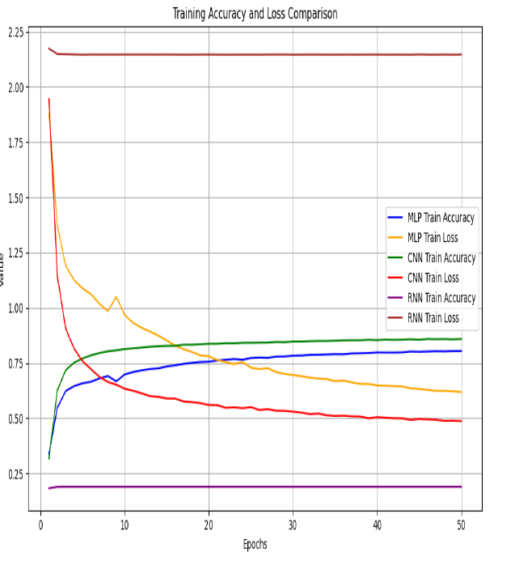
RESULT ANALYSIS
So from the graph we can see that, accuracy
of our proposed models are- MLP (87.5%),
CNN (87.4%) and RNN (18.86%).
Overall, MLP and CNN models
performed better than RNN, with
some challenges related to overfitting
in both cases.

Slide 10
MODEL COMPARISON
In the comparison analysis:
1. MLP and CNN models show promise but exhibit signs of overfitting, with CNN having an edge due to its ability to capture spatial patterns in image data.
2. RNN performs poorly, with consistently low validation accuracy, making it unsuitable for this dataset.
3. Further optimization, regularization, and hyperparameter tuning may be needed for both MLP and CNN models.
4. CNN is a slightly better choice between the two, but additional testing is required to make a definitive decision.

Slide 11
FUTURE WORK PLAN
In future work, the focus is on addressing overfitting in MLP and CNN models by fine-tuning hyperparameters, applying regularization methods, and utilizing data augmentation and ensemble techniques. For the RNN model, improvements will involve data preprocessing, dataset expansion, domain-specific knowledge integration, and potential transfer learning. Thorough model assessment through cross-validation is a key aspect of this strategy to enhance machine learning solutions for the SVHN dataset.

Slide 12
CONCLUSION
Additionally, our findings highlight the need for models tailored to dataset characteristics, with RNN's unsuitability for spatial dependencies in the SVHN dataset as an example. This understanding enhances the field of machine learning, aiding future research and applications.Additionally, our findings highlight the need for models tailored to dataset characteristics, with RNN's unsuitability for spatial dependencies in the SVHN dataset as an example. This understanding enhances the field of machine learning, aiding future research and applications.

