Slide 1
Deep Learning-based Online Alternative Product Recommendations at Scale
Submitted by
Arnob Mitra Utsab - 19101030
Hasan Muhammed Zahidul Amin - 21166019
Mohammad Tariqul Islam Tuhin - 21166037
Al Hasib Mahamud - 21366007 Marwa Nabi - 20266021
Course title: CSE431/712 - Symbolic Machine Learning II

Slide 2
What is recommender system?
Recommender systems are the systems that are designed to recommend things to the user based on many different factors. These systems predict the most likely product that the users are most likely to purchase and are of interest to.

Slide 3
Introduction:
A good alternative recommendation system is necessary for having a better consumer experience in E-Commerce system.
For recommendation both textual product data and customer behavior data has been analyzed.
Build a Siamese Network with Bidirectional LSTM system providing 12% increasing conversion rate at A/B.
KNN computation task has been used for scaling throughout the entire product catalog and accelerated by NMSLIB.

Slide 4
Problem formulation:
We have the textual information T of a catalog of products P where T and P is T = { X₁, ……..X_{N}} and P = { p₁, ……..p_{N}} The goal is to make a recommendations to learn embedding projection function f_{w}
The goal of the alternative recommendation is to learn a embedding projection function f_{w} so that the embedding of an anchor product that is viewed by customer f_{w} (x_{a} ) is close to embeddings of its alternative f_{w} (x_{r} )

Slide 5
Deep learning embedding approach
Textual data and co-compared Data
Product Id | Product title | Description
‘876432134’ | Fossil Men's Copeland Stainless Steel Quartz Watch with Leather Strap | About this item Fossil has always been inspired by American creativity and ingenuity. Since 1984, we’ve strived to bring new life into the industry by making quality, fashionable watches and accessories that were both fun and accessible.
Product textual Data
Product Id | Product title | Description
‘876432134’ | ‘76432678’ | 1
‘87208547’ | ‘174527432’ | 1
Co-compared example

Slide 6
Deep learning embedding approach
Siamese Network with Bidirectional LSTM
1: A and B are compared together
-1: A and B have never been co-compared
Input A
Embedding Layer
Bi-directional LSTM
Vector A Output
Co-sine similarity
Same or Not ???
Input B
Embedding Layer
Bi-directional LSTM
Vector B Output

Slide 7
Deep learning embedding approach
Creating Training Data
Fig. 2 Connected Graphs
Table 3. Training Data Statistics
A
B
C
[ A,C, 1 ] [ A,D, -1 ] [ A,E, -1 ] [ A,F -1 ]
D
E
F
How many data points | How many products | What is the time period(year)
331900 | 65684 | 1

Slide 8
Training the Model and Generating Embeddings
cosine similarity, and rank the similarity scores from higher to lower to get the Top-N recommended products.
NMSLIB library to conduct heavy kNN computations.
Scalable Recommendation Generation
compute distances with the rest of millions of product embeddings using a similarity metric.
NMSLIB library to conduct heavy kNN computations because it has high performance in recall and queries per second.

Slide 9
Performance Evaluation
Baseline 1: Attribute Based
Uses product attributes to generate recommendations
Attributes contain numerical and categorical data
2. Baseline 2: Frequently Compared
Uses the actual customer co-compared data
Recommendations are ranked by the co-comparison counts
3. Proposed: Deep Learning Based
The cutting threshold is chosen 0.8 for the cosine similarity score

Slide 10
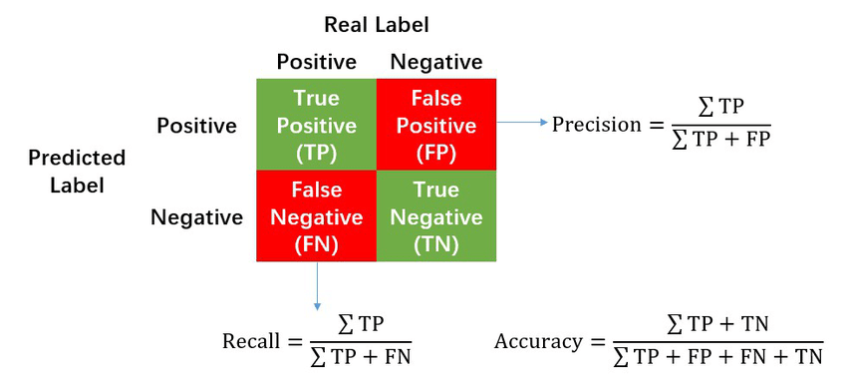
Offline Evaluation

Slide 11
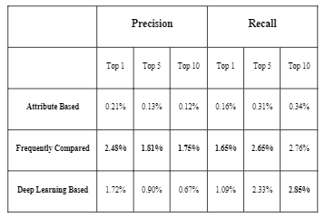
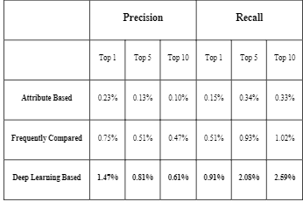
Precision and Recall
Figure: Comparison 1 for Raw Sessions
Figure: Comparison 2 for Filtered Sessions

Slide 12
Online A/B Testing
A/B test was run for three weeks
Conversion Rate
Used to measure success
Can be calculated as number of purchases divided by number of visits
Captures similarity between anchor and recommendation
Deep learning model outperforms the existing hybrid algorithm which combined Attribute Based and Frequently Compared with a 12% higher conversion rate

Slide 13
Related work
Content-based recommendations
Collaborative Filtering, Example - Matrix Factorization
Deep learning, Example - Airbnb’s listing recommendations, Pinterest’s recommendation engine

Slide 14
Conclusion

Slide 15
Thank you!

