Slide 1



JSON Config Driven Dashboard
Jaypee University of Information Technology
Department of Computer Science and Engineering and Information Technology
Major Project - II (18B19CI891) | AY 2025-26
Mid-Term Evaluation |May 2026.
Group No.: IG02
Team Member (s)
Tarish Sharma(221030011)
Supervisor
Name: Mr. Akshay Kumar
Designation: Assistant Professor (Grade 1)

Slide 2
Outline
Introduction
Problem Statement
Objectives
Literature Review
Project Design
Tools, Technologies and Languages
Dataset
Implementation (if any)
Results (if any)
Key Learnings
Work Plan till End-Term Evaluation
Project Plan
Work Contribution and Attendance
Supervisor Interactions
References

Slide 3
Introduction
Modern web applications often require frequent UI updates to accommodate new data sources, KPIs, or features. However, hard-coding these changes increases development time and reduces flexibility. A JSON config-driven dashboard allows developers or administrators to control what data, layout, and components appear on the dashboard through a simple configuration file (e.g., JSON), without altering the source code.
This project aims to design and develop a JSON Config-Driven Dashboard that dynamically renders cards, charts, and tables based on configuration files. It enables easy customization, modularity, and scalability — ideal for analytics and administrative use cases.

Slide 4
Problem Statement
In traditional frontend applications, updating UI elements (like adding charts or rearranging components) requires manual code modifications. This leads to:
Increased development and deployment time.
High maintenance cost for minor UI changes.
Poor scalability when dashboards must vary for multiple users or departments.
Hence, there is a need for a JSON config-driven system where UI layouts and data sources can be easily managed through configuration files rather than code changes.

Slide 5
Objectives
To develop a dynamic, configurable dashboard using modern frontend technologies.
To design a JSON-based configuration model that controls layout, components, and data sources.

Slide 6
Literature Review
S. No. | Author & Paper Title [Citation] | Journal/ Conference (Year) | Tools/ Techniques/ Dataset | Key Findings/ Results | Limitations/ Gaps Identified
1. | MDN Web Docs [MDN][1] | Foundational Web Documentation (2005) | HTML, CSS, JavaScript Standards | Provides comprehensive, up-to-date documentation for web technologies, enabling rapid development. | Depth can be overwhelming for absolute beginners; community maintenance introduces potential for minor inconsistencies.
2. | Angular Framework Documentation [Angular][2] | Official Project Documentation (2016) | TypeScript, Angular CLI, RxJS | Offers authoritative guidance on framework usage, architecture, and core concepts. | Primarily focused on the framework; assumes familiarity with underlying web technologies (TS, JS).
3. | The Official Angular Style Guide [Style][3] | Community Best Practices (2016) | TypeScript, Component Architecture, Naming Conventions | Establishes a consistent, maintainable code base; improves team onboarding and code review efficiency. | Subjective compliance across large teams; guide is opinionated and may not suit all project requirements.
4. | Pro Angular [Freeman][4] | Apress / Technical Publication (2017) | Real-world examples, advanced features (e.g., Universal, PWA) | Provides a structured, in-depth learning path from beginner to advanced topics; reinforces practical application. | Requires periodic updates to keep pace with rapid Angular releases; cost barrier for access.

Slide 7
Literature Review
5. | Articles on Usability and UX [NNG][5] | NN/g Research Publications (1998) | Heuristic evaluation, A/B testing, user studies | Delivers evidence-based best practices for designing highly usable and accessible web applications. | Findings are general design principles and require interpretation for specific technical implementations.
6. | RxJS Documentation [RxJS][6] | Official Project Documentation (2012) | Observables, Operators (e.g., map, filter, switchMap) | Clear explanation of reactive programming concepts in JavaScript; crucial for state management and async operations. | Steep learning curve due to paradigm shift (imperative to reactive); over-reliance on complex operators reduces readability.
7. | NgRx: Reactive State for Angular [NgRx][7] | Official Project Documentation (2016) | Redux Pattern, Store, Effects, Selectors | Enables predictable, centralized state management for complex applications; facilitates time-travel debugging. | Introduces significant boilerplate code (though reduced in newer versions); complexity often unnecessary for small apps.
8. | TypeScript Handbook [TypeScript][8] | Microsoft Documentation (2012) | Static Typing, Interfaces, Generics, Decorators | drastic reduction in runtime errors; improves code refactoring, autocompletion, and scalability in large teams. | Requires a compilation step; creates a learning curve for developers accustomed to dynamic typing in JavaScript.

Slide 8
Literature Review
9. | Web Vitals [Google][9] | Google Search Central (2020) | LCP, INP, CLS, Lighthouse Performance Audits | Provides quantifiable, unified metrics (Core Web Vitals) to measure and optimize real-world user experience and SEO. | Metrics can fluctuate based on user device/network; "gaming" metrics does not always equate to better perceived UX.
10. | Comparative Analysis of Angular, React, & Vue.js [IJISRT][10] | Int. Journal of Innovative Science (2024) | Framework Benchmarking, DOM Manipulation Tests | Identifies Angular as superior for large-scale enterprise systems due to strict structure, while React excels in flexibility. | Relies on synthetic benchmarks which may not perfectly reflect the performance nuances of complex, real-world scenarios.

Slide 9
Work Done (after MP-I)
Advanced Feature Implementation
Dynamic Data Upload & Parsing: Implemented a robust CsvParserService using PapaParse to ingest user-provided CSV files directly from the UI.
Expanded Feature Modules: Developed dedicated UI modules for Analytics, Users, Products, and Orders.
Performance & Optimization.
State Persistence: Enhanced the DashboardService caching mechanism for flicker-free rendering when receiving new data.

Slide 10
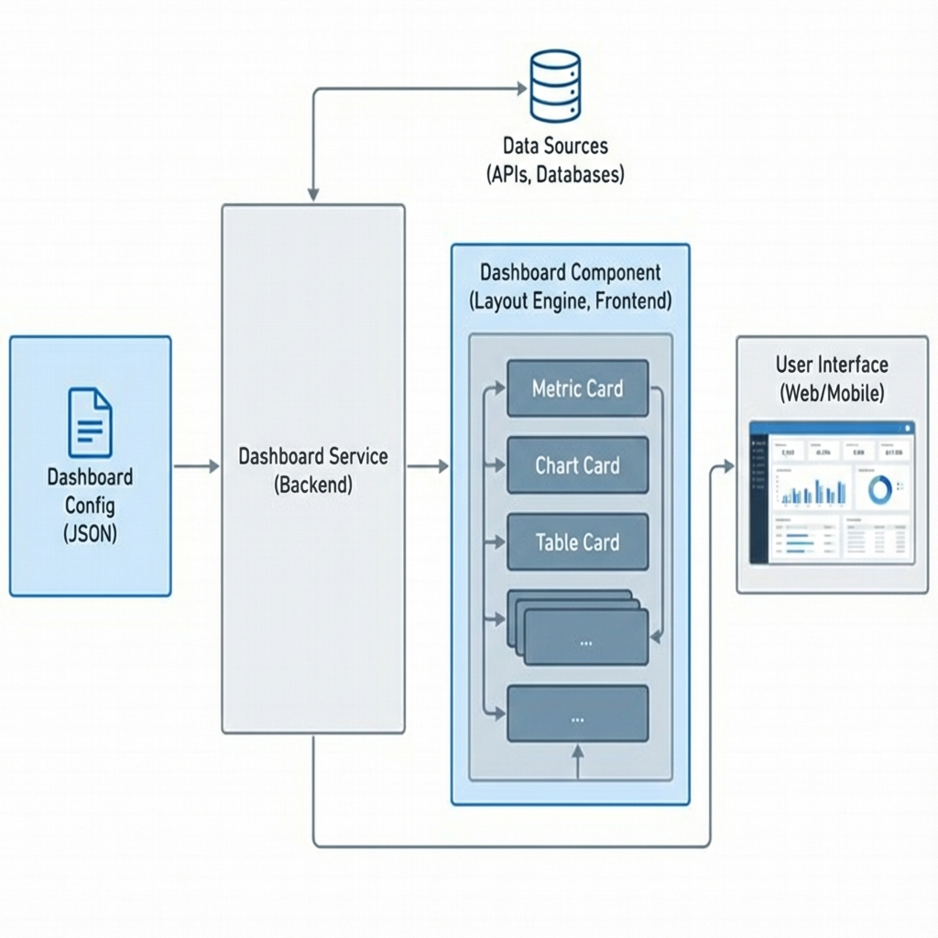
Project Design (cont…)
Key Design Decisions:
Config-Driven UI: The entire dashboard layout and content are defined by a JSON configuration object (DashboardConfig), enabling dynamic rendering without code changes.
Separation of Concerns: Decouples the Definition (Config) from the Presentation (Components), allowing runtime flexibility.
Scalable Component Factory: A central DashboardComponent iterates over the config and dynamically hosts specific card types (Metric, Chart, Table).
Figure 1:System Architecture Diagram

Slide 11
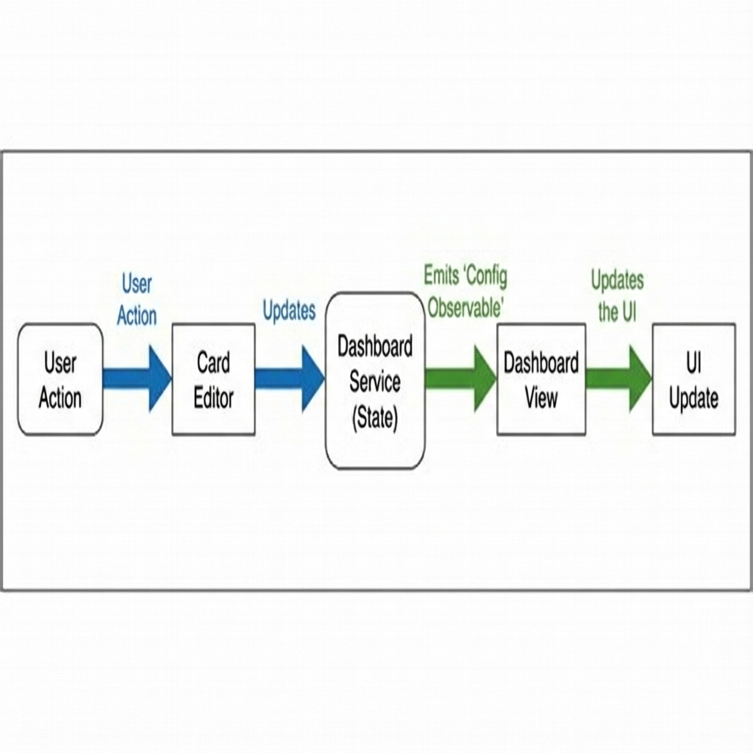
Project Design (cont…)
Data Flow Logic:
Single Source of Truth: The DashboardService holds the state in a BehaviorSubject, ensuring all components see consistent data.
Reactive Updates:
Dashboard View: Subscribes to config$ observable to render the layout.
Card Editor: Uses Angular Signals (toSignal, computed) to derive instant preview states from form inputs.
Immutable Actions: Updates are processed via pure functions in the service, emitting new state references to trigger change detection only when necessary.
Figure 2: Data Flow Diagram
Figure 1:System Architecture Diagram

Slide 12
Project Design (cont…)
Module Interactions:
Core Module: Contains singleton services (DashboardService) and data models (DashboardConfig). Loaded once at app startup.
Features Modules:
DashboardModule: Consumes config to render the view.
CardEditorModule: Consumes config to provide editing capabilities.
Shared Module: Provides reusable UI atoms (Buttons, Inputs) and Pipes (Formatters) to both feature modules, ensuring visual consistency.
Key Algorithm: Dynamic Style Injection
Sanitization: The CardStyles interface acts as an allowlist.
Application: Styles are applied via Angular's [style] binding (e.g., [style.gridColumn]), preventing XSS risks while allowing user customization.

Slide 13
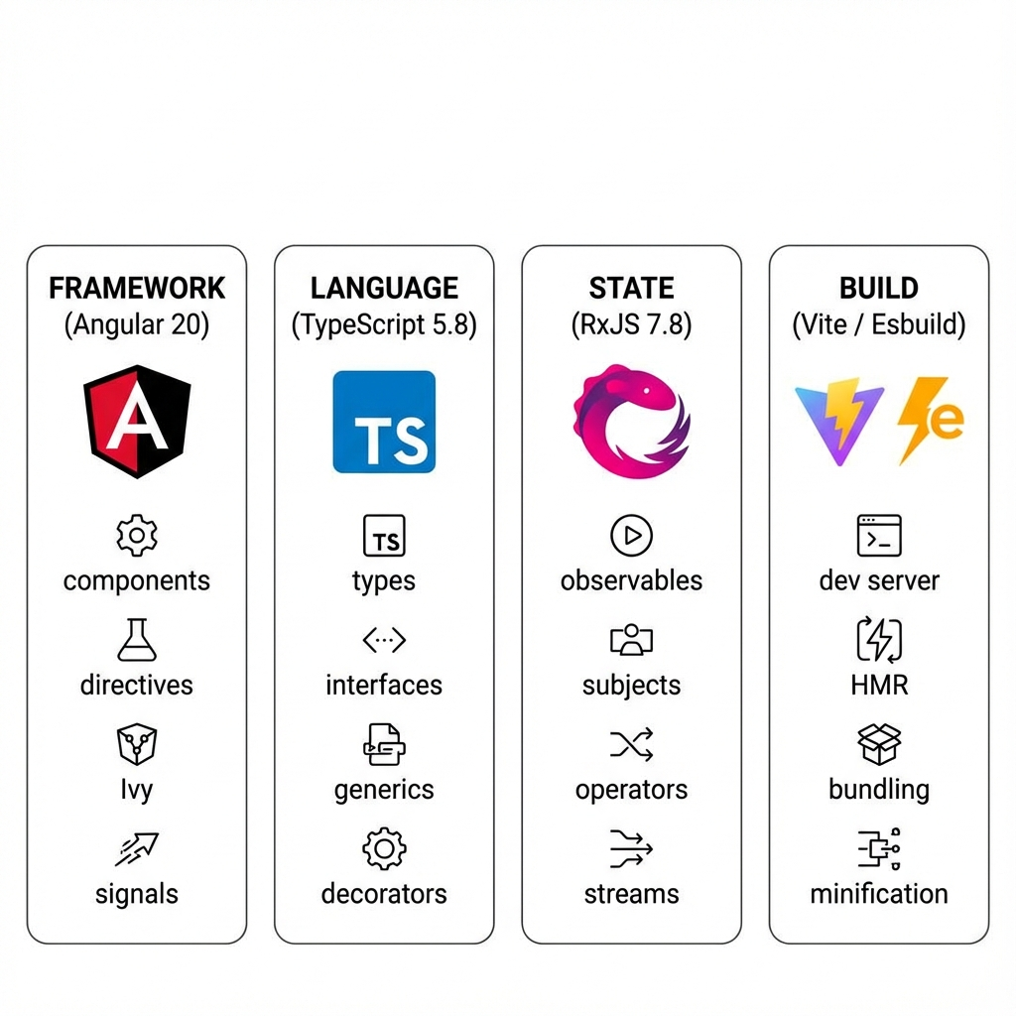
Tools, Technologies and Languages
Primary Frameworks & Languages:
Angular v20.1.0: The core framework used for component-based architecture and dependency injection.
TypeScript v5.8.2: The primary programming language, ensuring type safety and modern ECMAScript features.
RxJS v7.8.0: Reactive Extensions library used for handling asynchronous data streams (Observables).
Zone.js v0.15.0: Handles change detection and execution context.
Runtime Environment:
Node.js v22.15.1: The JavaScript runtime used for the development server and build process.
Figure 3 Tech Stack Diagram

Slide 14
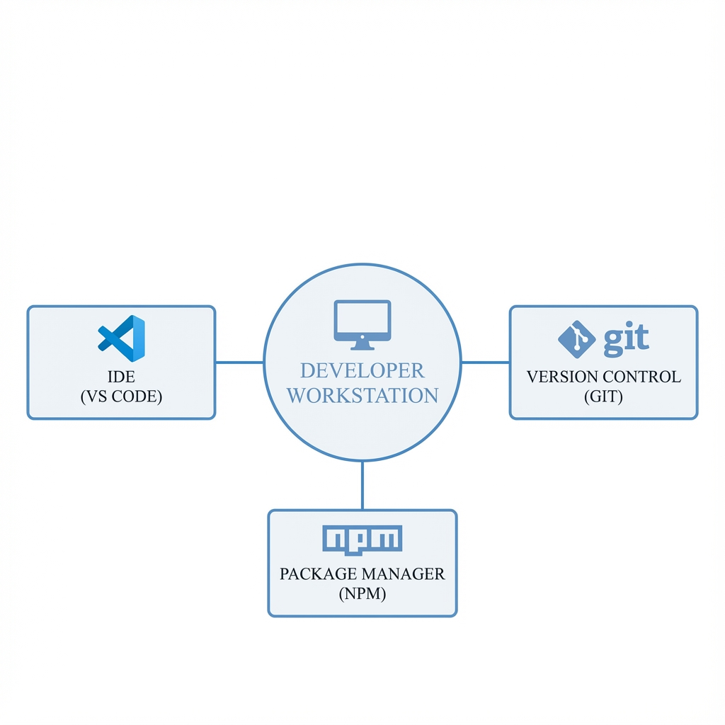
Tools, Technologies and Languages (cont…)
Build & Package Management:
Angular CLI v20.1.3: The command-line interface for scaffolding, building, and serving the application.
NPM v10.9.2: The package manager used for dependency resolution.
Figure 4 Dev Tools

Slide 15
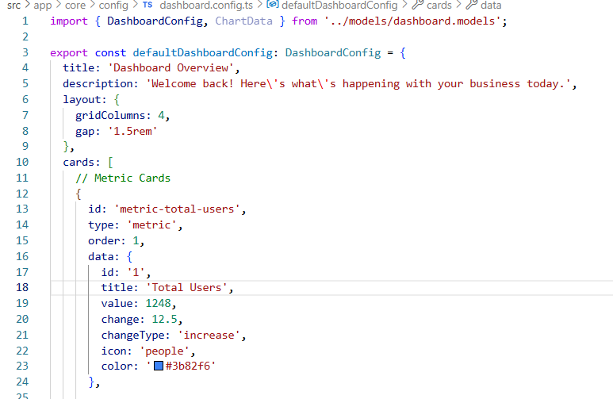
Dataset
Data Source Logic:
JSON as Dataset: The application state acts as its own dataset, defined in a hierarchical JSON structure (
dashboard.config.ts).
Schema Definitions:
Metrics: { id, value, change, icon } - Drives the KPI cards.
Charts: { labels[], datasets[] } - Compatible with Chart.js inputs.
Logs: { timestamp, user, action } - Simulates an audit trail.
Figure 5 Configuration Sample

Slide 16
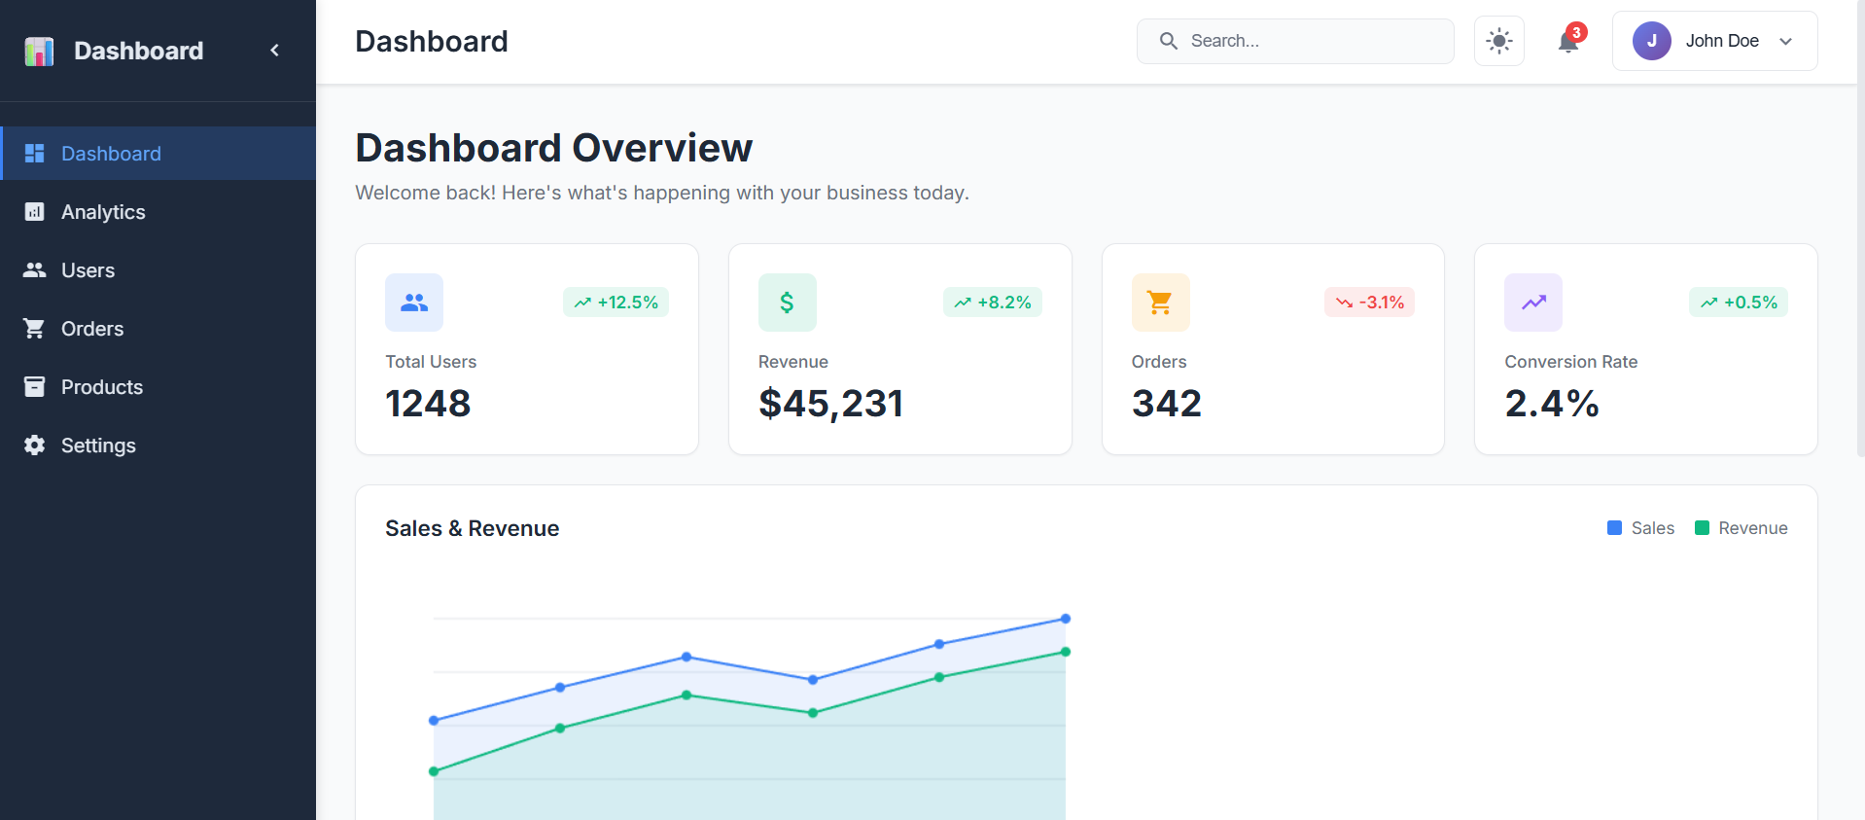
Implementation (if any)
Core Dashboard Engine
Dynamic Rendering Strategy:
Implemented with ngSwitch & Directive Composition for scalable card types.
Eliminates hardcoded templates, allowing runtime layout generation.
Configuration Parser:
Typed JSON Interfaces ensure runtime safety against malformed config.
Acts as the central schema definition for the entire application.
Figure 6 Dashboard App

Slide 17
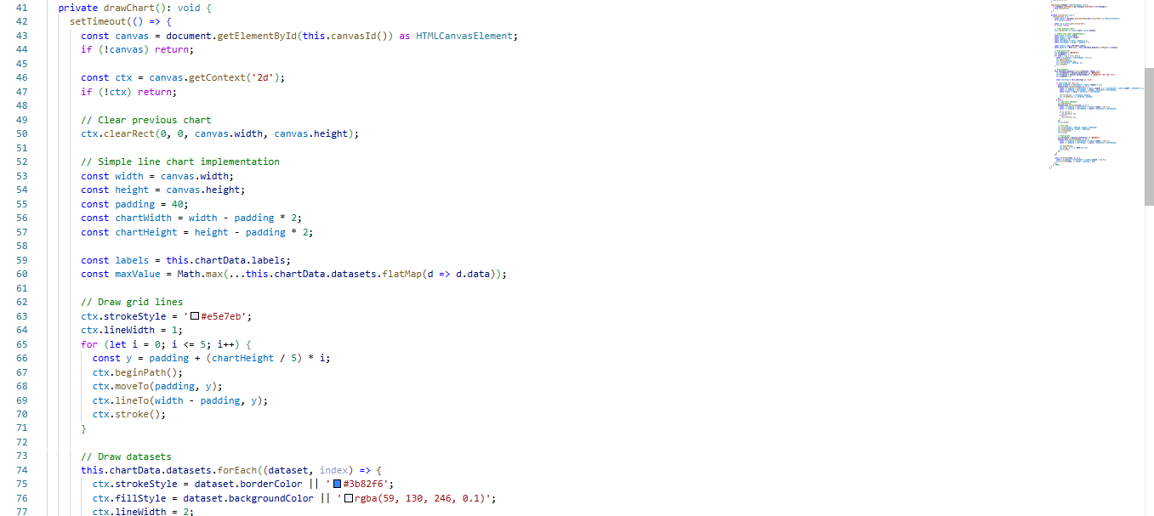
Implementation (if any)
Figure 7 Layout Calculation & Drawing

Slide 18
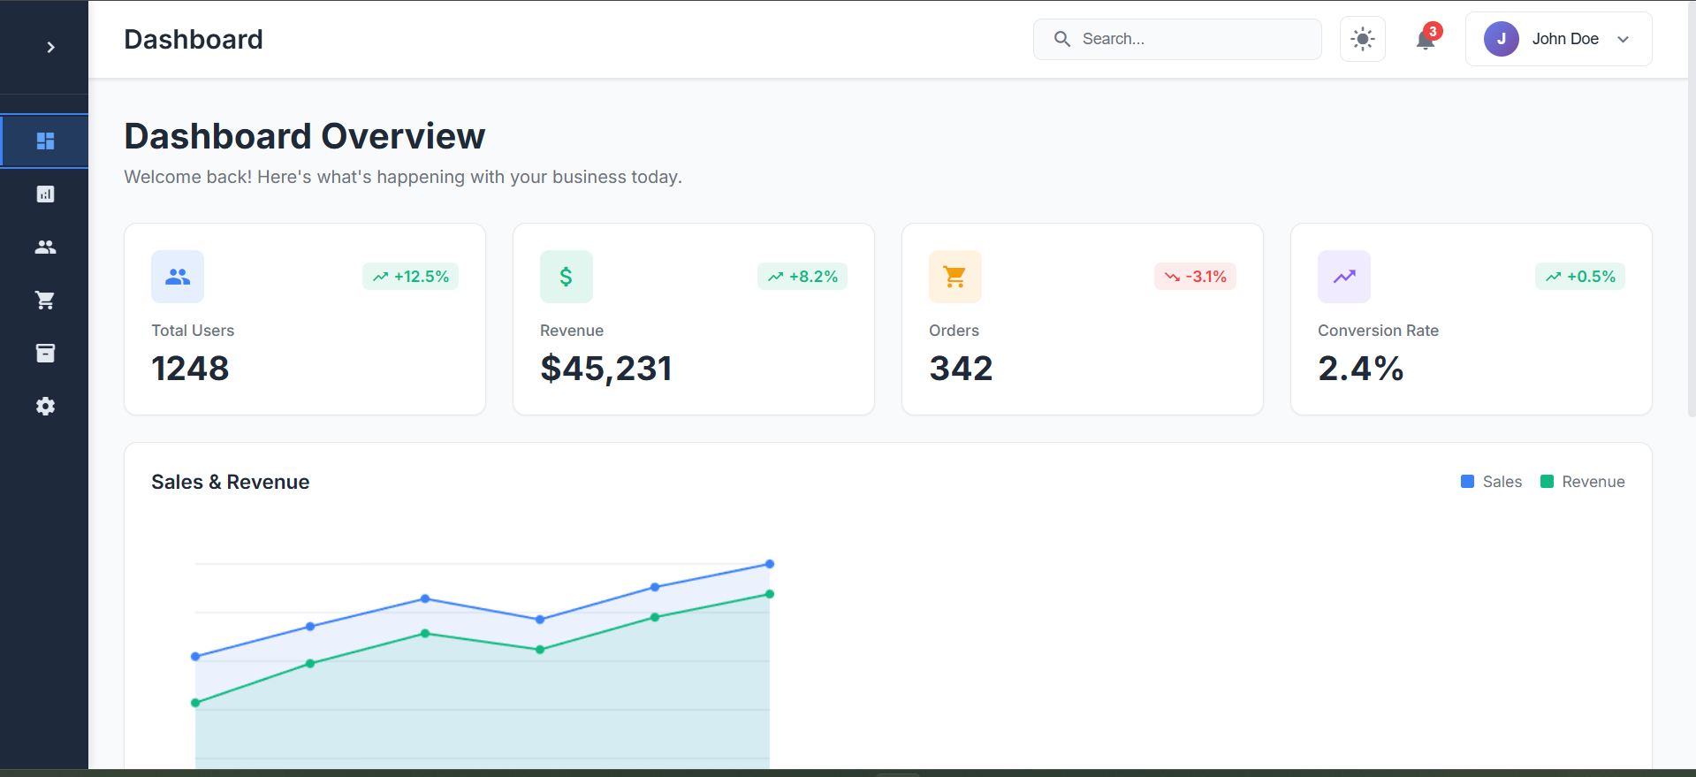
Experimental Results (if any)
Key Outcomes
Dynamic Rendering Engine:
Successfully rendered mixed card types (Metrics, Charts, Tables) from a single JSON source.
Performance Benchmarks:
Change Detection Reduction: Fewer cycles compared to Zone.js-only approach.
Figure 7 Dashboard

Slide 19
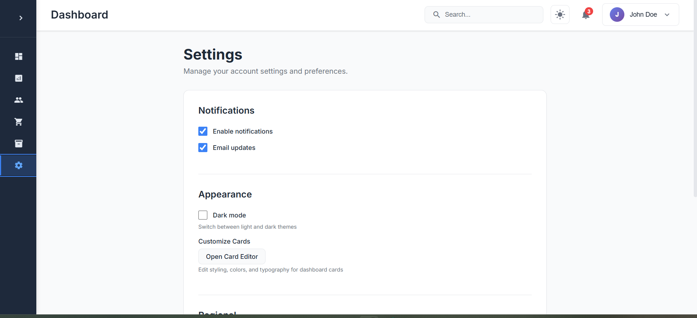
Experimental Results (if any)
Figure 8 Setting

Slide 20
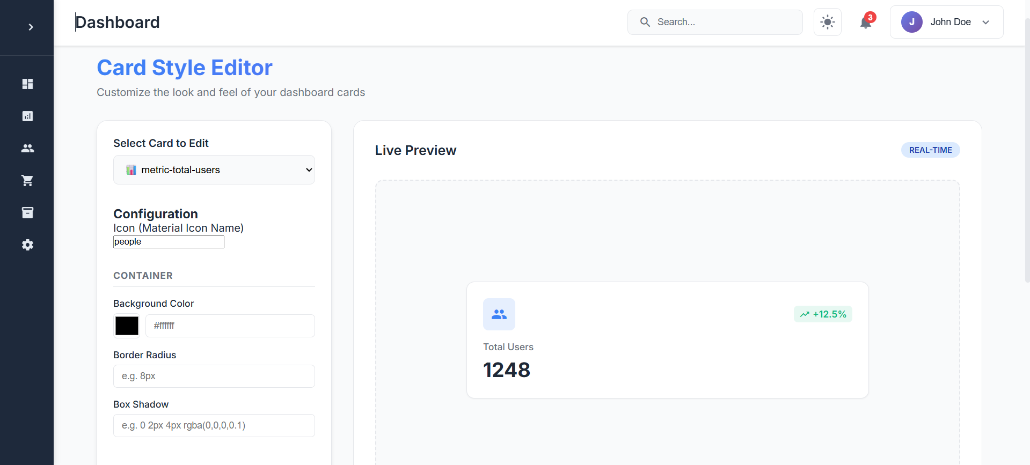
Experimental Results (if any)
Figure 9 Card Editor

Slide 21
Key Learnings
Technical Mastery
Advanced Angular Architecture: Deep dive into Standalone Components, Signals, and Dynamic Component Loading (ngSwitch/ViewContainerRef).
Reactive Programming: Mastered RxJS patterns for complex state management and async data streams (Subject, BehaviorSubject, heavy use of operators).
Modern CSS: Leveraged CSS Variables and Grid/Flexbox for a robust, theme-able layout engine.
Methodologies
Configuration-Driven Development: Learned to decouple "What to render" (Data) from "How to render" (Component), improving scalability.
Performance-First Mindset: Prioritized runtime performance using OnPush change detection and Signals to minimize rendering cost.
Blogs and Articles Referred:
Angular Official Documentation: Interactive guide on Signals and standalone components.

Slide 22
Project Plan

Slide 23
Work Contribution and Attendance
GitHub Repository URL:
Team Member | Roll No. | Work Done (provide complete details) | Work Contribution (%) | Lines of Code (if any) | Lab Attendance (%)
1. | 221030011 |  | 100 | 1000+

Slide 24
Supervisor Interactions (as mentioned in weekly log)
No. of Meetings with Supervisor:
Week No. | Duration | Remarks (as mentioned in the weekly log) | Incorporated (Yes/No)
1.
2.
3.
4.
5.

Slide 25
Supervisor Interactions (cont…)
Week No. | Duration | Remarks (as mentioned in the weekly log) | Incorporated (Yes/No)
6.
7.
8. | dd/mm/2025 to dd/mm/2025 | Remark 1 Remark 2 Remark 3
9. | dd/mm/2025 to dd/mm/2025 | Remark 1 Remark 2 Remark 3
10. | dd/mm/2025 to dd/mm/2025 | Remark 1 Remark 2 Remark 3

Slide 26
References
[1] MDN Web Docs, “Web technology for developers,” 2005-Present. [Online]. Available: https://developer.mozilla.org/en-US/
[2] Angular Team at Google, “Official Angular Documentation,” 2016-Present. [Online]. Available: https://angular.dev/
[3] Angular Team at Google, “Angular Style Guide,” 2016-Present. [Online]. Available: https://angular.dev/style-guide
[4] A. Freeman, “Pro Angular,” Apress, 2017. [Online]. Available: https://www.apress.com/gp/book/9781484223062
[5] J. Nielsen and D. Norman, “NN/g Research Publications,” 1998-Present. [Online]. Available: https://www.nngroup.com/articles/
[6] RxJS Core Team, “RxJS Official Documentation,” 2012-Present. [Online]. Available: https://rxjs.dev/guide/overview
[7] NgRx Team, “NgRx: Reactive State for Angular,” 2016-Present. [Online]. Available: https://ngrx.io/docs
[8] Microsoft, “TypeScript Handbook,” 2012-Present. [Online]. Available: https://www.typescriptlang.org/docs/
[9] Google Chrome Team, “Web Vitals,” 2020-Present. [Online]. Available: https://web.dev/articles/vitals
[10] S. A. Kumar and R. S. Devi, “Comparative Analysis of Angular, React, and Vue.js,” International Journal of Innovative Science and Research Technology, 2024. [Online]. Available: https://ijisrt.com/

Slide 27

Thanks.

