Slide 1



FUDAN UNIVERSITY
飞虎队课题：AIGC生成的人物异常检测week3
汇报人：刘皓蓝
指导老师：孙未未
2026-1-6

Slide 2

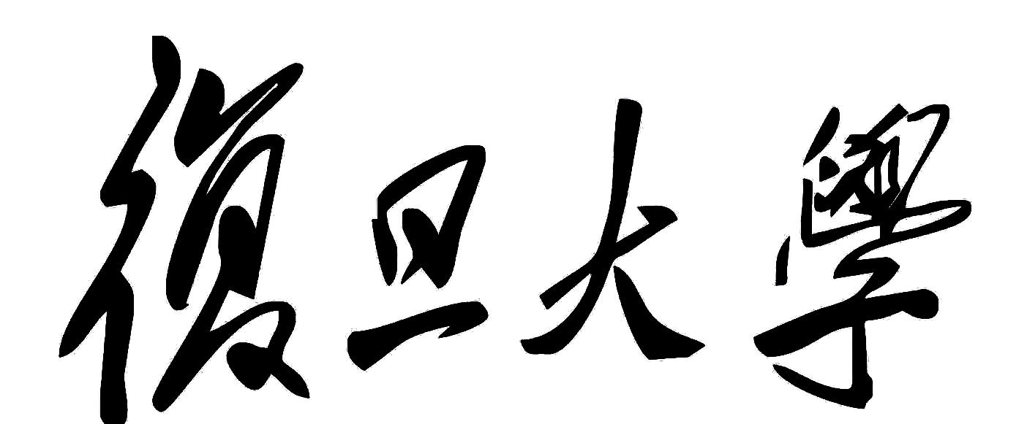
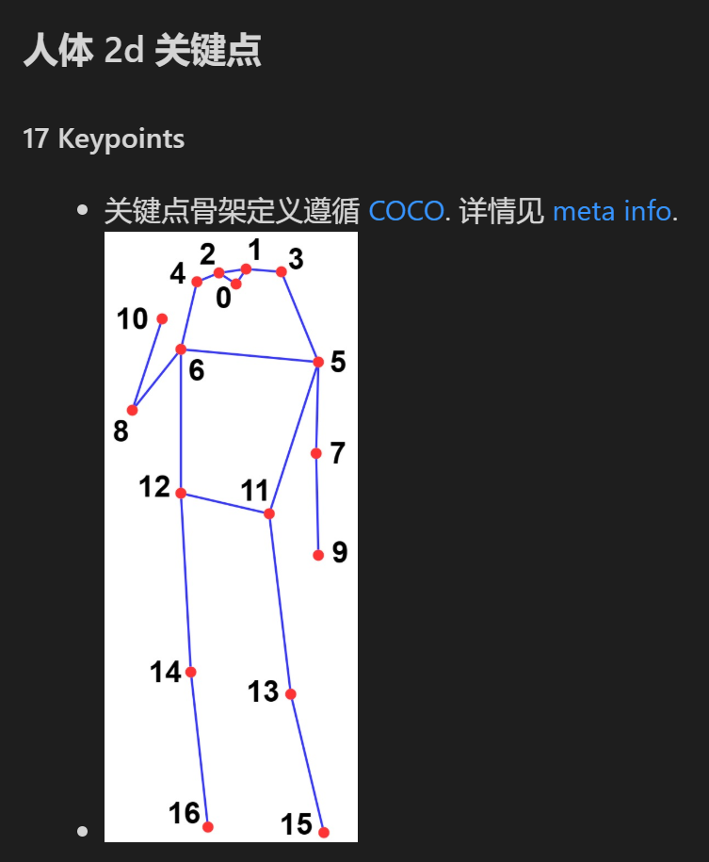
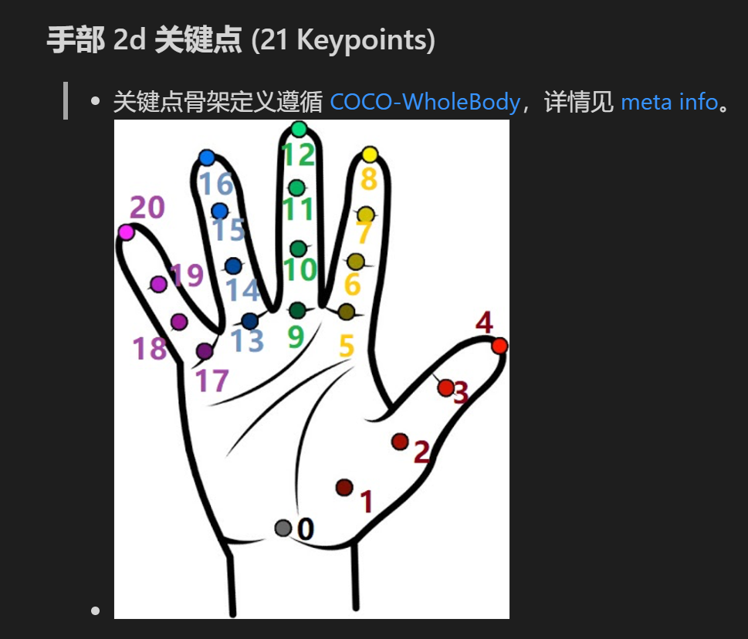

01
骨架注入
FUDAN UNIVERSITY
在此输入标题
2

Slide 3
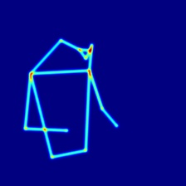
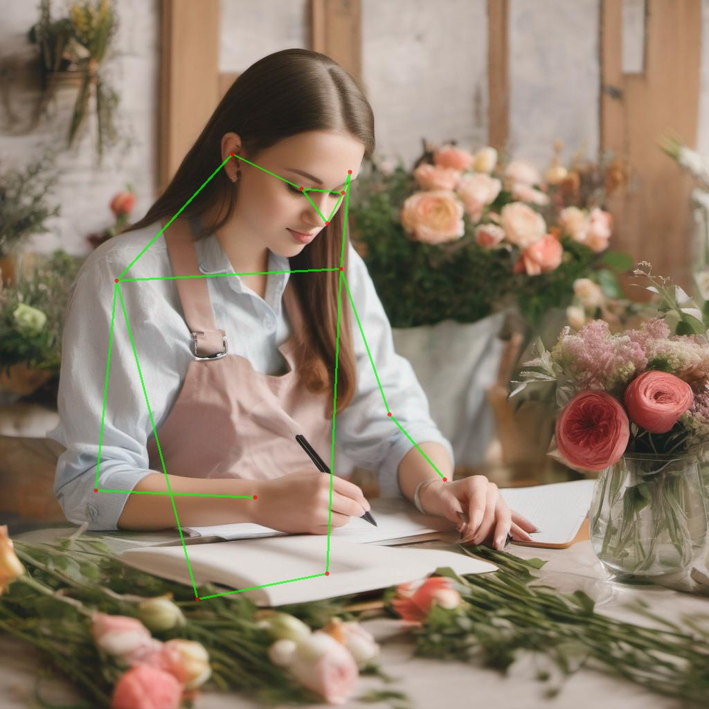

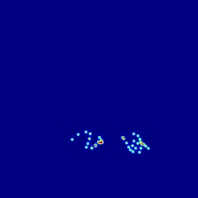

01
骨架注入
FUDAN UNIVERSITY
· 使用mmdet+mmpose模型
· 对人体骨架、手部关键点做划分
· 信息注入resnet网络中

Slide 4
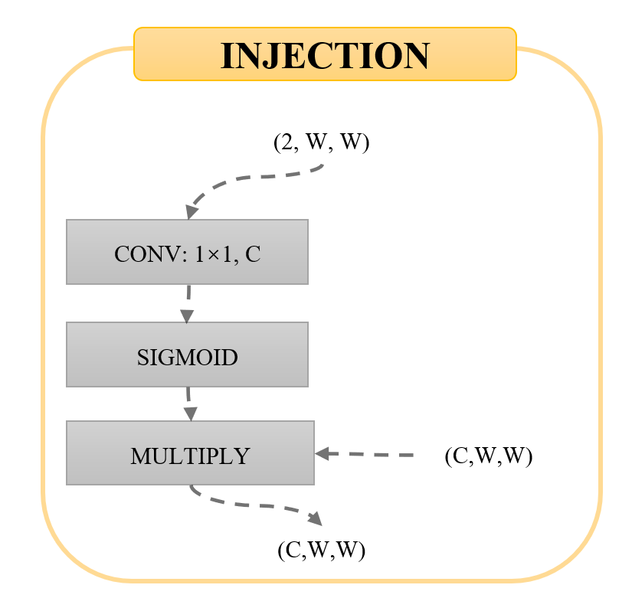
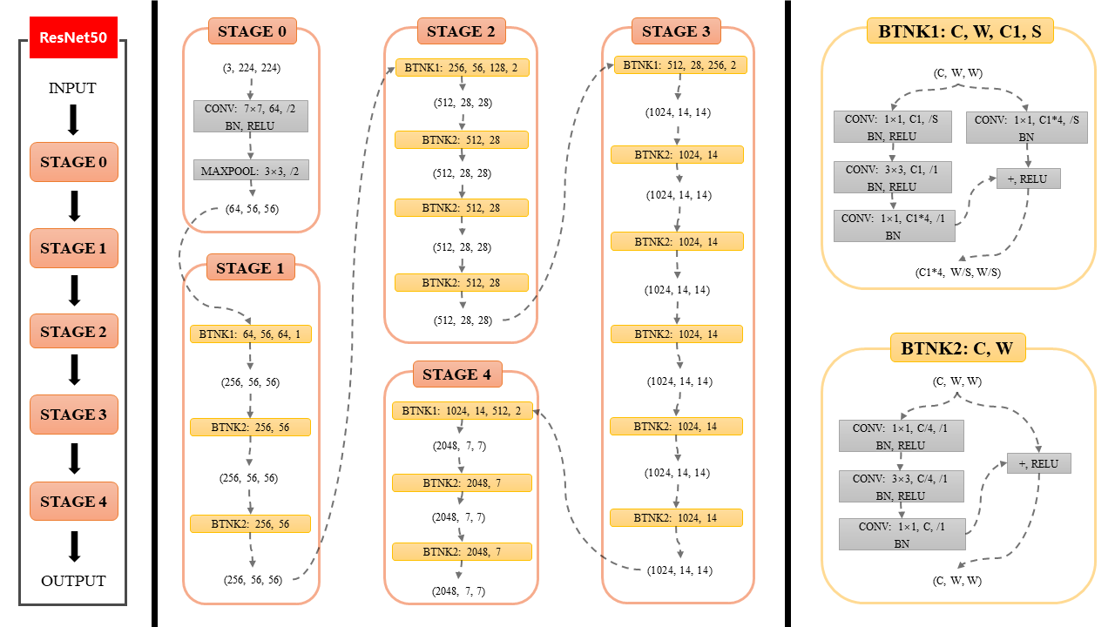
01
骨架注入
FUDAN UNIVERSITY
Pose_skeleton
injection
Hand_skeleton
injection
在此输入标题
Pose_skeleton
injection
Hand_skeleton
injection
Pose_skeleton
injection
Hand_skeleton
injection
Pose_skeleton
injection
Hand_skeleton
injection
4

Slide 5
ResNet50
STAGE 0
STAGE 2
STAGE 3
INJECTION
(3, 224, 224)
BTNK1: 256, 56, 128, 2
BTNK1: 512, 28, 256, 2
(2, W, W)
INPUT
CONV: 7×7, 64, /2
BN, RELU
(512, 28, 28)
(1024, 14, 14)
CONV: 1×1, C
STAGE 0
BTNK2: 512, 28
BTNK2: 1024, 14
MAXPOOL: 3×3, /2
(512, 28, 28)
SIGMOID
(1024, 14, 14)
(64, 56, 56)
BTNK2: 512, 28
MULTIPLY
(C,W,W)
STAGE 1
(512, 28, 28)
BTNK2: 1024, 14
STAGE 1
(C,W,W)
BTNK2: 512, 28
(1024, 14, 14)
STAGE 2
(512, 28, 28)
BTNK1: 64, 56, 64, 1
BTNK2: 1024, 14
BTNK2: C, W
(256, 56, 56)
STAGE 4
(1024, 14, 14)
(C, W, W)
STAGE 3
BTNK1: 1024, 14, 512, 2
BTNK2: 256, 56
BTNK2: 1024, 14
CONV: 1×1, C/4, /1
BN, RELU
(2048, 7, 7)
(1024, 14, 14)
+, RELU
(256, 56, 56)
BTNK2: 2048, 7
CONV: 3×3, C/4, /1
BN, RELU
STAGE 4
BTNK2: 256, 56
(2048, 7, 7)
BTNK2: 1024, 14
CONV: 1×1, C, /1
BN
BTNK2: 2048, 7
OUTPUT
(256, 56, 56)
(1024, 14, 14)
(C, W, W)
(2048, 7, 7)
Notes:
ResNet50

Slide 6
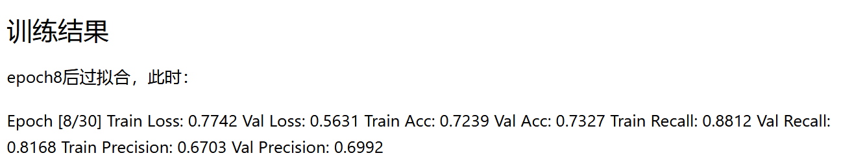
02
效果
FUDAN UNIVERSITY
1
3
3
3
加入骨架后：recall 81，acc 73左右
没有带来明显的效果提升
JUNE 12th

Slide 7
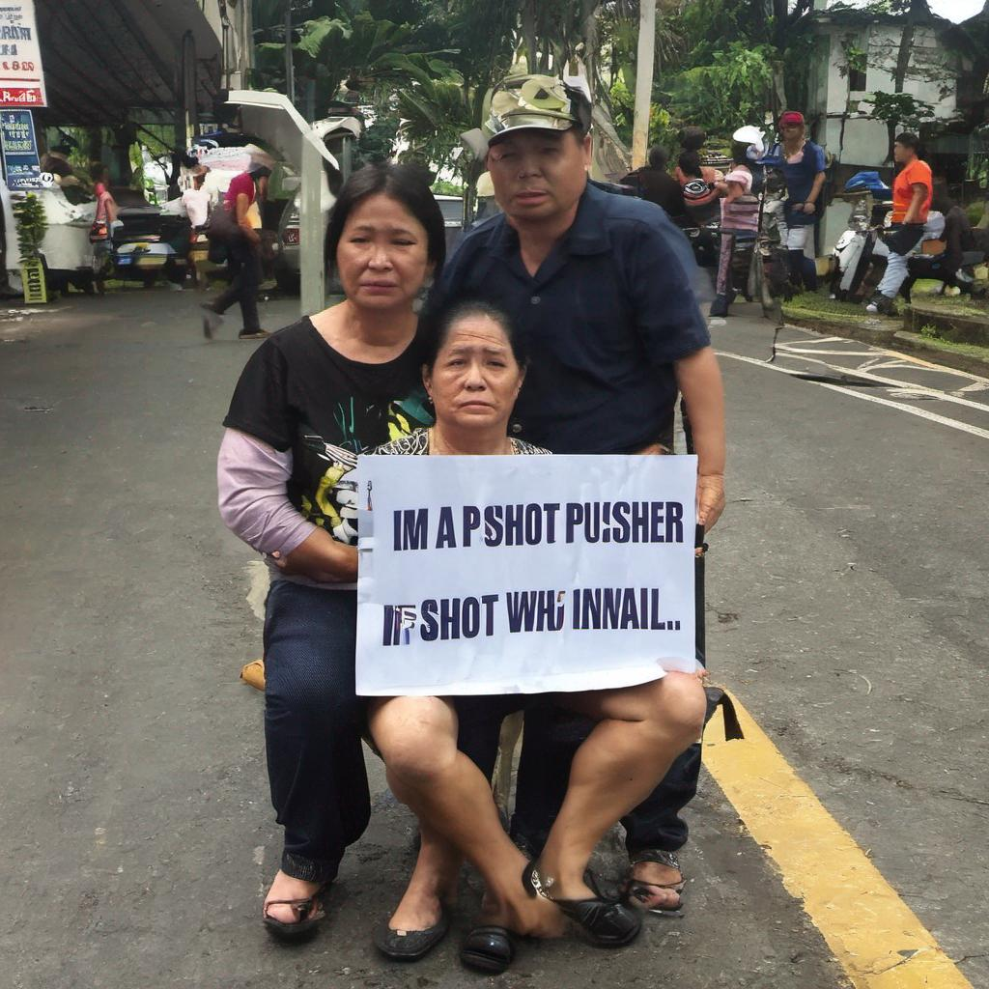
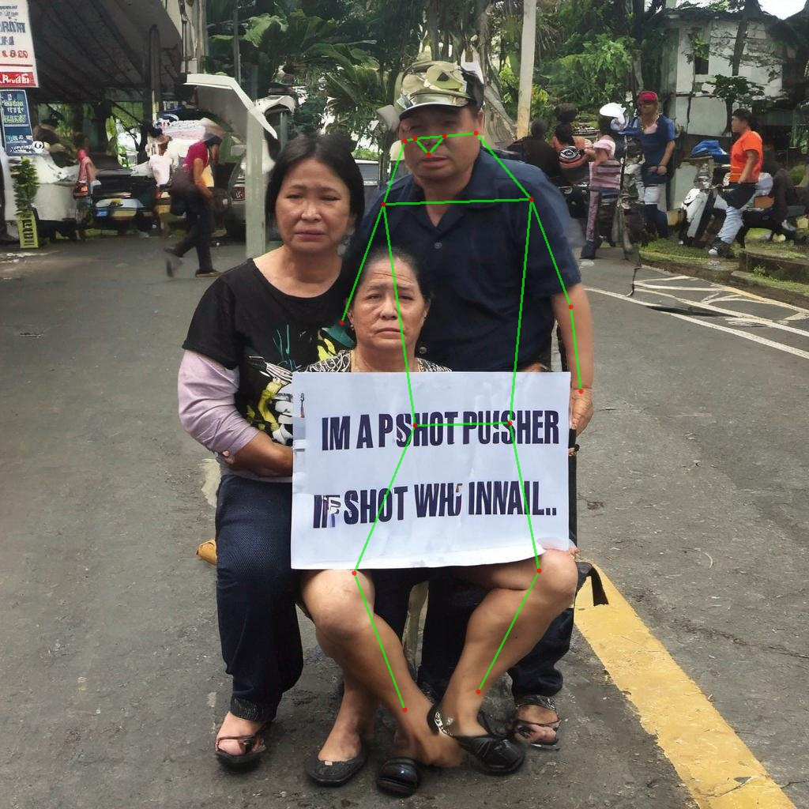
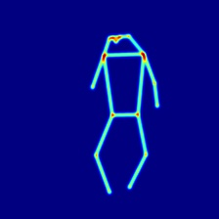
03
问题分析与改进方案
FUDAN UNIVERSITY
1
3
3
3
问题：骨架生成质量差；目前没有对图片中的人物做分割。在多人物场景下无法工作。
而多人物图片是出现异常的主要场景。
改进措施：使用更好的人物在人物姿态估计前引入人物分割模型。
JUNE 12th

