Slide 1



FUDAN UNIVERSITY
飞虎队课题：AIGC生成的人物异常检测week4
汇报人：刘皓蓝
指导老师：孙未未
2026-1-13

Slide 2

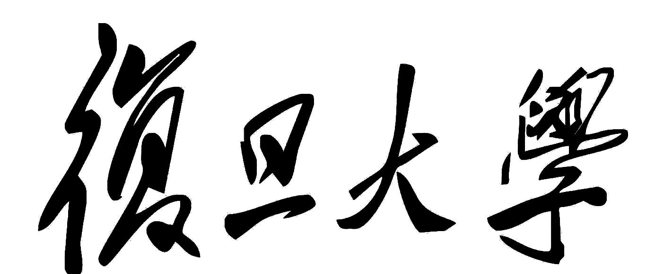
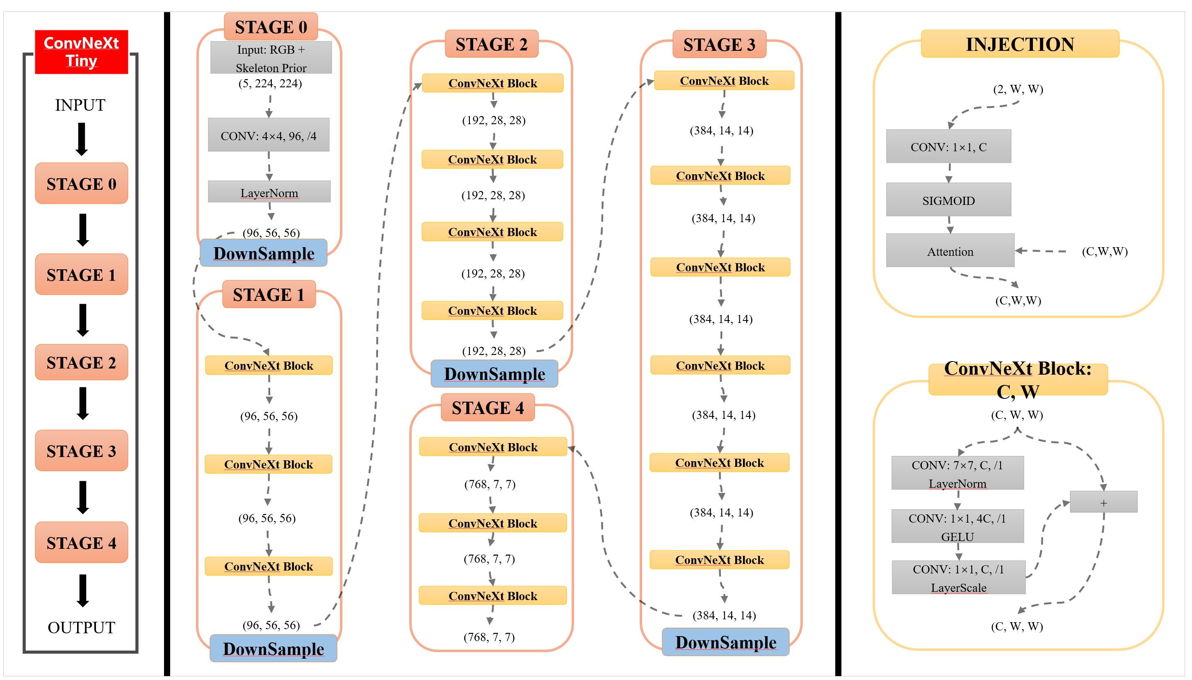

01
骨架注入
FUDAN UNIVERSITY
在此输入标题
Pose_skeleton
injection
Hand_skeleton
injection
Pose_skeleton
injection
Hand_skeleton
injection
2

Slide 3
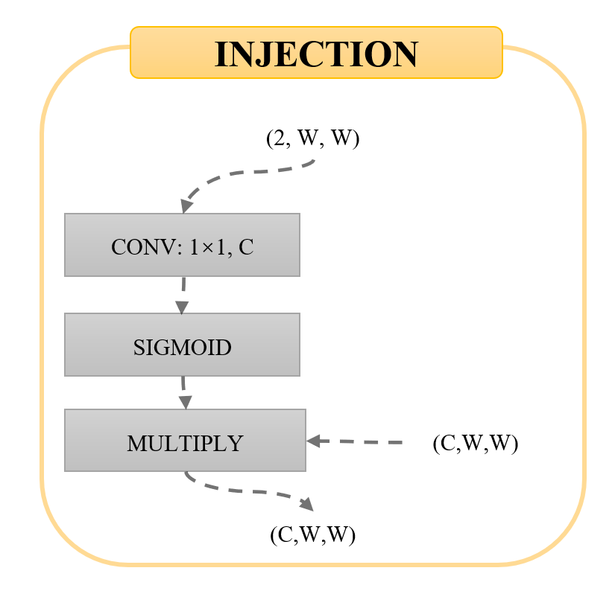
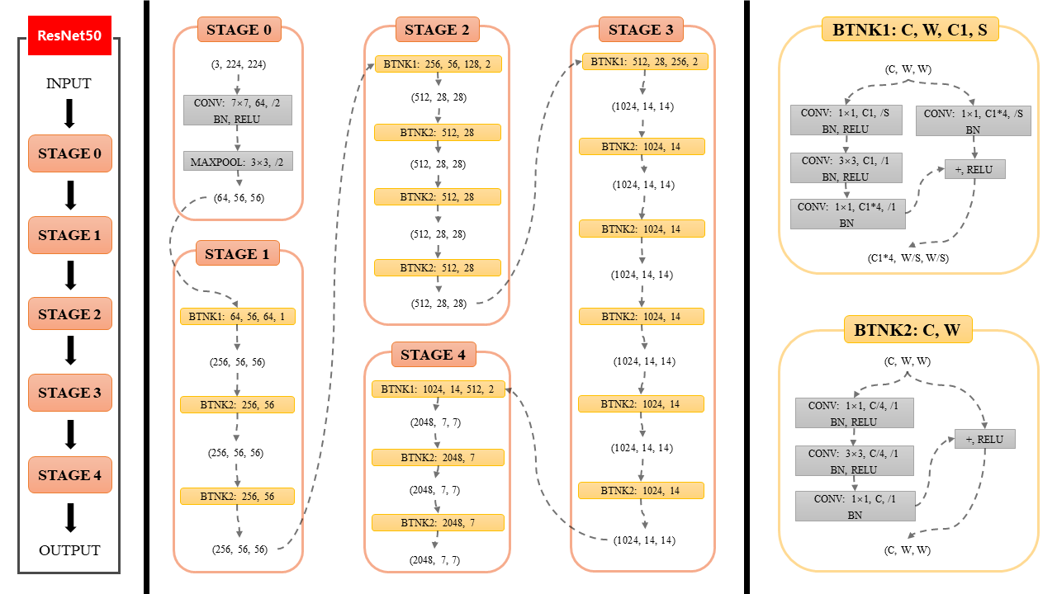
01
骨架注入
FUDAN UNIVERSITY
Pose_skeleton
injection
Hand_skeleton
injection
在此输入标题
Pose_skeleton
injection
Hand_skeleton
injection
Pose_skeleton
injection
Hand_skeleton
injection
Pose_skeleton
injection
Hand_skeleton
injection
3

Slide 4
ResNet50
STAGE 0
STAGE 2
STAGE 3
INJECTION
(3, 224, 224)
BTNK1: 256, 56, 128, 2
BTNK1: 512, 28, 256, 2
(2, W, W)
INPUT
CONV: 7×7, 64, /2
BN, RELU
(512, 28, 28)
(1024, 14, 14)
CONV: 1×1, C
STAGE 0
BTNK2: 512, 28
BTNK2: 1024, 14
MAXPOOL: 3×3, /2
(512, 28, 28)
SIGMOID
(1024, 14, 14)
(64, 56, 56)
BTNK2: 512, 28
MULTIPLY
(C,W,W)
STAGE 1
(512, 28, 28)
BTNK2: 1024, 14
STAGE 1
(C,W,W)
BTNK2: 512, 28
(1024, 14, 14)
STAGE 2
(512, 28, 28)
BTNK1: 64, 56, 64, 1
BTNK2: 1024, 14
BTNK2: C, W
(256, 56, 56)
STAGE 4
(1024, 14, 14)
(C, W, W)
STAGE 3
BTNK1: 1024, 14, 512, 2
BTNK2: 256, 56
BTNK2: 1024, 14
CONV: 1×1, C/4, /1
BN, RELU
(2048, 7, 7)
(1024, 14, 14)
+, RELU
(256, 56, 56)
BTNK2: 2048, 7
CONV: 3×3, C/4, /1
BN, RELU
STAGE 4
BTNK2: 256, 56
(2048, 7, 7)
BTNK2: 1024, 14
CONV: 1×1, C, /1
BN
BTNK2: 2048, 7
OUTPUT
(256, 56, 56)
(1024, 14, 14)
(C, W, W)
(2048, 7, 7)
Notes:
ResNet50

Slide 5
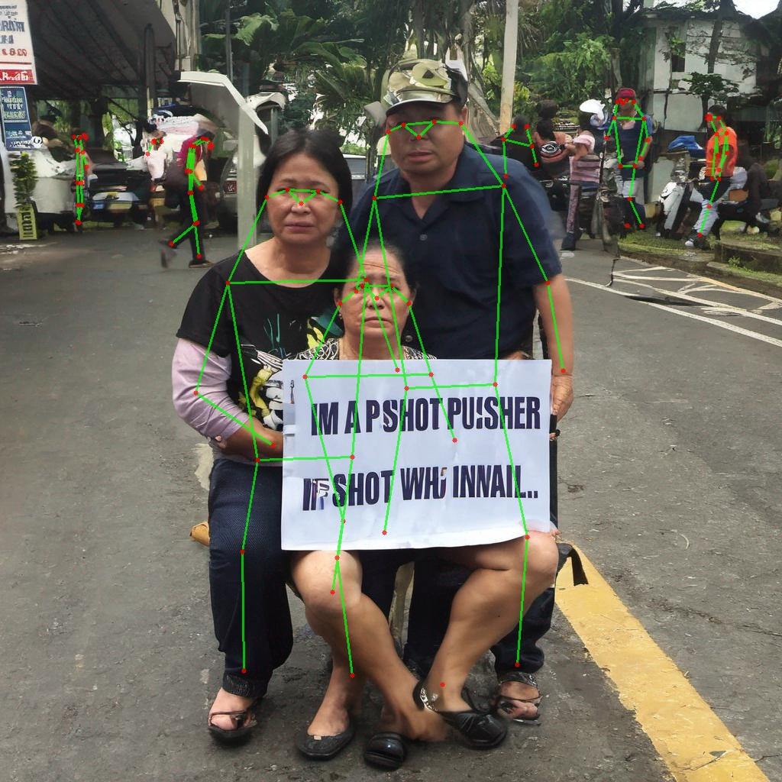
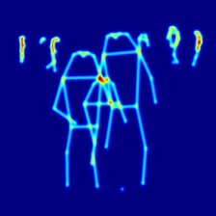
01
多人场景骨架注入
FUDAN UNIVERSITY
1
3
3
3
JUNE 12th

Slide 6
02
多个分类头
FUDAN UNIVERSITY
1
单分类头
多分类头
Feature
Feature
FC
FC
FC
Output logits
（8类）
multilabel logits
（8类）
Binarylabel logits
（2类）
Total loss
JUNE 12th

Slide 7
03
实验结果
FUDAN UNIVERSITY
Resnet+二分类建模：acc 73 recall 74
Resnet+多标签建模：acc 72 recall 85
Resnet+多标签建模+身体骨架：acc 72 recall 85
Resnet+多标签建模+身体、手部骨架：acc 73 recall 81
Resnet+多标签建模+身体、手部分割和骨架识别：acc 73 recall 88
ConvNeXt+多标签建模+身体、手部分割和骨架识别：acc 68 recall 94
ConvNeXt+多标签建模+身体、手部分割和骨架识别+多个分类头：acc 75 recall 82
目前所有超参都是经验参数，未来一周计划对涉及的超参数做细致的调优
把各部位切分出来塞入模型通道中
1
3
3
3
JUNE 12th

