Slide 1


BIG DATA AND E-COMMERCE PROJECT
Group members:
Aaron Pereira
Adrian Texeira
Arya Mukherjee
Tarjani Shah

Slide 2
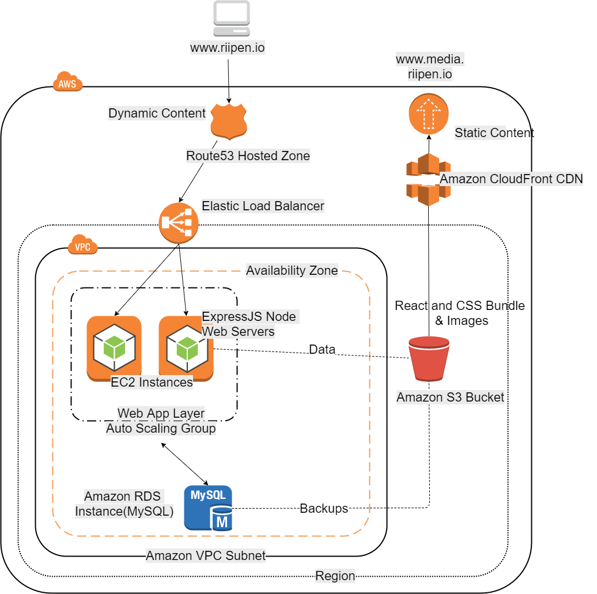
Existing Riipen Architecture

Slide 3
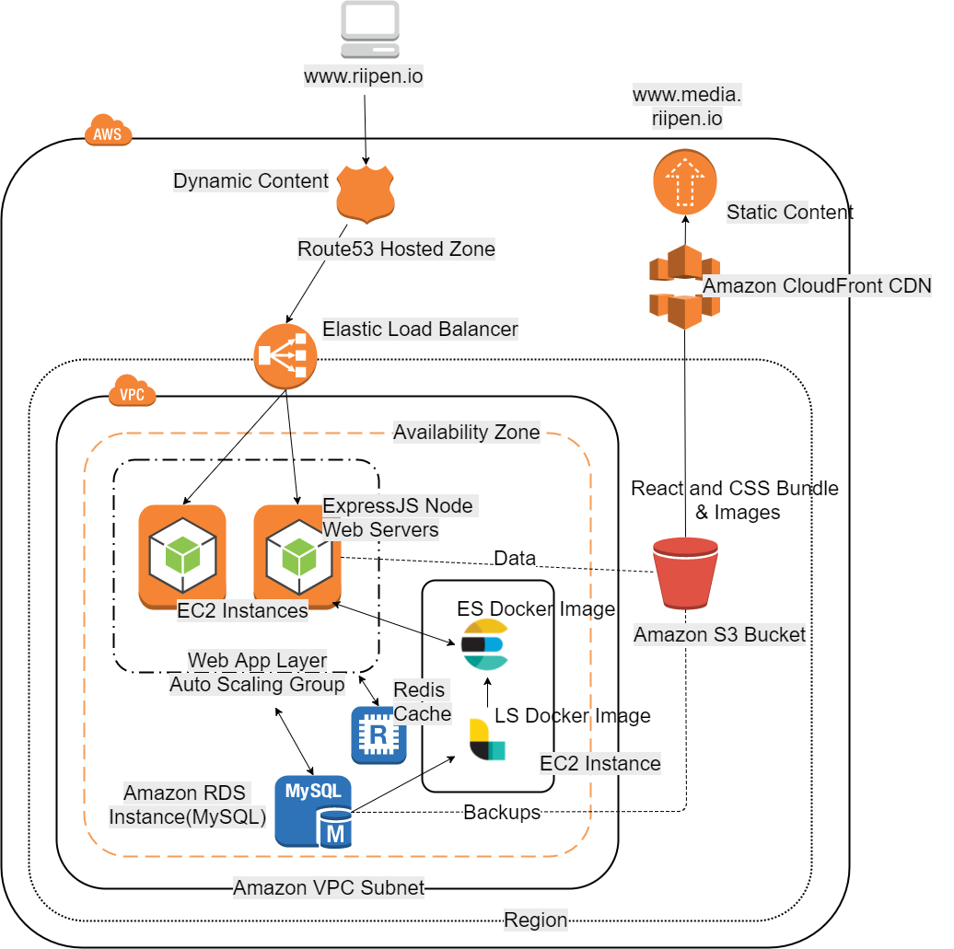
Proposed Architecture

Slide 4
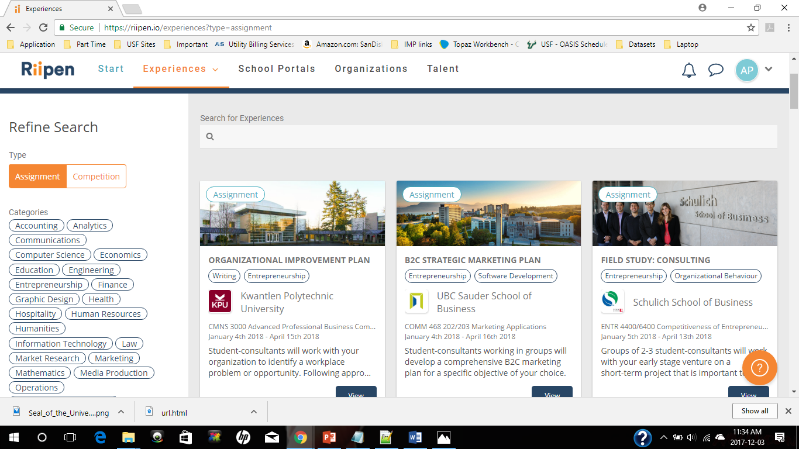
Riipen Website (https://riipen.io/ )

Slide 5


Slide 6

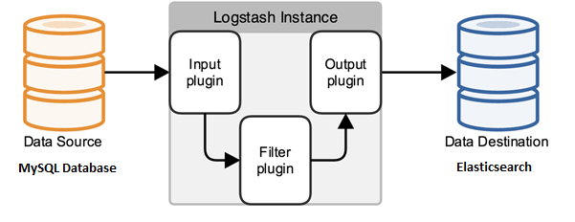
Logstash Configuration
Pipeline

Slide 7
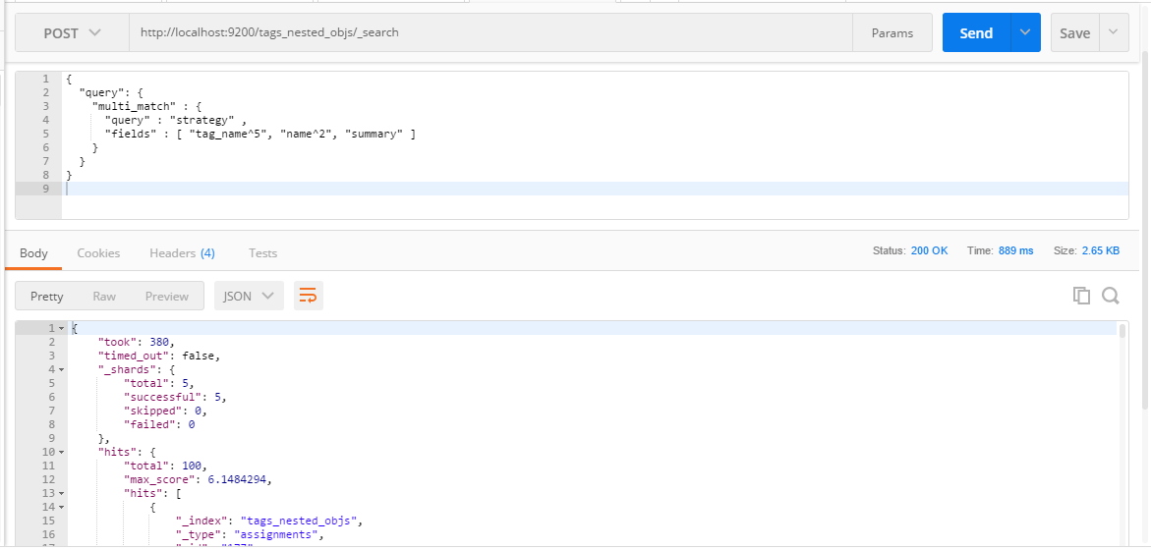
Elasticsearch Query DSL- Boosting

Slide 8
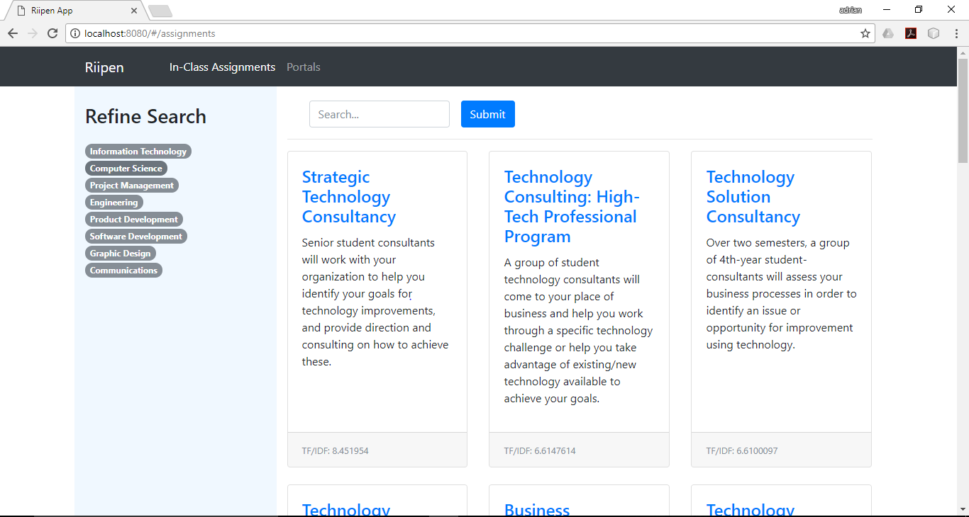
Application prototype

Slide 9

Redis Caching and Recommendation

Slide 10
Challenges and Solutions
Understanding current architecture of Riipen website
Transferring data from RDBMS to ES/configuration
Indexing while maintaining the relationship (nested objects)

Slide 11
DELIVERABLES
Youtube video presentation:
https://youtu.be/Wc2YpaOZgJs
GitHub URL :
https://github.com/AdTexeira/Big-Data-and-E-commerce-Project.git

Slide 12
Thank You

