Slide 1
Player Analytics Methodologies at Micro-Level
Data Science Programming (ISM 6930)
University of South Florida
Adrian Texeira
Ankit Singh
Tarjani Shah

Slide 2
Motivation
• Most existing sports analytics done in the field of cricket is based on match-to-match data.
• Our novel attempt is at devising a model that would predict various attributes of a player’s game based on data from each ball (play-by-play) across multiple games.
• This would enable us to uncover hidden insights about the strength/weakness of a player and help define his play style.

Slide 3
Data Preprocessing
• We leveraged data from a cricbuzz.com service to fetch running commentary for all One Day Internationals played by each player in about 50 One-Day International matches from the year 2016 onwards.
• We extracted different attributes about each ball such as ‘Delivery Line’, ’Delivery Length’, ’Speed of Ball’, ‘Type of Shot’ etc. from the running commentary, eyeballed the data to complete otherwise missing records and successfully managed to obtain more than 2000 records for each player.
• Data was extracted for two of the leading run-scorers in Rohit Sharma (India) and David Warner (Australia).

Slide 4
Exploratory Data Analysis
The following useful visualizations done using Matplotlib, Seaborn libraries helped us to uncover further insights from our data. Some of these were expected, while others weren’t apparent.
• Average run-rate against every opponent, for a given ball type, based on delivery length.
• Dismissal types according to ball length. We can infer that the probability of getting Rohit’s wicket increases by bowling a short ball, outside the off stump line.

Slide 5
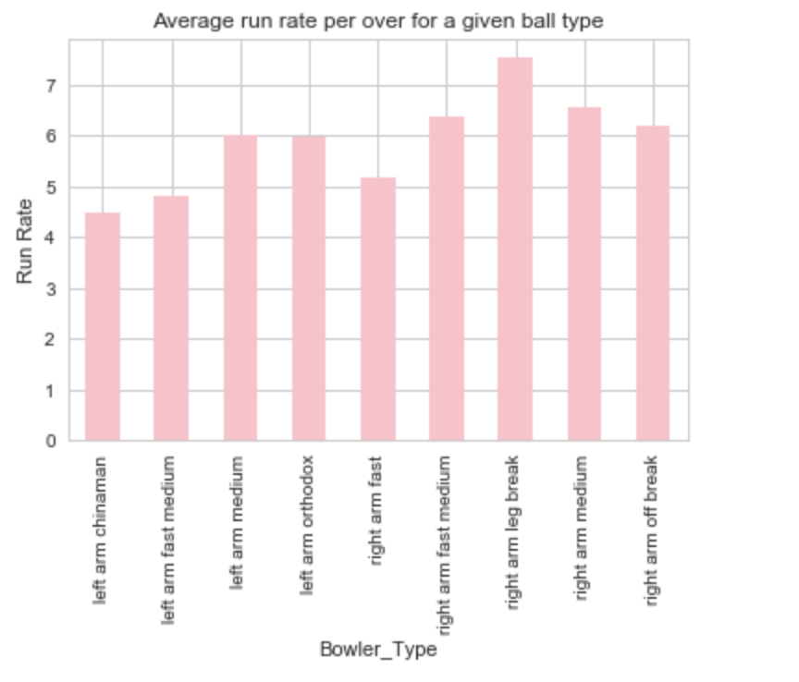
• The graph below shows average run-rate against each bowler type. In a crunch situation if there is a need to pick up a bowler who needs to defend runs, it can be seen from the graph that a left arm bowler would be much effective as compared to right arm.

Slide 6
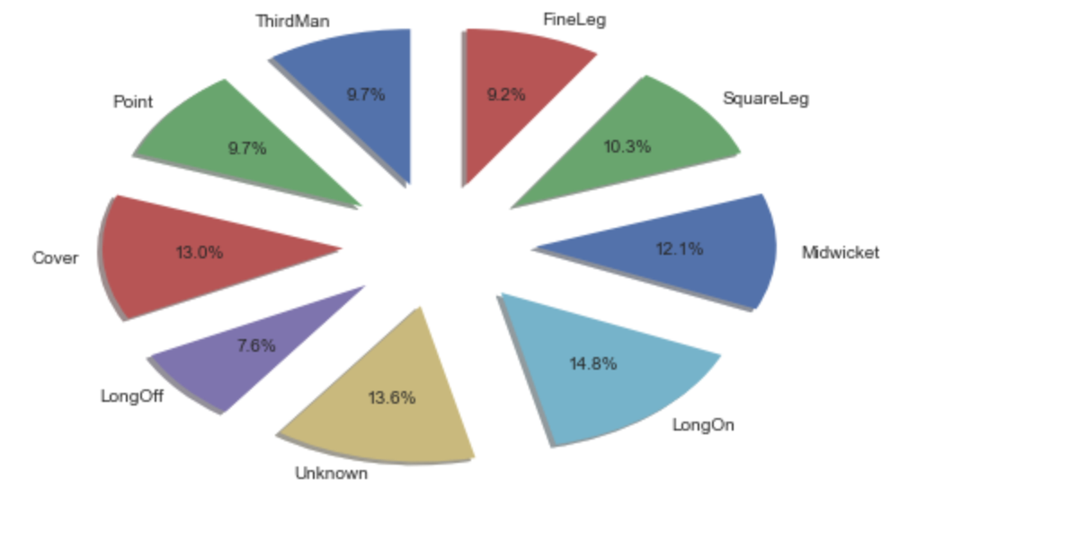
• A pie-chart showcasing the percentage of shots played across different zones of the field.
Rohit loves to play shots on the leg-side as is apparent by the higher percentage of shots played when compared to the off-side.

Slide 7
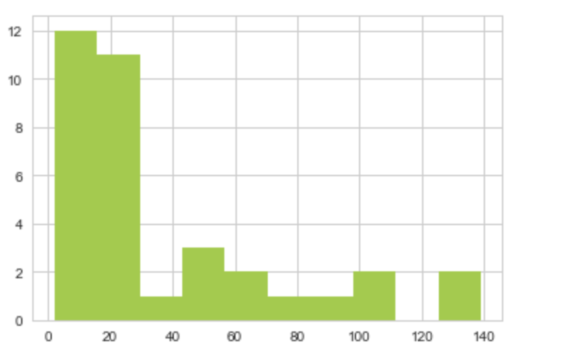
• Histogram showcasing his dismissal against the total number of balls played.
From the data it is apparent that the probability of getting Rohit Sharma’s wicket decreases drastically once he has played more than 30 ball. This was expected as most batsman start playing better once they have got their eyes set in.

Slide 8
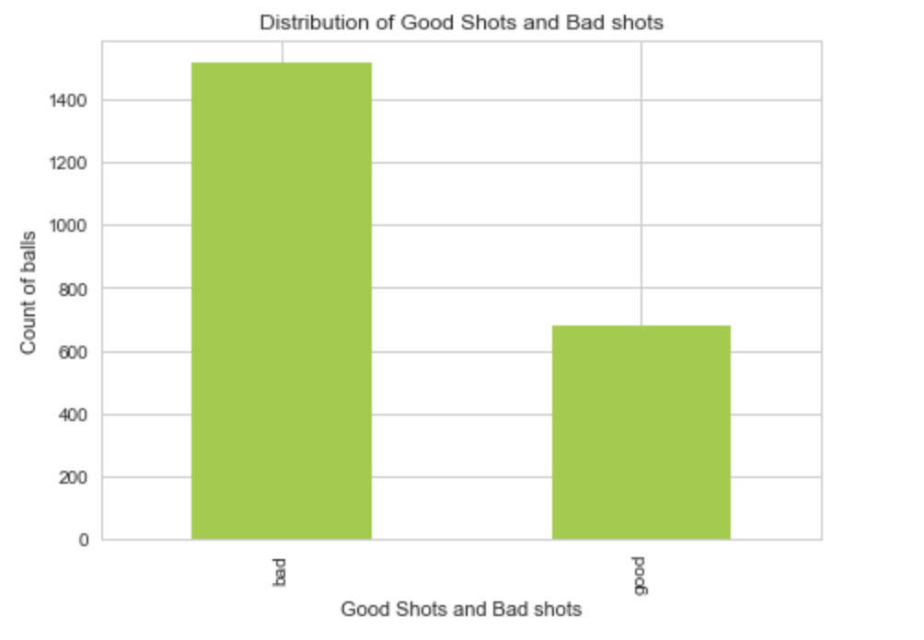
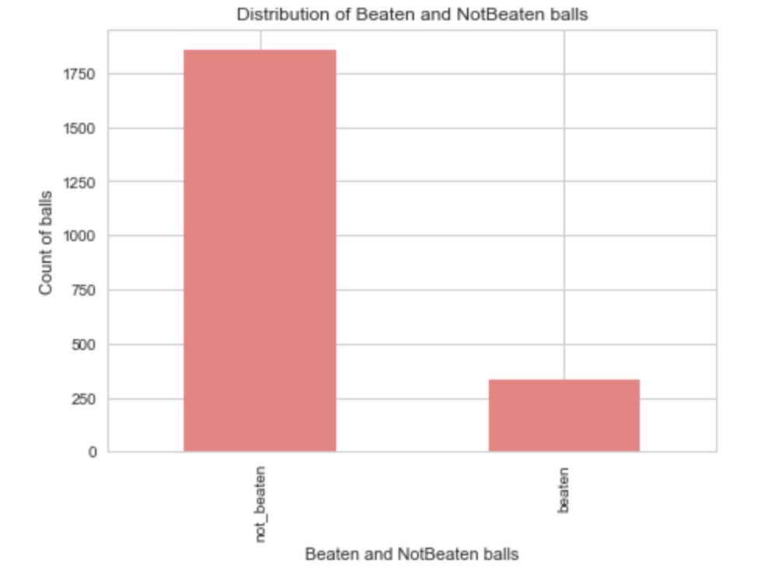
• Histograms showing
1) Distribution of good v/s bad shots.
2) Distribution of balls where the batsman was beaten/ not beaten.

Slide 9
Machine Learning Models
• Employed two machine learning algorithms in Decision Trees and Random Forest using Scikit-learn. These models took various attributes of the delivery such as line, length, bowler type, speed etc. to predict whether the batsman:
1) was beaten by the bowler.
2) managed to score runs.
3) hit a good shot (Any shot that fetched more than a run, excluding edges was classified as a good shot).
• Furthermore, the model’s hyper-parameter was tuned (using Randomized Search) and it’s performance evaluated.

Slide 10
Conclusion & Future Scope
• The suggested model does a good job at uncovering insights about the player’s game style. Such insights can be useful for the players to improve their game and for the opponents to devise strategies based on weaknesses.
• However, the project was challenging and meant that our team hit significant roadblocks during the journey. Since most of the data was categorical and a lot of machine learning models do not perform well with such data, a strategy to handle categorical variables proved to be critical. Moreover, extracting values from running commentary proved to be a tough task as speech can be ambiguous.
• Our model could be improved further by feeding it more data. Future advancements of technology ((optical imaging) could mean more sources of data to analyze and even more structure to the commentary style could make one’s job easier.

Slide 11
References
1) Commentary: http://www.cricbuzz.com/
2) Get speeds for each bowler: https://www.icc-cricket.com/, http://www.espncricinfo.com/
3) Service URL: https://stackoverflow.com/questions/43315307/python-web-scraping-unable-to-find-all-the-tags-in-a-webpage
4) Field positions: https://en.wikipedia.org/wiki/Fielding_(cricket)/
5) Data Visualization: https://matplotlib.org/contents.html
6) Machine Learning and modeling: Book: Hands-On Machine Learning With - Aurelien Geron_1620, https://github.com/jmportilla/Udemy---Machine-Learning
Thank You!

