Slide 1
Food Security in India

Slide 2
Team members
Tark
Malhar
Shashwat

Slide 3

What is food Security
❖ Food security means something more than getting two square meal.
Food security has the following dimensions :
Availability
Accessibility
Affordability
● Production of sufficient food within the country.
● Imports and previous year stock.
● Food is within the reach of every person.
● Everyone have the enough money to buy sufficient, safe and nutritious food
Food security is ensured in a country only if enough food is available for all the persons, all persons have the capacity to buy food of acceptable quality and there is no barrier on access to food.

Slide 4

❖ Population require food for survival ​
But may become food insecure during calamity
❖ How is Food security affected during a calamity?
Natural Calamity
Production of foodgrains decreases
= Shortage of food
∴ Prices goes up and some people cannot afford to buy food
This may lead to a situation of starvation and then to famine

Slide 5
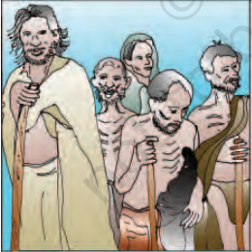
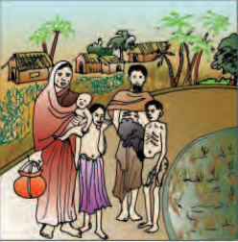
A Famine is characterized by wide spread deaths due to starvation an epidemics caused by forced use of contaminated water or decaying food and loss of body resistance due to weakening from starvation.
Starvation victims arriving at a relief center, 1945.
2 During the Bengal Famine of 1943, a family leaves its village in Chittagong district in Bengal.
Class 9th - Economics - Food Security in India ​

Slide 6

THANK YOU
BY Allies
Document (tark-patel.github.io)

