Slide 1

SMART INDIA HACKATHON 2026
NAUPLAN
Problem Statement ID – SIH26006
Problem Statement Title- Development of an Intelligent Freight Forecasting Model for Optimized Vessel Chartering and Bulk Cargo Procurement from overseas to East Coast of India
Theme- Transportation & Logistics
PS Category- Software
Team ID- 183490
Team Name (Registered on portal) - Vector66

Slide 2
IDEA TITLE: NAUPLAN
Vector66
Proposed Solution (Describe your Idea/Solution/Prototype)
NauPlan: a working prototype that moves SAIL from daily spot fixtures to short / medium term multi-voyage contracts for East Coast coal imports.
Detailed explanation of the proposed solution
Freight forecast: P10 / P50 / P90 ranges 1 to 26 weeks ahead, judged by walk-forward backtest
Vessel-port fit: Baltic standard ships vs draft, LOA, beam at 7 East Coast and 12 load ports
Contract strategy: optimiser picks spot, 3 / 6-month time charter or COA, and when to fix
Idle control: spare chartered days relet to the market; idle days tracked each month
Early warnings: sea state at all 7 ports, freight volatility, missing data flagged
How it addresses the problem
Replaces daily fixing with a contract plan tested on 200 freight scenarios
Shows why each ship can or cannot call, and the cargo cut at each draft limit
Innovation and uniqueness of the solution
Plans on honest ranges and worst-case cost (CVaR), not on a single price guess
Every port limit cites its source; Paradip Capesize cargo within 1% of a real call

Slide 3
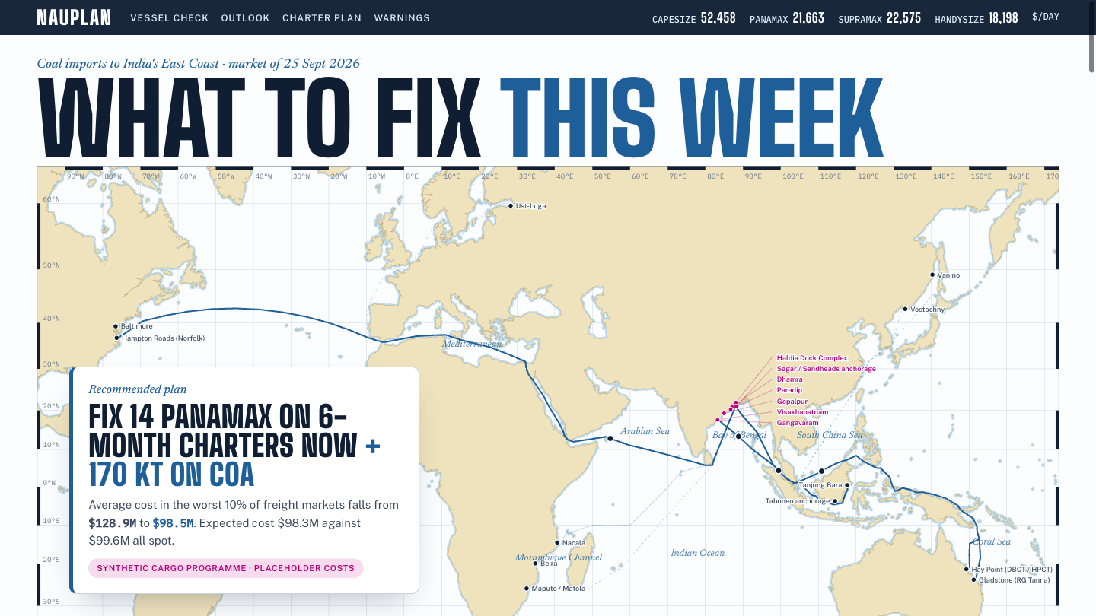
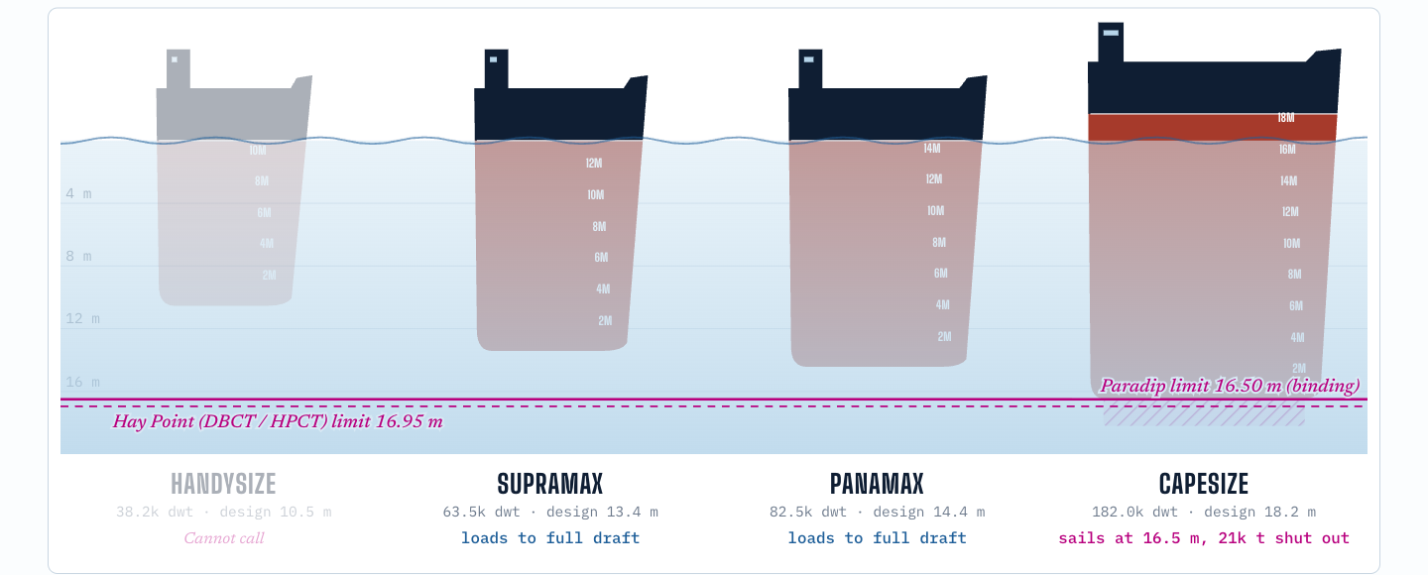
TECHNICAL APPROACH
Vector66
Technologies to be used (e.g. programming languages, frameworks, hardware)
Data & ML: Python, pandas, statsmodels, LightGBM; FRED, World Bank, Open-Meteo, BDRY feeds
Ports & routes: cited berth limits for 19 ports; searoute (MARNET) with deep-draft and avoid-Suez routes
Optimisation: two-stage stochastic MILP in PuLP with the HiGHS solver; CVaR risk term
App: FastAPI backend, React + Vite + d3 dashboard; 37 automated tests; code on GitHub
Methodology and process for implementation (Flow Charts/Images/ working prototype)
1. Data
2. Forecast
3. Optimise (MILP)
4. Decide
• Freight proxy, fuel, FX, coal prices
• Berth limits for 19 ports, cited
• Sea routes and sea state
• 6 models, walk-forward backtest
• P10 / P50 / P90, 1 to 26 weeks
• Volatility warning
• Ship fit and draft cargo cut
• Spot vs TC vs COA, entry month
• 200 scenarios, cost + CVaR
• Dashboard: plan and timeline
• Why each ship fits or not
• Warnings; manager approves
Built and running
• One-command data refresh
• 19 ports, every limit cited
• Forecast backtest report
• Plan in seconds
• 37 automated tests
• Public code on GitHub
Prototype: recommended plan on a chart of voyage tracks
Draft gauge: which ship fits Hay Point to Paradip

Slide 4
FEASIBILITY AND VIABILITY
Vector66
Analysis of the feasibility of the idea
Built: data pipeline, cited limits for 19 ports, forecasting, optimiser, dashboard (37 tests)
Checked: Hay Point to Paradip Capesize, model 153,810 t vs 152,702 t actual call (6 Sep 2026)
Tested: forecasts backtested on 2021 to 2026 data; a 6-month plan solves in seconds
Cost: open-source stack on a laptop or one cloud VM; code public on GitHub
Needs from SAIL: import plan, fixture history, bunker and port costs (placeholders today)
Potential challenges and risks
1. Public data cannot predict freight direction (no model beat "no change" in testing)
2. Per-class and period freight rates are licensed data
3. Port limits change with tide and dredging; a few are not yet sourced
4. Managers may not trust a black-box plan
Strategies for overcoming these challenges
1. Plan on ranges and scenarios; add the FFA forward curve with licensed data
2. Baltic S8 route (Indonesia to East Coast India) or SAIL fixtures use the same pipeline
3. Each limit stored with source and date; gaps shown on the dashboard
4. Reasons for every ship choice; manager sets the risk weight; plan shown against all spot

Slide 5
IMPACT AND BENEFITS
Vector66
Potential impact on the target audience
Chartering team: a forward contract plan and ship choice with reasons, not daily market scanning
Plant operations: steadier coal arrivals, fewer stock-outs
Port users: ships sized to each port's draft, fewer waiting days
Management: expected and worst-case freight cost visible before committing
Benefits of the solution (social, economic, environmental, etc.)
Economic (example run*): worst-10% programme cost $128.9M all spot vs $98.5M with the plan
Operational: spare chartered days relet, not idle; every decision auditable
Environmental: fewer ballast and waiting days means less fuel burnt
*Synthetic 3.88 Mt, 6-month programme with placeholder costs and 200 freight scenarios; real figures need SAIL data.

Slide 6
RESEARCH AND REFERENCES
Vector66
Details / Links of the reference and research work
SIH 2026 problem statement SIH26006 (Ministry of Steel, SAIL)
sih.gov.in/sih2026PS
Baltic Exchange: Guide to Market Benchmarks v8.7 (Aug 2026), standard vessels and TCE method
balticexchange.com/.../ocean-bulk-guides-policies/GMB.pdf
East Coast limits: Visakhapatnam Port Authority berth dimensions; Paradip Port Authority
vpt.shipping.gov.in/admin_assets/uploads/1640237145_Berth Details.pdf | paradipport.gov.in
Adani Ports: Gangavaram BPTS (Oct 2024) and Dhamra BPTS (Oct 2025), berth parameters
cdn.gac.com/prod/docs/INDIA-Gangavaram_New-BPTS-Oct-2024.pdf | adaniports.com (Dhamra BPTS)
Load ports: DBCT Terminal Information Booklet (Hay Point); Port of Gladstone Handbook
dbct.squarespace.com/s/Terminal-Information-Booklet-Procedure.pdf | gpcl.com.au
Passages: Torres Pilots draft limits; Suez Canal Authority; Danish Maritime Authority
torrespilots.com.au/pilot-info/draft-restrictions | suezcanal.gov.eg | soefartsstyrelsen.dk
Data feeds: FRED (Brent, USD/INR); World Bank Pink Sheet; Open-Meteo ERA5 marine; BDRY
fred.stlouisfed.org | worldbank.org/en/research/commodity-markets | open-meteo.com
Methods: searoute (Eurostat MARNET); HiGHS solver; LightGBM; statsmodels
github.com/genthalili/searoute-py | highs.dev | lightgbm.readthedocs.io
Project repository, method notes and backtest report (Team Vector66)
github.com/Tarkshya-26/nauplan

