Slide 1
Introduction to R
DSI Workshop on Automated Media Content Analysis
FS 2020
PD Dr. Gerold Schneider
Department of Computational Linguistics, University of Zürich
gschneid@ifi.uzh.ch
Dr. Martin Wettstein Department of Communication and Media Research
m.wettstein@ikmz.uzh.ch

Slide 2
Overview
Objects and Syntax
Functions and Packages
Files and Tables
Loops
Note: This very brief introduction of 35 slides is adapted from a brief crash-course in R, spanning 90 slides and taking 4 hours. It merely covers the absolute basics of R.

Slide 3
Objects
R is an object oriented programming language, which uses functions and operations to manipulate and visualize objects.
There are generally two types of objects:
atomic objects or symbols (e.g.: A number or a word)
Composite or complex objects (e.g.: A vector or list)

Slide 4
Atomic Objects
Atomic Objects may have one of the following object classes. An object class defines what operations and functions may be used on an object:
Logical: May only be TRUE or FALSE
Integer: Any positive or negative number without decimals
Double: Any decimal number
Character: Any string

Slide 5
Composite Objects
Composite Objects are a collection of atomic objects, which may or may not be limited to a sinlge class:
Vector: An 1-dimensional array of objects of the same class. R will enforce the same class on all elements.
Matrix: A 2-dimensional array of objects of the same class
List: A 1-dimensional array of objects of any class. Objects in a list may even be lists, themselves.

Slide 6
Storing objects
Objects may be stored in variables.
Each variable has an unique name.
It has to start with a letter
It is case-sensitive
It may not contain any mathematical operator or special character (+,-,*,/,=,!,?,#,$)
It may contain periods and underscores (.,_)
Its value may be any object.
There may be only one object per variable
If a new object is assigned to an existing variable, the value of this variable is overwritten without any warning.

Slide 7
Mathematical operations on objects
Numeric objects (integer and double) may be combined by mathematical operators.
If one object is a vector or matrix, the operation will be done for each element of this object.
If both objects are vectors of equal length, the operation is done pairwise for corresponding elements.
If the length of vectors differ, the shorter one is repeated until it matches the longer one.
Operator | meaning
+ | Addition
- | Subtraction
* | Multiplication
/ | Division (Returns double, if the divisor is not divisible without remains)
%% | Modulo (Remainder of the division)
** or ^ | Power

Slide 8
Examples
In this example, three variables are assigned three different objects:
a ist a single character object
b is a single double object
c is a vector of integers
If an operation is used on an object it may not be used on, R returns an error.
> a = "hallo welt"
> b = 1.5
> c = c(10,18,4,1)
>
> b*2
[1] 3
> c+b
[1] 11.5 19.5 5.5 2.5
> c*b
[1] 15.0 27.0 6.0 1.5
> a+b
Error in a + b : non-numeric argument to binary operator
> c*a
Error in c * a : non-numeric argument to binary operator

Slide 9
Logical Operations
Any object may be used in logical operations. The result of a logical operation is always either TRUE or FALSE.
If logical operations are used on vectors, the result is a logical vector.
Operator | meaning
== | Is equal (any class)
!= | Is not equal (any class)
>; < | Is greater/smaller than (only numeric objects)
>=; <= | Is greater/smaller or equal than (only numeric objects)
! | NOT (only logical)
& | AND (only logical)
| | OR (only logical)

Slide 10
Examples
> a = "hallo welt"
> b = 1.5
> c = c(10,18,4,1)
>
> 3>1
[1] TRUE
> a=="hallo welt"
[1] TRUE
> a=="hallo"
[1] FALSE
> b < 5
[1] TRUE
> c >= 10
[1] TRUE TRUE FALSE FALSE
> b < 1 | b > 2
[1] FALSE
> b > 1 & b < 2
[1] TRUE
The variables defined in the last example are used again.

Slide 11
Targeting elements in vectors
Each element in a vector has an index by which it may be recognized.
Indices are integer objects and start at 1.
Indices are entered in square brackets
Multiple indices may be entered in the form of an integer vector.
The index may be used to read or write a value
R may change the class of objects to enforce unity.
A range of integer values may be entered as: start:end
> c = c(10,18,4,1)
> c[1]
[1] 10
> c[3]
[1] 4
> c[c(3,1,1,2)]
[1] 4 10 10 18
> c[2] = 20
> print(c)
[1] 10 20 4 1
> c[6] = 9.0
> print(c)
[1] 10 20 4 1 NA 9
> c[5] = "a"
> print(c)
[1] "10" "20" "4" "1" "a" "9"
> print(c[2:4])
[1] "20" "4" "1"

Slide 12
Filtering elements in vectors
Alternatively to the index, elements of vectors may be selected by means of a logical filter vector.
If the filter vector is shorter than the vector, it will be repeated until it matches its length
The filter vector may be produced by a logical operation on the vector
> c = c(10,18,4,1)
> c[c(TRUE,FALSE,TRUE,FALSE)]
[1] 10 4
> c[c(TRUE,FALSE)]
[1] 10 4
> c>10
[1] FALSE TRUE FALSE FALSE
> c[c>10]
[1] 18
> c[c<18 & c>2]
[1] 10 4
> c[c(1,2,3,4)%%2==0]
[1] 18 1

Slide 13
Targeting elements in matrices
Each element in a matrix has two indices, the first one for the row, the second one for the column
Indices are integer objects and start at 1.
Indices are entered in square brackets, separated by a comma
Multiple indices may be entered in the form of an integer vector.
The index may be used to read or write a value
R may change the class of objects to enforce unity.
> m = matrix(1:12,nrow=3)
> print(m)
[,1] [,2] [,3] [,4]
[1,] 1 4 7 10
[2,] 2 5 8 11
[3,] 3 6 9 12
> m[2,3]
[1] 8
> m[1,3:4]
[1] 7 10
> m[,1]
[1] 1 2 3
> m[1,]
[1] 1 4 7 10

Slide 14
Targeting elements in lists
> l = list("Course"="ACA",
+ "Date"="19.3.20",
+ 17,
+ c(3,5,1,23))
> print(l)
$Course
[1] "ACA"
$Date
[1] "19.3.20"
[[3]]
[1] 17
[[4]]
[1] 3 5 1 23
> l[[2]]
[1] "19.3.20"
> l[["Date"]]
[1] "19.3.20"
> l$Date
[1] "19.3.20"
Each element in a list has an index and sometimes a name. If there is a name, there are several ways to get an element:
Put the index in double square brackets
Put the name of the element in double square brackets
Put the name of the element behind a dollar sign

Slide 15
Overview
Objects and Syntax
Functions and Packages
Files and Tables
Loops and sapply

Slide 16
Functions
A function is a small program, taking a series of specific inputs (arguments) and performing operations on them. It may return an object and it may have an effect.
Effects may be:
Drawing a plot
Writing, changing or moving a file
Changing options within R (e.g.: graphics options)

Slide 17
Functions
Functions are called by writing their name and putting the arguments you want to pass in brackets behind this name (no blanks!)
If the object returned by the function is to be stored in a variable, this variable may be set equal to the function call.
If there is no variable to store the object in, R will print the result to the terminal.
Argument, which is passed
Name of the function
Function call
n = as.integer("123")
Variable to catch the output

Slide 18
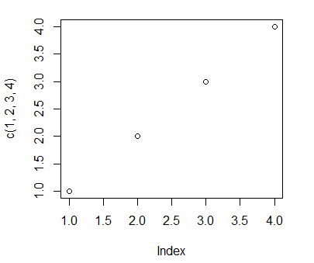
Examples
The most important functions for this workshop are class conversions, univariate statistics and plotting.
Conversion:
as.integer(): Transforms to integer
as.character(): Transforms to Characgter
as.matrix(): Coerces an object to matrix
Statistics:
mean(): Computes the mean of a vector
sd(), var(): Computes Standard deviation/variance
sum(): Computes the sum of a vector
Plotting:
plot(): Plots a scatter- or boxplot
hist(): Plots a histogram
barplot(): Plots a barplot
> as.integer("123")
[1] 123
> as.character(34)
[1] "34"
> mean(c(1,2,3,4))
[1] 2.5
> sd(c(1,2,3,4))
[1] 1.290994
> sum(c(1,2,3,4))
[1] 10
> plot(c(1,2,3,4))

Slide 19
Arguments
A function may take multiple arguments.
Each argument has a fixed order in which it is entered
Some arguments have names
Some arguments have default values which are used if the argument is not passed.
Example:
The function matrix() takes, a vector, two integer arguments (nrow and ncol) that specify the dimension and a logical argument (byrow), which indicates whether the matrix is filled by rows (as opposed to columns) and is FALSE by default.
> matrix(1:12,nrow=2)
[,1] [,2] [,3] [,4] [,5] [,6]
[1,] 1 3 5 7 9 11
[2,] 2 4 6 8 10 12
> matrix(1:12,ncol=4,byrow=TRUE)
[,1] [,2] [,3] [,4]
[1,] 1 2 3 4
[2,] 5 6 7 8
[3,] 9 10 11 12
> matrix(1:12,nrow=3,ncol=3)
[,1] [,2] [,3]
[1,] 1 4 7
[2,] 2 5 8
[3,] 3 6 9

Slide 20
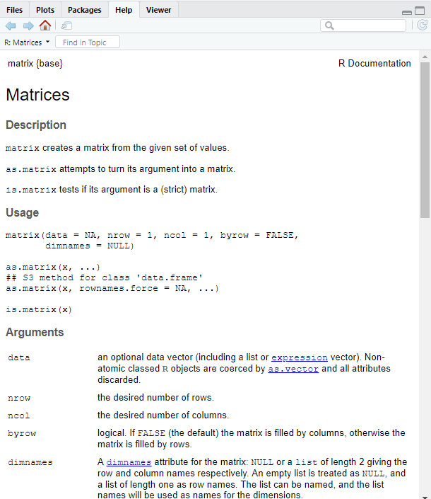
Help texts
If you need to know, what arguments a function takes and what kind of object it returns, you may summon up a help text by entering a question mark and the name of the function to the console.
Example:
?matrix

Slide 21
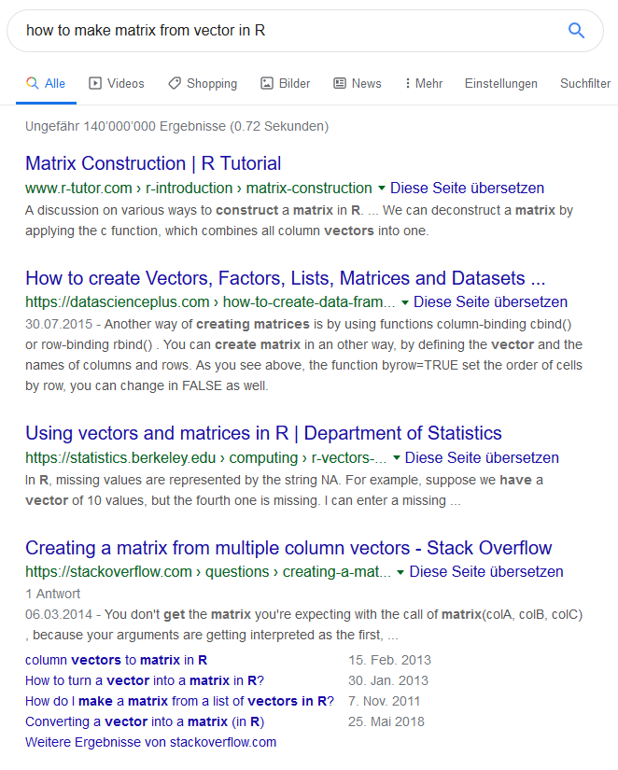
Google
If you need to know, whether there is a function for any given task (which there usually is), there is no shame in googling.
Tipps:
Use the terms "how" and "in R" to make the search specific.
Use the correct terms and object classes in the query
Tutorials are always a good start.

Slide 22
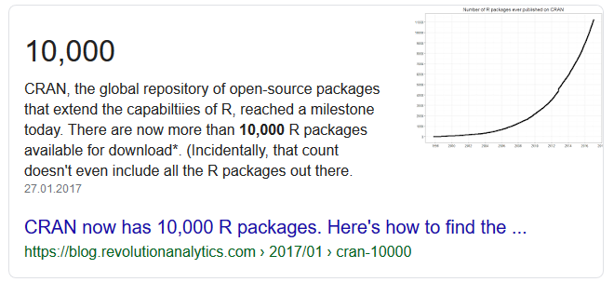
Packages
If there is no function for a given problem in the basic repertoire of R, there may be a package. Packages are collections of functions, object classes, and (sometimes) data.
Install a new package using: install.packages("NAME"). It will be available until you de- and reinstall R.
If needed, load a package using: library(NAME). All functions and data will be available until you restart the R session. You have to load libraries at the beginning of each session.

Slide 23
Custom Functions
If you need a function which does not exist yet, you may define new functions.
The definition of a function start with its name, set equal to a function()-statement.
The function()-statement specifies the order and names of all arguments and is followed by a block of commands in curly brackets.
It ends with a return()-statement, returning a single object.
> add.them = function(number1,number2){
+ result = number1+number2
+ return(result)
+ }
>
> add.them(1,3)
[1] 4
> add.them(-10,10)
[1] 0
> add.them(5,c(1,2,3))
[1] 6 7 8

Slide 24
Overview
Objects and Syntax
Functions and Packages
Files and Tables
Loops and sapply

Slide 25
Reading and Writing Files
For some purposes, you need to read data from files or store processed data to a file. There are several functions facilitating these tasks:
write(): Writes the contents of a vector to a file.
scan(): Reads the contents of a file into a vector. If the file contains characters, use the argument character() to indicate this. Otherwise there will be errors.
read.table(): Reads a table as data.frame from a file. You may specify the separator and whether or not the first line contains column names.
write.table(): Writes a data.frame to a table.

Slide 26
Data.Frames
Tables are usually stored as data.frames in R.
A data.frame is an object similar to a list but it has the restriction that all elements must be vectors of equal length. It has some useful built-in methods:
dim(): Returns the number of rows and columns as integer vector of length 2
names(): Returns the column names
summary(): Returns a comprehensive summary of each variable.
head(): Returns the first 6 rows

Slide 27
Example
> data1 = data.frame("Name"=c("Anton","Babette","Caspar"),
+ "Age"=c(20,34,54),
+ "Mark"=c(4.75,5,5.34),
+ "Present"=c(TRUE,TRUE,FALSE))
> dim(data1)
[1] 3 4
> summary(data1)
Name Age Mark Present
Anton :1 Min. :20 Min. :4.750 Mode :logical
Babette:1 1st Qu.:27 1st Qu.:4.875 FALSE:1
Caspar :1 Median :34 Median :5.000 TRUE :2
Mean :36 Mean :5.030
3rd Qu.:44 3rd Qu.:5.170
Max. :54 Max. :5.340

Slide 28
Getting data out of a data.frame
Each cell in a data.frame has a row index and a column index, just as a matrix.
Each vector of values has a name and may be called just like a list element (by index or name)
> print(data1)
Name Age Mark Present
1 Anton 20 4.75 TRUE
2 Babette 34 5.00 TRUE
3 Caspar 54 5.34 FALSE
> data1['Name']
Name
1 Anton
2 Babette
3 Caspar
> data1[2,3]
[1] 5
> data1[2,"Mark"]
[1] 5
> data1[1:2,"Present"]
[1] TRUE TRUE

Slide 29
Composite class: factor
Data.frames usuall interpret character vectors as factors.
A factor is a composite class where each unique element has an index and the vector only stores these indices.
The values behind the indices are stored in a dictionary invisible to the user.
> f1 = as.factor(c("Anna","Charlie","Berta"))
> f1
[1] Anna Charlie Berta
Levels: Anna Berta Charlie
> as.integer(f1)
[1] 1 3 2
> as.character(f1)
[1] "Anna" "Charlie" "Berta"
> f2 = as.factor(c("2018","2019","2020"))
> f2
[1] 2018 2019 2020
Levels: 2018 2019 2020
> as.character(f2)
[1] "2018" "2019" "2020"
> as.integer(f2)
[1] 1 2 3
> as.integer(as.character(f2))
[1] 2018 2019 2020
The indices are alphabetically sorted
as.integer() will always return the indices

Slide 30
Overview
Objects and Syntax
Functions and Packages
Files and Tables
Loops and sapply

Slide 31
Necessity for loops
Since any operation on vectors is applied to all their elements, there is less need for loops in R. In addition, functions may be applied to all elements of a vector using the sapply()-function.
Loops are only required if a series of commands has to be executed for all elements of a vector. For example, if a character vector holds the names of files that have to be opened and processed.

Slide 32
The for-loop
For-Loops execute a series of commands for each element of an iterable (mostly a vector).
The loop starts with a for-statement indicating the vector and the variable that should be used to store the element for each iteration of the loop.
The commands are then given in curly brackets.
It ends when the end of the iterable is reached.
> for(i in c(2,3,5)){
+ print(i)
+ }
[1] 2
[1] 3
[1] 5
>
> for(c in letters[1:5]){
+ print(paste("Letter:",c))
+ }
[1] "Letter: a"
[1] "Letter: b"
[1] "Letter: c"
[1] "Letter: d"
[1] "Letter: e"

Slide 33
The while-loop
While-Loops execute a series of commands until a condition is no longer true.
The loop starts with a while-statement defining the condition that has to be true.
The commands are then given in curly brackets.
It ends when the condition is no longer true.
Warning: Endless loops may occur if the condition is never false.
> number = 1
> while(number<100){
+ number=number*2
+ }
> print(number)
[1] 128
>
> number = 5
> while(number>1){
+ print(number)
+ number=number/2
+ }
[1] 5
[1] 2.5
[1] 1.25
> print(number)
[1] 0.625

Slide 34
sapply
If a single command is to be applied to all elements in a vector, sapply() may be used instead of a for-loop.
sapply() takes a vector and a function.
It returns a named vector where all elements were transformed by the function.
> names = c("Hans","FRITZ","Anna","berta")
> lower = sapply(names,tolower)
> print(lower)
Hans FRITZ Anna berta
"hans" "fritz" "anna" "berta"

Slide 35
Working with R
Building on these basics on objects, functions and data import, we may use R for the various tasks that are presented today.
We hope that everyone may work with R if we:
Use the vocabulary on these slides as precisely and consistently as possible.
Discuss the arguments and returned objects of all functions we introduce
Assist in any error-handling occurring in this workshop

Slide 36

Further material
Video tutorial:
https://tube.switch.ch/profiles/61305
Book:
Schneider, Gerold; Lauber, Max (2019). Statistics for Linguists: A patient, slow-paced introduction to statistics and to the programming language R. Zurich: Digitale Lehre und Forschung UZH.

Slide 37

Questions ???

