Slide 1
CITS 5506 The Internet of Things Group 25 Trash Talk: Exploring City Waste Management and Smart Bin Technology

Slide 2
Project and Team
Trash Talk: Exploring City Waste Management and Smart Bin Technology
Team members' names and Student Numbers:
Han Sun (23913189)
Tom Nguyen (22914578)
Koid Xian Ting (24292249)
Difu Xiao (24473616)
Steven Li (24291799)
Department of Engineering and Mathematical Sciences
15/10/2024

Slide 3
Problem statement (Why)
Traditional Waste collection
Unpredictable waste generation: Bins are emptied on fixed schedules, regardless of whether they're full or not.
Manual inspections: Waste collection teams must physically check each bin to see if it's full, leading to inefficient use of time and resources.
Inefficient use of resources: Trucks drive the same routes even when some bins are nearly empty, wasting fuel and labour.
Increased operational costs: The combination of unnecessary trips, manual checks, and rigid schedules adds to the overall cost of waste management.

Slide 4
Problem statement (Why)
Traditional Waste collection
Unpredictable waste generation: Bins are emptied on fixed schedules, regardless of whether they're full or not.
Manual inspections: Waste collection teams must physically check each bin to see if it's full, leading to inefficient use of time and resources.
Inefficient use of resources: Trucks drive the same routes even when some bins are nearly empty, wasting fuel and labour.
Increased operational costs: The combination of unnecessary trips, manual checks, and rigid schedules adds to the overall cost of waste management.

Slide 5
Problem statement (Why)
Traditional Waste collection
Unpredictable waste generation: Bins are emptied on fixed schedules, regardless of whether they're full or not.
Manual inspections: Waste collection teams must physically check each bin to see if it's full, leading to inefficient use of time and resources.
Inefficient use of resources: Trucks drive the same routes even when some bins are nearly empty, wasting fuel and labour.
Increased operational costs: The combination of unnecessary trips, manual checks, and rigid schedules adds to the overall cost of waste management.

Slide 6
Problem statement (Why)
Traditional Waste collection
Unpredictable waste generation: Bins are emptied on fixed schedules, regardless of whether they're full or not.
Manual inspections: Waste collection teams must physically check each bin to see if it's full, leading to inefficient use of time and resources.
Inefficient use of resources: Trucks drive the same routes even when some bins are nearly empty, wasting fuel and labour.
Increased operational costs: The combination of unnecessary trips, manual checks, and rigid schedules adds to the overall cost of waste management.

Slide 7
Objectives of the project (What)
Aim of the Trash Talk System
Develop a complete smart trash bin system that integrates backend, cloud infrastructure, frontend, and IoT devices with sensors.
Make waste collection more efficient and cost-effective.
Improve cleanliness, safety, and sustainability in public areas.
Offer real-time updates on bin fill levels, locations, and temperature.

Slide 8
Objectives of the project (What)
Aim of the Trash Talk System
Develop a complete smart trash bin system that integrates backend, cloud infrastructure, frontend, and IoT devices with sensors.
Make waste collection more efficient and cost-effective.
Improve cleanliness, safety, and sustainability in public areas.
Offer real-time updates on bin fill levels, locations, and temperature.

Slide 9
Objectives of the project (What)
Aim of the Trash Talk System
Develop a complete smart trash bin system that integrates backend, cloud infrastructure, frontend, and IoT devices with sensors.
Make waste collection more efficient and cost-effective.
Improve cleanliness, safety, and sustainability in public areas.
Offer real-time updates on bin fill levels, locations, and temperature.

Slide 10
Objectives of the project (What)
Aim of the Trash Talk System
Develop a complete smart trash bin system that integrates backend, cloud infrastructure, frontend, and IoT devices with sensors.
Make waste collection more efficient and cost-effective.
Improve cleanliness, safety, and sustainability in public areas.
Offer real-time updates on bin fill levels, locations, and temperature.

Slide 11
Literature Review
Perth Smart Cities Initiative
Ultrasonic sensor to calculate the bin levels
Bin Temperature
Battery Power
Lid Tilt / Openings
LoRaWAN
How the project builds on or differs from existing solutions:
An end-to-end system built with system modularity in mind.
Focuses on integrating with smart city infrastructure.

Slide 12
System Overview
1. Hardware Subsystem
2. Communication Subsystem
3. Software Subsystem
4. User Interface / Dashboard Subsystem
5. Cloud Infrastructure

Slide 13
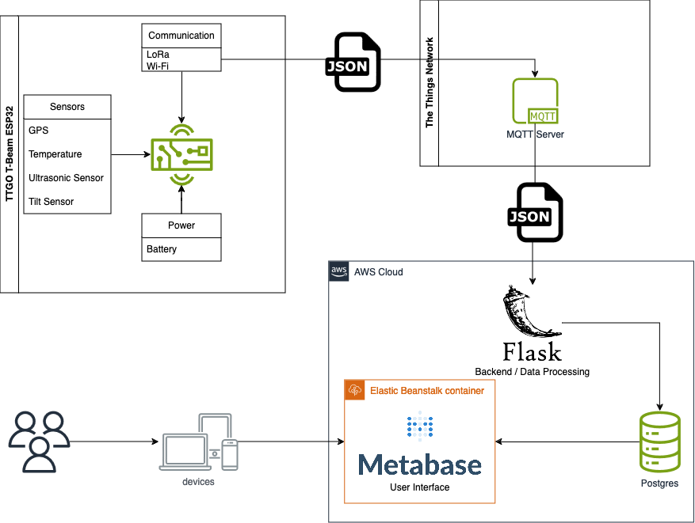
Project Description (How)

Slide 14
Methodology (How)
Divide and Conquer:
Hardware Team
Han, Difu
Software Team
Tom, Steven
Data Analytics Team
Koid

Slide 15
Design and Development Process
System Design / Architecture
Prototyping
Software Testing
Software Optimization / Sensor Calibration
Data Analyses / UI / Dashboard

Slide 16
System Architectures
Hardware Subsystem
Event Driven Architecture
​
Software Subsystem
TCP/IP
MQTT Protocol
PUB/SUB Topology
Client Server Architecture

Slide 17
Hardware Subsystem
Technologies used to develop the Hardware
Ultrasonic sensor
Temperature sensor
GPS module
Wi-Fi communication
Tilt Sensor
LoRa
Arduino IDE

Slide 18
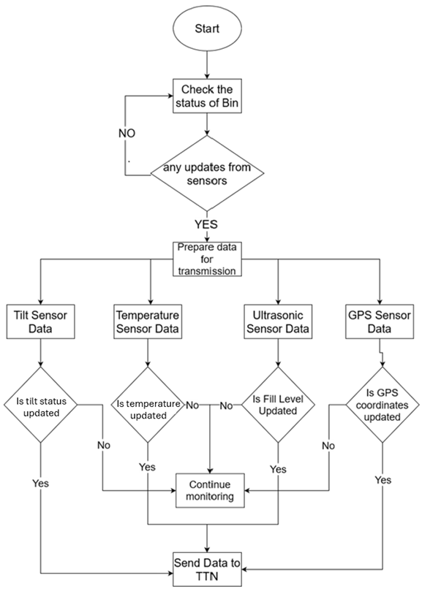
Hardware Subsystem
Event Driven Architecture​
​

Slide 19
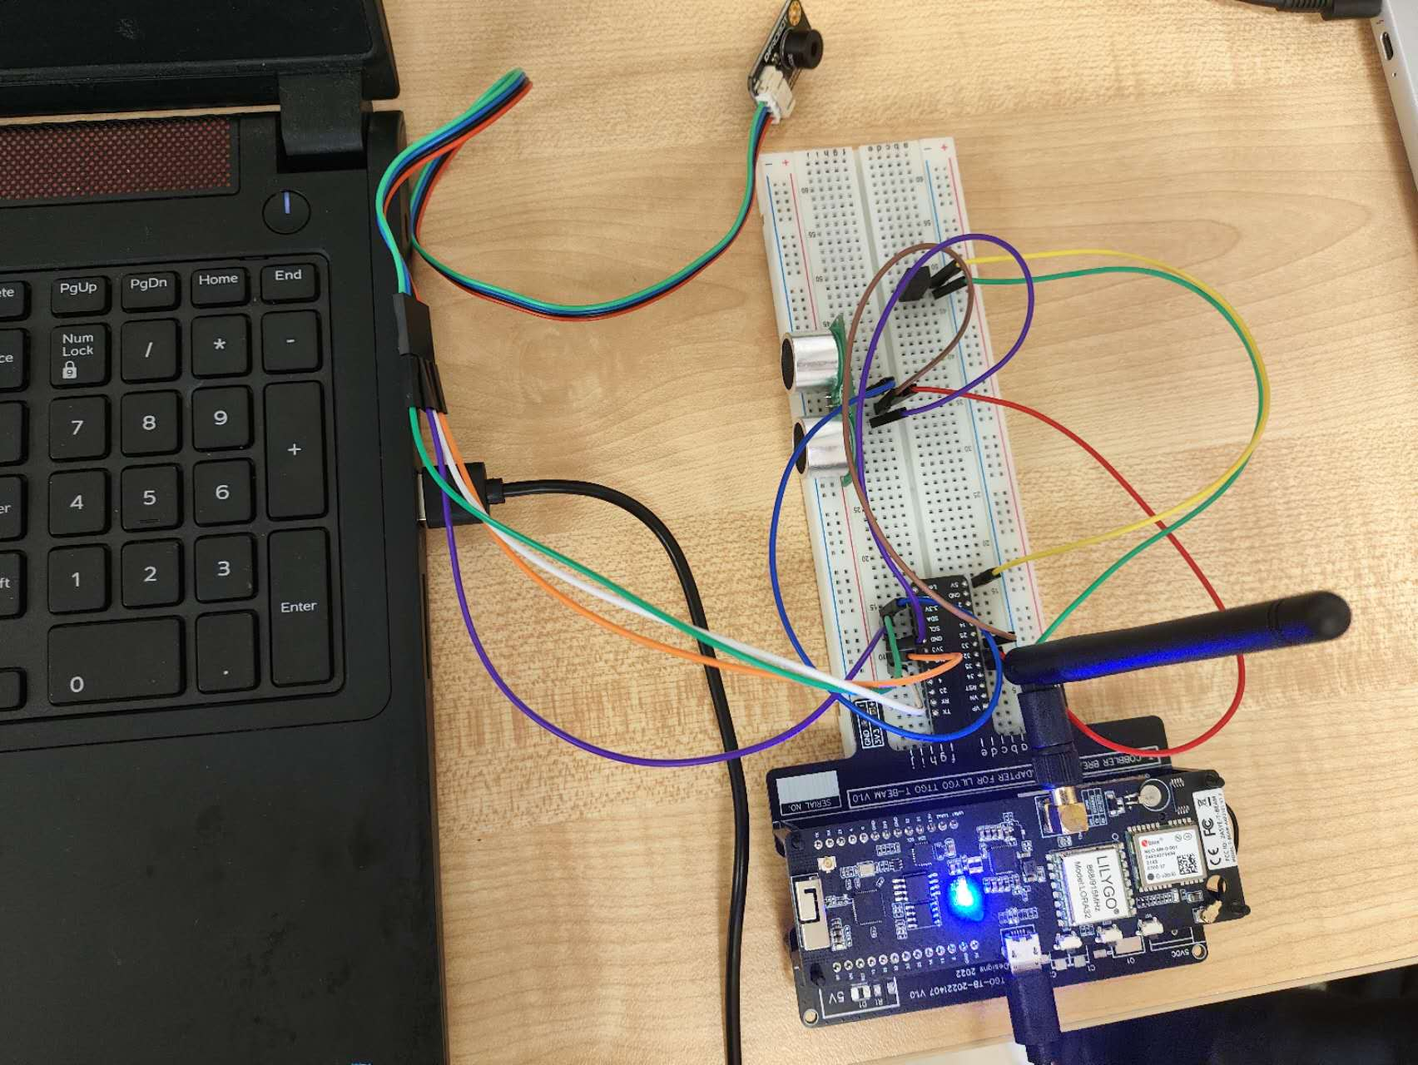
Hardware Subsystem

Slide 20
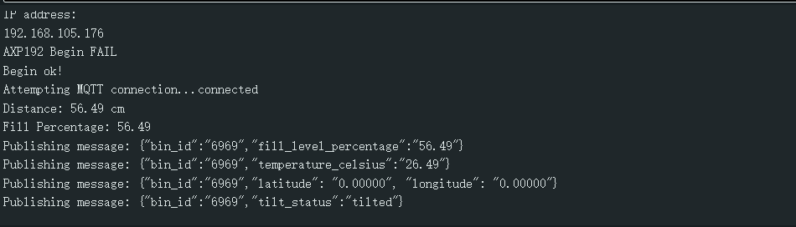
Hardware Subsystem (Arduino)

Slide 21
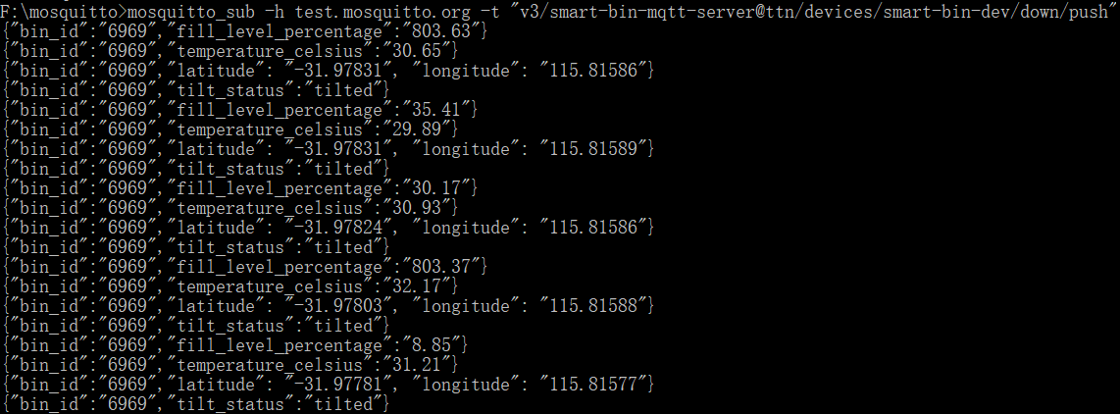
Hardware Subsystem (mosquitto)

Slide 22
Cost
Price of the components:
Ultrasonic Sensor: $7.95
Temperature Sensor: $4.00
TTGO T-Beam v1.2 ESP32: $54.19
AA Battery: $4.55
Jumper wires: $5.20
USB Cable: $5.70
TTGO T-Beam v1.0 Breadboard adapter: $45.00
8. Tilt sensor: $4.55
Total cost of the prototype: $131.14

Slide 23
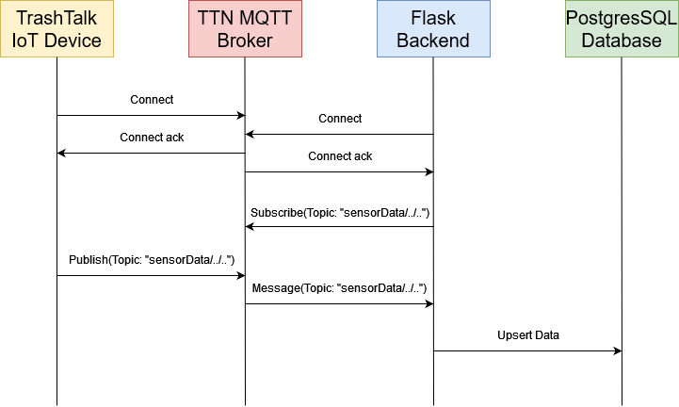
Software Subsystem
PUB/SUB Topology

Slide 24
Software Subsystem
Technologies used in the software subsystem
C
Python
Paho for Python MQTT communication
Flask for web services
SQLAlchemy ORM as cross-platform solution
SQL (initially implemented with python DBAPI and SQL )
Unit tests (unittest and automated github actions)
Mosquitto utilities for MQTT pub/sub testing
Shell for application deployment.

Slide 25
Cloud Services
Cloud Services used:
TTN for MQTT server
https://au1.cloud.thethings.network/console/applications/smart-bin-mqtt-server/
Mosquitto for MQTT testing server
https://test.mosquitto.org/
Github for coding CR
https://github.com/steven-app/smartbin
AWS for database services
PostgreSQL
Metabase for interactive dashboard
https://www.metabase.com/
Render for application deployment
https://dashboard.render.com/
Uptime for monitoring webservice availability
https://uptime.com/

Slide 26
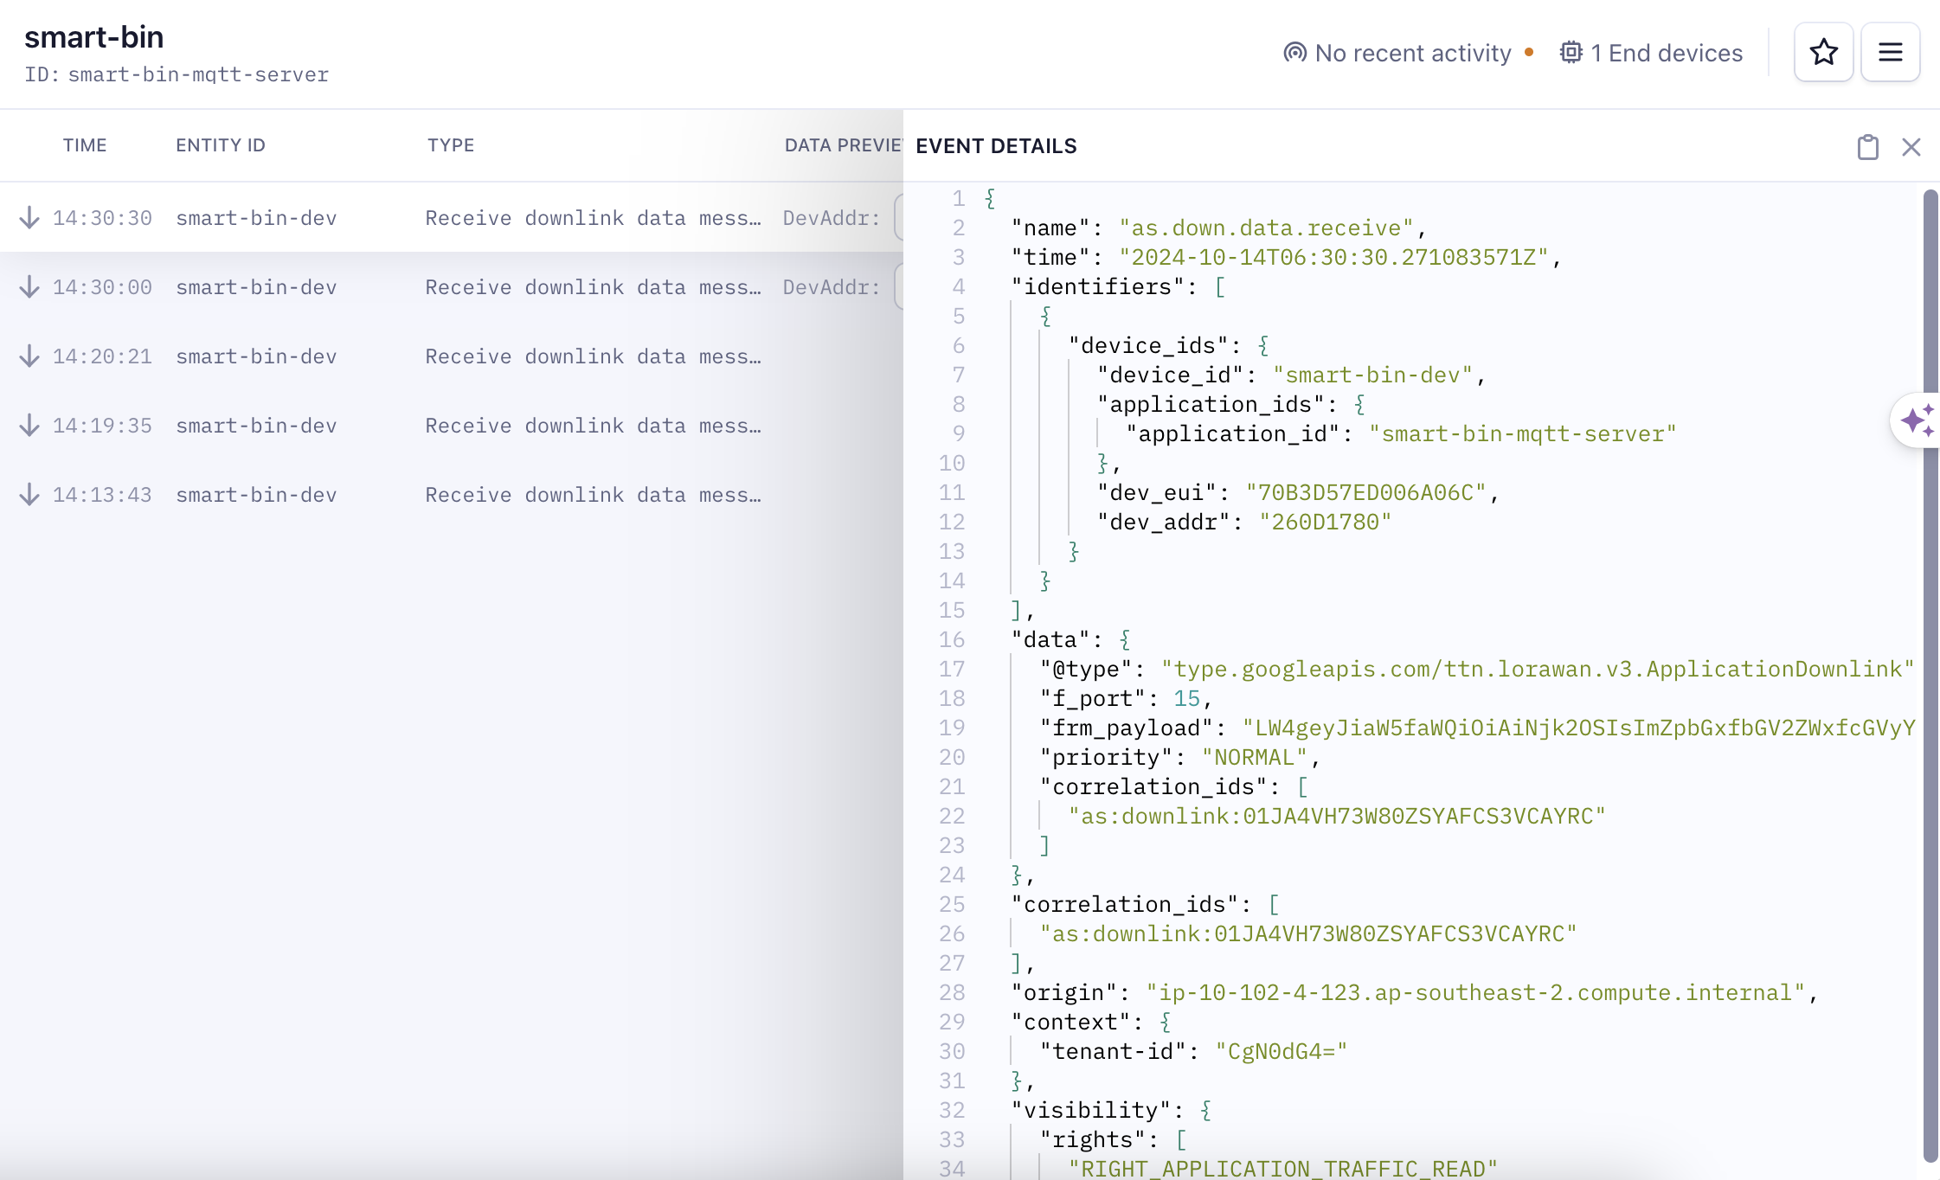
The Things Network Console

Slide 27
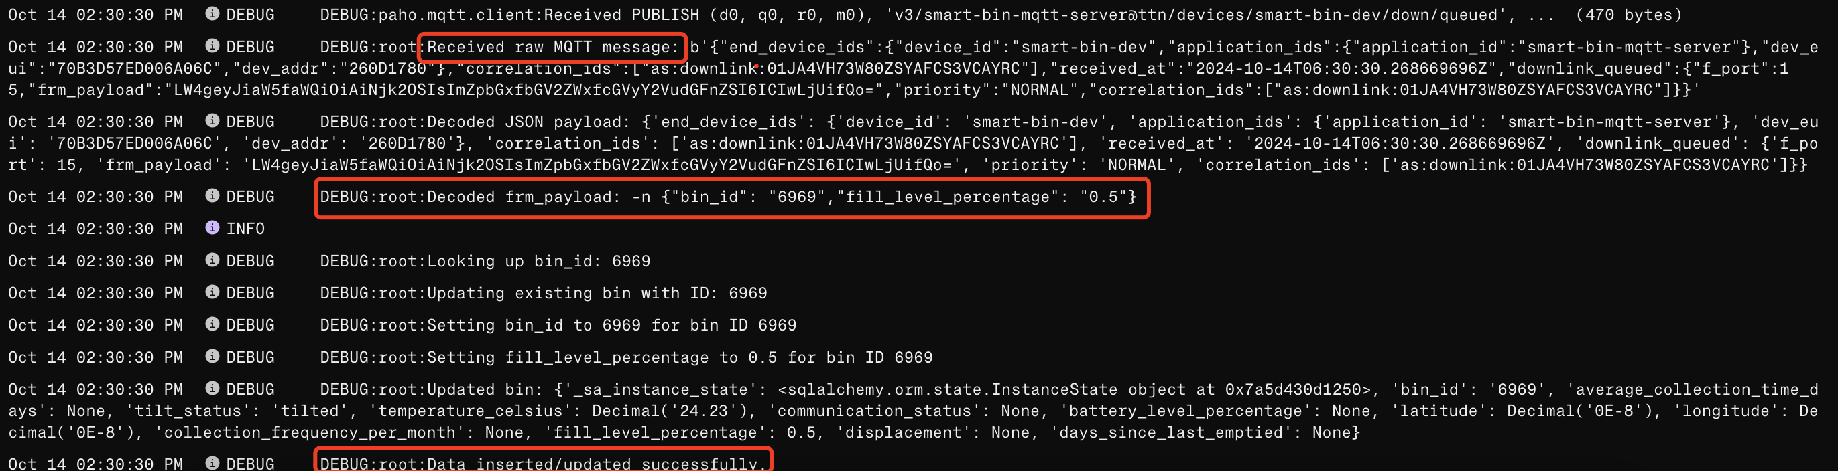
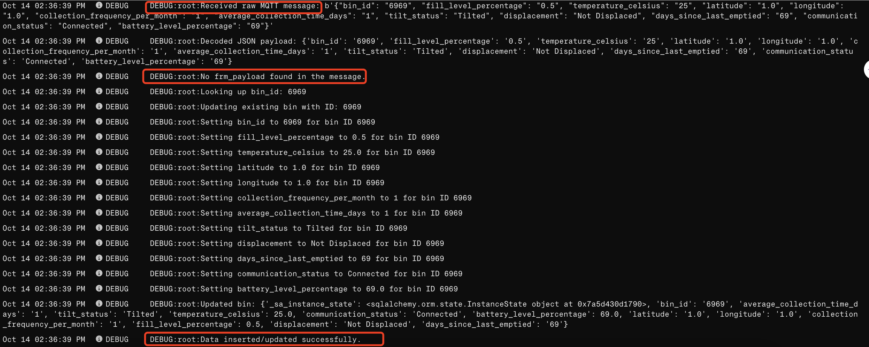
Backend Console
Base64 Encoded JSON
Plain Text

Slide 28
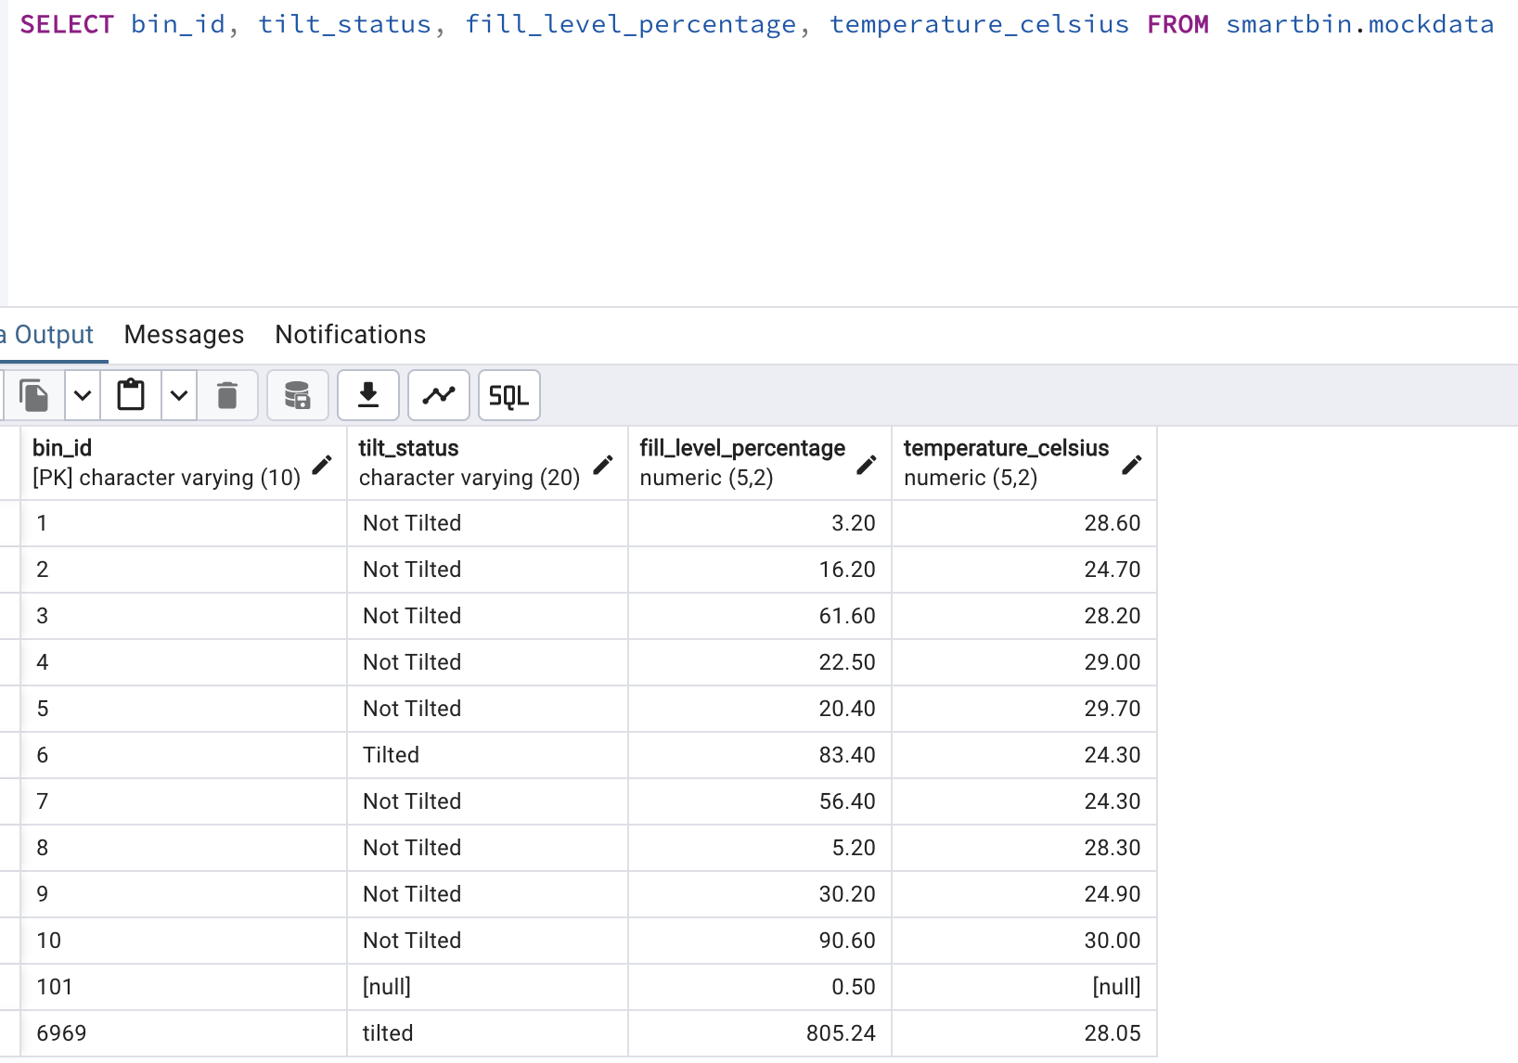
PostgreSQL

Slide 29
Key challenges and solutions
Ensuring long-term power supply for sensors:
AA battery capacity is too low.
Used a high-capacity power bank
Reliable LoRa Communication:
Unable to reliably connect to LoRaWAN
WiFi was used as a back up if LoRaWAN was unavailable.
Cloud Infrastructure Pricing:
AWS can be expensive.
Used AWS Free Tier.

Slide 30
Results and Discussion
How does the result address the problem statement?
Improved waste management efficiency
Enhanced public space cleanliness
Cost savings
Unexpected issues:
Underestimated the time constraint (6 weeks) and complexity of Lora technology
Availability of LoRaWAN (not available at home)
Not enough meaningful data from our own smart bin system
Notes:
By having this system
Management team can plan the garbage collection route and time schedule based on previous data and current fill level of the bins.
2. By improving the efficiency of garbage collection, we can prevent bin overflow.
3. Save both labor & fuel cost.
Unable to connect to the Lora gateway at home, can only connect in UWA.

Slide 31
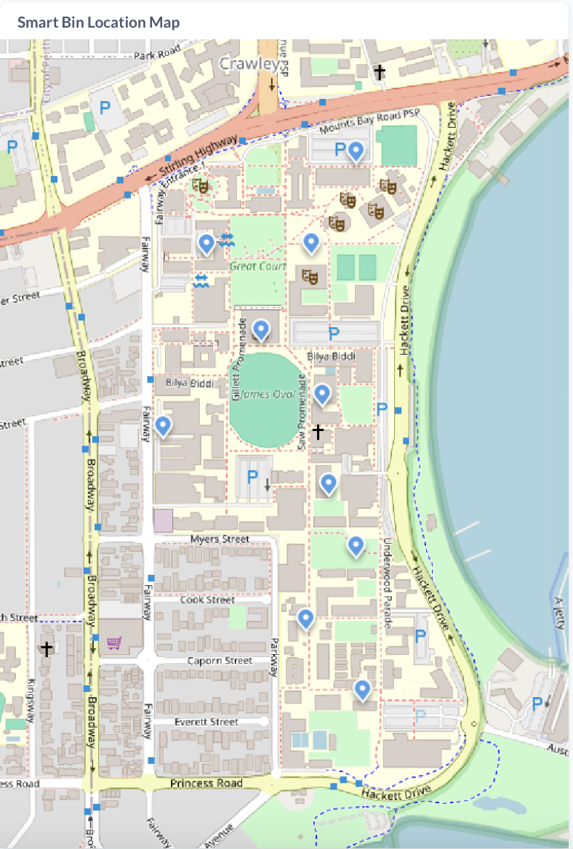
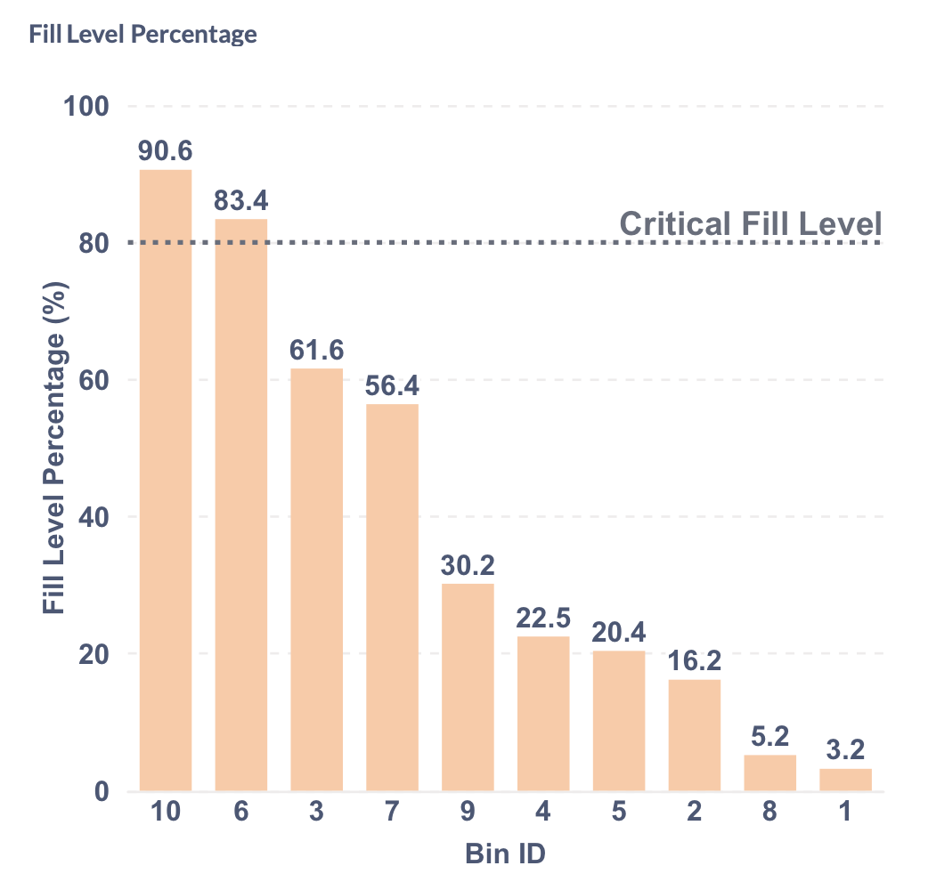
Dashboard Results
Metabase dashboard built using Mock Data and real-world data from City of Melbourne
Location of 10 smart bins in UWA (GPS sensor)
Fill Level Overview of 10 bins
(Ultrasonic sensor)
Notes:
Users can find and access the smart bins in UWA. (gps sensor)
(ultrasonic sensor) 80% is the critical fill level of the fill level percentage which needs to be emptied immediately.
Two bins are nearly full, which requires immediate collection.

Slide 32
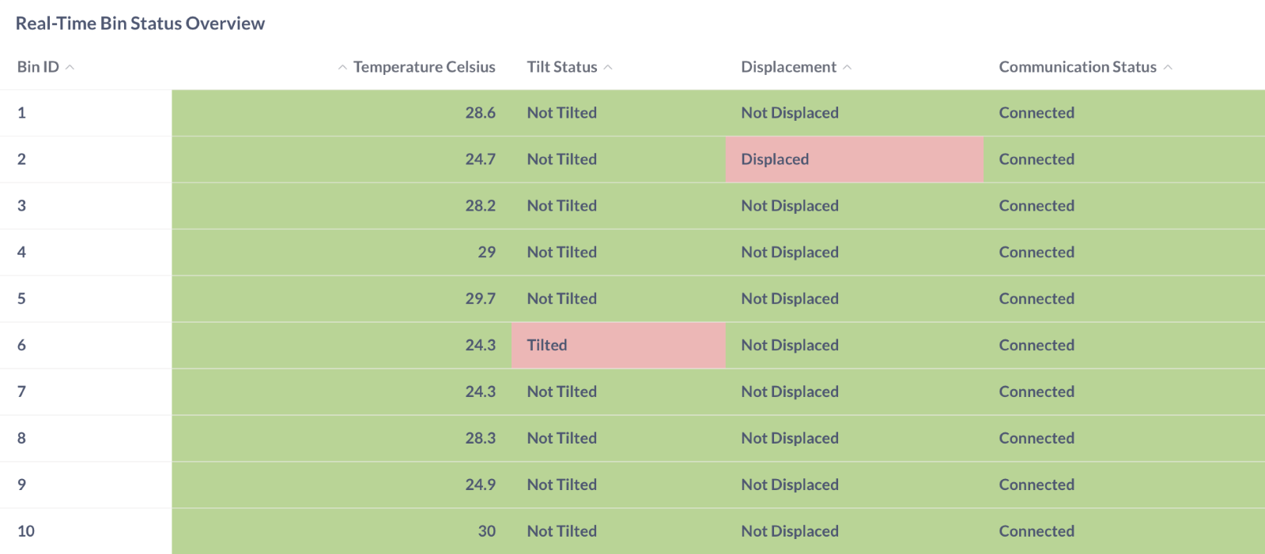
Dashboard Results
Overview of Real-Time Bin Status
Normal – Green
Anomalies - Red
Notes:
Real Time Bin Status Overview (temperature, tilt, communication & displacement status)
Normal status is coded in green color.
Status anomalies is coded in red color
Bin ID 2 displaced and Bin ID 6 is tilted.

Slide 33
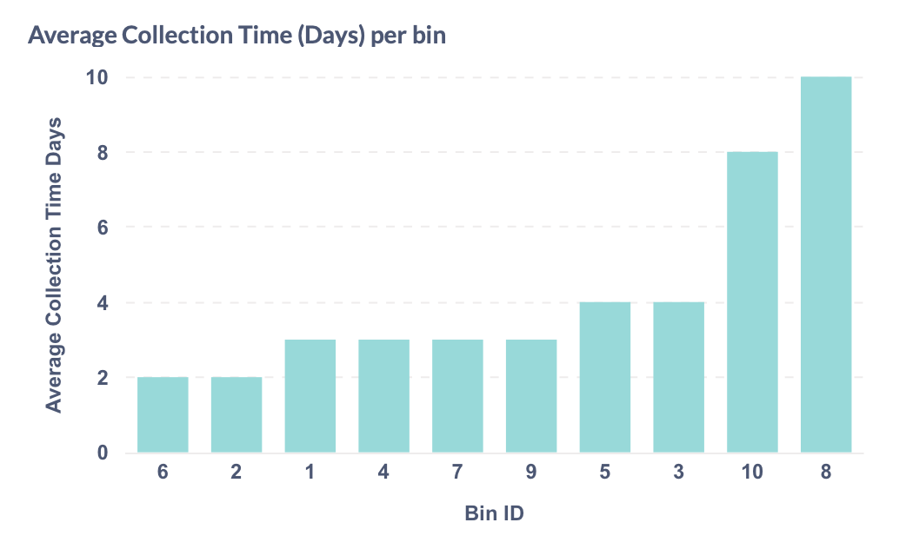
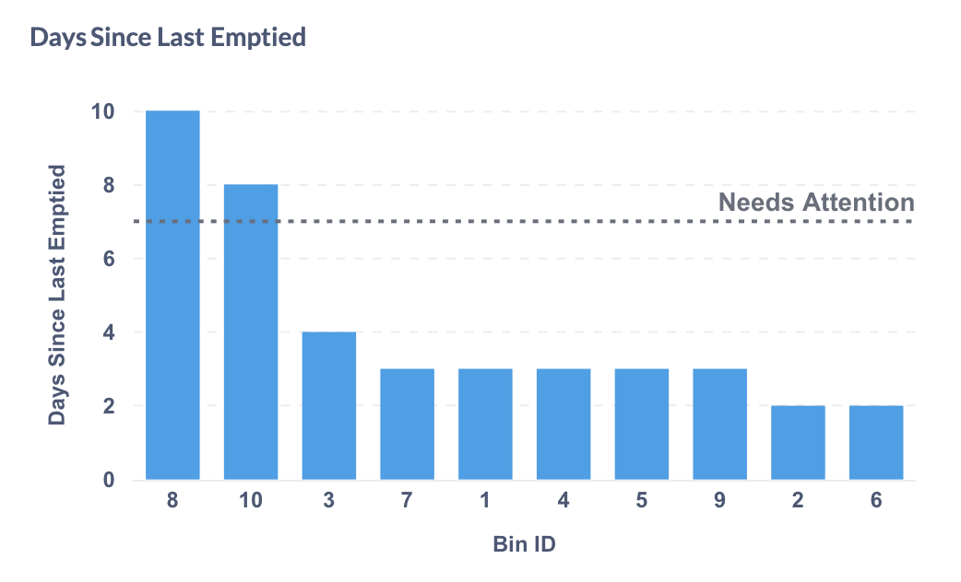
Dashboard Results
Garbage Collection Frequency for:
Efficient garbage collection route planning
Flags for bins that have not been emptied for more than seven days
Notes:
---- We considered the garbage is being collected after fill Level drops below more than 30% of its previous fill level. The average collection time & days since last emptied are being calculated automatically based on the logic of algorithm.
Left: Average Collection Time (Days) -efficient garbage collection
Right:
Sends an email to the stakeholders (needs attention). Attract rodents and produce bad smells if organic matters have been left unattended for more than 7 days.

Slide 34
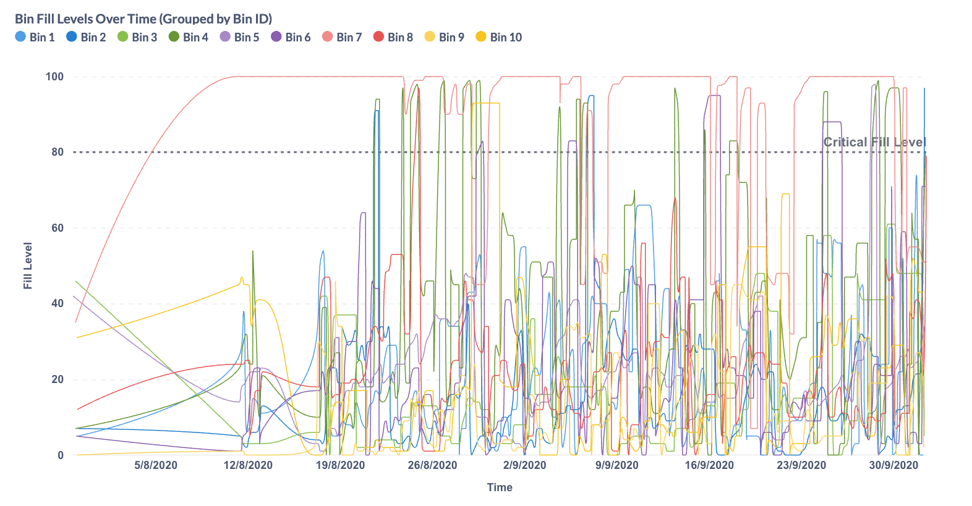
Dashboard Results
Notes:
We've got the real world data from the city of Melbourne local government.
The fill level fluctuates regularly, with some bins filling up faster than others like bin 6 and 7..

Slide 35
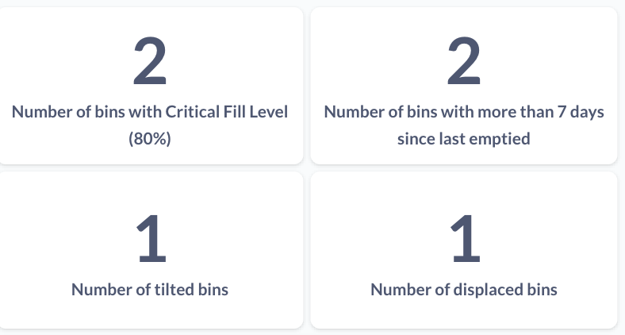
Dashboard Results
Summary of Key Metrics
Allow for quick decisions and actions
Notes:
Put on top of the dashboard ---> easy for management team to have a quick overview of the current key status of the system in order to make quick actions and decisions.
For example : clean the bins, straighten the tilted bins and reposition displaced bins.

Slide 36
Conclusion
Summary of the project outcomes:
Successfully developed an end-to-end smart trash bin system
Real-time waste management monitoring
Demonstrated potential for improving urban cleanliness and efficiency
Lessons learned:
Importance of testing and validating sensor accuracy
Underestimated LoRaWAN complexity
Communication and well-defined responsibilities were important to successfully deliver the project and its subsystems.
Potential for future work or improvements:
Expansion to include waste sorting capabilities
Implementation of machine learning for predictive waste generation
Algorithm based routing and scheduling

Slide 37
Q&A Slide
?

Slide 38
Demo

Slide 39
References
Technovation, "Smart Garbage Monitoring System Using Internet of Things (IOT)"
CleanRobotics, "Smart Waste Management: Why Smart Bins are the Future of Recycling"
RTS, "What are Smart Waste Bins and How are They Changing Recycling?"
City of Perth, "Smart Cities"
PRNewswire, "City of Sydney to Deploy SmartBin™ and Revolutionise Waste Collections"
STREETS DEPARTMENT, "Review of Streets Department Bigbelly Operations"
IJCRT, "A Review of IoT Based Intelligent Bins & Smart Waste Management Systems"
Gatti et al., "Toward Greener Smart Cities: A Critical Review of Classic and Machine-Learning-Based Algorithms for Smart Bin Collection"
Metabase, "Metabase: An open-source business intelligence tool"
Amazon Web Services, Inc., "Amazon Web Services (AWS) - Cloud Computing Services"
The Things Network, "The Things Network - Global open LoRaWAN network"

