Slide 1
ศึกษาความเป็นไปได้ในการใช้สัญญาอัจฉริยะและลายเซ็นดิจิทัลเพื่อทําการเซ็นสัญญาผ่านช่องทางดิจิทัลให้มีผลในโลกจริง และทําการพัฒนาเว็บแอปพลิเคชันต้นแบบเพื่อการเผยแพร่ต่อไปแบบโอเพนซอร์ส Investigate the possibility of using smart contracts and digital signatures to create a legally binding contract, and to create a prototype opensource web application as a proof of concept
สอบวิทยานิพนธ์ ปริญญาโท สาขา วิทยาศาสตร์คอมพิวเตอร์
ภาควิชา วิศวกรรคอมพิวเตอร์ คณะวิศวกรรมศาสตร์ จุฬาลงกรณ์มหาวิทยาลัย

Slide 2
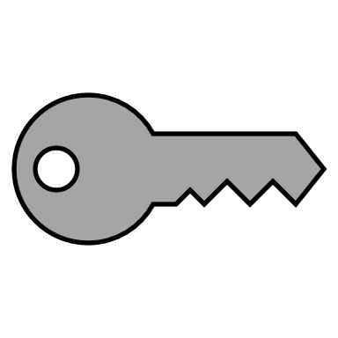
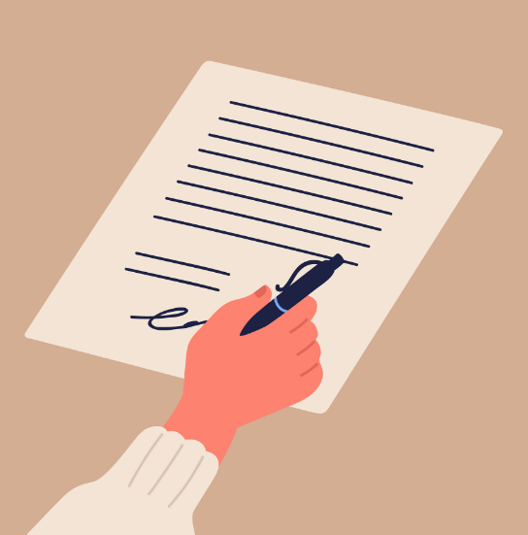


Contract
Private key
Public key
sign
verify
Blockchain’s Private key
Contract
Blockchain’s Public key
sign
verify
Decentralized identity

Slide 3
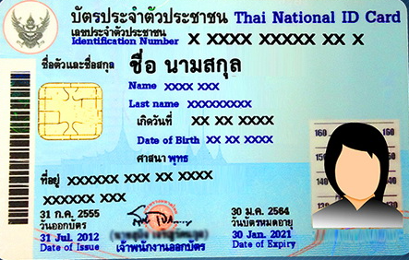

Digital certificate
Verifable credential
Signed by issuer
Signed by issuer

Slide 4

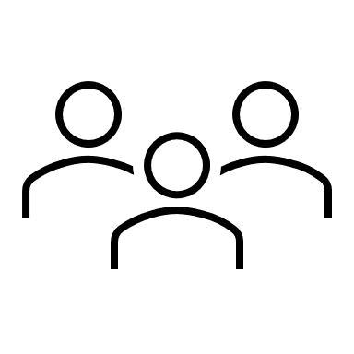
สร้างเว็บเซ็นสัญญา
1. คู่เซ็นสัญญา ยืนยันตัวตนก่อนเซ็น (verifiable credential)
2. ร่างสัญญาและเซ็นสัญญาผ่านเว็บโดยใช้กุญแจจากบล็อกเชน (decentralized identity)
3. มีระบบตรวจสอบเอกสารที่ถูกเซ็นแล้ว
Web app
4. สำหรับสัญญาเช่าอย่างง่าย สามารถใช้ smart contract ควบคุมเงื่อนไขสัญญาได้

Slide 5
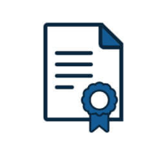

Digital signature
Public key
verify

Slide 6
OUTLINE
Problem statement
Review:
Electronic signature and Digital signature
Blockchain (decentralized identity/ Verifiable credential/ Smart contract)
Method:
Using blockchain in signing a contract
Enforce the term of the contract with blockchain
Demo:
Show case a proof-of-concept web application
https://github.com/TaroAndMulan/VCsignAlpha

Slide 7
Problem statement
Signing a document required an electronic signature.
We can use blockchain to create this signature in a better way.
For a lease agreement, can we enforce the term with smart contract?
The answer is yes, we can. But smart contract do have it limitation.

Slide 8
Abstract
We use these 3 blockchain-based technology to create a legally binding contract.
Decentralized identity = use to sign a contract
Verifiable credentials = bind real world identity to the decentralized identity
3. Smart contract = enforce the term of the contract

Slide 9
Review

Slide 10
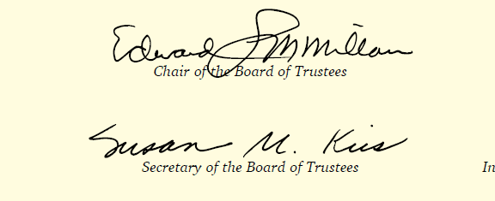
Electronic signature
Replace a handwritten signature on paper.
Digital data that can represent a person.
Legally recognized in Thailand.

Slide 11
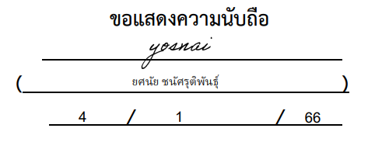
Electronic signature
Electronic signature
For a non serious contract, this is enough
NOT GOOD ENOUGH FOR A SERIOUS CONTRACT !

Slide 12
Digital signatures
Using a cryptographic algorithm, a signature can be enhanced in many ways.
- Verifiable
Nonrepudiation

Slide 13
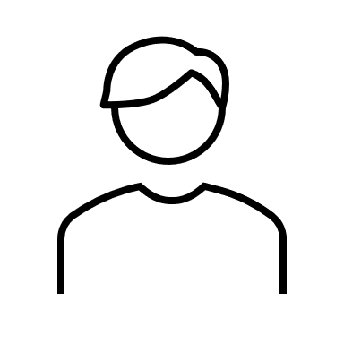
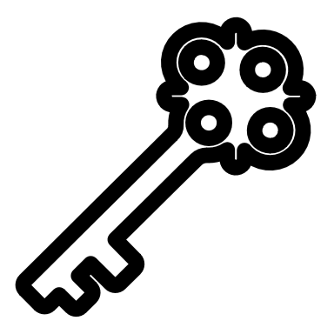
PUBLIC KEY INFRASTRUCTURE (PKI)
Each person carries 2 keys.
A private key
A public key

Slide 14
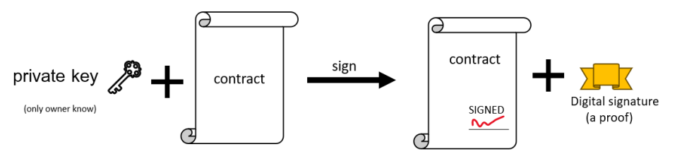
Private key
Private key can be used to sign a document

Slide 15
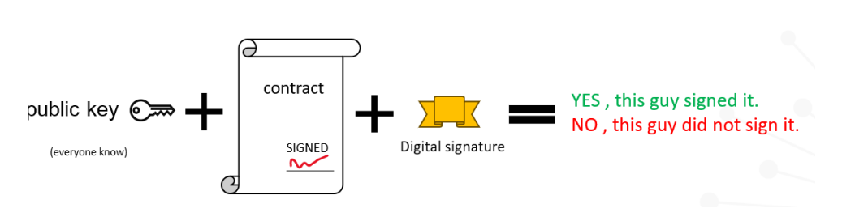
Public key
Public key can be used to authenticate the signed document

Slide 16
Digital certificate
Digital certificate
public key
Issue by : xxx xxx
Digital signature : xxxxx
A digital certificate bind real-world identity to a key pairs

Slide 17
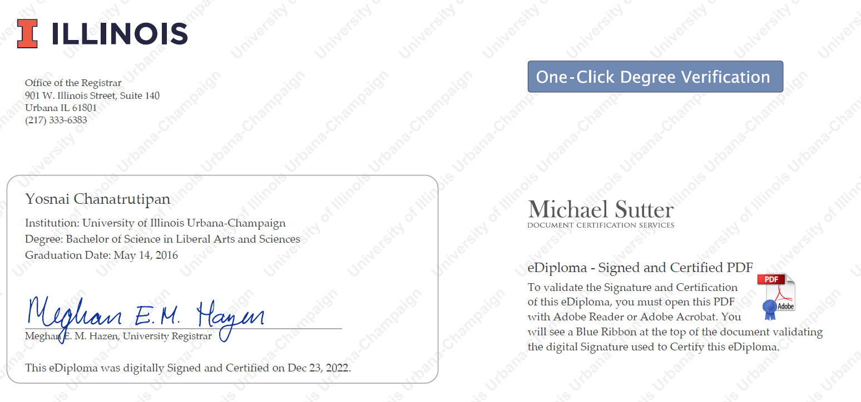
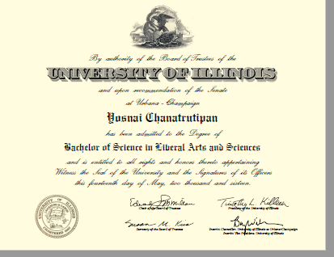
PKI in actions
My Diploma, signed with private key

Slide 18
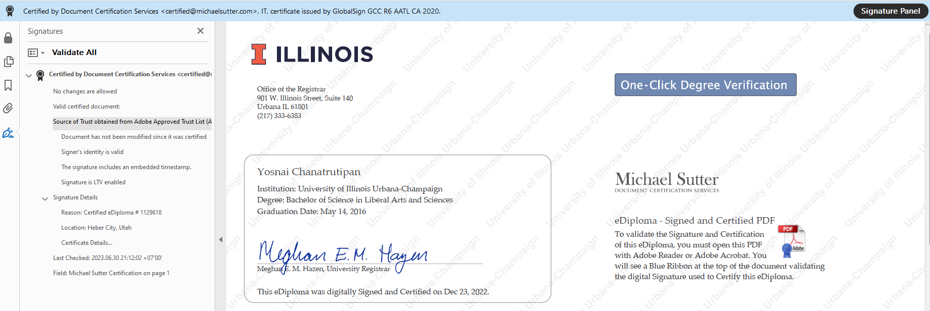
Adobe software can validate the signed document with a digital signature

Slide 19
Blockchain = decentralized + PKI
We can use blockchain to sign the contract in the same way

Slide 20
Blockchain
Majority rules !!
Immutable, Timestamped , Verifiable
PKI = cryptographically secured
Blockchain is public. Anyone can access it.

Slide 21
What if we use Blockchain to store our information?
such as digital ID, driving license, diploma, birth certificate?

Slide 22
DECENTRALIZED IDENTITY
Decentralized identity = Blockchain + Digital ID

Slide 23
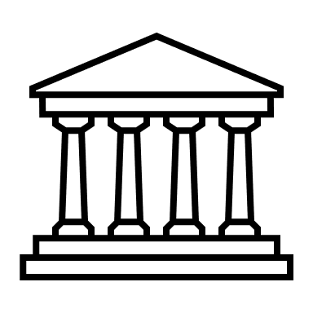

Decentralized identity
Blockchain
Unique ID
Unique ID
Unique ID
Institute
User 1
User 2
Every is connected to the blockchain

Slide 24
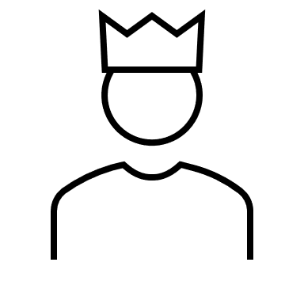
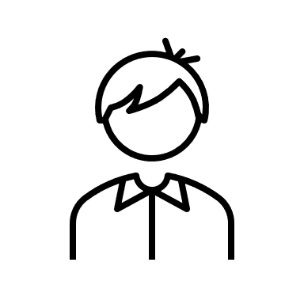
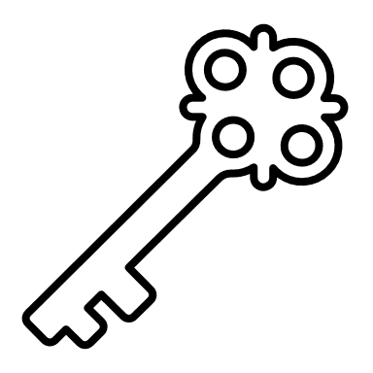
KEY IDEA OF DECENTRALIZED IDENTITY
Blockchain
Your data
claim
read
you
other
Reading the blockchain doesn’t leave any record (nobody know who search for you).

Slide 25

Decentralized identity standard
Each users has a unique identifier (decentralized identifier : DID)

Slide 26
SET UP A DECENTRALIZED IDENTITY
Key pairs
DID
DID document
DID:BTCR:f1Xe5ae54
DID document
id: DID:BTCR:f1Xe5ae54
Name: ____
Date of birth: ____
School : ____
<<cryptographic proof>>
<<public key>>
https://www.gsma.com/identity/decentralised-identity

Slide 27

Publishing your identity
DID document
id: DID:BTCR:f1Xe5ae54
Name: ____
Date of birth: ____
School : ____
<<cryptographic proof>>
<<public key>>
Upload to blockchain

Slide 28
I know him , he is ……
Who is
DID:BTC:f1Xe5ae54 ?
DID document
id: DID:BTCR:f1Xe5ae54
Name: ____
Date of birth: ____
School : ____
<<cryptographic proof>>
<<public key>>
anyone can search for you !
( in total privacy)

Slide 29
Mine !!
DID document
id: DID:BTCR:f1Xe5ae54
Name: ____
Date of birth: ____
School : ____
<<cryptographic proof>>
<<public key>>
claim
Only you can claim its ownership

Slide 30
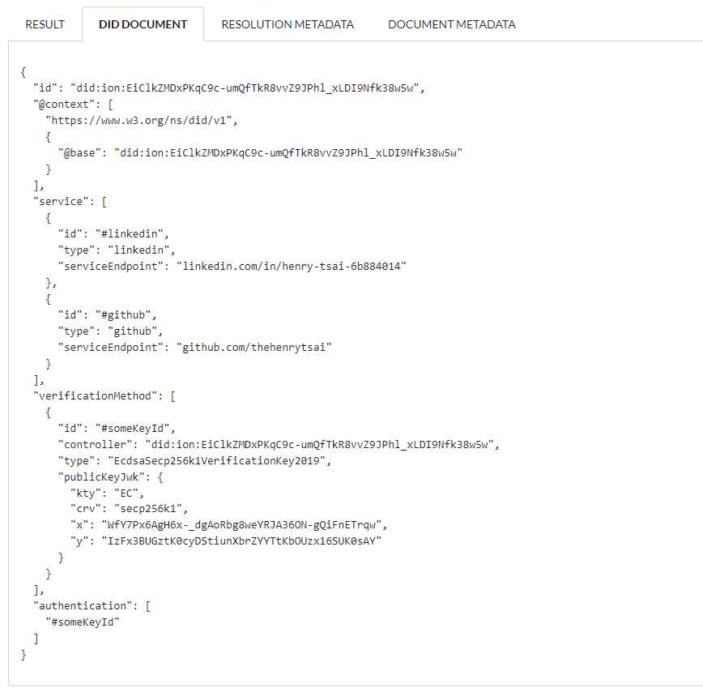
DECENTRALIZED IDENTITY IN ACTION

Slide 31
No one want to store a personal information on the internet.

Slide 32
WE WANT KEEP OUR PERSONAL INFORMATION PRIVATE
BUT somehow, made it so that anyone can verify it using a cryptographic proof the same way as before.

Slide 33
A VERIFIABLE CREDENTIALS
Decentralized identity <-> Real world identity

Slide 34
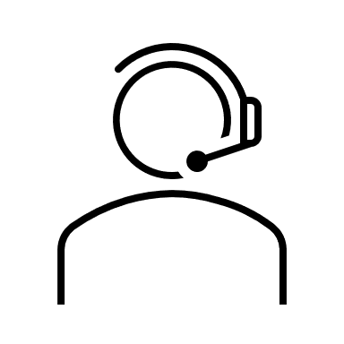



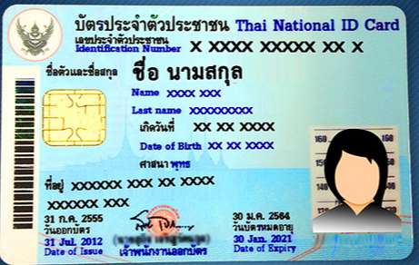
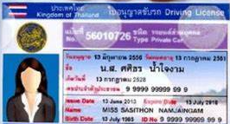
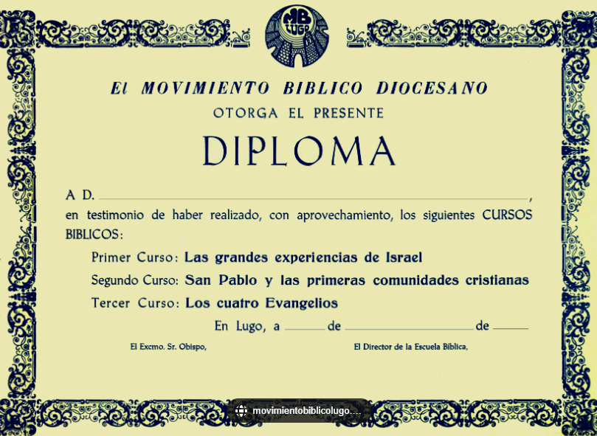
VERIFIABLE CREDENTIAL
A digital credential that can be verified , built on top of DID.
Decentralized identity
(DID)
Verifiable credential
(VC)

Slide 35
Verifiable credential
Blockchain
Proof
Part of the proof is store on a public blockchain.
Issue
Government
Proof
Part of the proof is attached to the issued credential

Slide 36
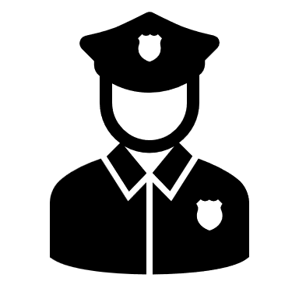
Verifiable credential
Blockchain
Proof
This digital ID is valid
Government
I can also prove that I am the real owner.
(*using a private key)
Proof

Slide 37
Blockchain
goverment
did:btcr:123456
<<cryptographic proof>>
<<public key>>
DID DOCUMENT
Proof
Proof
Ok
My ID is did:btcr:123456
Government
Anyone can verify any data signed by the government by using a government’s public key store inside government’s DID document
37

Slide 38
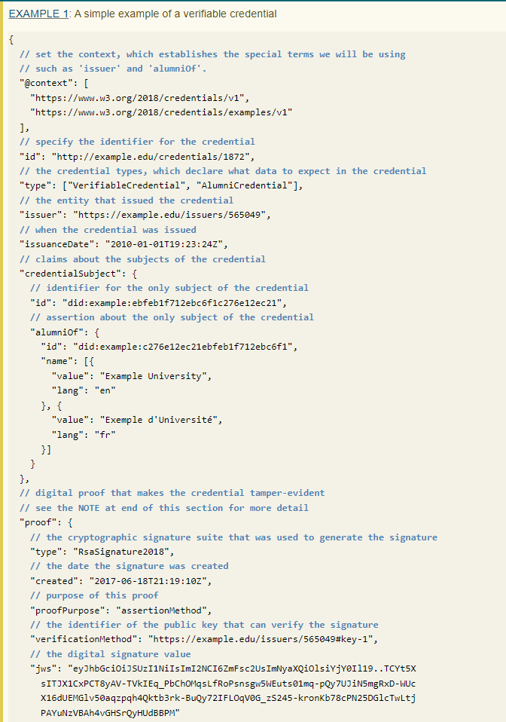

Slide 39
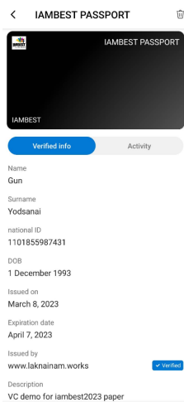
A verifiable credential stored on the user wallet.

Slide 40
Verifiable credentials
Verifiable credential advantage over Traditional digital ID :
Can be verified by anyone.
Your credential usage cannot be tracked.
Can not be tampered.
Once issued, it’s belonged to you and only you.
Blockchain is still in it early stage,
It is evolving.

Slide 41
Smart contract
Smart Contract
PayRent() {
Transfer (Alice,Bob,200$)
}
isTerminated(){
if(paid)
return false
}
WithdrawDepositFee(){
Transfer(Alice,50)
}
A code runs on blockchain
Do exactly what it program to do.
Public and Immutable.
Can hold money
Smart contract is a programmable script running on blockchain

Slide 42
Smart contract limitation
Inactive by default
Requires user private key.
Cannot run on schedule
Does not support real money transfer

Slide 43
Smart contract automation.
Blockchain
CAN
Transfer money out of smart contract to landlord
Terminate the contract if the condition is not fulfilled.
CAN NOT
Force tenant to pay rent
Set up a recurring payment system.
Smart Contract
Schedule a command
Web app

Slide 44
RECAP
Decentralized identity = use to sign a contract
Verifiable credentials = bind real world identity to the decentralized identity
3. Smart contract = enforce the term of the contract

Slide 45
METHOD:
Signing a contract with the blockchain-based web application

Slide 46
Web application
1. Tenants and landlord authenticate each other with Verifiable credentials.
2. A lease agreement is signed using a decentralized identity private key.
3. A smart contract is created based on the condition specified in a lease agreement.
4. Tenant can pay rents through smart contract.
5. The smart contract will detect any breach of contract and notified the landlord.

Slide 47
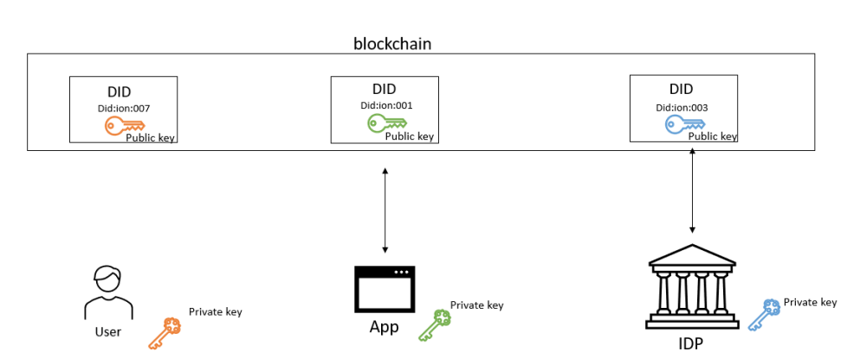
Blockchain act as an intermediary between all participants

Slide 48
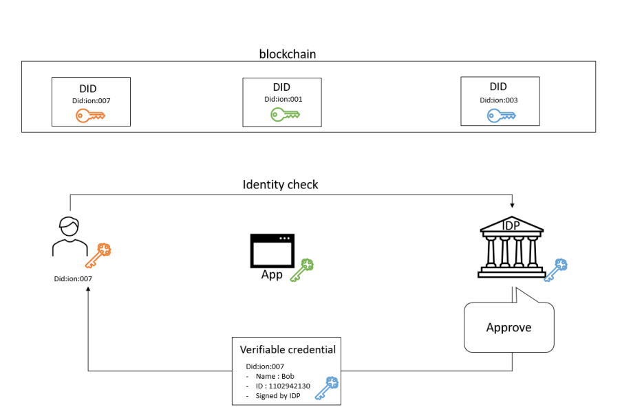
Users must obtain a verifiable credentials before using our web application

Slide 49
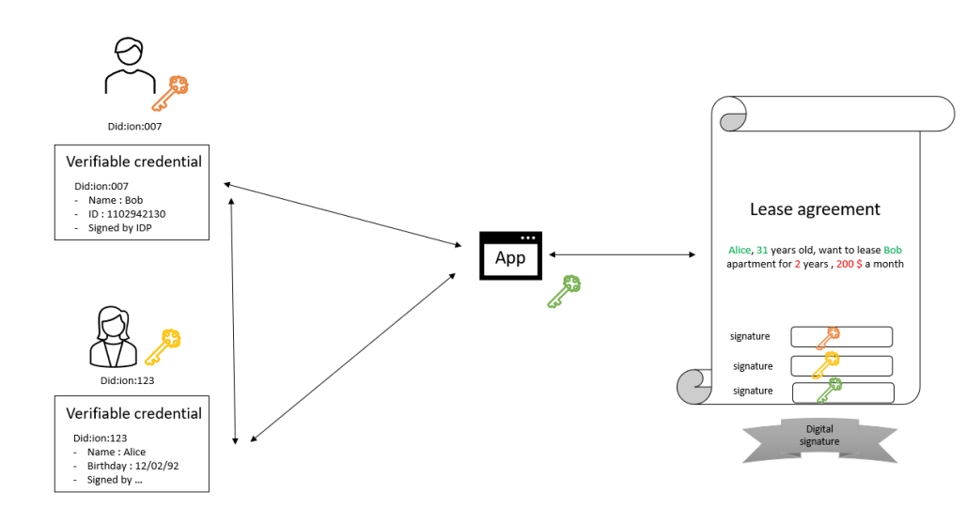
Users can fill in a contract with a verifiable credentials

Slide 50
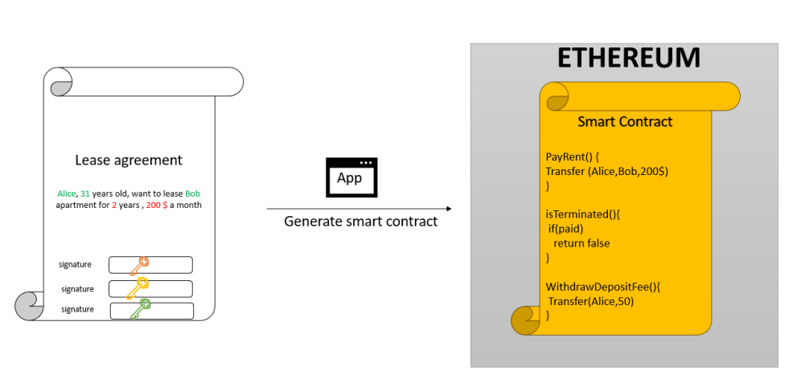
The web application will turn this contract into a smart contract

Slide 51
Tenants and landlord interact with the smart contract via web application
Smart Contract
Tenant & Landlord
Check status
Web app
pay rent
Web application allows users to interact with the smart contract with no coding required

Slide 52
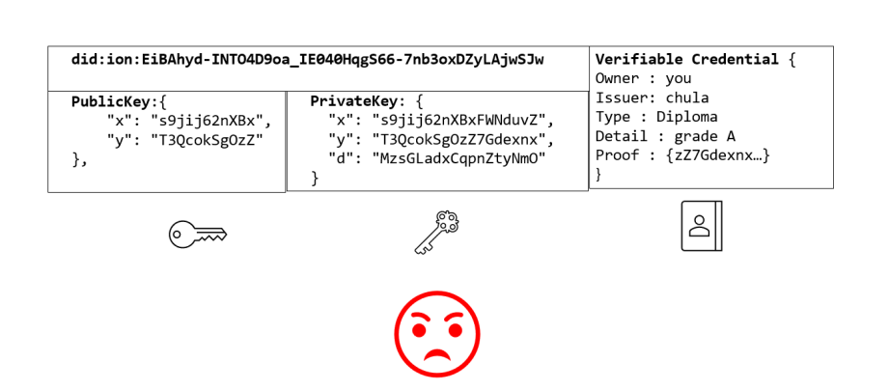
The method I presented earlier is too hard to use for a general public

Slide 53
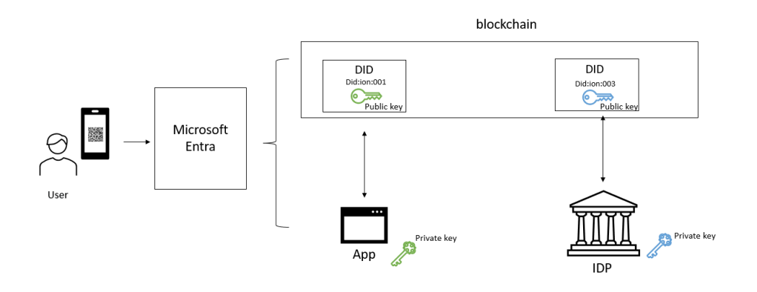
We use Microsoft Entra to abstract away the hard part from the user
The user simply need a phone to sign a contract, they don’t have to worry about private key and stuffs

Slide 54
NEXT VIDEO
WEB APPLICATION DEMO
https://github.com/TaroAndMulan/VCsignAlpha

