Slide 1
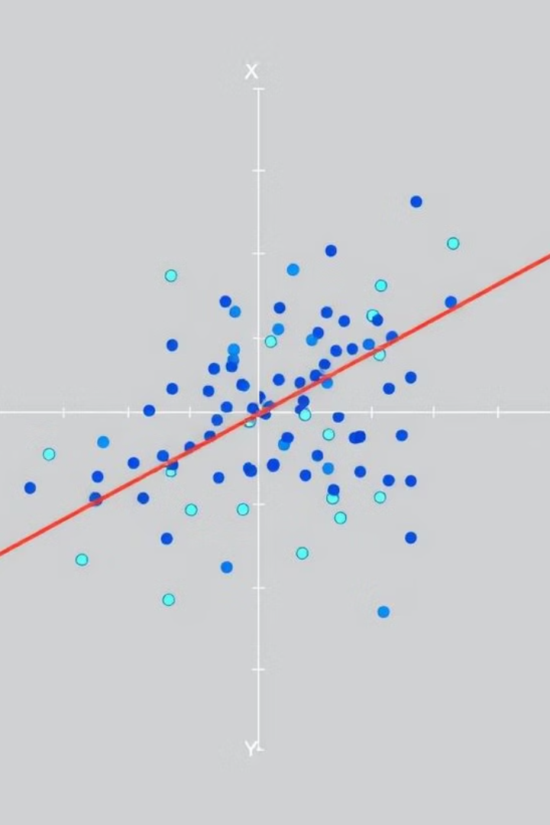

Bank Churn Prediction Using Machine Learning
Predicting Customer Attrition with Logistic Regression Random Forest
& XGBoost.
by Tarun Tanwar

Slide 2
Objective
Analyze customer behavior and patterns.
Predict the probability of customer churn.
Use insights to reduce churn and improve retention.
Apply ML models: Logistic Regression Random Forest and XGBoost.
Goal of the project is to minimize bank customer attrition using machine learning.

Slide 3
Dataset Overview
Files: Bank_Churn_Messy.xlsx, Bank_Churn.csv
Sheets: Customer_Info & Account_Info
~10,000 records
Target variable: Exited (1 = churned, 0 = stayed)
The dataset has information on bank customers and accounts. The target variable signifies customer churn status.

Slide 4
Data Cleaning & Preprocessing
Removed currency symbols from salary & balance.
Converted Yes/No fields to binary (1/0).
Standardized country names (e.g., FRA → France).
Merged customer and account sheets on CustomerId + Tenure.
Key steps involved cleaning and combining data to prepare for modeling. Standardized data ensures accurate results.

Slide 5
Exploratory Data Analysis (EDA)
High churn observed in older customers.
Fewer products → more churn.
Inactive members churn more.
Tools Used: Heatmaps, bar plots.
Important Features: Age, NumOfProducts, IsActiveMember.
EDA helps to understand relationships between variables and churn. Insightful findings drive feature selection.

Slide 6
Feature Engineering
Label encoded Gender (Male = 1, Female = 0).
One-hot encoded Geography (France dropped as base).
Standardized features using StandardScaler.
Final Features Used: CreditScore, Gender, Age, Tenure, Balance, NumOfProducts.
Engineered features enhance model performance. This improves prediction of customer churn.

Slide 7
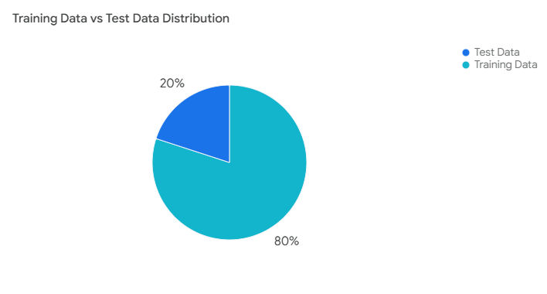
Train-Test Split
Training Set: 80%
Testing Set: 20%
random_state = 42 for reproducibility
The data was split into training and testing sets for model evaluation. Maintains reproducibility across runs.

Slide 8
Model 1 – Logistic Regression
Accuracy: ~80%
ROC AUC Score: 0.77
Pros: Simple, interpretable
Cons: Can miss complex patterns
Logistic Regression provides a baseline for churn prediction. Easily explainable but limited by linearity.

Slide 9
Model 2 – Random Forest
Accuracy: ~87%
ROC AUC Score: 0.8675
Pros: Simple, interpretable
Random Forest improves accuracy by combining multiple decision trees, reducing overfitting, and handling both regression and classification tasks effectively.

Slide 10
Model 3 – XGBoost
Accuracy: ~86%
ROC AUC Score: 0.86
Pros: High performance, handles non-linearity
Cons: Less interpretable, needs tuning
XGBoost delivers superior churn prediction accuracy. Feature importance helps in understanding key factors.

Slide 11
Results & Conclusion
Model Accuracy ROC AUC Logistic Regression~80%0.77 Random forest~87% 0.86 XGBoost~86% 0.86
Random Forest outperforms both the models.
Better suited for churn prediction.
Random Forest model is best deployed for churn prediction because of higher accuracy and ROC AUC.

Slide 12
Thank You!

