Slide 1
City Power Consumption Prediction
Project Presentation
By Tarun Tanwar

Slide 2
Project Overview
Goal: Predict power consumption in a city zone using environmental features.
Models Used: Linear Regression, Random Forest, XGBoost
Dataset: Real-time environmental and air quality data

Slide 3
Dataset Summary
Total Records: ~472499
Features: Temperature, Humidity, Wind Speed, Cloudiness, Diffuse Flows, AQI etc.
Target: Power Consumption in A Zone

Slide 4
Data Cleaning & Preprocessing
Dropped unnecessary columns (e.g., Serial No)
Converted object types to numeric (Temperature, Humidity)
Imputed missing values using Median strategy

Slide 5
Exploratory Data Analysis
Outliers present in AQI and Wind Speed
General diffuse flows and Diffuse flows highly correlated
Boxplots, Heatmap and Histograms plotted

Slide 6
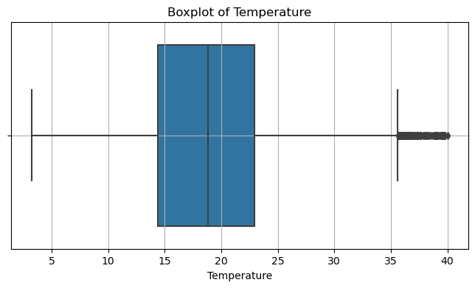
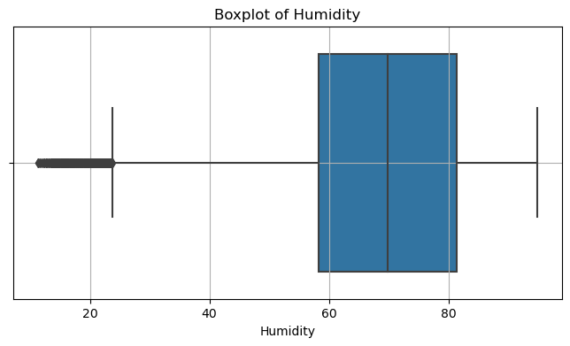

Slide 7
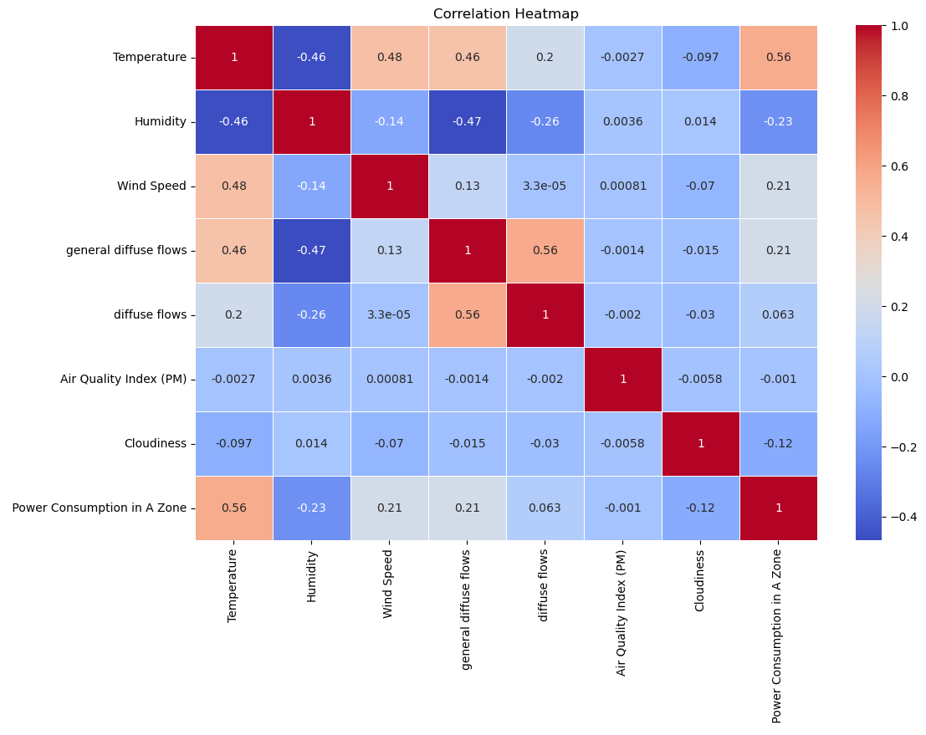

Slide 8
Feature Engineering
No encoding needed (all features were numeric)
Feature selection based on importance (XGBoost)

Slide 9
Linear Regression Results
Train R² Score: 0.32
Test R² Score: 0.33
Train MSE: 43357740.9
Test MSE: 43215505.1

Slide 10
Random Forest Results
Train R² Score: 0.948
Test R² Score: 0.638
Train MSE: 3,323,625
Test MSE: 23,359,474

Slide 11
XGBoost Results
Train R² Score: 0.666
Test R² Score: 0.550
Train MSE: 21,442,289
Test MSE: 29,023,393

Slide 12
Model Comparison & Conclusion
Best Test R²: 0.638 (Random Forest)
Best MSE: 23.3 Million (Random Forest)
Overall moderate performance due to data limits
XGBoost offered stable but not superior results

Slide 13
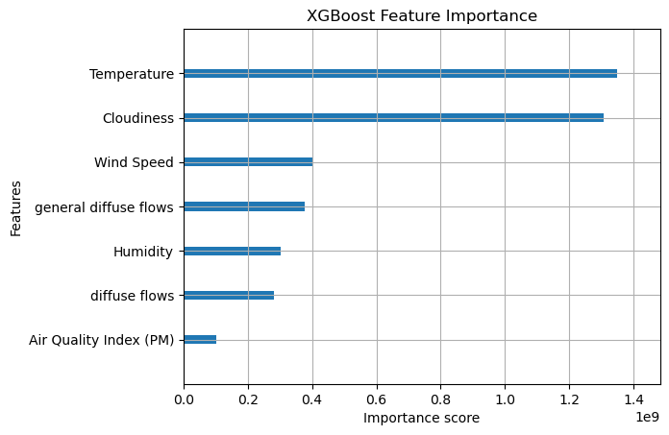
Top Features (XGBoost)

Slide 14
Business Insights
Temperature and Cloudiness strongly affect power consumption
High temperatures tend to increase usage
Power grid managers can plan based on climate forecasts

Slide 15
Thank You
Project by: Tarun Tanwar

