Slide 1

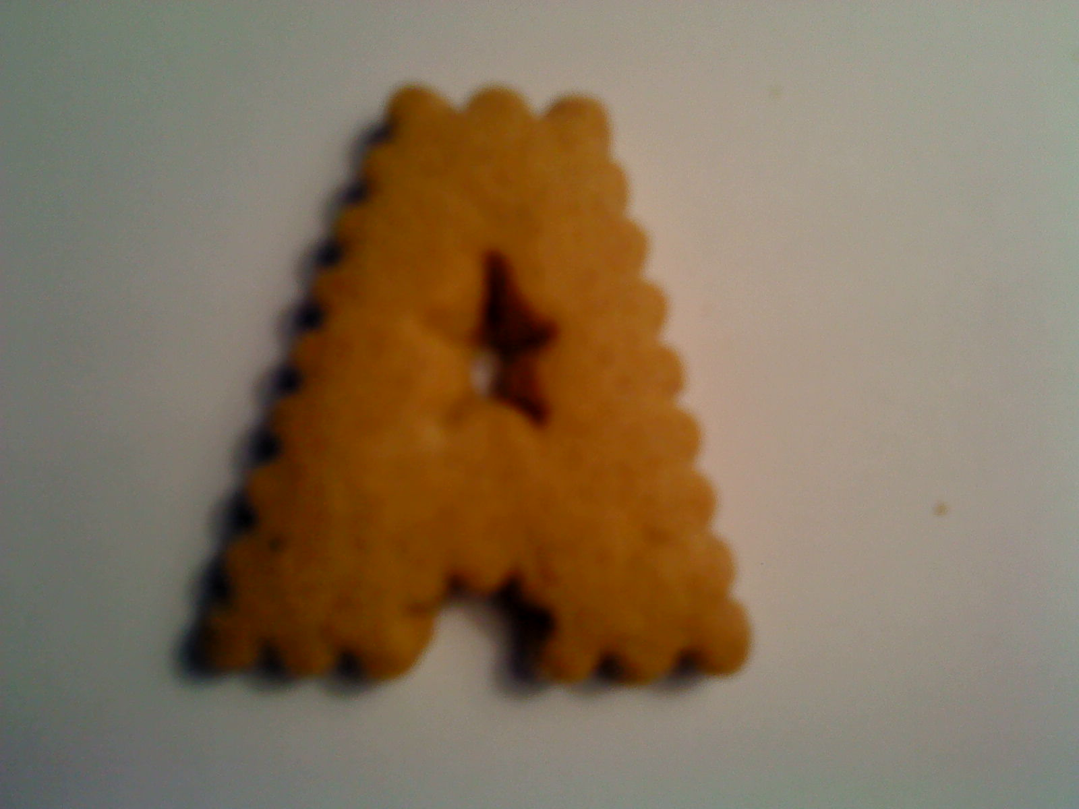
AlphaBiscuit
Reading biscuit letters

Slide 2
Data Collection
Just buy biscuits and photograph them
A mobile camera is used
  I thought it wouldn't matter
  But it does!

Slide 3
Training process
Read Image from file
Classify manually
Filter
Feature extract
”Remember” feature-character association

Slide 4
Raw

Slide 5

Filtered

Slide 6
Features
Some features of biscuit A
Eccentricity: 0.6242
Solidity: 0.8780
Extent: 0.6500
ANPerimeter: 5.7346
num_holes: 1

Slide 7
How to classify?
First consider single characters
Compare biscuits by it's features.
Nearest neighbor classification.

Slide 8

What about sentences?

Slide 9
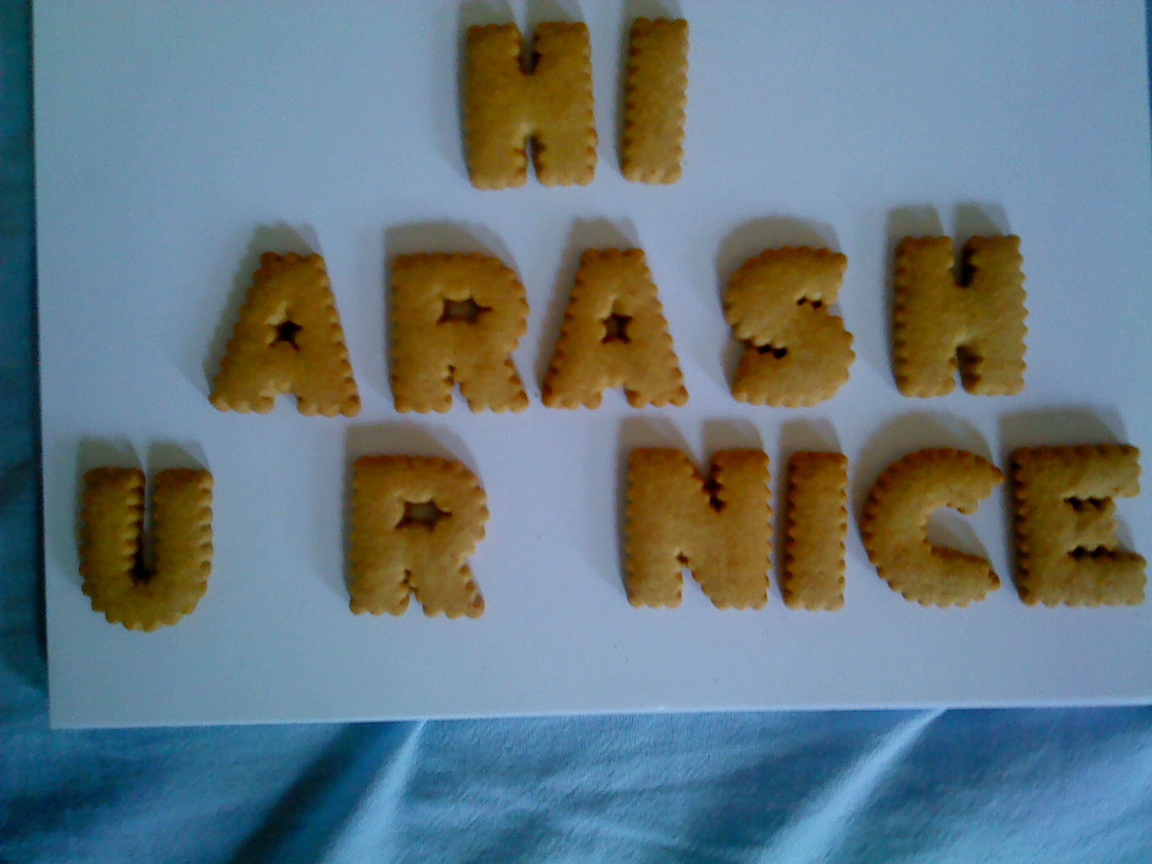
What about sentences?

Slide 10

What about sentences?

Slide 11
What about sentences?
Same way!!!
Only a wordizer is needed.

Slide 12
Lets roll!

Slide 13
Lets roll!
Result:
>> word2('img/word2/DSC00592.JPG')
hi
pbpsh
u b nicc

Slide 14
Other results
+80% with best paramters used

Slide 15
Biggest problems
FILTERING!!!!!!!!!! (or simply bad camera)
More features?
Please give your input! :D

