Slide 1
Me
Arash Rouhani
BSc. @ Chalmers University of Technology
  ”Datateknik” (~ CSE)
Top interests
  Haskell
  Programming competitions (Code Jam etc.)
    I'm organizing ”Programmeringsolympiaden” (Swedish IOI)

Slide 2
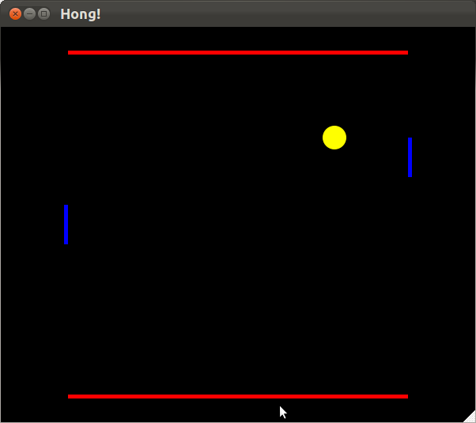
My Pong Clone
Focus on technology, not gameplay features

Slide 3
Technologies
Functional
  sum [] = 0
  sum (x:xs) = x + sum xs
Reactive
  a(t) = b(t) + c(t)
Testing
  it ”should bounce on walls”

Slide 4
Intro - Reactive programming
Functions of time
  We write: a = b + c
  We mean: a(t) = b(t) + c(t)
Declare, not assign!
  Equality (=) now bears its mathematical meaning
  aka. referential transperancy
Useful for games!

Slide 5
Implementing the ball (1/2)
ballpos = (xpos, ypos)
ypos = …
xpos = integral xvel
xvel = 5

Slide 6
Implementing the ball (2/2)
xpos = integral xvel
xvel = 5, negate on xbounce
xbounce = lbounce or rbounce
rbounce = rdy < a and rdx < 0.00001
rdy = abs (rpy – ypos)
rdx = …
a
rpy
rdx
rdy
ypos

Slide 7
Testing – Why?
Our program must follow a specification
Let the tests be the specification
Tests pass → Product finished!

Slide 8
Testing pure functions
Side effects hinder testing!
FRP is side-effect free!
  My tests pass today ↔ they also pass tomorrow

Slide 9
IRL tests
, let ss = run startState{ xVelocity = 0 }
in describe "bounces on walls" [
it "always have ball inside" $ alwaysInside ss
, it "bounces roof" $ ever (\s -> yVelocity s < 0) ss
, it "bounces floor" $
ever (\s -> yPosition s < 0 && yVelocity s > 0) ss
]

Slide 10
Questions?

