Slide 1
Control and Dataflow Analysis

Slide 2
Flow Analysis
Control flow analysis
Interprocedural
Program
Flow analysis
Intraprocedural
Procedure
Data flow analysis
Local
Basic block
Control Flow Analysis: determine the control structure of a program and build a Control Flow Graph.
Data Flow Analysis: determine the flow of scalar values and build Data Flow Graphs.
Solution to the Flow Analysis Problem: propagate data flow information along a flow graph.

Slide 3
Motivation: Constant Propagation
S₁: A ← 2 (def of A)
S₂: B ← 10 (def of B)
S_{k}: C ← A + B Is C a constant?
S_{k+1}: Do I = 1, C
.
.
.

Slide 4
Introduction to Code Optimizations
Code optimization - a program transformation that preserves correctness and improves the performance (e.g., execution time, space) of the input program.
Code optimization may be performed at multiple levels of program representation:
1. Source code
2. Intermediate code
3. Target machine code
Optimized vs. optimal - the term “optimized” is used to indicate a relative performance improvement.

Slide 5
Basic Blocks
A basic block is a sequence of consecutive
intermediate language statements
in which flow of control can only
enter at the beginning and leave at the end.
Only the last statement of a basic block can be a branch statement and only the first statement of a basic block can be a target of a branch.
In some frameworks, procedure calls may occur within a basic block.
(AhoSethiUllman, pp. 529)

Slide 6
Basic Block
Partitioning Algorithm
1. Identify leader statements (i.e. the first statements
of basic blocks) by using the following rules:
(i) The first statement in the program is a leader
(ii) Any statement that is the target of a branch
statement is a leader (for most intermediate
languages these are statements with
an associated label)
(iii) Any statement that immediately follows a branch
or return statement is a leader
(AhoSethiUllman, pp. 529)

Slide 7
Example: Finding Leaders
The following code computes the inner product of two vectors.
(1) prod := 0
(2) i := 1
(3) t1 := 4 * i
(4) t2 := a[t1]
(5) t3 := 4 * i
(6) t4 := b[t3]
(7) t5 := t2 * t4
(8) t6 := prod + t5
(9) prod := t6
(10) t7 := i + 1
(11) i := t7
(12) if i <= 20 goto (3)
begin
prod := 0;
i := 1;
do begin
prod := prod + a[i] * b[i];
i = i+ 1;
end
while i <= 20
end
Source code
Three-address code
(AhoSethiUllman, pp. 529)

Slide 8
Example: Finding Leaders
The following code computes the inner product of two vectors.
Rule (i)
(1) prod := 0
(2) i := 1
(3) t1 := 4 * i
(4) t2 := a[t1]
(5) t3 := 4 * i
(6) t4 := b[t3]
(7) t5 := t2 * t4
(8) t6 := prod + t5
(9) prod := t6
(10) t7 := i + 1
(11) i := t7
(12) if i <= 20 goto (3)
(13) …
begin
prod := 0;
i := 1;
do begin
prod := prod + a[i] * b[i];
i = i+ 1;
end
while i <= 20
end
Source code
Three-address code

Slide 9
Example: Finding Leaders
The following code computes the inner product of two vectors.
Rule (i)
(1) prod := 0
(2) i := 1
(3) t1 := 4 * i
(4) t2 := a[t1]
(5) t3 := 4 * i
(6) t4 := b[t3]
(7) t5 := t2 * t4
(8) t6 := prod + t5
(9) prod := t6
(10) t7 := i + 1
(11) i := t7
(12) if i <= 20 goto (3)
(13) …
begin
prod := 0;
i := 1;
do begin
prod := prod + a[i] * b[i];
i = i+ 1;
end
while i <= 20
end
Rule (ii)
Source code
Three-address code

Slide 10
Example: Finding Leaders
The following code computes the inner product of two vectors.
Rule (i)
(1) prod := 0
(2) i := 1
(3) t1 := 4 * i
(4) t2 := a[t1]
(5) t3 := 4 * i
(6) t4 := b[t3]
(7) t5 := t2 * t4
(8) t6 := prod + t5
(9) prod := t6
(10) t7 := i + 1
(11) i := t7
(12) if i <= 20 goto (3)
(13) …
begin
prod := 0;
i := 1;
do begin
prod := prod + a[i] * b[i];
i = i+ 1;
end
while i <= 20
end
Rule (ii)
Source code
Rule (iii)
Three-address code

Slide 11
Forming the Basic Blocks
Now that we know the leaders, how do we form
the basic blocks associated with each leader?
2. The basic block corresponding to a leader consists of the leader, plus all statements up to but not including the next leader or up to the end of the program.

Slide 12
Example: Forming the Basic Blocks
B1
(1) prod := 0
(2) i := 1
B2
(3) t1 := 4 * i
(4) t2 := a[t1]
(5) t3 := 4 * i
(6) t4 := b[t3]
(7) t5 := t2 * t4
(8) t6 := prod + t5
(9) prod := t6
(10) t7 := i + 1
(11) i := t7
(12) if i <= 20 goto (3)
Basic Blocks:
B3
(13) …

Slide 13
Control Flow Graph (CFG)
A control flow graph (CFG), or simply a flow graph,
is a directed multigraph in which:
(i) the nodes are basic blocks; and
(ii) the edges represent flow of control
(branches or fall-through execution).
The basic block whose leader is the first intermediate
language statement is called the start node.
In a CFG we have no information about the data.
Therefore an edge in the CFG means that the
program may take that path.

Slide 14
Control Flow Graph (CFG)
There is a directed edge from basic block B1 to basic block B2 in the CFG if:
(1) There is a branch from the last statement of B1 to the first
statement of B2, or
(2) Control flow can fall through from B1 to B2 because:
(i) B2 immediately follows B1, and
(ii) B1 does not end with an unconditional branch

Slide 15
Example: Control Flow Graph Formation
B1
(1) prod := 0
(2) i := 1
Rule (2)
B2
(3) t1 := 4 * i
(4) t2 := a[t1]
(5) t3 := 4 * i
(6) t4 := b[t3]
(7) t5 := t2 * t4
(8) t6 := prod + t5
(9) prod := t6
(10) t7 := i + 1
(11) i := t7
(12) if i <= 20 goto (3)
B1
B2
B3
B3
(13) …

Slide 16
Example : Control Flow Graph Formation
B1
(1) prod := 0
(2) i := 1
Rule (1)
Rule (2)
B2
(3) t1 := 4 * i
(4) t2 := a[t1]
(5) t3 := 4 * i
(6) t4 := b[t3]
(7) t5 := t2 * t4
(8) t6 := prod + t5
(9) prod := t6
(10) t7 := i + 1
(11) i := t7
(12) if i <= 20 goto (3)
B1
B2
B3
B3
(13) …

Slide 17
Example : Control Flow Graph Formation
B1
(1) prod := 0
(2) i := 1
Rule (1)
Rule (2)
B2
(3) t1 := 4 * i
(4) t2 := a[t1]
(5) t3 := 4 * i
(6) t4 := b[t3]
(7) t5 := t2 * t4
(8) t6 := prod + t5
(9) prod := t6
(10) t7 := i + 1
(11) i := t7
(12) if i <= 20 goto (3)
B1
B2
B3
Rule (2)
B3
(13) …

Slide 18
CFGs are Multigraphs
Note: there may be multiple edges from one basic block to another in a CFG.
Therefore, in general the CFG is a multigraph.
The edges are distinguished by their condition labels.
A trivial example is given below:
[101] . . .
[102] if i > n goto L1
Basic Block B1
False
True
[103] label L1:
[104] . . .
Basic Block B2

Slide 19
Identifying loops
Question: Given the control flow graph of a procedure,
how can we identify loops?
Answer: We use the concept of dominance.

Slide 20
Dominators
A node a in a CFG dominates a node b if every path from the start node to node b goes through a. We say that node a is a dominator of node b.
The dominator set of node b, dom(b), is
formed by all nodes that dominate b.
Note: by definition, each node dominates itself,
therefore, b ∈ dom(b).

Slide 21
Domination Relation
Definition: Let G = (N, E, s) denote a flowgraph, where:
N: set of vertices
E: set of edges
s: starting node.
and let a ∈ N, b ∈ N.
1. a dominates b, written a ≤ b, if
every path from s to b contains a.
2. a properly dominates b, written a < b, if
a ≤ b and a ≠ b.

Slide 22
Domination Relation
Definition: Let G = (N, E, s) denote a flowgraph, where:
N: set of vertices
E: set of edges
s: starting node.
and let a ∈ N, b ∈ N.
3. a directly (immediately) dominates b, written a <_{d} b if:
a < b and
there is no c ∈N such that a < c < b.

Slide 23
An Example
Domination relation:
{ (1, 1), (1, 2), (1, 3), (1,4) …
(2, 3), (2, 4), …
(2, 10)
}
1
S
2
3
Direct Domination:
1 <_{d} 2, 2 <_{d} 3, …
4
5
Dominator Sets:
DOM(1) = {1}
DOM(2) = {1, 2}
DOM(3) = {1, 2, 3}
DOM(10) = {1, 2, 10)
6
7
8
9
10

Slide 24
Question
Assume that node a is an immediate
dominator of a node b.
Is a necessarily an immediate predecessor
of b in the flow graph?

Slide 25
Example
1
S
Answer: NO!
Example: consider nodes 5 and 8.
2
3
4
5
6
7
8
9
10

Slide 26
Dominance Intuition
Imagine a source of light
at the start node, and that
the edges are optical fibers
1
S
2
3
4
To find which nodes are
dominated by a given node a,
place an opaque barrier at a
and observe which nodes
became dark.
5
6
7
8
9
10

Slide 27
Dominance Intuition
The start node dominates all
nodes in the flowgraph.
1
S
2
3
4
5
6
7
8
9
10

Slide 28
Dominance Intuition
1
S
Which nodes are dominated
by node 3?
2
3
4
5
6
7
8
9
10

Slide 29
Dominance Intuition
1
S
Which nodes are dominated
by node 3?
2
3
4
Node 3 dominates nodes
3, 4, 5, 6, 7, 8, and 9.
5
6
7
8
9
10

Slide 30
Dominance Intuition
1
S
Which nodes are dominated
by node 7?
2
3
4
5
6
7
8
9
10

Slide 31
Dominance Intuition
1
S
Which nodes are dominated
by node 7?
2
3
4
Node 7 only dominates
itself.
5
6
7
8
9
10

Slide 32
Finding Loops
Motivation: Programs spend most of the
execution time in loops, therefore there is a larger
payoff for optimizations that exploit loop structure.
How do we identify loops in a flow graph?
The goal is to create an uniform treatment for
program loops written using different loop structures
(e.g. while, for) and loops constructed out of goto’s.
Basic idea: Use a general approach based on analyzing graph-theoretical properties of the CFG.

Slide 33
Definition
A strongly-connected component (SCC) of a flowgraph G = (N, E, s) is a subgraph
G’ = (N’, E’, s’) in which there is a path
from each node in N’ to every node in N’.
A strongly-connected component G’ = (N’, E’, s’) of a flowgraph G = (N, E, s) is a loop with entry s’ if s’ dominates all nodes in N’.

Slide 34
Example
In the flow graph below, do nodes 2 and 3
form a loop?
1
2
3
Nodes 2 and 3 form a strongly connected component,
but they are not a loop. Why?
No node in the subgraph dominates all the
other nodes, therefore this subgraph is not a loop.

Slide 35
How to Find Loops?
Look for “back edges”
start
An edge (b,a) of a flowgraph G is a back edge
if a dominates b, a < b.
a
b

Slide 36
Natural Loops
start
a
Given a back edge (b,a),
a natural loop associated with (b,a)
with entry in node a is the subgraph
formed by a plus all nodes that can
reach b without going through a.
b

Slide 37
Natural Loops
One way to find natural loops is:
start
1) find a back edge (b,a)
a
2) find the nodes that are
dominated by a.
3) look for nodes that can reach
b among the nodes dominated
by a.
b

Slide 38
An Example
1
Find all back edges in this graph
and the natural loop associated
with each back edge
2
3
4
(9,1)
5
6
7
8
9
10

Slide 39
An Example
1
Find all back edges in this graph
and the natural loop associated
with each back edge
2
3
4
(9,1)
Entire graph
5
6
7
8
9
10

Slide 40
An Example
1
Find all back edges in this graph
and the natural loop associated
with each back edge
2
3
4
(9,1)
Entire graph
(10,7)
5
6
7
8
9
10

Slide 41
An Example
1
Find all back edges in this graph
and the natural loop associated
with each back edge
2
3
4
(9,1)
Entire graph
(10,7)
5
6
7
8
9
10

Slide 42
An Example
1
Find all back edges in this graph
and the natural loop associated
with each back edge
2
3
4
(9,1)
Entire graph
(10,7)
{7,8,10}
5
6
7
8
9
10

Slide 43
An Example
1
Find all back edges in this graph
and the natural loop associated
with each back edge
2
3
4
(9,1)
Entire graph
(10,7)
{7,8,10}
5
6
(7,4)
7
8
9
10

Slide 44
An Example
1
Find all back edges in this graph
and the natural loop associated
with each back edge
2
3
4
(9,1)
Entire graph
(10,7)
{7,8,10}
5
6
(7,4)
7
8
9
10

Slide 45
An Example
1
Find all back edges in this graph
and the natural loop associated
with each back edge
2
3
4
(9,1)
Entire graph
(10,7)
{7,8,10}
5
6
(7,4)
{4,5,6,7,8,10}
7
8
9
10

Slide 46
An Example
1
Find all back edges in this graph
and the natural loop associated
with each back edge
2
3
4
(9,1)
Entire graph
(10,7)
{7,8,10}
5
6
(7,4)
{4,5,6,7,8,10}
7
(8,3)
8
9
10

Slide 47
An Example
1
Find all back edges in this graph
and the natural loop associated
with each back edge
2
3
4
(9,1)
Entire graph
(10,7)
{7,8,10}
5
6
(7,4)
{4,5,6,7,8,10}
7
(8,3)
8
9
10

Slide 48
An Example
1
Find all back edges in this graph
and the natural loop associated
with each back edge
2
3
4
(9,1)
Entire graph
(10,7)
{7,8,10}
5
6
(7,4)
{4,5,6,7,8,10}
7
(8,3)
{3,4,5,6,7,8,10}
8
9
10

Slide 49
An Example
1
Find all back edges in this graph
and the natural loop associated
with each back edge
2
3
4
(9,1)
Entire graph
(10,7)
{7,8,10}
5
6
(7,4)
{4,5,6,7,8,10}
7
(8,3)
{3,4,5,6,7,8,10}
8
(4,3)
9
10

Slide 50
An Example
1
Find all back edges in this graph
and the natural loop associated
with each back edge
2
3
4
(9,1)
Entire graph
(10,7)
{7,8,10}
5
6
(7,4)
{4,5,6,7,8,10}
7
(8,3)
{3,4,5,6,7,8,10}
8
(4,3)
9
10

Slide 51
An Example
1
Find all back edges in this graph
and the natural loop associated
with each back edge
2
3
4
(9,1)
Entire graph
(10,7)
{7,8,10}
5
6
(7,4)
{4,5,6,7,8,10}
7
(8,3)
{3,4,5,6,7,8,10}
8
(4,3)
{3,4,5,6,7,8,10}
9
10

Slide 52
A Dominator Tree
A dominator tree is a useful
way to represent the
dominance relation.
In a dominator tree the start
node s is the root, and each
node d dominates only its
descendents in the tree.

Slide 53
A Dominator Tree (Example)
1
1
2
3
2
3
4
4
5
6
7
5
6
7
8
8
9
10
9
10

Slide 54
Regions
A region is a set of nodes N that include a header with the
following properties:
(i) the header must dominate all the nodes in the region;
(ii) All the edges between nodes in N are in the region (except
for some edges that enter the header);
A loop is a special region that has the following additional
properties:
(i) it is strongly connected;
(ii) All back edges to the header are included in the loop;
Typically we are interested on studying the data flow
into and out of regions. For instance, which definitions
reach a region.

Slide 55
Points and Paths
B1
points in a basic block:
- between statements
- before the first statement
- after the last statement
d₁: i := m-1
d₂: j := n
d₃: a := u1
B2
d₄: i := i+1
B3
d₅: j := j+1
In the example, how many points
basic blocks B1, B2, B3, and B5 have?
B4
B5
B6
B1 has four, B2, B3, and B5
have two points each
d₆: a := u2
(AhoSethiUllman, pp. 609)

Slide 56
Points and Paths
B1
d₁: i := m-1
d₂: j := n
d₃: a := u1
A path is a sequence of points
p₁, p₂, …, p_{n} such that either:
(i) if p_{i} immediately precedes S,
then p_{i+1} immediately follows S.
(ii) or p_{i} is the end of a basic block and
p_{i+1} is the beginning of a successor block
B2
d₄: i := i+1
B3
d₅: j := j+1
In the example, is there a path from
the beginning of block B5 to the
beginning of block B6?
B4
B5
B6
d₆: a := u2

Slide 57
Points and Paths
B1
d₁: i := m-1
d₂: j := n
d₃: a := u1
A path is a sequence of points
p₁, p₂, …, p_{n} such that either:
(i) if p_{i} immediately precedes S,
then p_{i+1} immediately follows S.
(ii) or p_{i} is the end of a basic block and
p_{i+1} is the beginning of a successor block
B2
d₄: i := i+1
B3
d₅: j := j+1
In the example, is there a path from
the beginning of block B5 to the
beginning of block B6?
B4
B5
B6
Yes, it travels through the end point
of B5 and then through all the points
in B2, B3, and B4.
d₆: a := u2

Slide 58
Global Dataflow Analysis
Motivation
We need to know variable def and use information between basic blocks for:
  constant folding
  dead-code elimination
  redundant computation elimination
  code motion
  induction variable elimination
  build data dependence graph (DDG)

Slide 59
Definition and Use
1. Definition & Use
S_{k}: V₁ = V₂ + V₃
S_{k} is a definition of V₁
S_{k} is an use of V₂ and V₃

Slide 60
Reach and Kill
Kill
a definition d₁ of a variable v
is killed between p₁ and p₂
if in every path from p₁ to p₂
there is another definition of v.
d₁: x := …
Reach
a definition d_{i} reaches a point p_{j}
if ∃ a path d_{i} → p_{j}, and d_{i} is not killed
along the path
d₂ : x := …
In the example, do d₁ and d₂ reach the
points and ?
both d₁, d₂ reach point
but only d₁ reaches point

Slide 61
Problem Formulation: Example 1
Can d₁ reach point p₁?
d₁
x := exp1
d₁ x := exp1
s₁ if p > 0
s₂ x := x + 1
s₃ a = b + c
s₄ e = x + 1
s₁
if p > 0
p₁
s₂
x := x + 1
s₃
a = b + c
It depends on what point
p₁ represents!!!
s₄
e = x + 1

Slide 62
Problem Formulation: Example 2
d₁
x := exp1
Can d₁ and d₄ reach point p₃?
s₂
if y > 0
d₁ x := exp1
s₂ while y > 0 do
s₃ a := b + 2
d₄ x := exp2
s₅ c := a + 1
end while
s₃
a := b + 2
p₃
d₄
x = exp2
s₅
c = a + 1

Slide 63
Available Expressions
An expression x+y is available at a point p if:
(1) Every path from the start node to p evaluates
x+y.
(2) After the last evaluation prior to reaching p,
there are no subsequent assignments to
x or to y.
We say that a basic block kills expression x+y if it may
assign x or y, and does not subsequently recomputes
x+y.

Slide 64
Available Expression:
Example 3
S2: Y = A * B + C
S1: X = A * B + C
B2
B1
B3
S3: C = 1
B4
S4: Z = A * B + C - D * E
Is expression A * B available at the begin
of basic block B4?

Slide 65
Redundant Expressions: Example 3
S2: TEMP = A * B
Y = TEMP + C
S1: TEMP = A * B
X = TEMP + C
B2
B1
B3
S3: C = 1
B4
S4: Z = TEMP + C - D * E
Yes, because it is generated in all paths leading
to B4 and it is not killed after its generation in any path.
Thus the redundant expression can be eliminated.

Slide 66
D-U and U-D Chains (Motivation)
Many dataflow analyses need to find the use-sites
of each defined variable or the definition-sites of
each variable used in an expression.
Def-Use (D-U), and Use-Def (U-D) chains are efficient
data structures that keep this information.
Notice that when a code is represented in Static
Single-Assignment (SSA) form (as in most modern
compilers) there is no need to maintain
D-U and U-D chains.

Slide 67
UD chain
An UD chain is a list of all definitions
that can reach a given use of a variable.
...
S₁’: v= ...
...
S_{m}’: v = ...
S_{n}: ... = … v …
. . .
A UD chain: UD(S_{n}, v) = (S₁’, …, S_{m}’).

Slide 68
DU chain
A DU chain is a list of all uses that can
be reached by a given definition of a variable.
. . .
S_{n’}: v = …
S₁: … = … v …
...
S_{k}: … = … v …
...
A DU chain: DU(S_{n’}, v) = (S₁, …, S_{k}).
(AhoSethiUllman, pp. 632)

Slide 69
Reaching Definitions
Problem Statement:
Determine the set of definitions reaching a point in
a program.
To solve this problem we must take into consideration
the data-flow and the control flow in the program.
A common method to solve such a problem is to
create a set of data-flow equations.

Slide 70
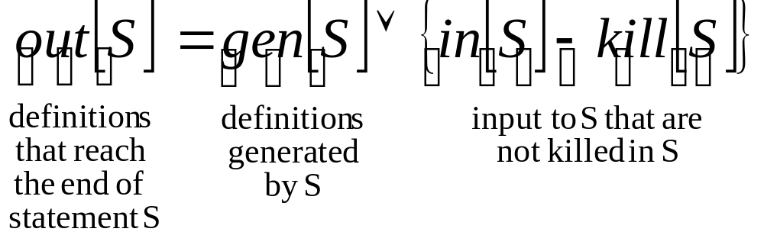
Global Data-Flow Analysis
Set up dataflow equations for each basic block.
For reaching definition the equation is:
Note: the dataflow equations depend
on the problem statement
(AhoSethiUllman, pp. 608)

Slide 71
Data-Flow Analysis of Structured Programs
Structured programs have an useful property: there is a single
point of entrance and a single exit point for each statement.
We will consider program statements that can be described
by the following syntax:
Statement → id := Expression
| Statement ; Statement
| if Expression then Statement else Statement
| do Statement while Expression
Expression → id + id
| id
(AhoSethiUllman, pp. 611)

Slide 72
Data-Flow Analysis of Structured Programs
S ::= id := E
| S ; S
| if E then S else S
| do S while E
E ::= id + id
| id
This restricted syntax results in the
forms depicted below for flowgraphs
S₁
S₁
If E goto S₁
S₂
S₁
S₂
If E goto S₁
S₁; S₂
if E then S₁ else S₂
do S₁ while E
(AhoSethiUllman, pp. 611)

Slide 73
Dataflow Equations for
Reaching Definition
gen[S] = {d}
kill [S] = Da - {d}
S
d : a := b + c
S₁
gen [S] = gen [S₂] ∪ (gen [S₁] - kill [S₂])
kill [S] = kill [S₂] ∪ (kill [S₁] - gen [S₂])
S
Data-flow equations for reaching definitions
S₂
gen [S] = gen [S₁] ∪ gen [S₂]
kill [S] = kill [S₁] ∩ kill [S₂]
S
S₁
S₂
gen [S] = gen [S₁]
kill [S] = kill [S₁]
S
S₁
(AhoSethiUllman, pp. 612)

Slide 74
Dataflow Equations for Reaching Definition
S
d : a := b + c
out [S] = gen [S] ∪ (in [S] - kill [S])
in [S₁] = in [S]
in [S₂] = out [S₁]
out [S] = out [S₂]
S
S₁
Date-flow equations for reaching definitions
S₂
in [S₁] = in [S]
in [S₂] = in [S]
out [S] = out [S₁] ∪ out [S₂]
S
S₁
S₂
S
S₁
in [S₁] = in [S] ∪ out [S₁]
out [S]= out [S₁]
(AhoSethiUllman, pp. 612)

Slide 75
Dataflow Analysis:
An Example
Using RD (reaching definition) as an example:
d₁ :
i = 0
in
Question:
What is the set of reaching
definitions at the exit of the loop L?
loop L
.
.
i = i + 1
d₂ :
out
in [L] = {d₁} ∪ out[L]
gen [L] = {d₂}
kill [L] = {d₁}
out [L] = gen [L] ∪ {in [L] - kill[L]}
in[L] depends on out[L], and out[L] depends on in[L]!!

Slide 76
Solution?
Initialization
out[L] = ∅
d₁ :
i = 0
in
First iteration
in[L] = {d₁} ∪ out[L]
= {d₁}
out[L] = gen [L] ∪ (in [L] - kill [L])
= {d₂} ∪ ({d₁} - {d₁})
= {d₂}
loop L
.
.
i = i + 1
d₂ :
out
in [L] = {d₁} ∪ out[L]
gen [L] = {d₂}
kill [L] = {d₁}
out [L] = gen [L] ∪ {in [L] - kill[L]}

Slide 77
Solution
First iteration
out[L] = {d₂}
Second iteration
in[L] = {d₁} ∪ out[L]
= {d₁,d₂}
out[L] = gen [L] ∪ (in [L] - kill [L])
= {d₂} ∪ {{d₁,d₂} - {d₁}}
= {d₂} ∪ {d₂}
= {d₂}
d₁ :
i = 0
in
loop L
.
.
i = i + 1
d₂ :
out
in [L] = {d₁} ∪ out[L]
gen [L] = {d₂}
kill [L] = {d₁}
out [L] = gen [L] ∪ {in [L] - kill[L]}
We reached the fixed point!

Slide 78
Iterative Algorithm for Reaching Definitions
Step 1: Compute gen and kill for each basic block
B1
d₁: i := m-1
d₂: j := n
d₃: a := u1
gen[B1] = {d₁, d₂, d₃}
kill[B1] = {d₄, d₅, d₆, d₇}
gen[B2] = {d₄, d₅}
kill [B2] = {d₁, d₂, d₇}
gen[B3] = {d₆}
kill [B3] = {d₃}
gen[B4] = {d₇}
kill [B4] = {d₁, d₄}
B2
d₄: i := i+1
d₅: j :=j - 1
B3
d₆: a := u2
B4
d₇: i := u3
(AhoSethiUllman, pp. 626)

Slide 79
Iterative Algorithm for Reaching Definitions
Step 2: For every basic block, make:
out[B] = gen[B]
B1
d₁: i := m-1
d₂: j := n
d₃: a := u1
Initialization:
in[B1] = ∅
out[B1] = {d₁, d₂, d₃}
in[B2] = ∅
out[B2] = {d₄, d₅}
in[B3] = ∅
out[B3] = {d₆}
in[B4] = ∅
out[B4] = {d₇}
B2
d₄: i := i+1
d₅: j :=j - 1
B3
d₆: a := u2
B4
d₇: i := u3

Slide 80
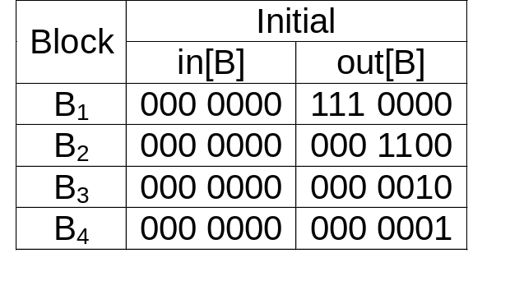
Iterative Algorithm for Reaching Definitions
To simplify the representation, the in[B]
and out[B] sets are represented by
bit strings. Assuming the representation
d₁d₂d₃ d₄d₅d₆d₇ we obtain:
B1
d₁: i := m-1
d₂: j := n
d₃: a := u1
Initialization:
in[B1] = ∅
out[B1] = {d₁, d₂, d₃}
in[B2] = ∅
out[B2] = {d₄, d₅}
in[B3] = ∅
out[B3] = {d₆}
in[B4] = ∅
out[B4] = {d₇}
B2
d₄: i := i+1
d₅: j :=j - 1
B3
d₆: a := u2
B4
d₇: i := u3
Notation: d₁d₂d₃ d₄d₅d₆d₇
(AhoSethiUllman, pp. 627)

Slide 81
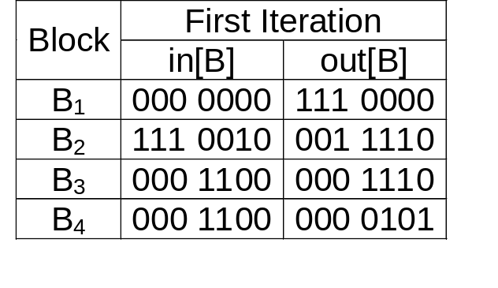
Iterative Algorithm for Reaching Definitions
gen[B1] = {d₁, d₂, d₃}
kill[B1] = {d₄, d₅, d₆, d₇}
gen[B2] = {d₄, d₅}
kill [B2] = {d₁, d₂, d₇}
gen[B3] = {d₆}
kill [B3] = {d₃}
gen[B4] = {d₇}
kill [B4] = {d₁, d₄}
while a fixed point is not found:
in[B] = ∪ out[P] where P is a
predecessor of B
out[B] = gen[B] ∪ (in[B]-kill[B])
B1
d₁: i := m-1
d₂: j := n
d₃: a := u1
B2
d₄: i := i+1
d₅: j :=j - 1
B3
d₆: a := u2
B4
d₇: i := u3
Notation: d₁d₂d₃ d₄d₅d₆d₇

Slide 82
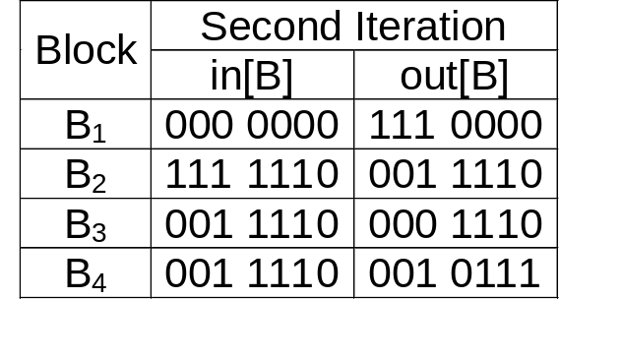
Iterative Algorithm for Reaching Definitions
gen[B1] = {d₁, d₂, d₃}
kill[B1] = {d₄, d₅, d₆, d₇}
gen[B2] = {d₄, d₅}
kill [B2] = {d₁, d₂, d₇}
gen[B3] = {d₆}
kill [B3] = {d₃}
gen[B4] = {d₇}
kill [B4] = {d₁, d₄}
while a fixed point is not found:
in[B] = ∪ out[P] where P is a
predecessor of B
out[B] = gen[B] ∪ (in[B]-kill[B])
B1
d₁: i := m-1
d₂: j := n
d₃: a := u1
B2
d₄: i := i+1
d₅: j :=j - 1
B3
d₆: a := u2
B4
d₇: i := u3
Notation: d₁d₂d₃ d₄d₅d₆d₇

Slide 83
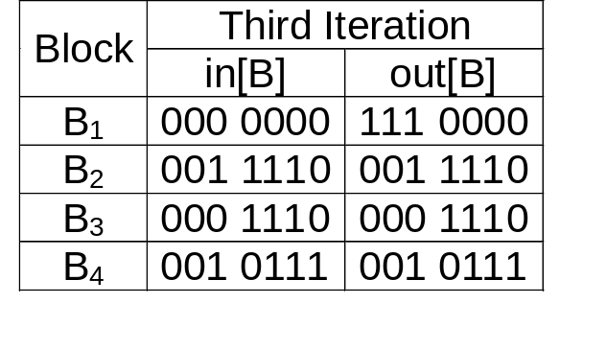
Iterative Algorithm for Reaching Definitions
gen[B1] = {d₁, d₂, d₃}
kill[B1] = {d₄, d₅, d₆, d₇}
gen[B2] = {d₄, d₅}
kill [B2] = {d₁, d₂, d₇}
gen[B3] = {d₆}
kill [B3] = {d₃}
gen[B4] = {d₇}
kill [B4] = {d₁, d₄}
while a fixed point is not found:
in[B] = ∪ out[P] where P is a
predecessor of B
out[B] = gen[B] ∪ (in[B]-kill[B])
B1
d₁: i := m-1
d₂: j := n
d₃: a := u1
B2
d₄: i := i+1
d₅: j :=j - 1
B3
d₆: a := u2
B4
d₇: i := u3
Notation: d₁d₂d₃ d₄d₅d₆d₇

Slide 84
Algorithm Convergence
Intuitively we can observe that the algorithm converges
to a fix point because the out[B] set never decreases
in size.
It can be shown that an upper bound on the number of
iterations required to reach a fix point is the number of
nodes in the flow graph.
Intuitively, if a definition reaches a point, it can only reach the
point through a cycle free path, and no cycle free path
can be longer than the number of nodes in the graph.
Empirical evidence suggests that for real programs the
number of iterations required to reach a fix point
is less then five.
(AhoSethiUllman, pp. 626)

Slide 85
Acknowledgements
For some of the material on the slides Special Thanks to
José Nelson Amaral
University of Alberta

