Slide 1
The Presentation of Paper-Reading
by Zhang Jingbin

Slide 2
Knowledge-Aware and Service-Oriented Middleware for deploying pervasive services (JNCA 2012)

Slide 3
Contents
Motivation
KASO Middleware (KASOM)
Overall Infrastructure
Middleware Architecture
The Process of Main Module
Scenario for KASOM
Validation Results

Slide 4
Motivation
The huge diversity of information transactions of context-aware applications in WSAN (Wireless Sensor and Actuator Network);
The aim to hide the heterogeneity in terms of hardware and software running on it with the aim of offering all those resources to the applications in a standardized way.
The resource cost of service mechanisms is not feasible for tiny resource-constrained nodes composing WSAN.
The aim of this research is to design a middleware approach which enables Service-Oriented Computing in pervasive network based on lightweight REST Web services.

Slide 5
KASO Middleware(KASOM)
The characteristics of the middleware:
Applied in WSAN with distributed deployment way
Knowledge Management to manage resources in WSAN
Integrating WSAN and conventional networks by REST approach
Enabling Service-Oriented Computing capabilities on nodes
Notes:
802.15.4 一种链路层无线传输协议

Slide 6
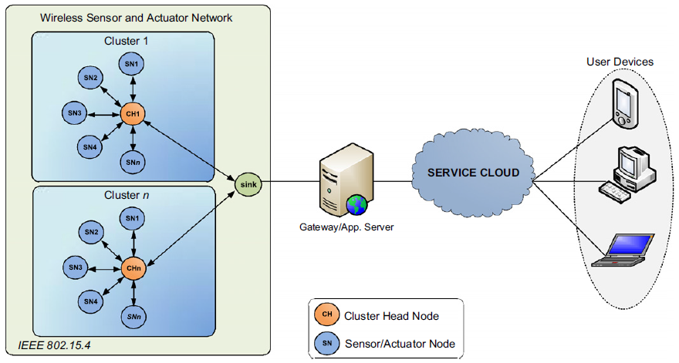
Overall Infrastructure
Notes:
802.15.4 一种链路层无线传输协议 WSDL 文件

Slide 7
WSAN’s Contextual Model
Contextual Model is the set of the semantic information
Low level resources : sensors, actuators, memory, energy
High level resources: simple services, contextual services, service composition rules
Repositories storing the information are called Knowledge Base
Notes:
这里的资源就是语义信息

Slide 8
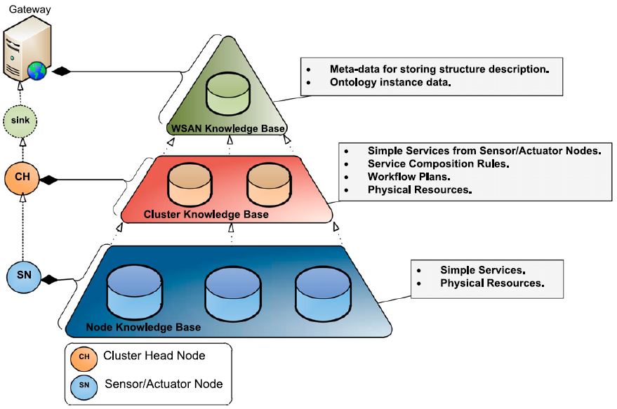
WSAN’s Contextual Model
Notes:
WSAN收集存储语义信息，建立起整个WSAN的语义模型，形成整个WSAN的本体，将WSAN service组成Web service

Slide 9
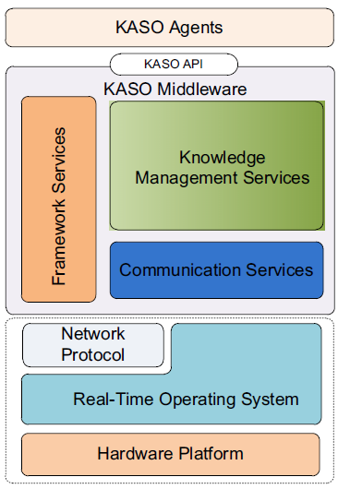
Nodes’ Conceptual Architecture
Generic Platform
Hardware Platform for nodes
Both commercial and open-source
Real-Time Operating System
Upper layers can use OS primitives to control underlying platform
Network Protocol
Routing protocols and algorithms
Knowledge-Aware & Service-Oriented Middleware
Perceptual Reason Agent (PRA) :N-PRA, C-PRA
Providing service composition rules
Made by users
Notes:
Sink node收集服务announcement到gateway，gateway负责把服务暴露给用户应用

Slide 10
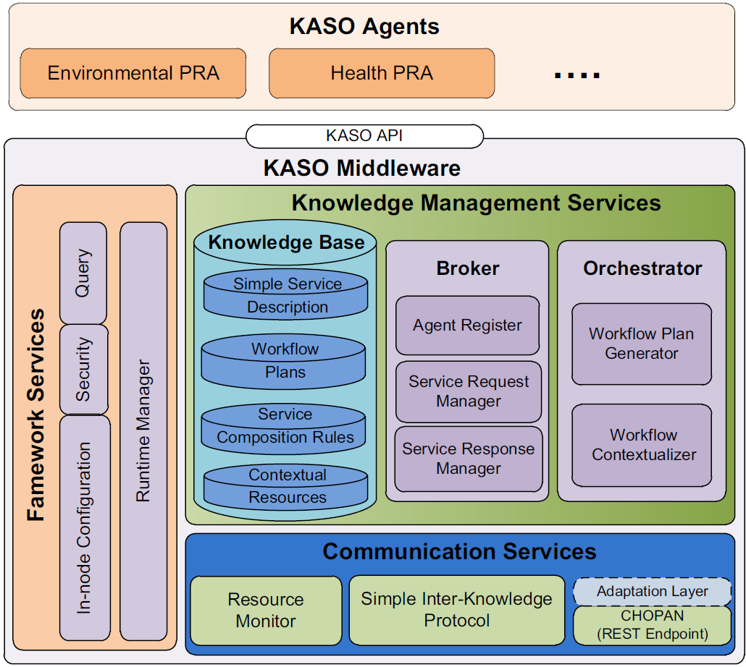
Middleware Architecture
Framework Services
In-node Configuration
Parameters: routing priorities
Security service
Query service
A dialect of SQL to query information about specific network parameters
Runtime Manager
Loading and unloading middleware components and PRAs
Notes:
框架服务是为RPA提供运行的框架环境 这里的组件通常指硬件组件

Slide 11
Middleware Architecture
Communication Services
Resource Monitor
Communicating with physical resources of the node and batteries or radio module
Simple Inter-Knowledge Protocol(SIKP)
Communicating and enabling service discovery between nodes in the same WSAN
CHOPAN Protocol
Offering the WSAN’s services in a RESTful way to the Service Cloud.
Notes:
Adaptation layer用来将REST方法结构转换成KASOM兼容的格式

Slide 12
Middleware Architecture
Knowledge Management Services
Knowledge Base
Broker Service
Generate services and register agents
Orchestrator Service
Orchestrated resources in order to assure a correct provision of services.

Slide 13
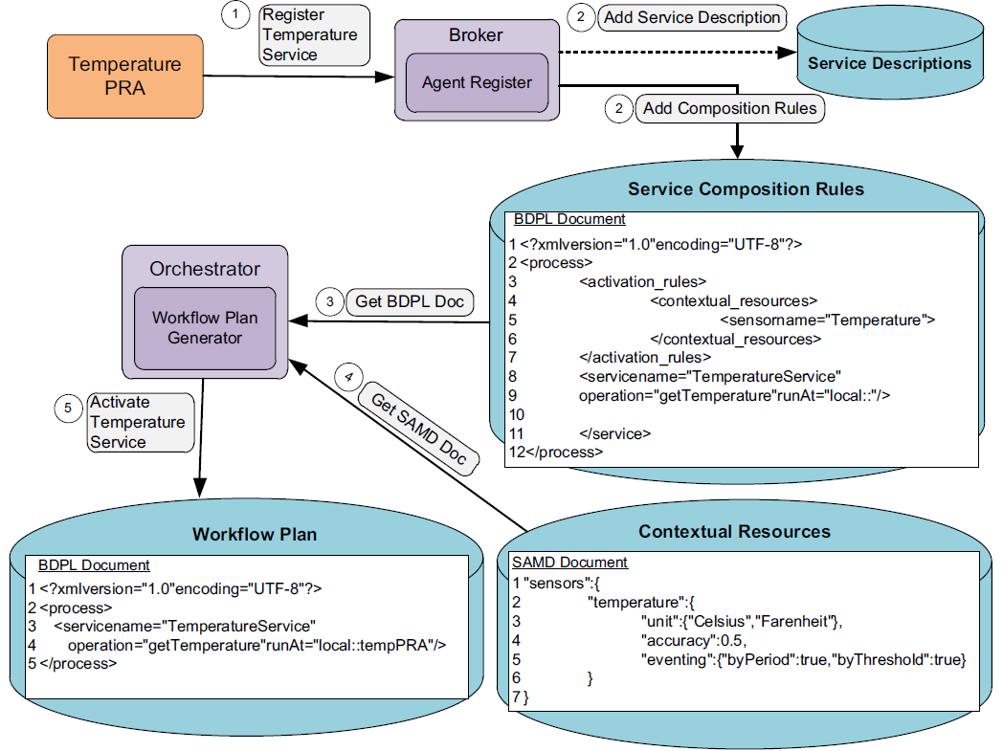
Composition Process for A Simple Service
Notes:
组成的服务通过SIKP协议暴露给其他实体 contextual service与此相似，不过语义资源就替换成了简单服务

Slide 14
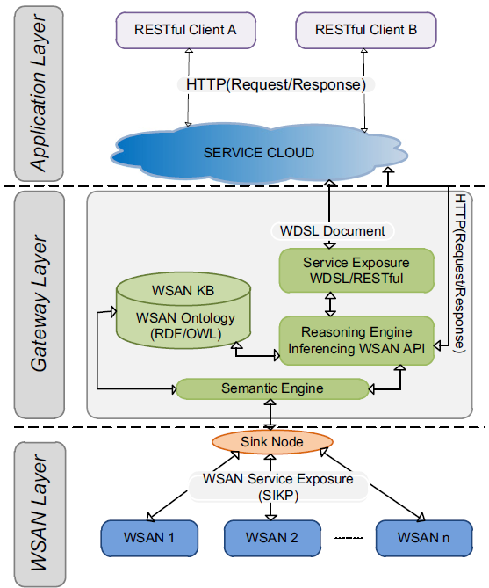
Services Exposure with RESTful Approach
Notes:
组成的服务通过SIKP协议暴露给其他实体 contextual service与此相似，不过语义资源就替换成了简单服务
最后，这个WSDL存储在公共UDDI注册表中，外部客户端可以从中访问WSAN的服务接口。

Slide 15
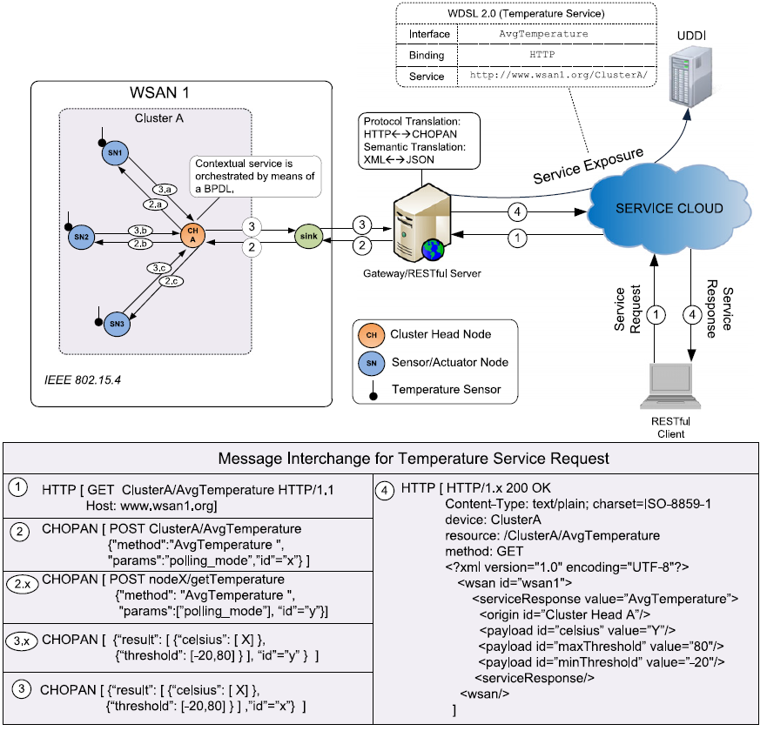
An Example of Service Request Process

Slide 16
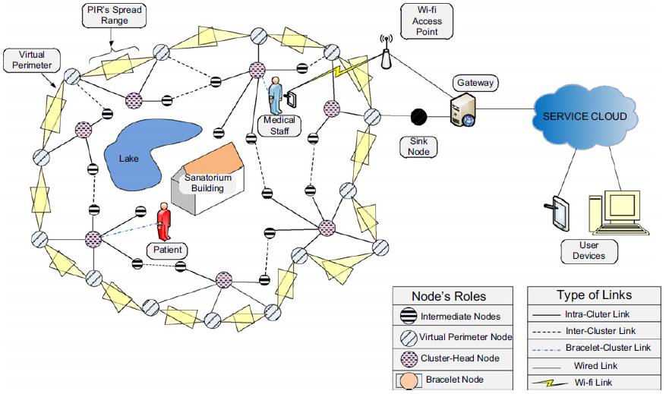
Scenario for KASOM

Slide 17
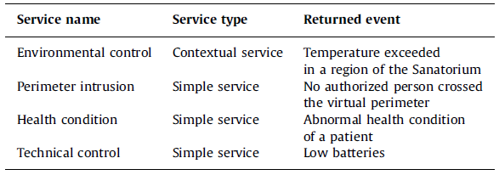
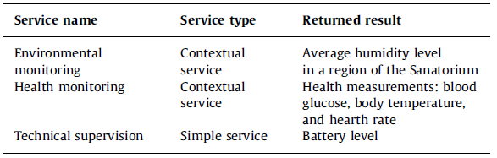
Validation Results
Event-based services (left side) and On-demand services (right side) for the validation scenario.

Slide 18
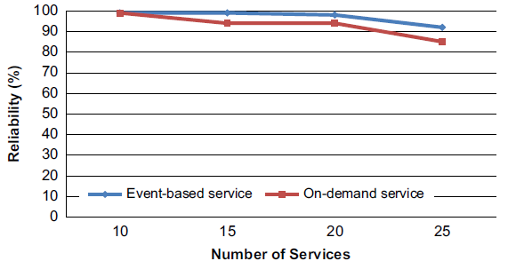
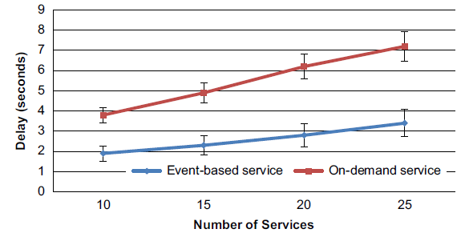
Validation Results

Slide 19
Relational Knowledge Extraction from Neural Networks (CoCoNIPS 2015)

Slide 20
Contents
Background
Motivation
CILP++ Neural-Symbolic System
Pipeline
Main Module
Results

Slide 21
Background
First-order logic
The logic of properties of, and relations between, objects and their parts
Proposition logic
The pairs of attribute-value
Relational learning
It can be described as the process of learning a first-order logic theory from examples and domain knowledge
Notes:
这里的资源就是语义信息

Slide 22
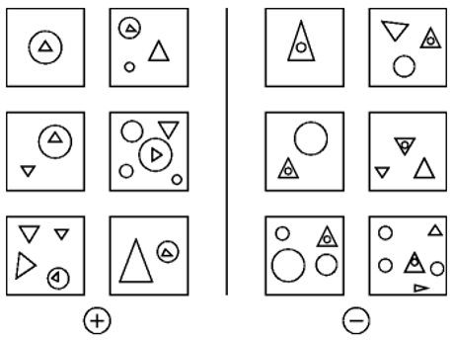
Background
Neural network or other propositional algorithm to solve this problem is more difficult. Through relational learning, using triangle and circle position logic, They can be easily classified.
Notes:
这里的资源就是语义信息

Slide 23
Motivation
Relational learning using simple neural nets that can be trained efficiently e.g. using backpropagation;
Propositionalization enables the use of any state-of-the-art attribute-value learner;
But results in a loss of the neat first-order knowledge representation which breaks down reasoning;
Should seek to reconcile efficient propositionalization, learning with backpropagation, and first-order logic reasoning.
Notes:
神经网络比较研究火热，如果应用到逻辑关系的学习中会提高现有效率
单纯对一阶逻辑进行命题化可以用这些现有的学习器，但可能会造成一些知识的丢失，不利于推理
因此需要去对命题化、关系学习以及逻辑推理三个方面进行协调

Slide 24
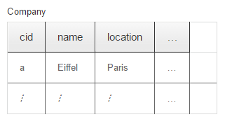
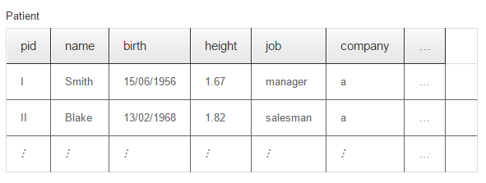
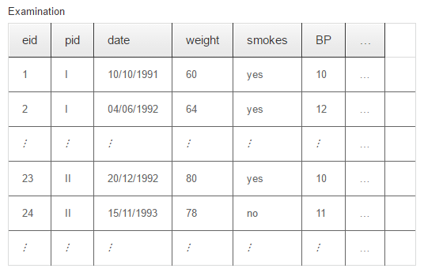
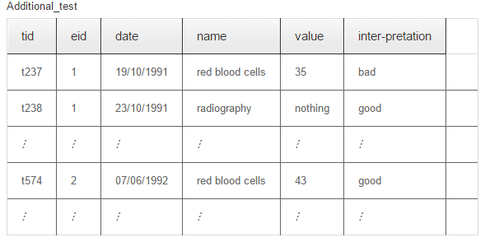
However, if the relational representation does not require recursion or complex quantifiers, relational hypotheses can be transformed into propositional expressions.
Notes:
递归或者复杂的量词 是可以转换到命题表达形式的
我个人的简单理解，举个简单例子，比方说关系数据库，很多张彼此有依赖关系的表，我们就可以把它整理到一张表来表示 这给表就是一个属性值对命题逻辑

Slide 25
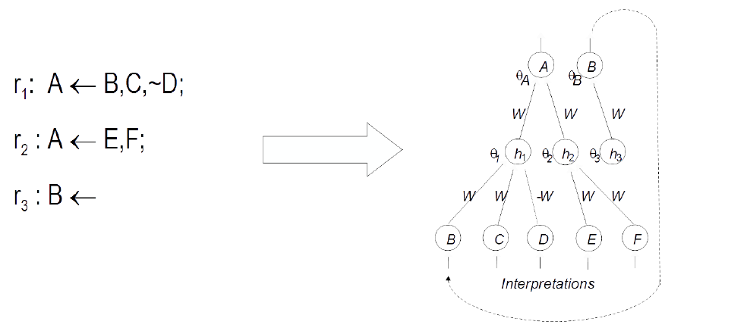
Motivation
THEOREM: For any logic program P there exists a neural network N such that N computes P
Give me a conclusion, the algorithm deduce its conditions！
Notes:
首先这样做是可行的，已经被证明了，将一阶逻辑推理的集合命题化后总能对应一个可以用来计算的神经网络

Slide 26
CILP++ Neural-Symbolic System
Extracting first-order logic relations from propositional learners(neural network and TREPAN), i.e., combining relational learning tasks with propositional learners.
Logic Reasoning + Neural Computation
Notes:
首先这样做是可行的，已经被证明了，将一阶逻辑推理的集合命题化后总能对应一个可以用来计算的神经网络

Slide 27
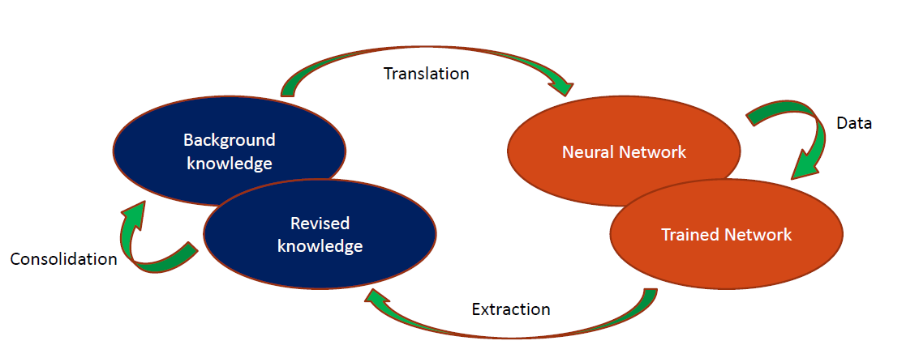
Pipeline
$Fire in Room A (Room \text{A} \text{Tem}\text{ > 50}\text{℃}\text{, }\text{Room} \text{Other} \text{Tem}\text{ <25}\text{℃}$)
Notes:
首先对背景知识及样本(中间件中的样本可以自动获取或者手动添加)进行命题化，转化并训练成神经网络，通过决策树的方法从神经网络中提取出新的关系加入到背景知识中。 越来越壮大，方便今后的关系推理

Slide 28
Main Modules
Bottom Clause Propositionalization
Establishing the Neural Network and training it
Using TREPAN, a decision tree algorithm, to extract new knowledge

Slide 29
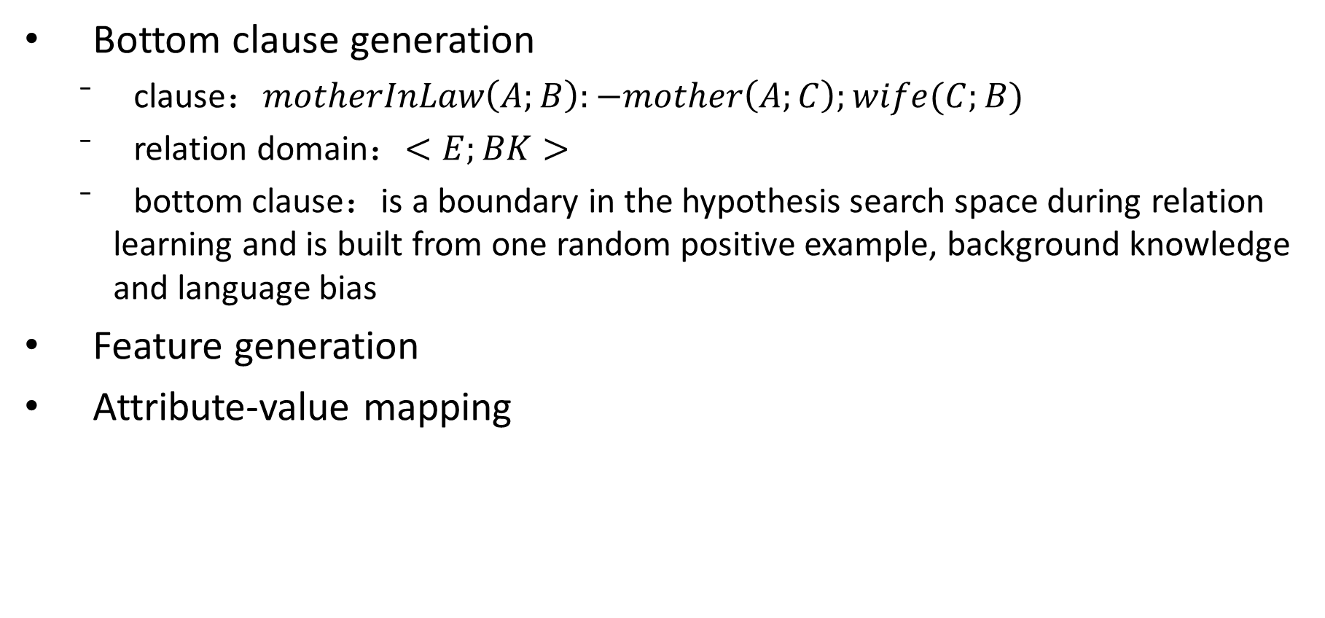
Bottom Clause Propositionalization
Bottom clause generation
clause：$motherInLaw\left(A;B\right):−mother\left(A;C\right);wife(C;B)$
relation domain：$<E;BK>$
bottom clause：is a boundary in the hypothesis search space during relation learning and is built from one random positive example, background knowledge and language bias
Feature generation
Attribute-value mapping

Slide 30
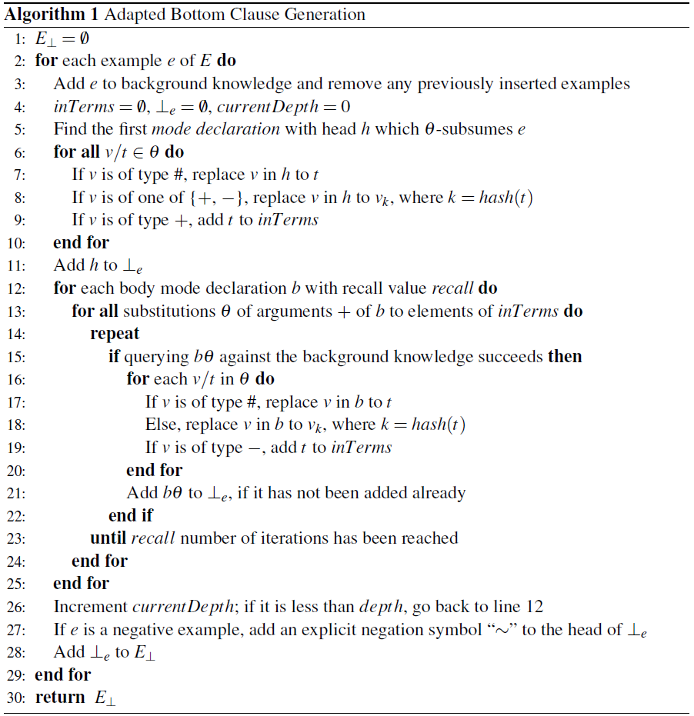
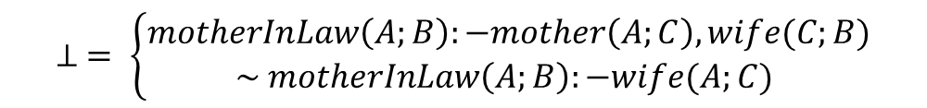


Bottom Clause Generation
$$E=\left\{\begin{aligned}motherInLaw\left(mom1, husband1\right) \\ motherInLaw\left(daughter1, husband2\right)\end{aligned}\right.$$
$$BK=\left\{\begin{aligned}mother(mom1, daughter1) \\ wife(daughter1,husband1) \\ wife(daughter2, husband2) \end{aligned}\right.$$
$$modeh\left(1,motherInLaw\left(+per,−per\right)\right)$$
$$modeb(1, wife(+per, −per))$$
$$modeb(1,mother(+per, −per))$$
$$⊥ = \left\{\begin{aligned}motherInLaw\left(A;B\right):−mother\left(A;C\right),wife(C;B) \\ \sim motherInLaw\left(A;B\right):−wife(A;C) \end{aligned}\right.$$
Notes:
论文对算法没有过多解释，我说一下自己的理解
#就是常数类型 +/-是主要和次要的关系
Interms集合

Slide 31
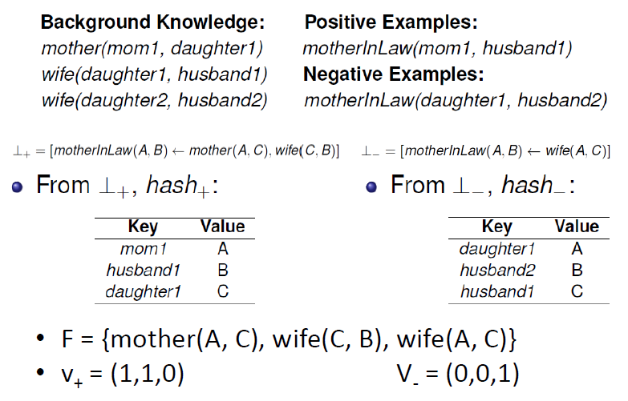
Feature & Attribute Value Generation
Notes:
1.会造成相当大的信息丢失 mother(A,B) wife(B,C) A,C之间的关系再进一步推理的时候就有可能会丢失了
2.存在大量冗余信息，会造成存储压力
3.如果进行特征选择的话，可能把重要的逻辑给丢掉，信息损失更加严重

Slide 32
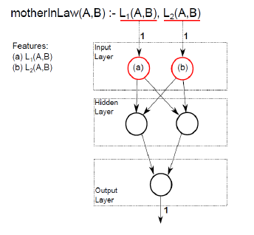




Feature & Attribute Value Generation
Notes:
然后我们就可以训练相应的神经网络得到良好的预测效果

Slide 33
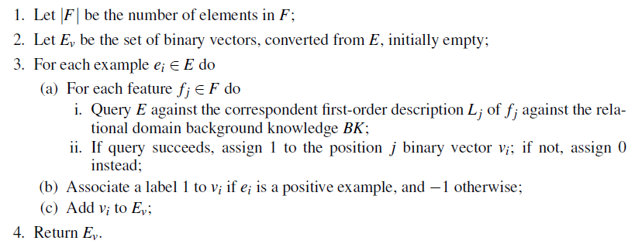
Feature & Attribute Value Generation

Slide 34
TREPAN rule extractor
The CILP++ network is used as an oracle to generate a set of examples by querying;
The examples are used to produce tree nodes following a greedy information gain heuristic;
The generated decision tree is converted into a set of disjunctive rules;
Feature descriptions from BCP are used to convert the features back to first-order literals.
Notes:
决策树算法的局限在于用于选择分裂的训练数据的量随着树的深度而减小，但是这个算法不同，它通过用神经网络的特性在每个节点生成辅助判断的新样本，生成的这些样本来帮助进行划分的选择，有利于提高准确性
生成的决策树的每条path被分离成相应的新的逻辑规则，最后再把对应的特征转化会一阶逻辑的literal
3.

Slide 35
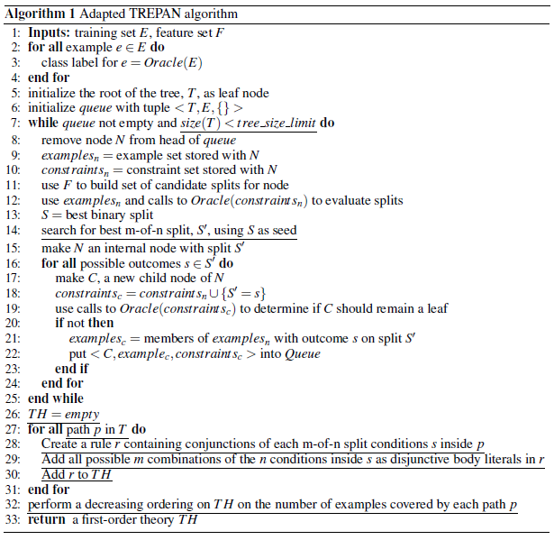
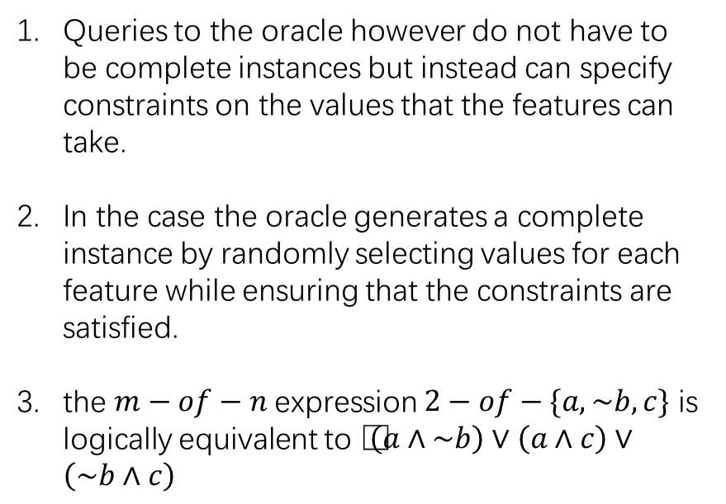
TREPAN rule extractor
Queries to the oracle however do not have to be complete instances but instead can specify constraints on the values that the features can take.
In the case the oracle generates a complete instance by randomly selecting values for each feature while ensuring that the constraints are satisfied.
the $m−of−n$expression $2−of−\{a,\sim b,c\}$ is logically equivalent to $\left(a∧\sim b\right)∨\left(a∧c\right)∨\left(\sim b∧c\right)$
Notes:
Best-first rather than Deep-first （他说这样有最大的能力去保证从网络中提取的决策树的保真度）
there is the greatest potential to increase the fidelity of the extracted tree to the network
满足当前的限定条件下尽可能生成一些样本通过神经网络进行预测，更好的进行属性的划分

Slide 36
TREPAN rule extractor
MIL:-L1,L2,L4
MIL:-L1,L3,L4
MIL:-L2,L3,L4
A given node becomes a leaf in the tree if, with high probability, the node covers only instances of a single class;
TREPAN also accepts a parameter that specifies a limit on the number of internal nodes in an extracted tree.
Notes:
从样本通过神经网络较高的概率都被标为同一类 限制树的深度

Slide 37
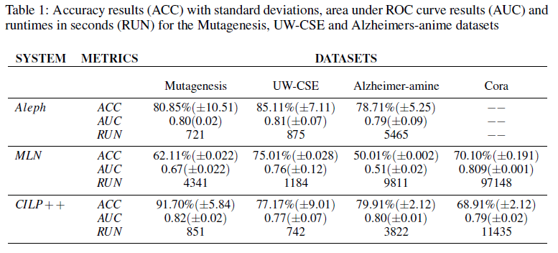
Validation Results

Slide 38
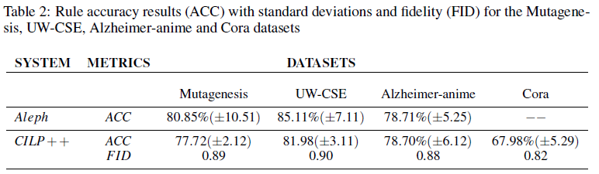
Validation Results

