Slide 1
Knowledge-Aware and Service-Oriented Middleware for deploying pervasive services (JNCA 2012)

Slide 2
Contents
Motivation
KASO Middleware (KASOM)
Overall Infrastructure
Middleware Architecture
The Process of Main Module
Scenario for KASOM
Validation Results

Slide 3
Motivation
The huge diversity of information transactions of context-aware applications in WSAN (Wireless Sensor and Actuator Network);
The aim to hide the heterogeneity in terms of hardware and software running on it with the aim of offering all those resources to the applications in a standardized way.
The resource cost of service mechanisms is not feasible for tiny resource-constrained nodes composing WSAN.
The aim of this research is to design a middleware approach which enables Service-Oriented Computing in pervasive network based on lightweight REST Web services.

Slide 4
KASO Middleware(KASOM)
The characteristics of the middleware:
Applied in WSAN with distributed deployment way
Knowledge Management to manage resources in WSAN
Integrating WSAN and conventional networks by REST approach
Enabling Service-Oriented Computing capabilities on nodes
Notes:
802.15.4 一种链路层无线传输协议

Slide 5
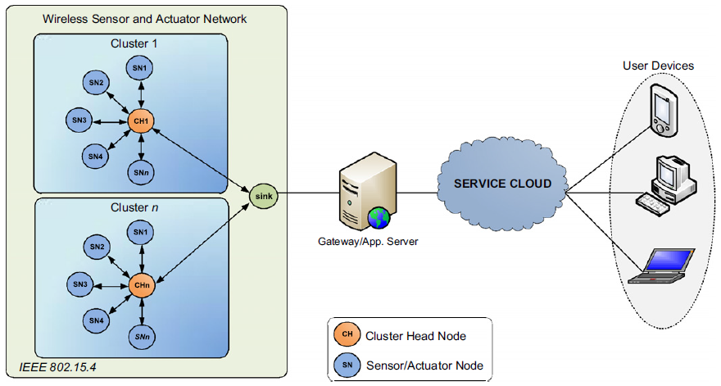
Overall Infrastructure
Notes:
802.15.4 一种链路层无线传输协议 WSDL 文件

Slide 6
WSAN’s Contextual Model
Contextual Model is the set of the semantic information
Low level resources : sensors, actuators, memory, energy
High level resources: simple services, contextual services, service composition rules
Repositories storing the information are called Knowledge Base
Notes:
这里的资源就是语义信息

Slide 7
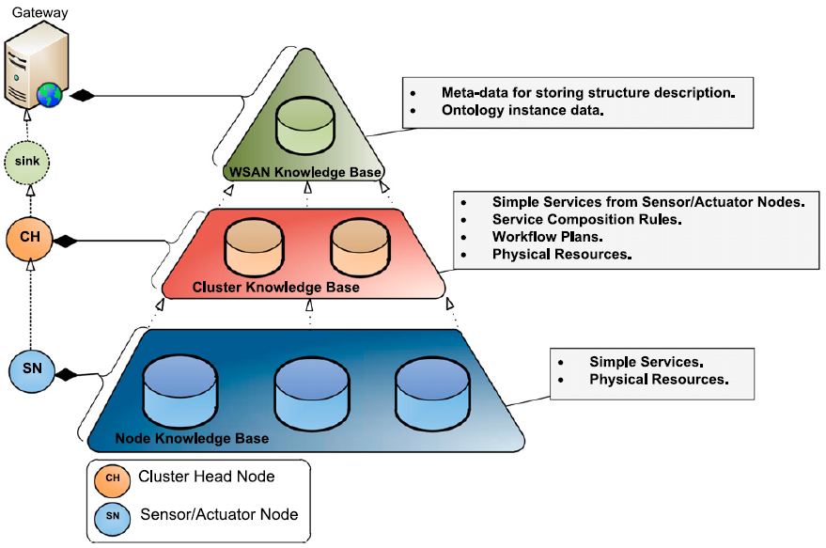
WSAN’s Contextual Model
Notes:
WSAN收集存储语义信息，建立起整个WSAN的语义模型，形成整个WSAN的本体，将WSAN service组成Web service

Slide 8
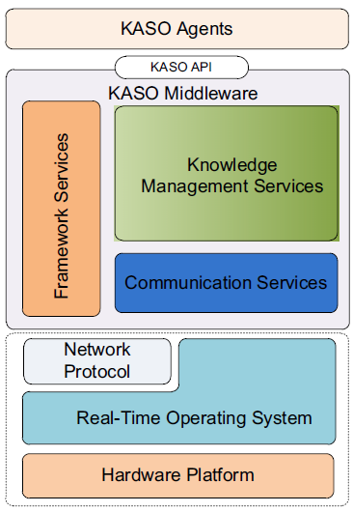
Nodes’ Conceptual Architecture
Generic Platform
Hardware Platform for nodes
Both commercial and open-source
Real-Time Operating System
Upper layers can use OS primitives to control underlying platform
Network Protocol
Routing protocols and algorithms
Knowledge-Aware & Service-Oriented Middleware
Perceptual Reason Agent (PRA) :N-PRA, C-PRA
Providing service composition rules
Made by users
Notes:
Sink node收集服务announcement到gateway，gateway负责把服务暴露给用户应用

Slide 9
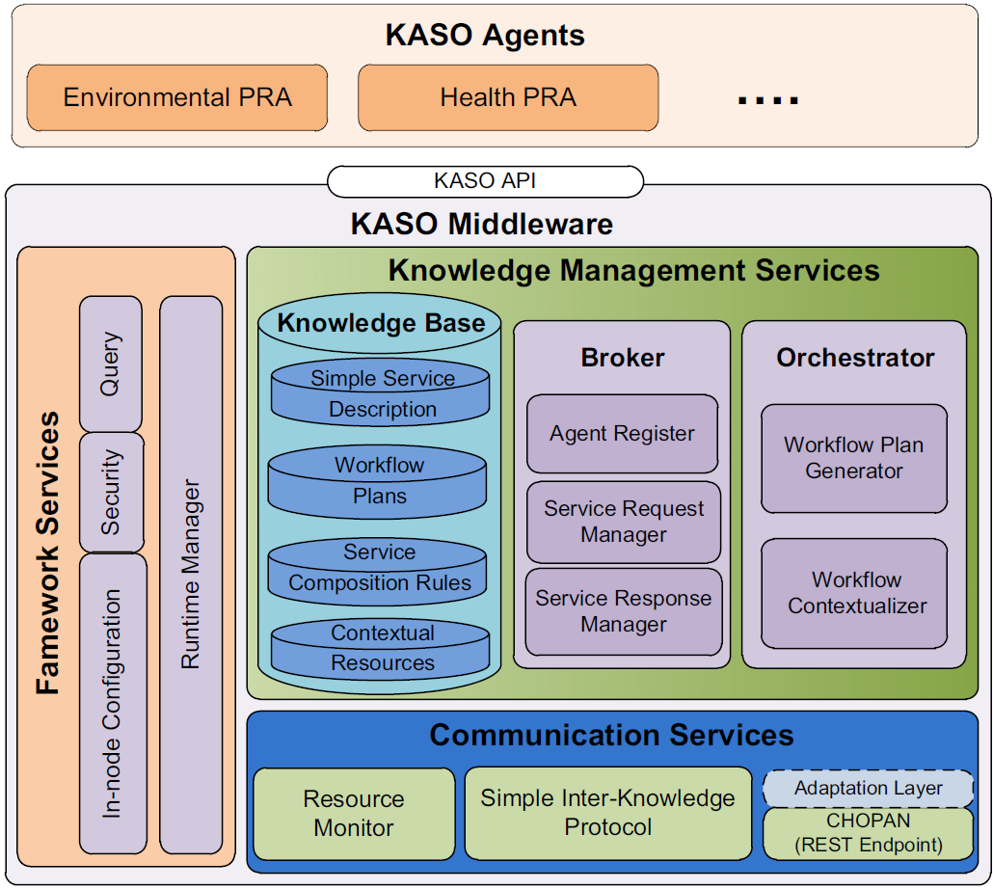
Middleware Architecture
Framework Services
In-node Configuration
Parameters: routing priorities
Security service
Query service
A dialect of SQL to query information about specific network parameters
Runtime Manager
Loading and unloading middleware components and PRAs
Notes:
框架服务是为RPA提供运行的框架环境 这里的组件通常指硬件组件

Slide 10
Middleware Architecture
Communication Services
Resource Monitor
Communicating with physical resources of the node and batteries or radio module
Simple Inter-Knowledge Protocol(SIKP)
Communicating and enabling service discovery between nodes in the same WSAN
CHOPAN Protocol
Offering the WSAN’s services in a RESTful way to the Service Cloud.
Notes:
Adaptation layer用来将REST方法结构转换成KASOM兼容的格式

Slide 11
Middleware Architecture
Knowledge Management Services
Knowledge Base
Broker Service
Generate services and register agents
Orchestrator Service
Orchestrated resources in order to assure a correct provision of services.

Slide 12
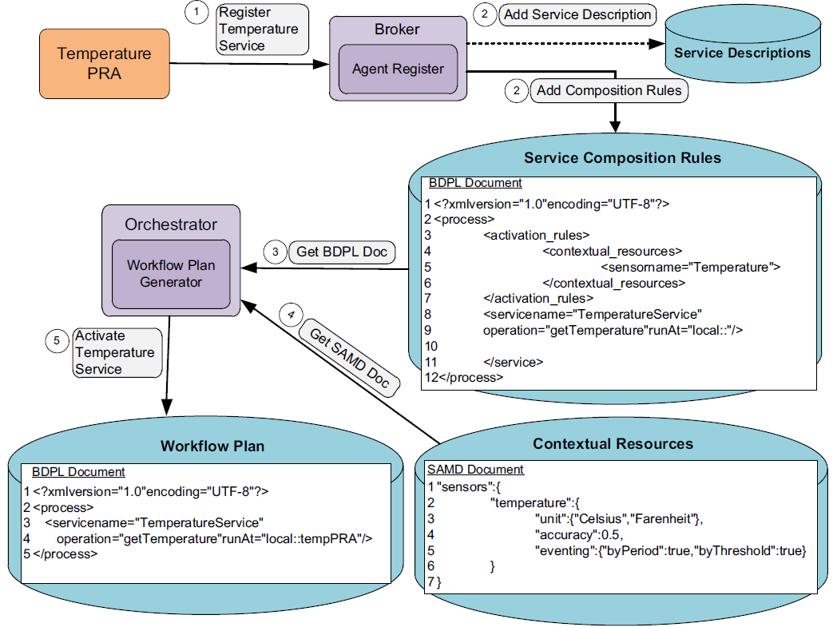
Composition Process for A Simple Service
Notes:
组成的服务通过SIKP协议暴露给其他实体 contextual service与此相似，不过语义资源就替换成了简单服务

Slide 13
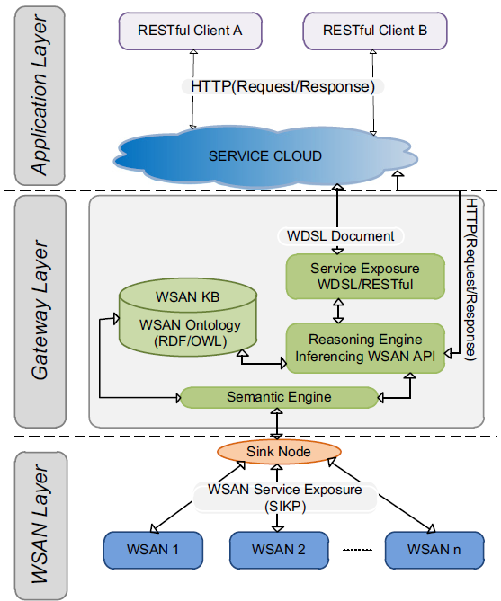
Services Exposure with RESTful Approach
Notes:
组成的服务通过SIKP协议暴露给其他实体 contextual service与此相似，不过语义资源就替换成了简单服务
最后，这个WSDL存储在公共UDDI注册表中，外部客户端可以从中访问WSAN的服务接口。

Slide 14
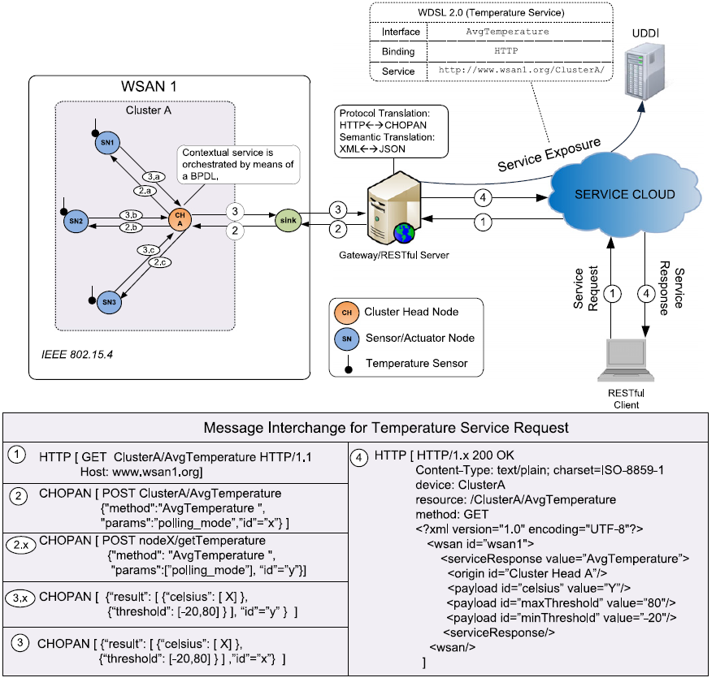
An Example of Service Request Process

Slide 15
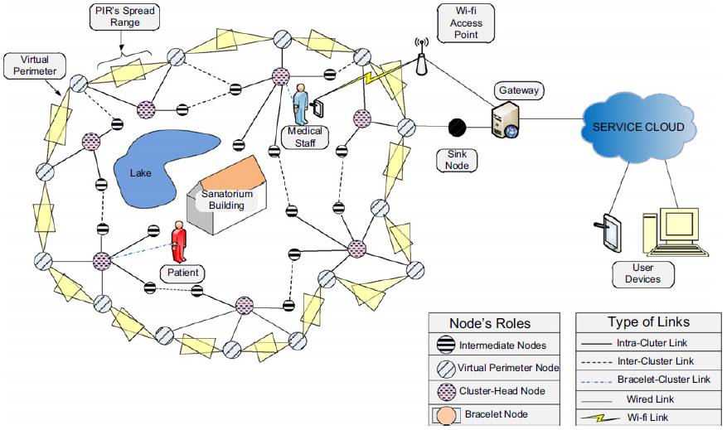
Scenario for KASOM

Slide 16
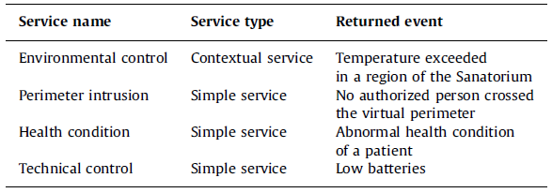
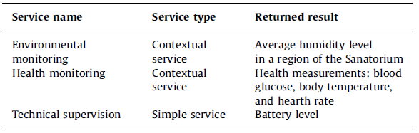
Validation Results
Event-based services (left side) and On-demand services (right side) for the validation scenario.

Slide 17
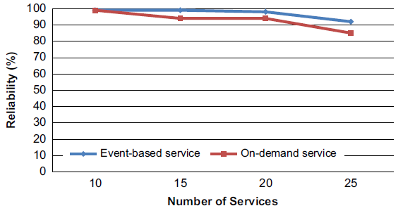
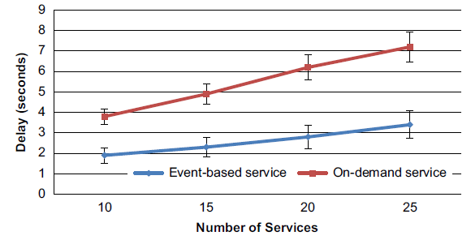
Validation Results

