Slide 1
SensorAct：The Advanced Edition of SenSip
Zhang Jingbin
Notes:
sensorAct 高级一点的sensip

Slide 2
Outline
Introduction
Motivation
Architecture
Main Module & Technology
Application Scenario
Contrast
Reference

Slide 3
Introduction
an open-source federated middleware for building management incorporating features targeting three specific requirements:
Accommodating a richer ecosystem of sensors, actuators, and higher level third-party applications;
Participatory engagement of stakeholders other than the facilities department, such as occupants, in setting policies for management of sensor data and control of electrical systems, without compromising on the overall privacy and safety;
Flexible interfacing and information exchange with systems external to a building.
Notes:
一个开源的联合中间件，针对建筑管理包含三个特性：
（i）容纳更丰富的传感器，致动器和更高级别的第三方应用的生态系统;
（ii）除设施部门以外的居住者参与制定传感器数据管理政策和电气系统控制政策，不影响总体隐私和安全;
（iii）与建筑物外部系统的灵活的接口和信息交换。

Slide 4
Motivation
Different subsystems interacting with diverse occupants;
Lack a complex Cyber-Physical-Human infrastructure;
Monitoring and controlling this complex ecosystem is essential both for efficient and optimized operations of building subsystems and for influencing the occupant behavior.
The limitations of existing systems in data privacy, Intermittent, real-time control.
Notes:
不同的子系统与不同的用户交互;
缺少一个复杂的网络 – 设备 - 人基础设施;
监控和控制这个复杂的生态系统对于子系统的操作以及对住户的行为管理是至关重要的。
现有系统在数据隐私，间歇，实时控制方面的局限性。
间歇：每隔两小时重新判定用户的接入权限

Slide 5
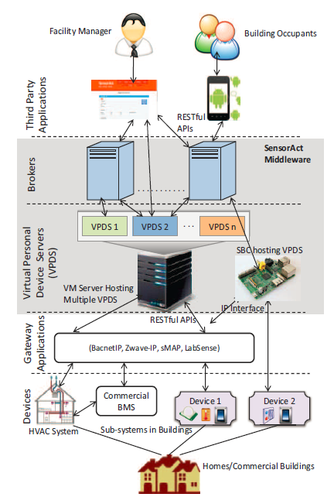
Architecture

Slide 6
Architecture
Device Layer
Notes:
这些设备都支持一些网络协议，传到一个相应的网关做数据的整合

Slide 7
Architecture
Gateway Layer

Slide 8
Architecture
VPDS
Data storage
Access control
Device management
Event control and management
Broker
User-VPDS connect management
Middleware Layer
Notes:
协调用户应用与VPDS建立连接

Slide 9
Architecture
A single user could be the owner of her own VPDS and user for some other VPDS, so they have two roles:
An owner of her own devices and their correspondingly associated VPDS;
A user with data and control access as per the privileges assigned by the owner of other VPDS.
User/App Layer
Notes:
每个用户都有两种角色：自己的设备和VPDS的拥有者，别人设备的使用者，他的数据和访问控制权限由该设备VPDS的拥有者分配。

Slide 10
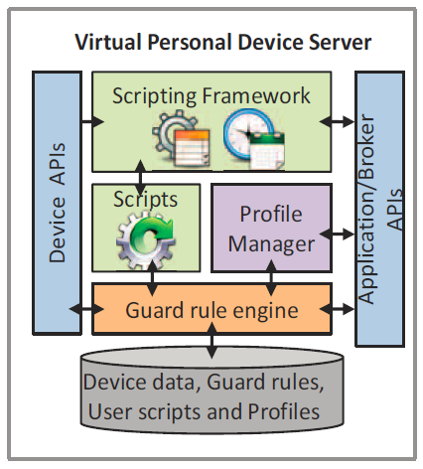
Virtual Personal Device Server (VPDS)
Guard rule engine
Macro
Task Framework
Tasklet & Lua & Quartz
Data storage
MongoDB
Profile Manager
Notes:
保护规则引擎，宏

Slide 11
Guard Rule Engine (VPDS)
Guard Rule Engine in SensorAct is designed to support selective sharing of sensor data and actuation control with other users as governed by the corresponding owner.
All access requests for actuators or sensor data are governed by Guard Rule Engine.
Guard Rule Engine enables fine-grained access control by allowing the owner to define rules based on user, group, time, location, sensor data, and actuators.
Notes:
选择性共享传感器数据和启动控制
细粒度的接入控制 允许用户根据具体情况详细的制定规则

Slide 12
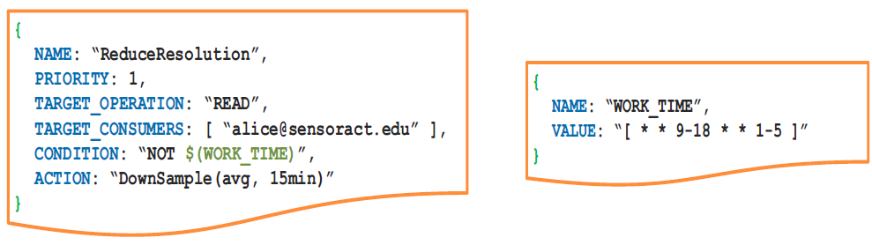
Guard Rule Engine (VPDS)
Notes:
下采样

Slide 13
Guard Rule Engine (VPDS)

Slide 14
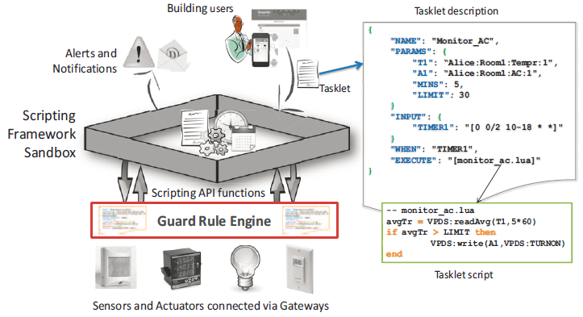
Script/Tasking Framework (VPDS)
The scripting framework in SensorAct provides an application execution environment within the middleware for high-level scripting languages in a sandbox.
Notes:
在中间件中注入自定义的应用程序逻辑，他会根据逻辑描述进行相应的控制或者接入操作。框架提供了读写传感器和制动器的功能，当然必须要满足保护规则

Slide 15
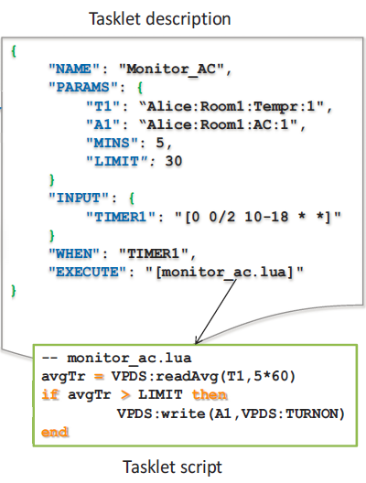
Script/Tasking Framework (VPDS)
The tasklet description contains meta information (sensors and actuators identifier, parameters, scheduling and triggering conditions)
Tasklet script contains the application logic in a high-level scripting language.
One-shot
Periodic
Event driven
Periodic and Event based
Lua
Notes:
每天的10-18点每隔两分钟，如果（温度计和空调）满足参数条件，就执行下面的操作
按照生命周期
Tasklet继承执行它的用户的权限

Slide 16
Script/Tasking Framework (VPDS)
The Tasklet manager uses Quartz. It receives the tasklet execution requests and executes a tasklet when its corresponding triggering conditions are met. Each tasklet runs with its own independent execution context which is monitored by the tasklet manager.
Lua
Notes:
Tasklet管理器同时也存储中间产生的数据，尤其是周期性任务
确保每个tasklet独立运行，它负责执行和触发脚本

Slide 17
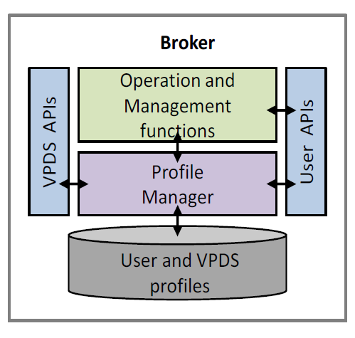
Broker
Broker contains a registry of users, a registry of VPDSes, and it acts as a mediator to assist client applications establish a connection with multiple VPDSes.
Notes:
协调用户应用与VPDS建立连接

Slide 18
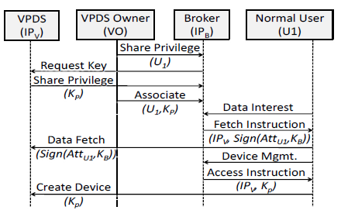
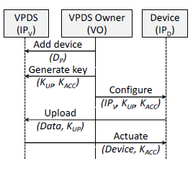
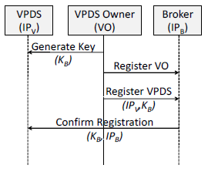
Broker
Notes:
每天的10-18点每隔两分钟，如果（温度计和空调）满足参数条件，就执行下面的操作
按照生命周期
Tasklet继承执行它的用户的权限

Slide 19
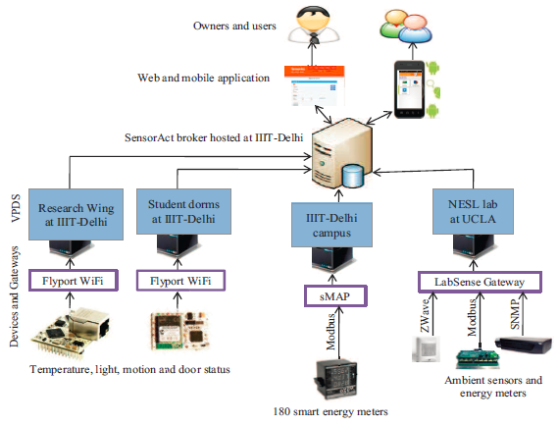
Application Scenario

Slide 20
Contrast
中间件 | 中间件类别 | 应用场景 | 部署平台 | 环境感知 | 设备发现 | QoS | 通信异构 | 互操作性 | 数据处理 | 数据隐私与安全
AllJoyn | SOA | 设备通信及发现 | Win/Linux/TinyOS/Android/IOS/… | × | mDNS | × | √ | Dbus | × | √
Hydra | SOA | Healthcare/建筑管理/… | Win/Win CE/TinyOS/… | 1. Ontology-based 2. State machine | × | √ | √ | × | √ | √
SensorAct | SOA | 建筑管理 | Win/Linux/… | Tasklet & Quartz | × | × | √ | Guard rule Tasklet | √ | √

Slide 21
Reference
[1] Arjunan P, Saha M, Choi H, et al. SensorAct: A Decentralized and Scriptable Middleware for Smart Energy Buildings[J].
[2] Arjunan P, Batra N, Choi H, et al. SensorAct: a privacy and security aware federated middleware for building management[C]//Proceedings of the Fourth ACM Workshop on Embedded Sensing Systems for Energy-Efficiency in Buildings. ACM, 2012: 80-87.
[3] Arjunan P, Saha M, Gulati M, et al. SensorAct: Design and Implementation of Fine-grained Sensing and Control Sharing in Buildings[C]//the poster track of 10th USENIX Symposium on Networked Systems Design and Implementation (NSDI’13). 2013.

