Slide 1
HW2 Bar Plots

Slide 2
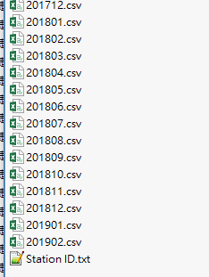
Data Set: Number of Passengers at Taipei MRT Stations
Attributes
date
hour
in – Entrance (station)
out – Exit (station)
num – Number of Passengers
Format
csv
Station name is in Chinese, so there is a text file can help you change the station name to station ID.

Slide 3
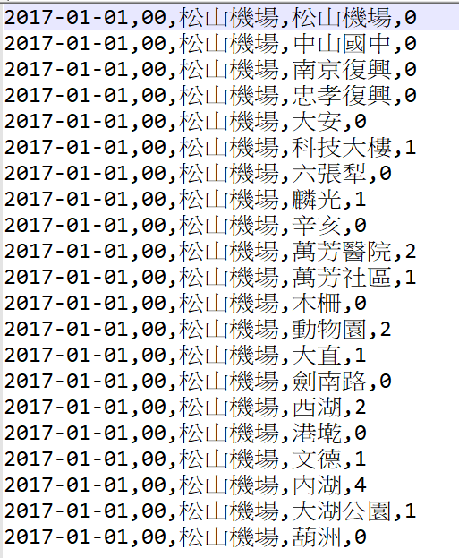
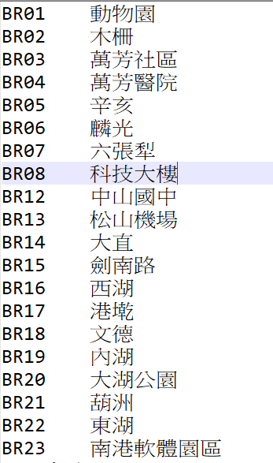
201701~201812.csv
Station ID.txt

Slide 4
Requirements
Add up the number of passengers at each station.
Show the top 10 numbers of passengers with bar chart.
Produce two figures, one for the number of passengers entering the station and the other for exiting the station, for each year (2017 and 2018).
Each figure includes 12 bar plots showing the statistics per month.
Thus, there are totally 4 figures including 48 bar plots.
Use Station ID as the tick label in the bar plots.

Slide 5
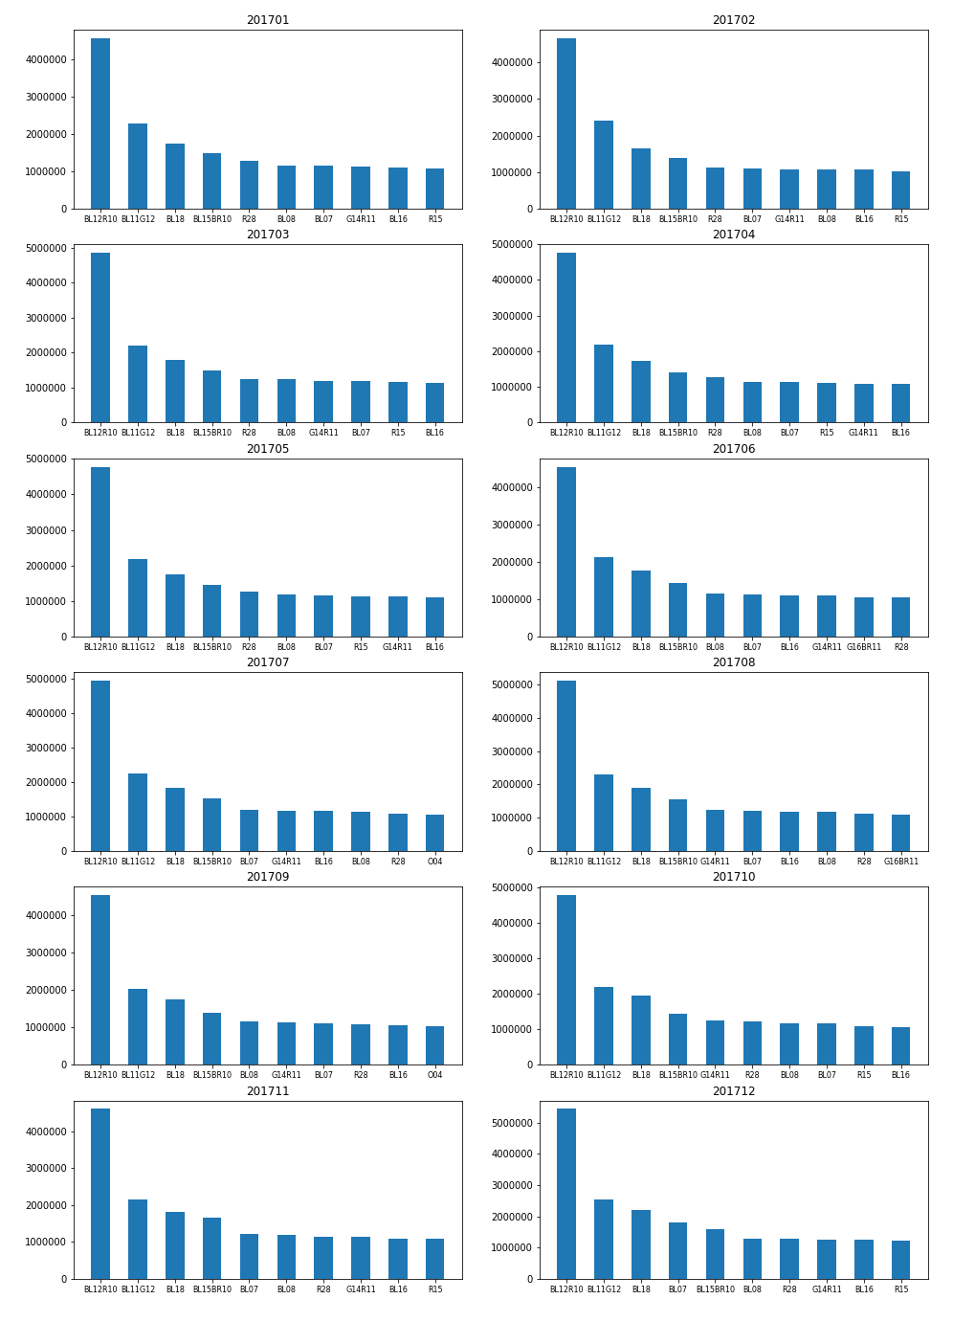
Example:
2017, Entrance

Slide 6
Files to Be Submitted
The source code (.ipynb, .py, or others).
4 Figures names as 2017_enter.png ( .jpg or other format)
All files are compressed into a file named HW2_MRT_studentID.zip( or .rar)

