Slide 1
Lighting/Shading SubDivision
2019/05/10

Slide 2
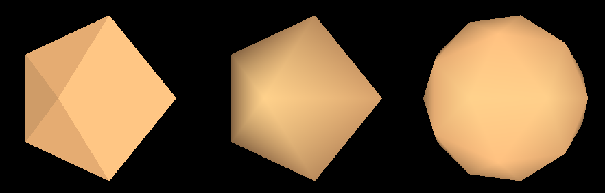
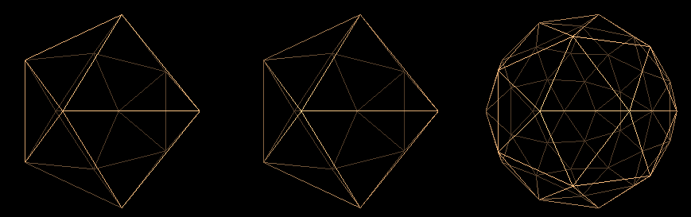
Shading and Subdivision
Use 3 viewport to display the icoshedron
3 Displaying Mode
Flat, Interpolate, Subdivision with interpolate shading
The third viewport shows the icoshedron with adjustable subdivision depth
Subdivide once, twice or more…

Slide 3
Subdivision
Use keyboard to control
Subdivision depth (+ , - )
(apply to the third view port only)
recursive how many times
Rotate the icosahedron along its own center
x-axis, y-axis, z-axis
Polygon mode
Line, fill

Slide 4
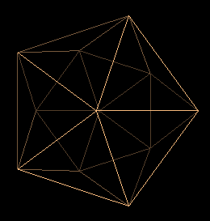
Icosahedron
Approximating a Sphere: using Icosahedron
Define the vertices
#define X .525731112119133606
#define Z .850650808352039932
static GLfloat vdata[12][3] = {
{-X, 0.0, Z}, {X, 0.0, Z}, {-X, 0.0, -Z}, {X, 0.0, -Z},
{0.0, Z, X}, {0.0, Z, -X}, {0.0, -Z, X}, {0.0, -Z, -X},
{Z, X, 0.0}, {-Z, X, 0.0}, {Z, -X, 0.0}, {-Z, -X, 0.0}
};

Slide 5
Defining the Faces
Index into vertex data array
static GLuint tindices[20][3] = {
{1,4,0}, {4,9,0}, {4,9,5}, {8,5,4}, {1,8,4},
{1,10,8}, {10,3,8}, {8,3,5}, {3,2,5}, {3,7,2},
{3,10,7}, {10,6,7}, {6,11,7}, {6,0,11}, {6,1,0},
{10,1,6}, {11,0,9}, {2,11,9}, {5,2,9}, {11,2,7}
};

