Slide 1
COMPUTATIONAL PROTEOMICS AND GENOMICS
Spectral Characterization of
SARS-CoV-2 Genome Using
KNN Classifier

Slide 2
Flow of Discussion
Introduction
Aim
Method Used
Data Used
Machine Learning Algorithm
Output
Conclusions
AGENDA

Slide 3

INTRODUCTION
COVID-19 BELONGS TO THE FAMILY OF CORONAVIRIDAE. IF A DISEASE'S FAMILY IS DETECTED UPON ENCOUNTERING IT, THEN FATALITIES CAN BE AVOIDED BY TRYING COMMON TREATMENT METHODS FOR DISEASES OF THE SAME FAMILY.

Slide 4

AIM
TO FIND OUT WHETHER A DISEASE BELONGS TO SAME FAMILY AS SARS COV-2

Slide 5
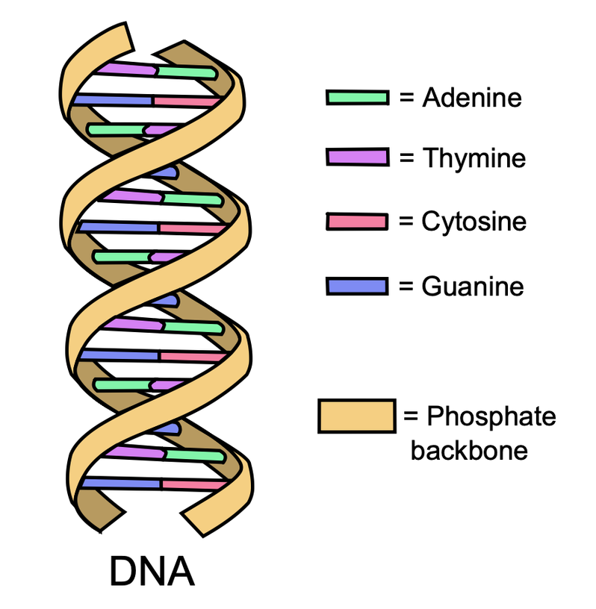
METHODS USED
DOWNLOAD DATA
INFER DATA RELATED TO DIFFERENT BASES
CONVERT THE SEQUENCE TO EIIP SCHEME
DO SIGNAL PROCESSING USING FFT
INFER SIGNAL-RELATED DATA
FEED THE DATA INTO ML MODEL
PREDICT THE DISEASE

Slide 6
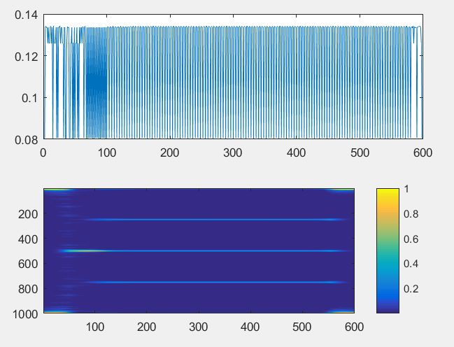
FEATURES EXTRACTED FROM FFT
MAXIMUM
MINIMUM
MEAN
MEDIAN
PEAK, ETC.

Slide 7
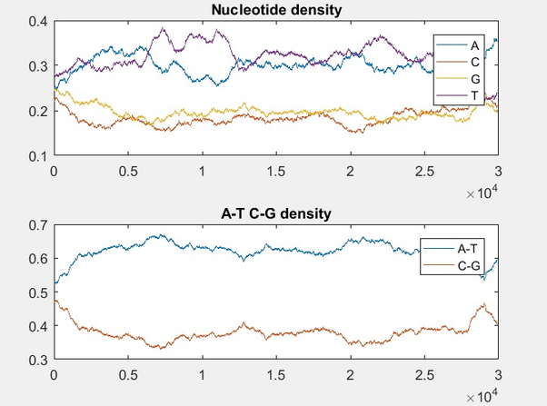
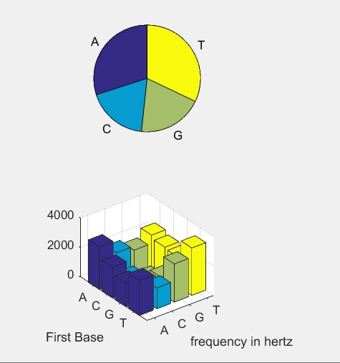
FEATURES EXTRACTED FROM ANALYSIS OF BASES
PERCENTAGE OF BASES AND COMPLEMENTARY BASE PAIR (BASECOUNT)
DIMER COUNT.

Slide 8

DATA USED
30 COVID Sequences and 25 non-COVID sequences have been downloaded from the NCBI website.
All data is in .fasta format.

Slide 9
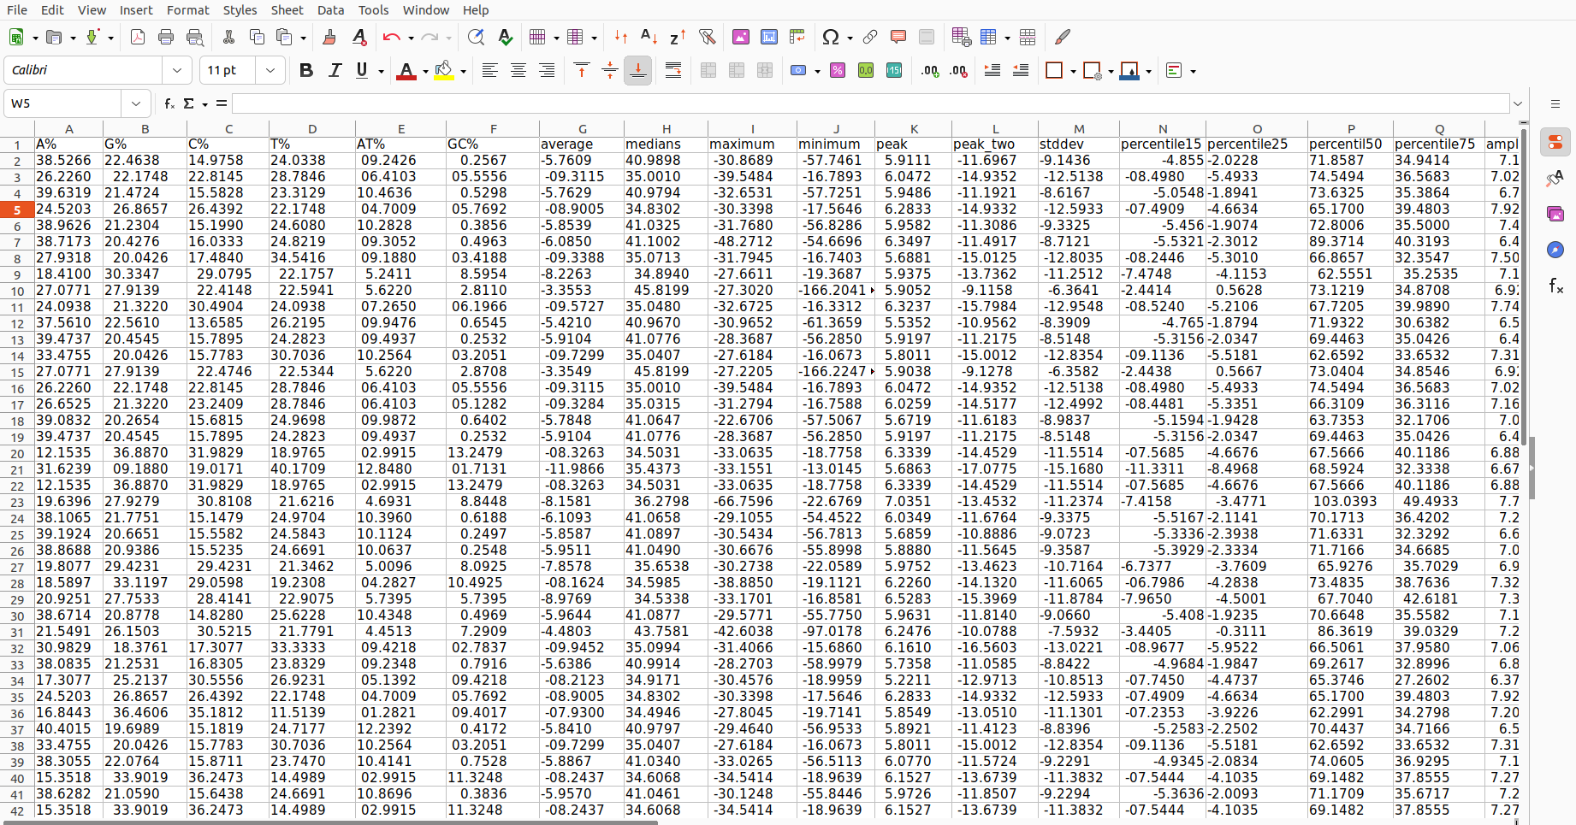
DATA AFTER FEATURE EXTRACTION

Slide 10
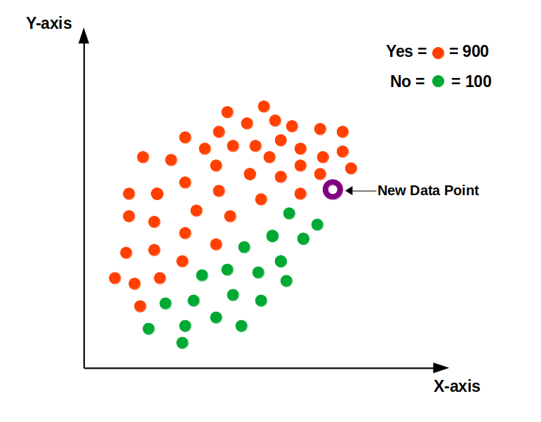
MACHINE LEARNING ALGORITHM USED
KNN ALGORITHM IS USED TO FIND RESULTS. IN THIS, RESULTS ARE FOUND USING THE CLOSEST PROXIMITY TO THE TRAINED MODEL'S K POINTS.

Slide 11
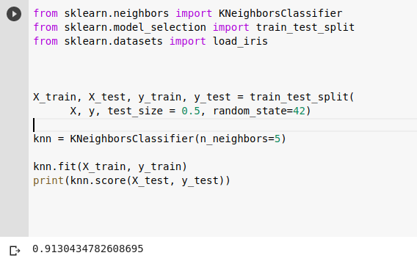
RESULTS AND CONCLUSION
The trained model gives an accuracy of 0.9130434782608695 when k=5.
From this, we can conclude that we can find the family a disease belongs to using Base and spectral analysis and optimize treatment procedures.

Slide 12
THANK YOU

