Slide 1

Topic: Trend Analysis of Study Permits Over Time (2015-2024)
GROUP 5
Akwesi Kusi
Dylan Coelho
Ranjit Odedra
Tarun Kumar

Slide 2
INTRODUCTION
The Trend Analysis of Study Permits Over Time (2015–2024) aims to uncover insights into the evolving patterns of international student mobility, providing actionable intelligence for stakeholders in education, government, and recruitment. This project leverages data-driven insights to address critical questions and inform strategies for future growth and decision-making.
Objective: Empower stakeholders with data-driven strategies to adapt to evolving trends and maximize opportunities.

Slide 3
DATASET OVERVIEW
Data Source: Temporary Residents: Study Permit Holders – Monthly IRCC Updates
Info: Temporary residents who are in Canada on a study permit in the observed calendar year. Datasets include study permit holders by year in which permit(s) became effective or with a valid permit in a calendar year or on December 31st.
Note: Values between 0 and 5 are shown as “--“ and all other values are rounded to the nearest multiple of 5.
Publisher - Current Organization Name: Immigration, Refugees and Citizenship Canada
Licence: Open Government Licence - Canada

Slide 4
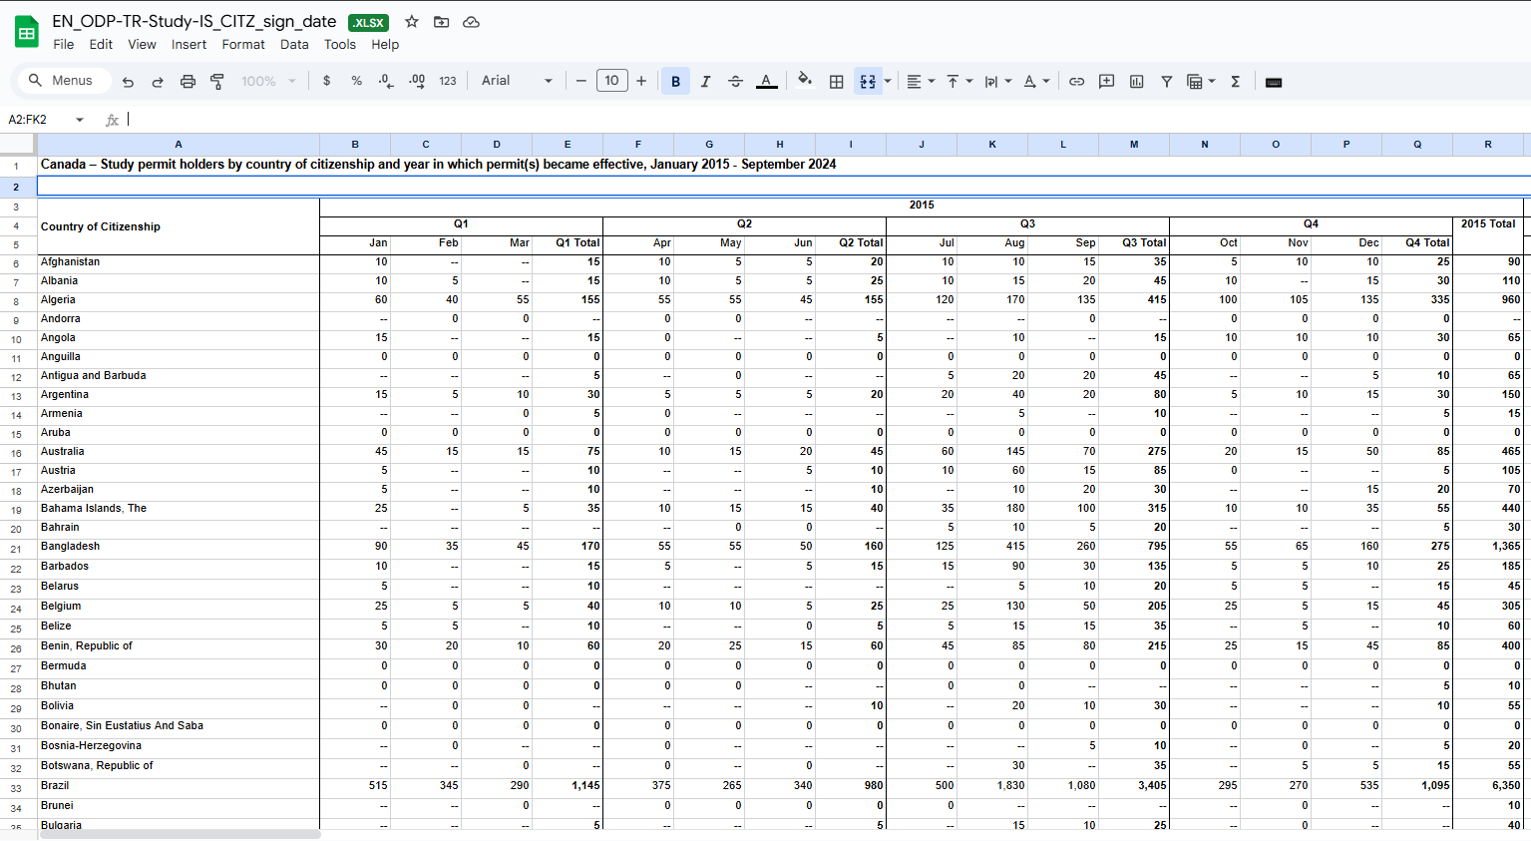
DATA PREPROCESSING
UNSTACKED DATA

Slide 5
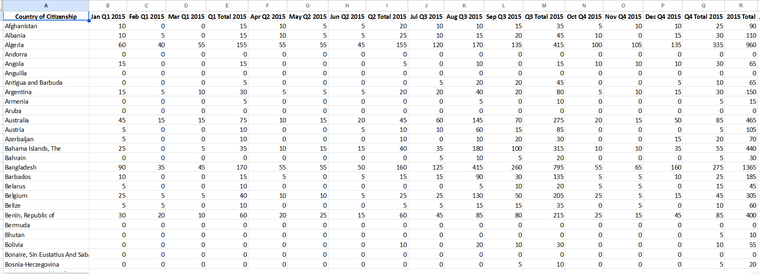
DATA PREPROCESSING
STACKED DATA

Slide 6
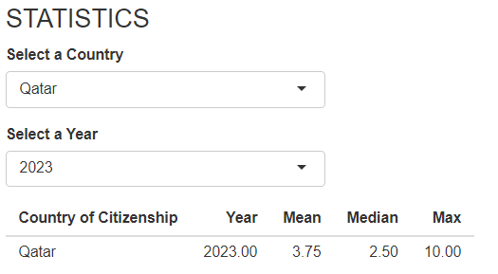
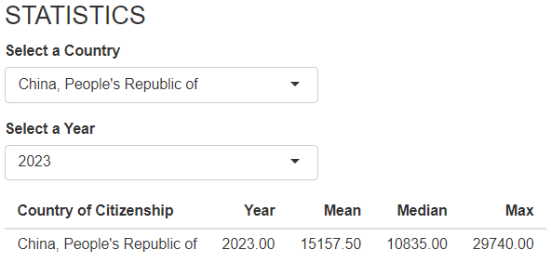
Exploratory Data Analysis (EDA)
STATISTICAL

Slide 7
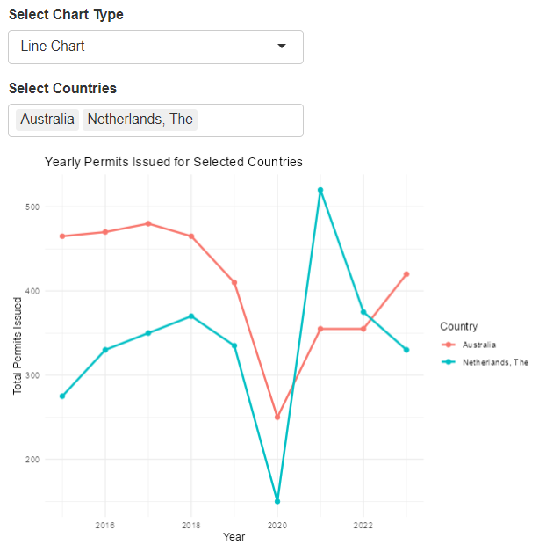
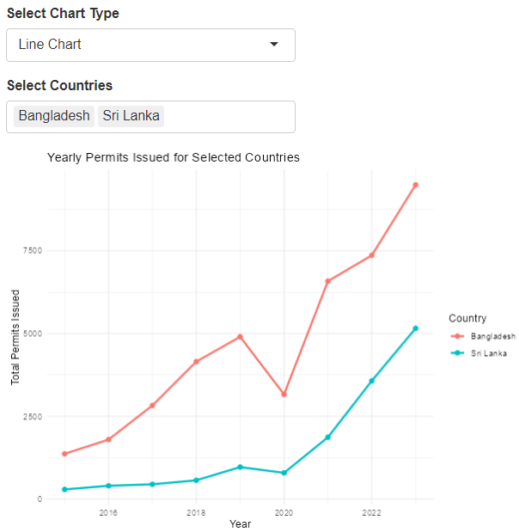
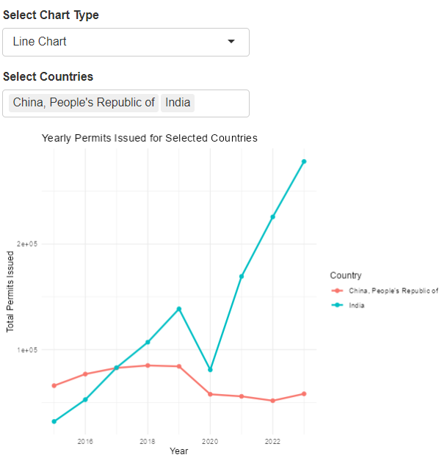
Exploratory Data Analysis (EDA)
VISUALIZATION
LINE CHART (TIME-SERIES)
How do values (e.g., totals for specific quarters of 2015 for India) change over different quarters or years ?

Slide 8
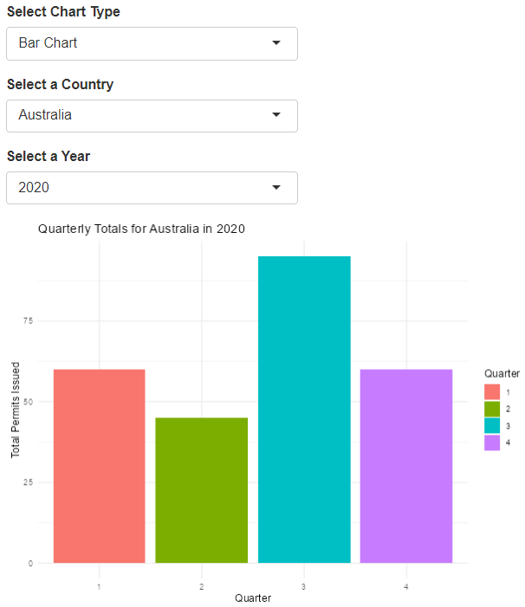
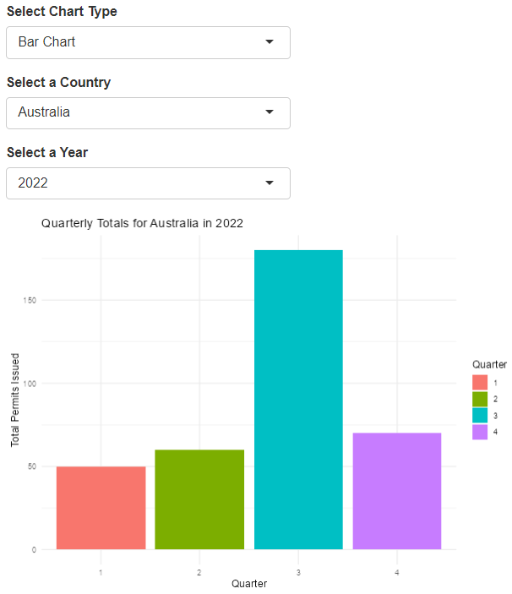
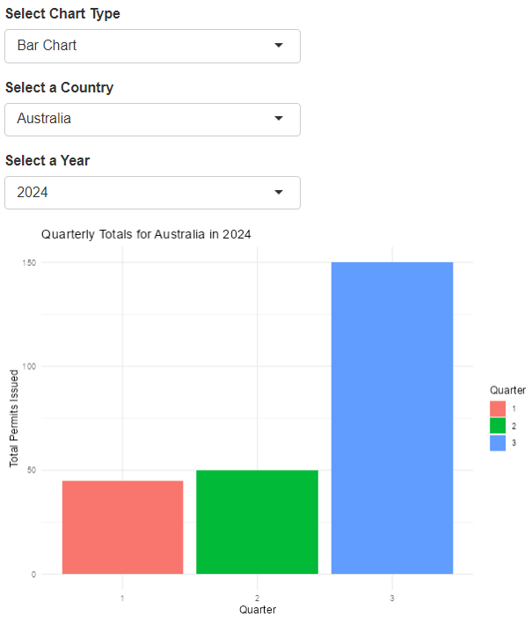
Exploratory Data Analysis (EDA)
VISUALIZATION
BAR CHART
How do Permits issued (e.g., totals for specific quarters of 2020 for Australia) change over different quarters?

Slide 9
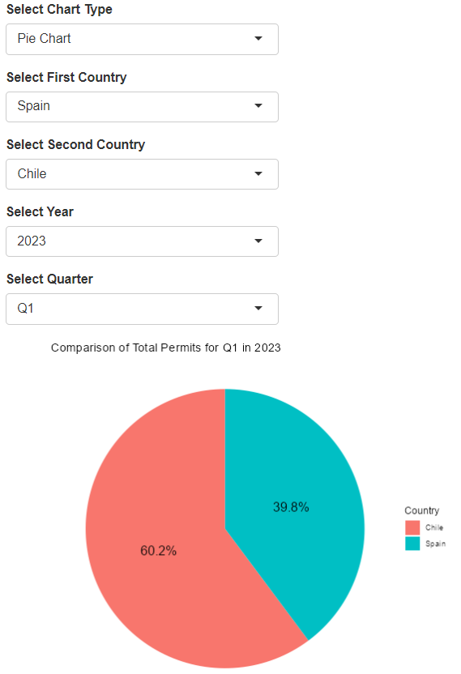
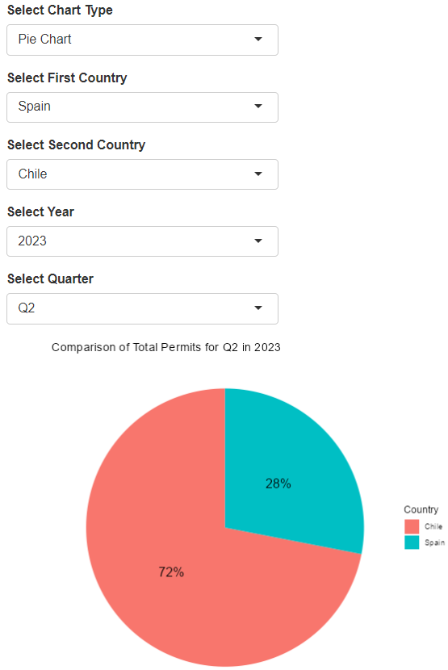
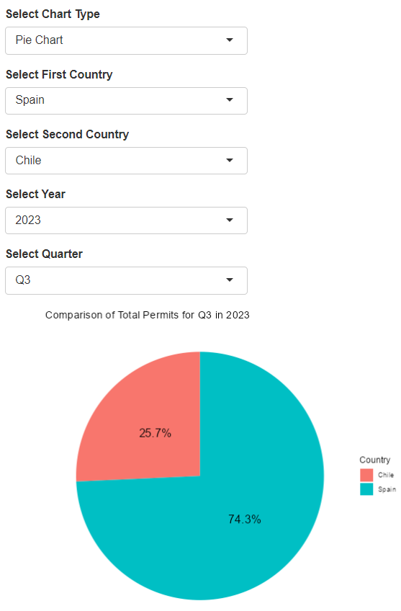
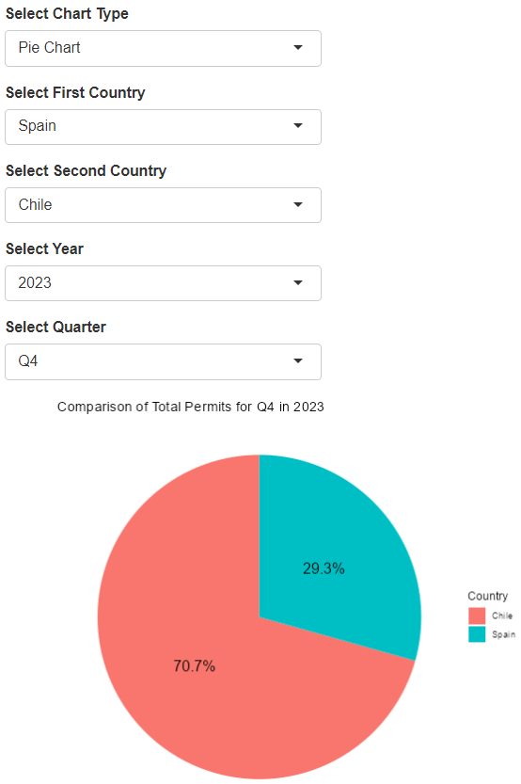
Exploratory Data Analysis (EDA)
VISUALIZATION
PIE CHART
How does the total permit issued for a specific quarter (e.g., Q1) compare across different years for selected countries

Slide 10
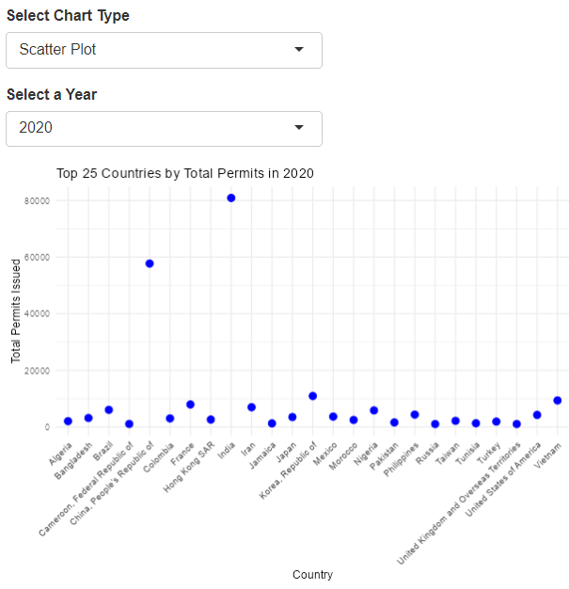
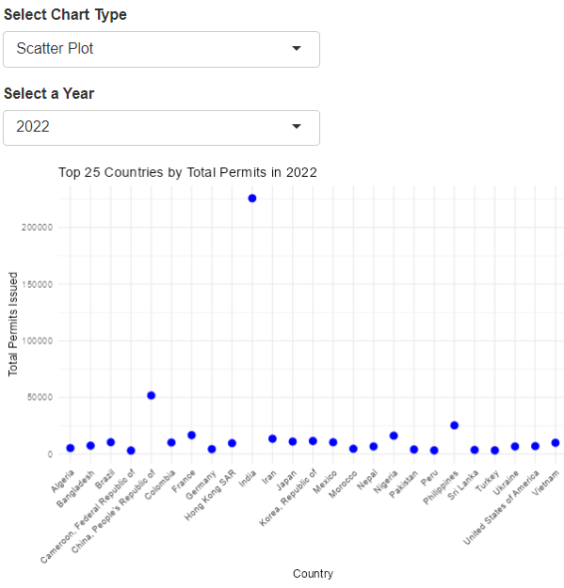
Exploratory Data Analysis (EDA)
VISUALIZATION
SCATTER PLOT
Identifying countries with unusual data spikes in specific year.

Slide 11
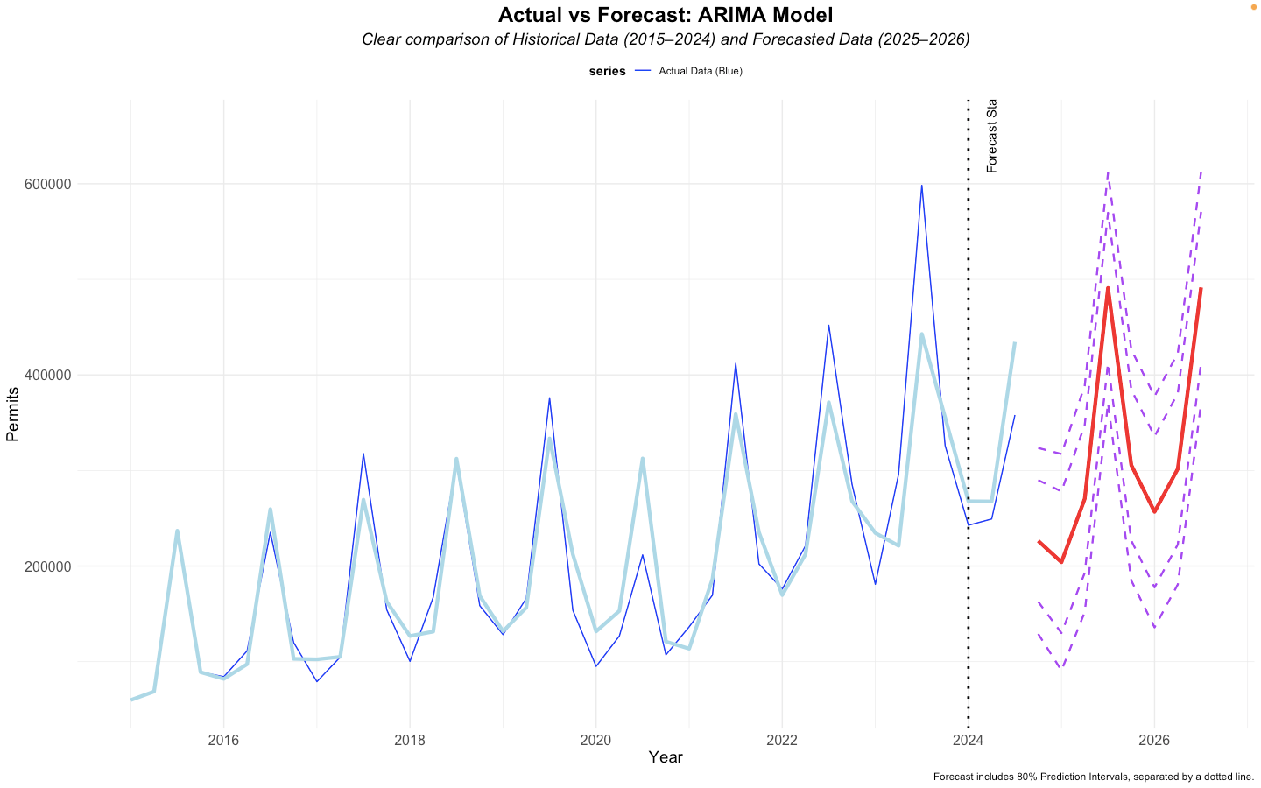
ML MODELING COMPARISON
How do the purple dotted lines (prediction intervals) help us understand the forecast better, and what do they tell us about how confident the model is in its predictions?

Slide 12
THANK YOU
QUESTIONS?

