Slide 1




Rocket Data Science: An Exploration of SpaceX Falcon 9 Rockets
Name: Tarun Tiwari

Slide 2


OUTLINE
Executive Summary
Introduction
Methodology
Results
SQL queries
Visualization
Dashboard
Predictive Analysis
Conclusion

Slide 3

EXECUTIVE SUMMARY
The Following Methodologies were implemented:
Data Collection
Data Wrangling (clean, organize, and transform raw data to usable data)
Exploratory Data Analysis (EDA for short, discovering patterns in the data)
Interactive Dashboards
Machine Learning (classification models)
Summary of Results
Landing success increased with number of flights
Difficult to assess if landing success depended on payload mass
Over time the success rate of landings increased from 0% between 2010-2013 to over 50% by 2016 to over 80% by 2019
The most successful launches favored the following orbit types: ES-L1, GEO, and HEO. The least successful was SO followed by GTO and ISS.
The most successful launch site was KSC LC-39 A
The learning models comparable in performance

Slide 4

INTRODUCTION
SpaceX achieved historic milestones by being the first private company to successfully land a rocket from low-earth orbit!
Why is this a big deal?
SpaceX Falcon 9 rocket launches cost about $62 million
Other providers cost upward of 165 million dollars each
Much of the savings is because Space X can reuse the first stage.
If we can determine if the first stage will land, we can determine the cost of a launch
We’ll use the power of data science to predict the success of landings and use these findings to aid in the decision-making process.
Let’s explore some data!
…but first…methodology

Slide 5

METHODOLOGY
We have to massage the insights from the data
Like a massage therapist we need to procure a client, for us, this is data collection
Get Requests to REST API and Web Scraping with BeautifulSoup
The client needs to be clean and transformed from their state of being clothed to discarding the unnecessary garb and positioned lying face down on the massage workstation, for us, we need to clean and transform data; data wrangling
Removed some NaN values with the .fillna() method of the Pandas DataFrame class
Create numerical Landing Outcome labels
The therapist explores the client’s muscle mass to find tension, likewise, we explore the data set looking for patterns
Use SQL, Pandas and Matplotlit to explore the data set
Use Feature Engineering and One-Hot Encoding to convert categorical variables to numerical ones
The therapist might interact with the client by showing them where there is tension, so too, we build dashboards to visually interact with the data
Created interactive dashboards using Plotly Dash and Folium
The therapist uses experience from past clients to predict areas of high tension and knows the best techniques to relieve the tension, analogously, we use the data to train machine learning models. Once the models are experienced, they too can make predictions
Used classification models such as Logistic Regression, Support Vector Machine, Decision Tree, and K-Nearest-Neighbor
Compare model performance using accuracy score

Slide 6
RESULTS: EDA with SQL (Summary)
Launch Site Names
Filter by Names beginning with CCA
Total Payload Mass by NASA
Average Payload Mass by SpaceX F9 v1.1
First Successful Landing
Successful Drone Ship Landings for a range of Payload masses
Total Success and Failure Mission Outcome
Names of Boosters carrying Maximum Payload
Drone Ship Landing Failures for a certain Year

Slide 7

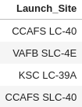

EDA SQL – Launch Sites
Unique Landing Sites
Landing Sites beginning with CCA

Slide 8

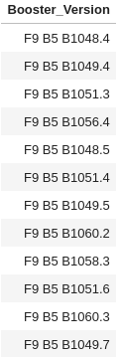




EDA SQL – Payload Mass
Boosters with Max Payload Mass - SpaceX
Total Payload Mass - NASA
Average Payload Mass - SpaceX

Slide 9


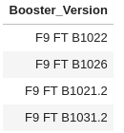

EDA SQL – Landing Outcomes
First Successful Ground Pad Landing
Boosters with Successful Drone Ship Landing and Payload Mass between 4000 and 6000 kg

Slide 10
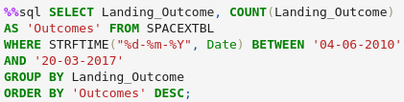
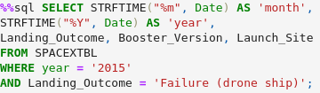
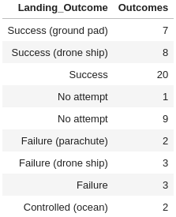

EDA SQL – Landing Outcomes
Landing Outcomes between 2010-2017
Ground Pad Failures in 2015

Slide 11

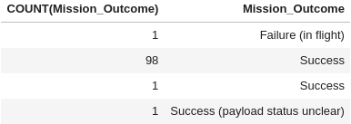
EDA SQL – Mission Outcomes
Total Successes and Failures

Slide 12

RESULTS: EDA with Visualization (Summary)
Payload Mass vs Flight Number
Scatter Plot
Launch Site vs Flight Number
Scatter Plot
Launch Site vs Payload Mass
Scatter Plot
Success vs Orbit Type
Bar Chart
Orbit Type vs Flight Number
Scatter Plot
Orbit Type vs Payload Mass
Scatter Plot
Success vs Time
Line Plot

Slide 13
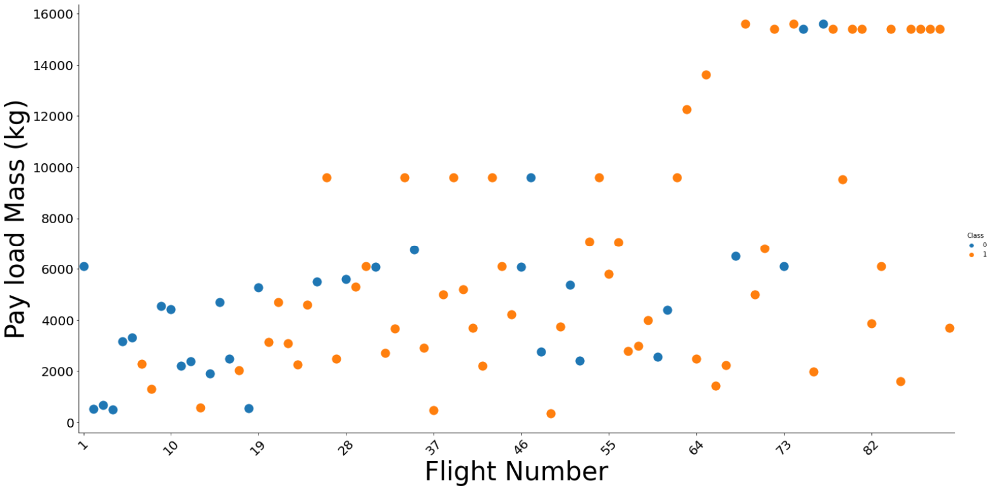
EDA Visual - Payload vs Flight Number
Blue dots = failure, orange dots = success
As the flight number increases, the first stage is more likely to land successfully.

Slide 14
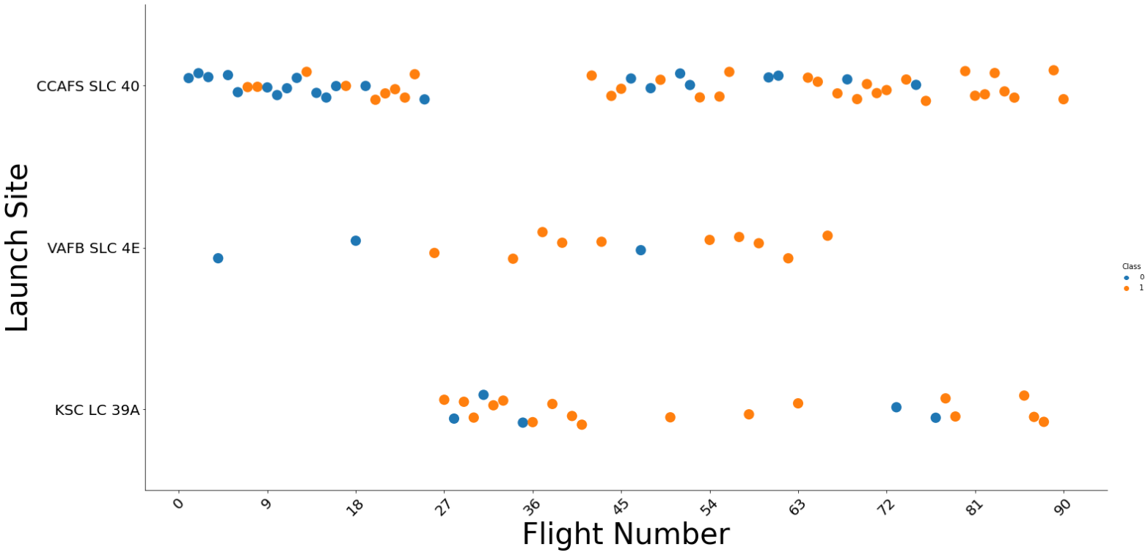
EDA Visual - Launch Site vs Flight Number
Blue dots = failure, orange dots = success
As the flight number increases, the first stage is more likely to land successfully at each site.
For CCAFS SLC 40 and VAFB SLC 4E we see more failures for flight numbers less than 35 and more success above this number
KSC LC 39A does not show any record of having very early flights as its flight number starts in the 20s. But we see more failures clustered around the low flight number end.

Slide 15
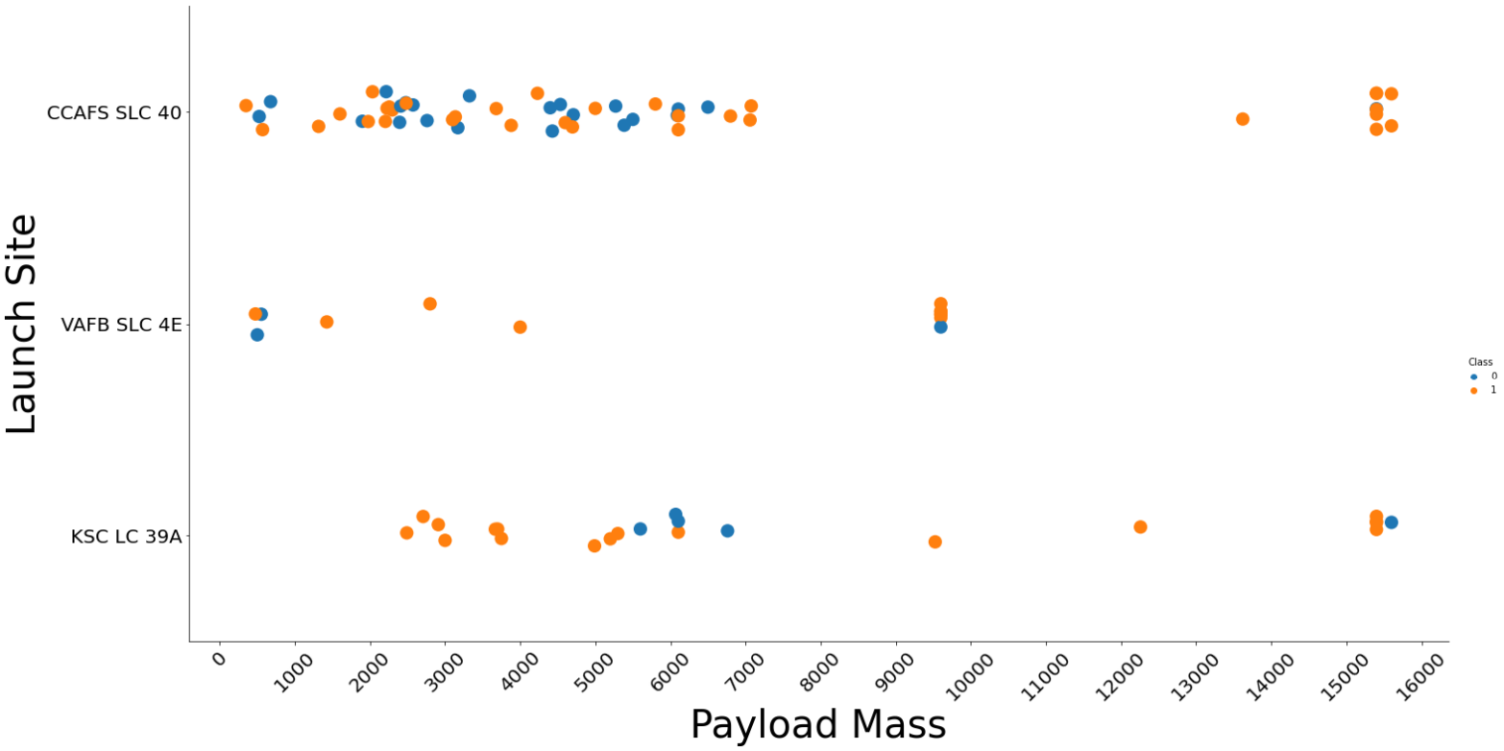
EDA Visual - Launch Site vs Payload
Blue dots = failure, orange dots = success
While there are more successes at higher masses for each launch site, there does not seem to be a strong relationship between payload mass and the success rate for each site
For CCAFS SLC 40 there seem to be as many failures as success below 8000 kg and more success between 12000 to 16000 kg
For KSC LC 39A there is more success in the low mass region between 2000 and 5000 kg with failures clustered around 6000-7000 kg region

Slide 16
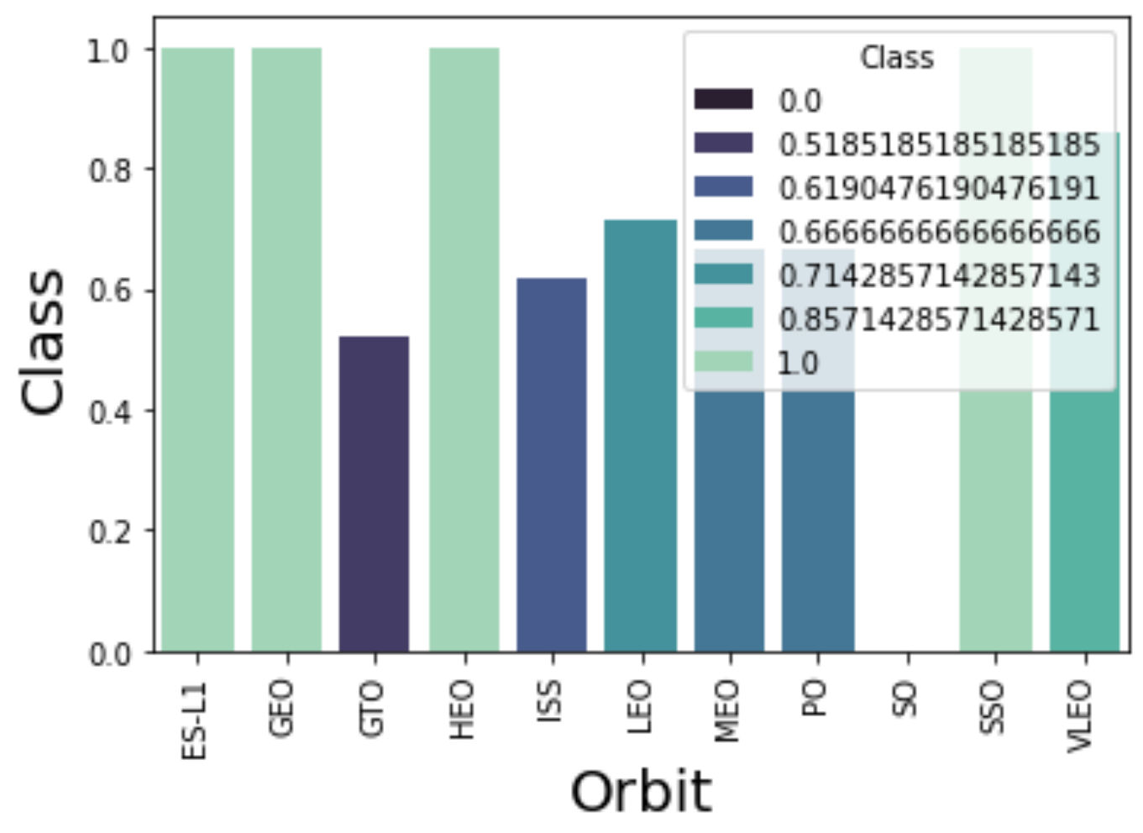
EDA Visual - Success vs Orbit Type
The least successful orbits:
SO (0%)
GTO (52%)
The most successful orbits:
ES-L1 (100%)
GEO (100%)
HEO (100%)
SSO (100%)
The other orbits have a success rate between 51.9% to 85.7%

Slide 17
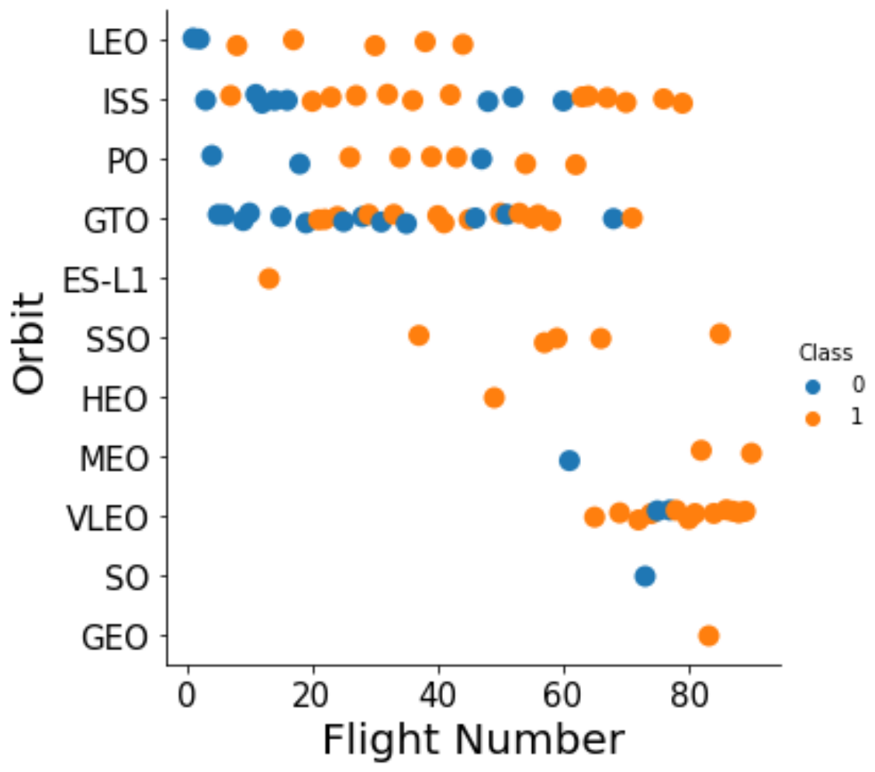
EDA Visual - Orbit vs Flight Number
It is not clear how flight number affects the success rate for the orbits
LEO orbit indicates a greater success rate with increasing flight number
Whereas, GTO shows about as many successes as failures across flight numbers
ISS has clumps of success and failures at low and high flight numbers
We cannot definitively conclude that flight number predicts the success or failure of a given orbit

Slide 18
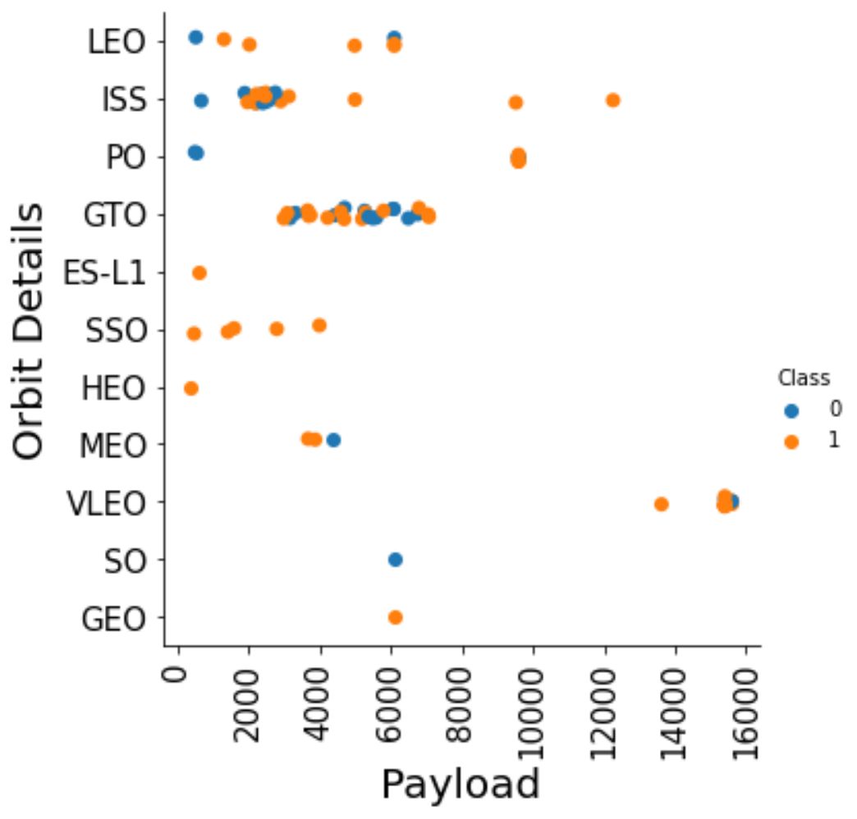
EDA Visual - Orbit vs Payload
It is not clear how payload mass affects the success rate for the orbits
Much like the Orbit vs Payload scatter plot, the results are mixed.

Slide 19
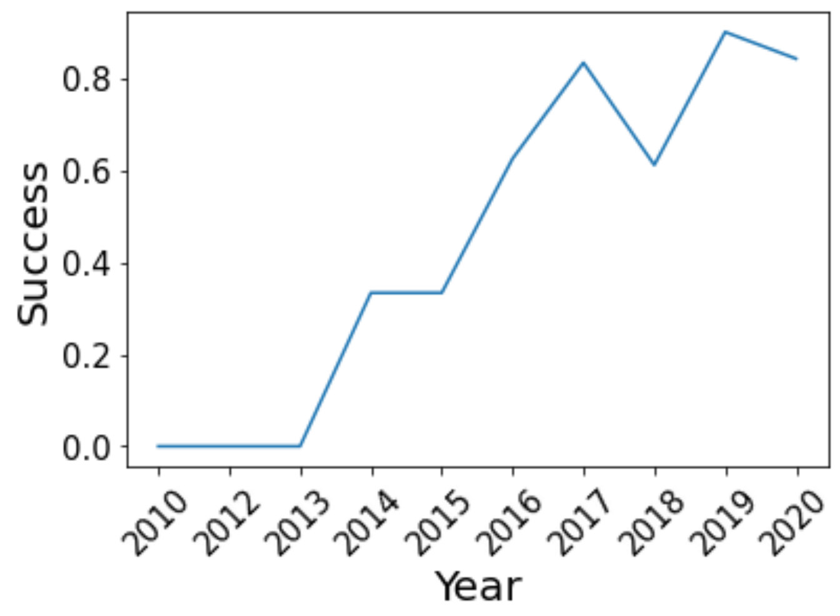
EDA Visual - Success over the years
Overall the success rate of the rocket landings increased over time
There were no successes between 2010-13
There was a sharp increase in success between 2013 and 2014 from 0% to more than 30% (but less than 40%) with a plateau between 2014-15.
From 2015-2017 there was an increase in success from <40% to >80%
There was a dip in success at 2018 where the success rate fell to approximately 60%
The rate increased again at 2019 to >80%

Slide 20




RESULTS: Interactive Dashboard
Folium for Geospatial Data
Identify Launch Sites on Map
Indicate Success/Failure for each Launch Site
Calculate Launch Site Proximity to Highways, Railroads, Cities and Coastline
Plotly Dash for Interactive Dashboard
Pie Chart Displaying Total Successful Launches Based on Launch Site Selection from a Dropdown menu
Scatter plot of Landing Outcome based on Payload Mass Selection from a Slider

Slide 21
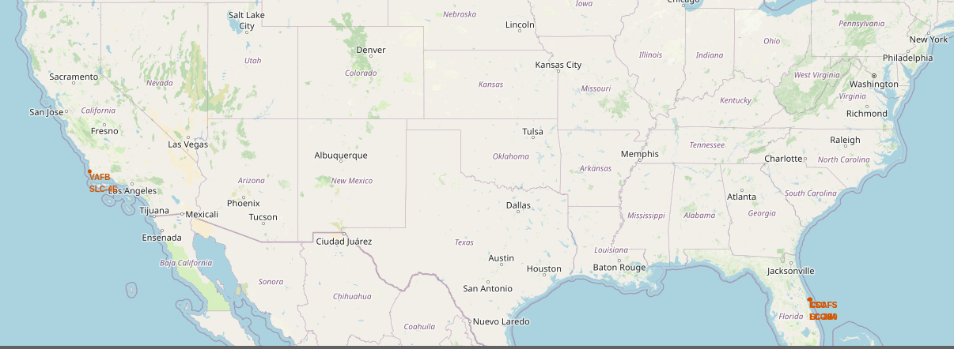
Folium – Launch Sites
Launch Sites in red
On the East Coast (Florida) and West Coast (California) of the United States of America

Slide 22
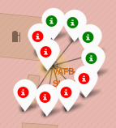
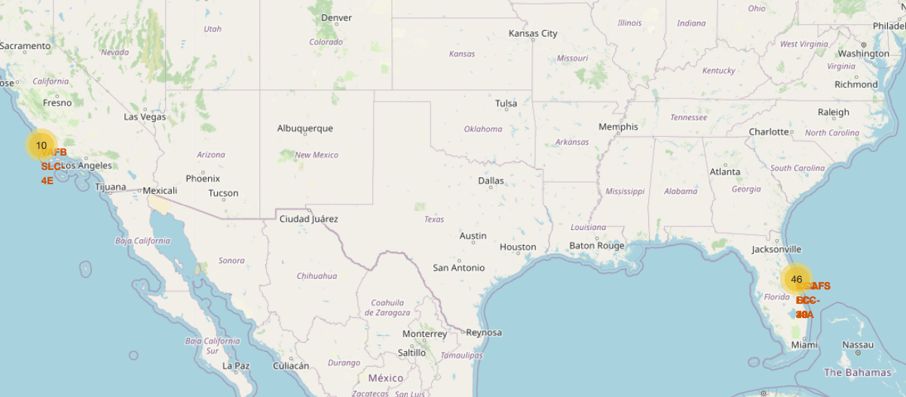
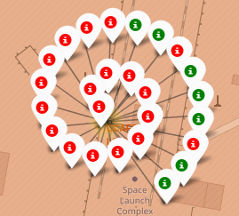

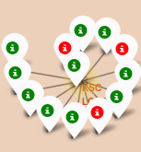
Folium – Launch Sites Outcomes
Red = Failure
Green = Success

Slide 23
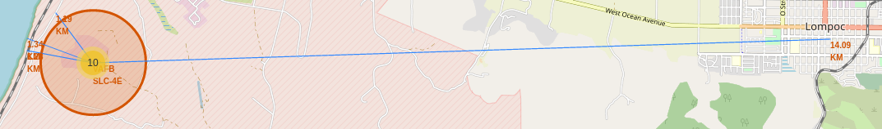
Folium – Launch Sites Proximities
Less than 1.5 km from
Coast
Railroad
Highway
About 14 km from city

Slide 24
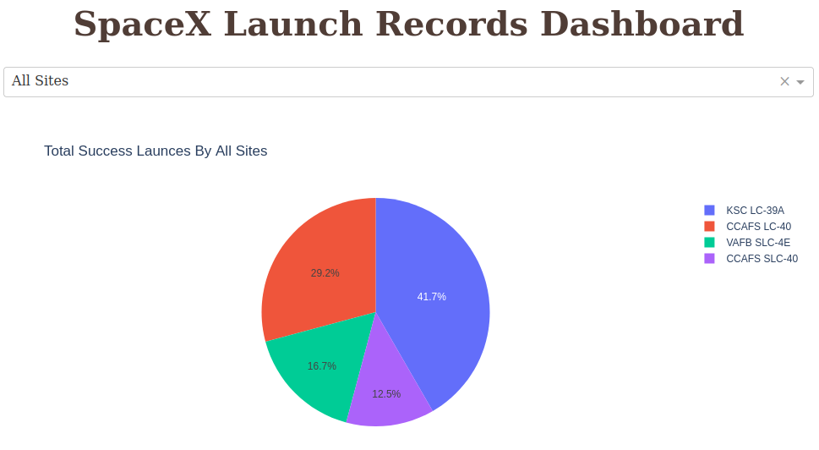
Plotly – Launch Sites Success
Can select each site from dropdown
KSC LC-39A highest success rate
CCASF SLC-40 lowest success rate

Slide 25
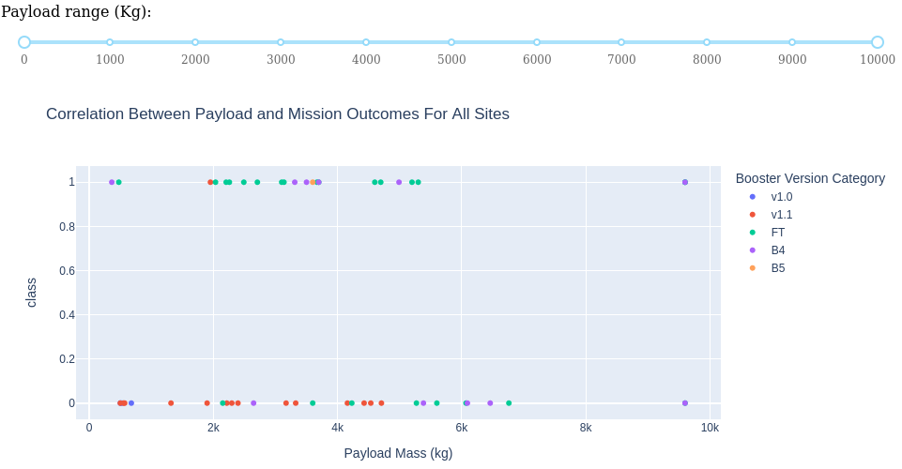
Plotly – Launch Sites Success
Very little data for masses beyond 7k
More failure than successes below 2k and beyond 6k
Above 2k but below 6k there seems to be about as much success as failure

Slide 26




RESULTS: Predictive Analysis (Summary)
Classification Models
Logistic Regression
Support Vector Machine
Decision Tree
K-Nearest-Neighbor
Compared models using the accuracy score
Examined Confusion Matrix for False Positives and False Negatives

Slide 27
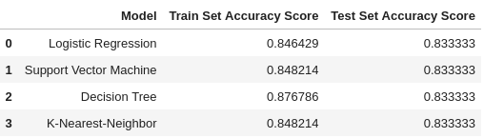
Predictive Analysis – Accuracy Score
All models had similar accuracy scores on the test set
Decision Tree had a higher score on the train set compared to other models
Bases on the accuracy scores on the train and test set all models had similar performance

Slide 28
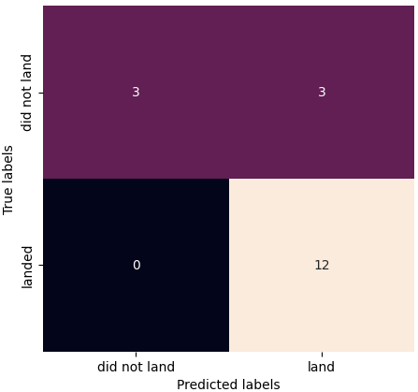
Predictive Analysis – Confusion Matrix
All Models had identical confusion matrices
16.7% (3 of 18) false positives
True Label = did not land and Predicted Label = landed
0% (0 of 18) false negatives
True Label = landed and Predicted Label = did not land

Slide 29

CONCLUSION
Landing success increased with number of flights
Difficult to assess if landing success depended on payload mass
Over time the success rate of landings increased from 0% between 2010-2013 to over 50% by 2016 to over 80% by 2019
The most successful launches favored the following orbit types: ES-L1, GEO, and HEO. The least successful was SO followed by GTO and ISS.
The most successful launch site was KSC LC-39 A
The learning models comparable in performance

Slide 30

Thank you!
Thank you for your time and attention!

