Slide 1

SOLAR ANALYSIS PLATFORM ADITYA

Slide 2







The location specific solar energy potential for various climatic conditions.
A feature to upload the image either from files or capturing by camera access
Report on the solar irradiance throughout the day, month and year through graphical visualizations.
Masking of the image by isolating the sky and ground region.
FEATURED
SERVICES
An estimate of solar energy for modern transportation and fuel savings.
The optimum angle for
the solar panel to be mounted to get
the maximum energy output.
Estimated count of solar panels required based on user’s household energy requirements and providing figure of savings.
Calculation of amount of electricity needed by using field area and daily agricultural power consumption
Continuous support to the user in case of reported queries or grievances.

Slide 3

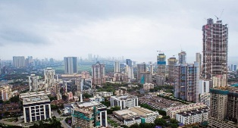


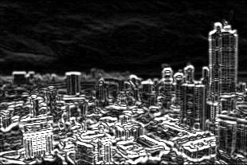





3
Process Outline
Step 1 - Uploading the Image:-
The image uploaded by the user is auto-tilted based on phone’s orientation and compressed to a standard resolution for efficiency before sending it to the cloud server.
Step 2 – Isolation of sky region through pixel clustering:-
A Sobel Gradient layout of the original image is generated to determine the edges and borders. Then the image is clustered using K-Means Clustering Technique (k=2) .
At last, the Semantic Segmentation is implemented for pixel-level isolation of sky region.
Step 3 – Horizon detection and Masking of Image:-
A hybrid model is developed by integrating the above methods to generate a dual-tone masked image for estimating optimum angle and the height for the solar panel setup.
Step 4 – Energy Potential:-
Extracting the coordinates and estimating the location specific solar energy potential
Step 5 – Energy Policy
Developing a domain-specific energy policy for sustainable development in agriculture, household and transportation sectors.
Report Generation
The detailed report on various parameters needed for a solar plant setup.
Note: Image processing is done on the cloud server to reduce processor strain and battery drain of the device.
Workflow
Technology
Stack
Database
-Google Cloud
Server-side Language
-Python
Libraries
- OpenCV, sklearn, TensorFlow
Frameworks
-Android API, Ionic
Operating System
- Android

Slide 4
In accordance to the statistics shown above, a corporate company can get the return on it’s investment in a short period of time.
On the other hand, the investment costs are quite lower as well.

Slide 5
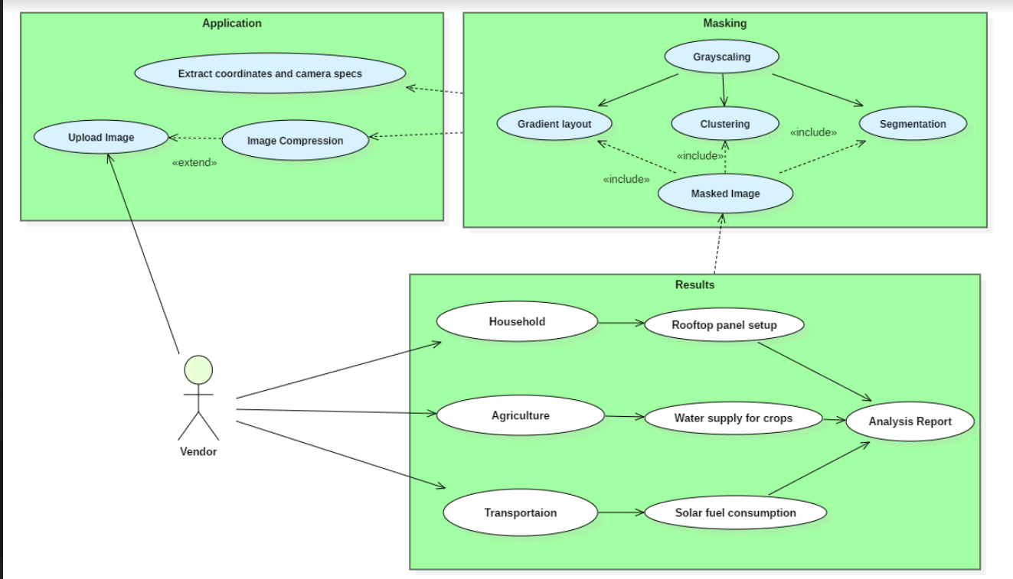
Camera Access
Internet Access
Global positioning system
Accelerometer sensor of the device
File System Access
D
E
P
E
N
D
E
N
C
I
E
S
USE CASE DIAGRAM
Adverse climatic conditions may lead to improper masking.
Inaccurate results in case of images with inadequate quality or captured during the night.
SHOW STOPPER

