Slide 1

House Pricing Prediction Using Machine Learning Algorithm
CAD VLSI PROJECT
DR. Gaurav Kaushal
Submitted To:
Submitted By
Baddam Ramesh Reddy(2020BCS-019)
Kadavath Tarun Nayak(2020BCS-43)
JJ Loknath(2020BCS-041)
Crop Recommendation and Disease De
using Deep N

Slide 2
Table of Contents
Introduction
Correlation Matrix
Objective
Model Training and Score
Collection of data sets
Test and Source code
Pre-processing (Noise Removal)
Synthesis Summary
Feature Extraction
Implementation Report
Import Scikit Learn
Test Train split
Linear Regression
N

Slide 3
Introduction
This aim of this project is to suggest the House price by using simple Machine learning techniques. In this Project we mainly use Linear Regression to predict the House prices.
The dataset contains various parameters like Avg. Area Income, Avg. Area House Age, Avg.Area of Number of Rooms, Avg.Area Number of Bedrooms, Area Population.
N

Slide 4
Objective
Training: Our training data consists of 3300 examples of houses with 6 features describing every aspect of the house. We are given sale prices (labels) for each house. The training data is what we will use to “teach” our models.
Testing: The test data set consists of 2200 examples with the same number of features as the training data. Our test data set excludes the sale price because this is what we are trying to predict. Once our models have been built we will run the best one to test data.
Task: Machine learning tasks are usually split into three categories; supervised, unsupervised and reinforcement. For this competition, our task is supervised learning.
N

Slide 5



Project WorkFlow
Collection of datasets
Pre-Processing(Noise Removal)
Use Linear Regression
N

Slide 6
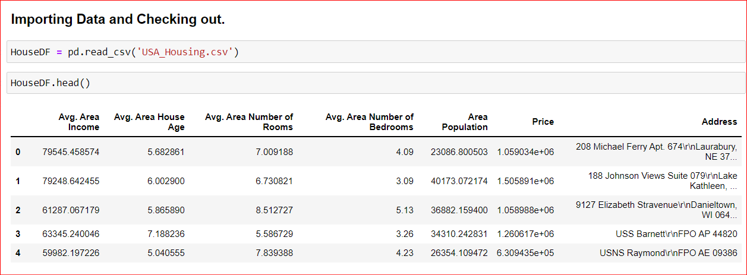
Steps Validation
Collection of datasets
Pre-Processing(Noise Removal)
For the successful application pre-processing is required. The data which is acquired from different resources are sometime in raw form. It may contain some incomplete, redundant, inconsistent data. Therefore in this step such redundant data should be filtered. Data should be normalized.
N

Slide 7
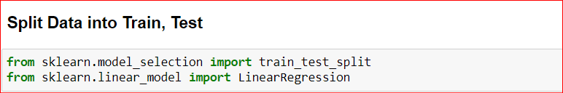
Steps Validation
Feature Extraction
This step is focus on identifying and using most relevant attribute from the dataset. Through this process irrelevant and redundant information is removed for the application of classifiers.
Scikit-Learn
N

Slide 8
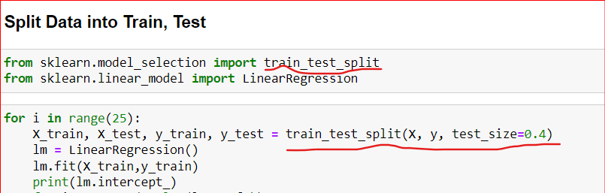
Steps Validation
Test-Train-Split
To split our dataset into two distinct sets according to our needs one for training the model and the other for evaluating the functionality and precision of the trained model we import train test split from scikit-learn.
This allows us to select the optimal method. On the training data, we use several supervised learning algorithms to get results on the testing data for each algorithm. Then the model’s top performing algorithm is chosen
N

Slide 9

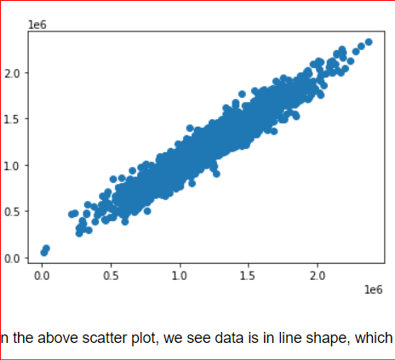
Steps Validation
Linear Regression
Linear regression analysis is used to predict the value of a variable based on the value of another variable. Here we are using 5 inputs to predict the house Price. The variable you want to predict is called the dependent variable. The variable you are using to predict the other variable's value is called the independent variable.
N

Slide 10
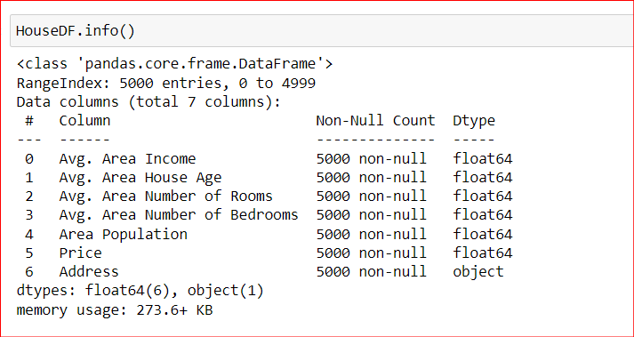
Schema of The DataSet
Detect
N

Slide 11
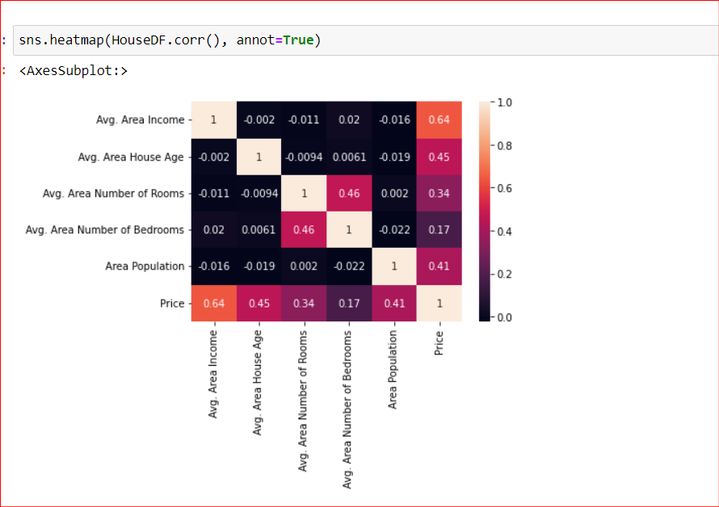
Correlation Matrix
A correlation matrix refer to the coeffiecients entered in tabular form, featuring the values for respective varibles.
N
Notes:
Take the conclusion from the correlation matrix

Slide 12
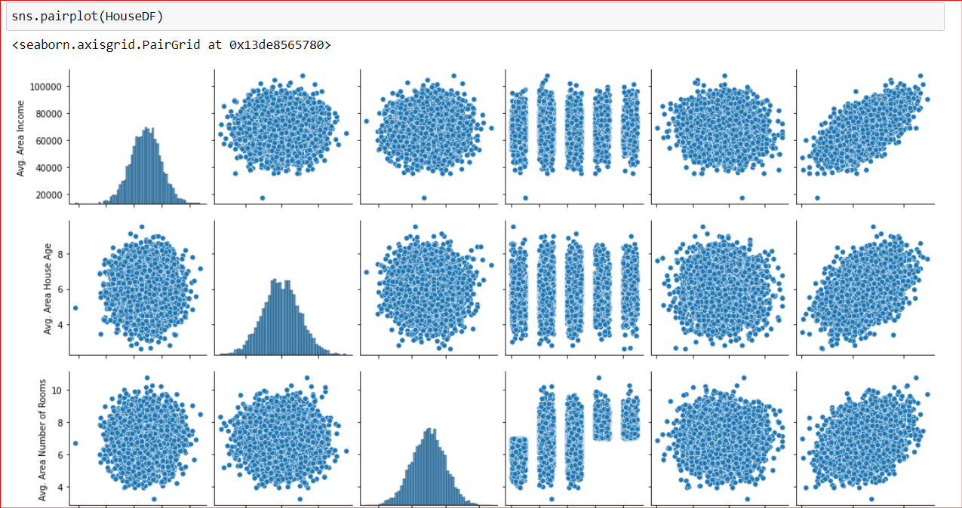
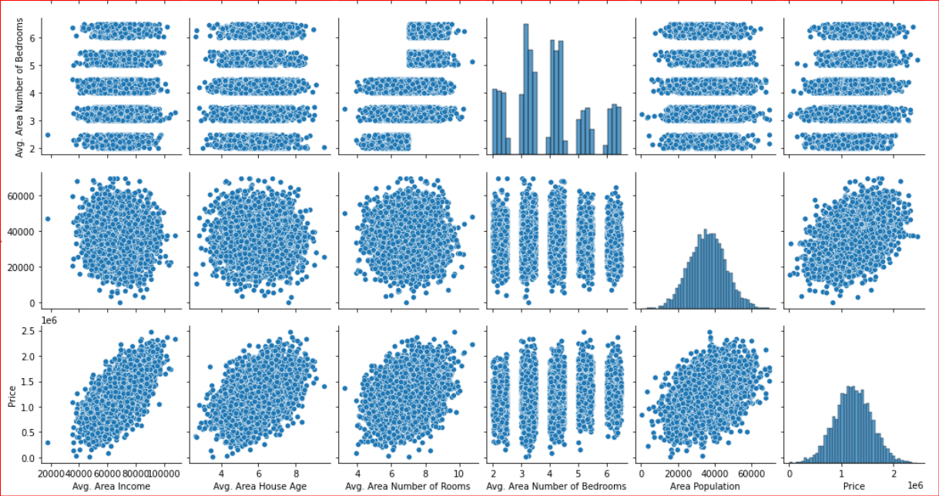
Pair Plot
Detect
N
Notes:
Take the conclusion from the correlation matrix

Slide 13
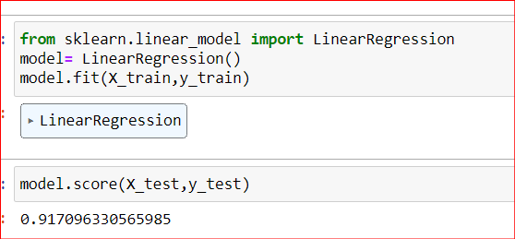
Model training and Score
The Score shown in the above fig is
Accuary Score:0.917 and approx: 91% is the Accuracy
N
Notes:
Take the conclusion from the correlation matrix

Slide 14
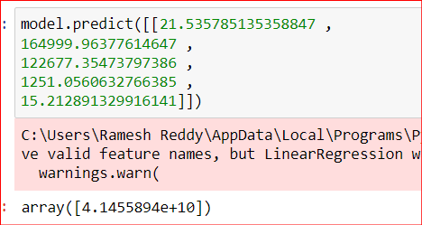
Model Evaluation
As we see In the above figure ,we have given input attribute values and it has predicted the price of the House.
N
Notes:
Take the conclusion from the correlation matrix

Slide 15
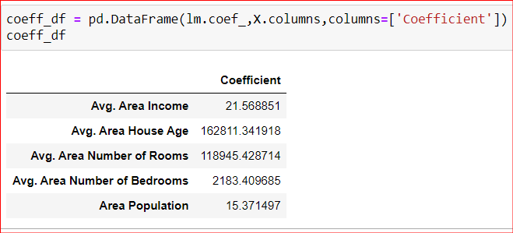

Weights and Bias
Weights
Bias
N
Notes:
Take the conclusion from the correlation matrix

Slide 16
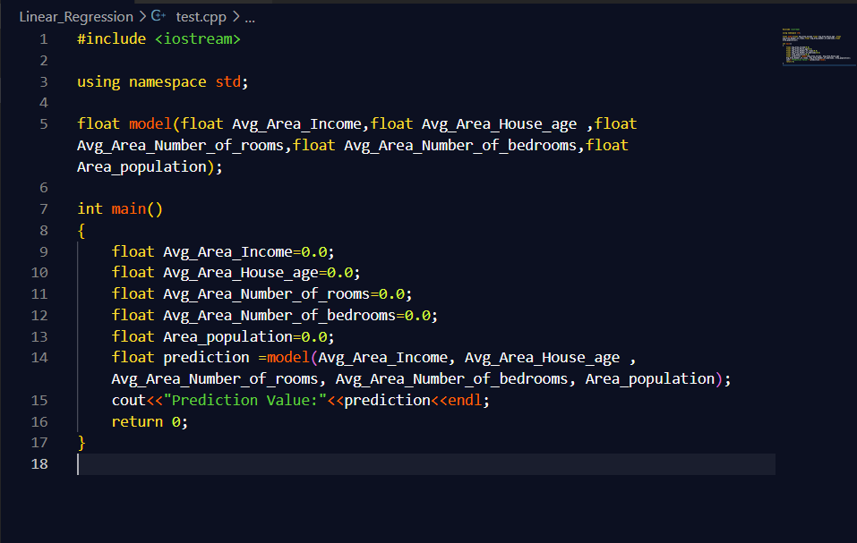
Test and Source Code
N
Notes:
Take the conclusion from the correlation matrix

Slide 17
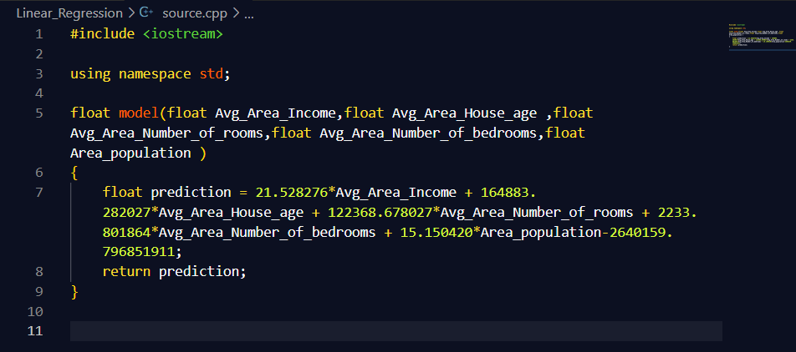
Test and Source Code
N
Notes:
Take the conclusion from the correlation matrix

Slide 18
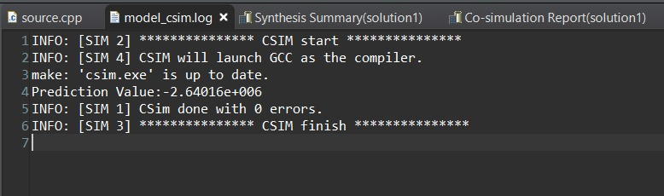
Output on Vivado
C Simulation
N
Notes:
Take the conclusion from the correlation matrix

Slide 19
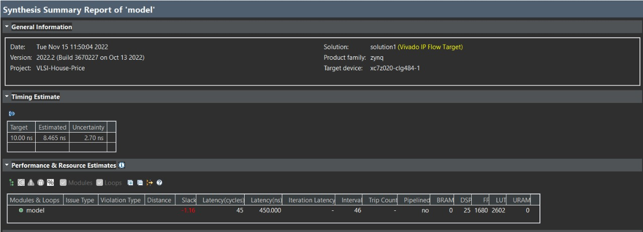
SYNTHESIS SUMMARY
N
Notes:
Take the conclusion from the correlation matrix

Slide 20
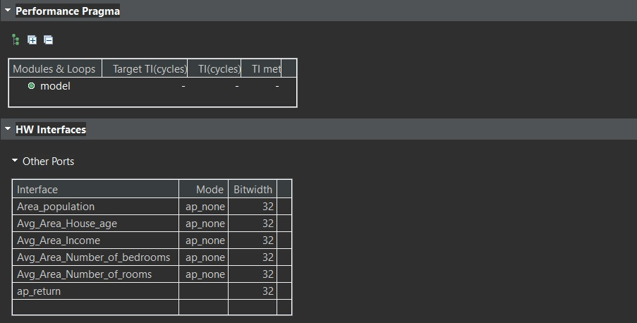
SYNTHESIS SUMMARY
N
Notes:
Take the conclusion from the correlation matrix

Slide 21
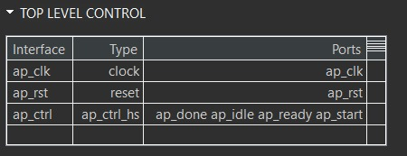
SYNTHESIS SUMMARY
N
Notes:
Take the conclusion from the correlation matrix

Slide 22
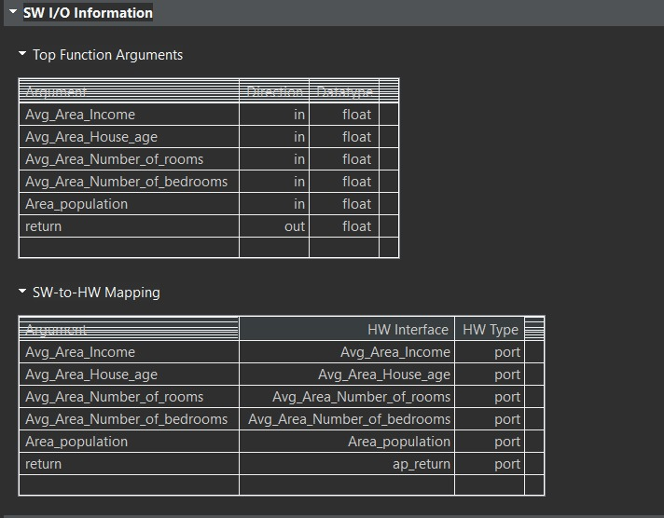
SYNTHESIS SUMMARY
N
Notes:
Take the conclusion from the correlation matrix

Slide 23
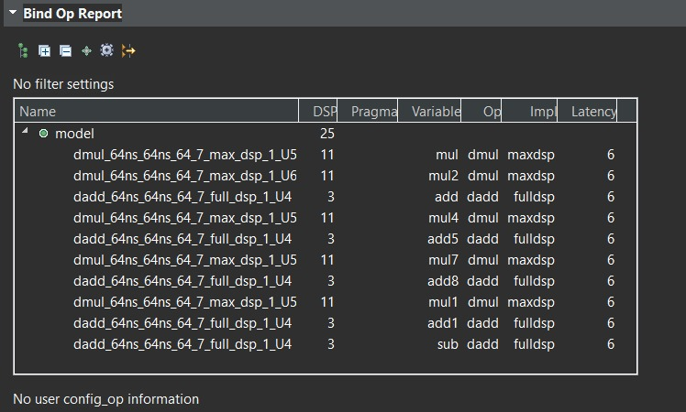
SYNTHESIS SUMMARY
N
Notes:
Take the conclusion from the correlation matrix

Slide 24
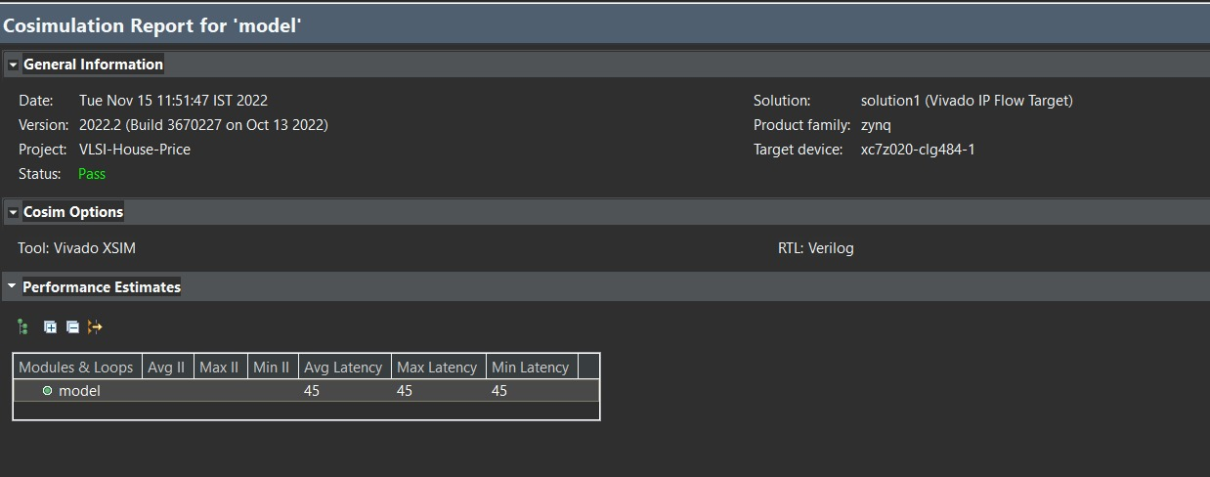
CO-SIMULATION REPORT
N
Notes:
Take the conclusion from the correlation matrix

Slide 25
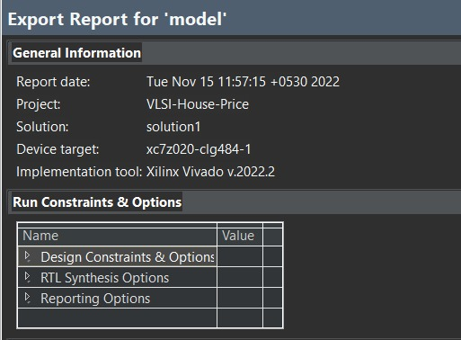
IMPLEMENTATION REPORT
N
Notes:
Take the conclusion from the correlation matrix

Slide 26
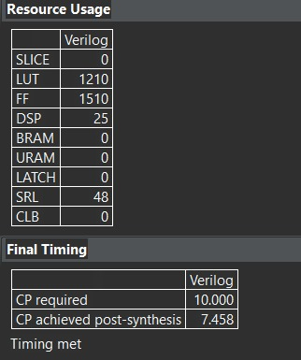
IMPLEMENTATION REPORT
N
Notes:
Take the conclusion from the correlation matrix

Slide 27
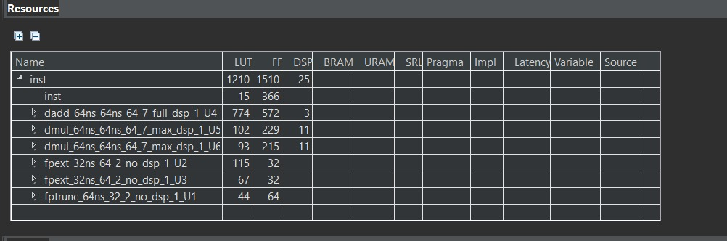
IMPLEMENTATION REPORT
N
Notes:
Take the conclusion from the correlation matrix

Slide 28
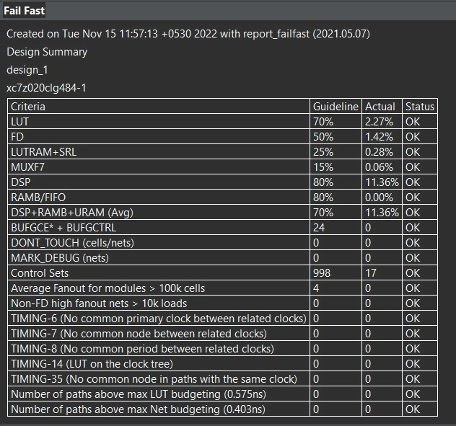
IMPLEMENTATION REPORT
N
Notes:
Take the conclusion from the correlation matrix

Slide 29
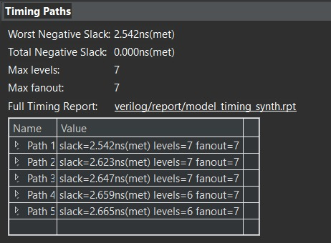
IMPLEMENTATION REPORT
N
Notes:
Take the conclusion from the correlation matrix

Slide 30
Thank You

