Slide 1
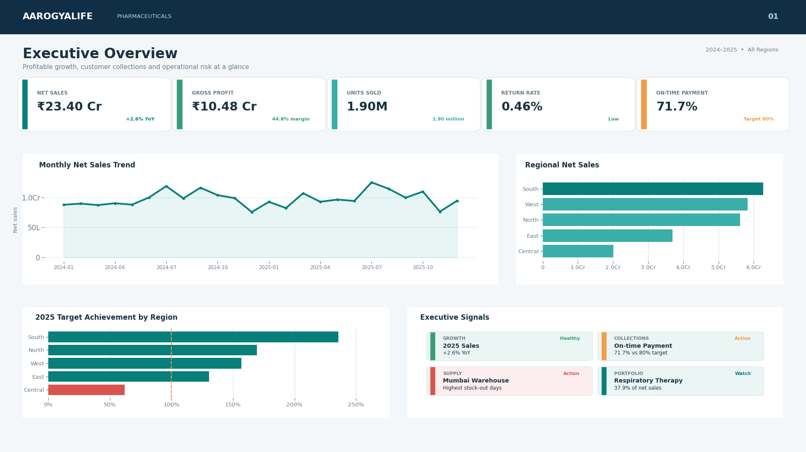
DATA ANALYTICS CASE STUDY
Pharmaceutical growth
without hidden risk
AarogyaLife Pharmaceuticals
A commercial, inventory, collections and safety-monitoring solution built with Python, MySQL and Power BI.
Tarun Yadav • Data Analyst Portfolio

Slide 2
AAROGYALIFE
PHARMACEUTICALS
02
THE CHALLENGE
Revenue growth alone could not explain business health
Leadership needed one view across profitability, availability, collections and reporting workload.
01
02
03
04
Commercial blind spots
Availability pressure
Cash collection risk
Safety workload
Which regions, therapies, products and channels were growing profitably?
Were stock-outs and damaged stock limiting high-demand products?
Which channels and distributors were paying beyond agreed terms?
Which reports required faster operational review and follow-up?
Business question
Where can the company grow without increasing returns, payment delays, stock-outs or unresolved safety-reporting workload?
Synthetic portfolio case study • Python + MySQL + Power BI

Slide 3
AAROGYALIFE
PHARMACEUTICALS
03
DATA FOUNDATION
Six linked tables created a single analytical view
Synthetic records covered January 2024 through December 2025.
13,210
Fact Sales
Fact Inventory
7,500 invoice lines
5,184 warehouse snapshots
total records
6
Adverse Events
Product Dimension
420 anonymized reports
36 products
relational tables
2 years
Distributor Dimension
Targets
60 distributors
10 year-region targets
commercial and operational history
Synthetic data • No personally identifiable patient information

Slide 4
AAROGYALIFE
PHARMACEUTICALS
04
APPROACH
The analysis moved from raw tables to decisions
A reproducible workflow connected Python preparation, MySQL analysis and Power BI reporting.
1
2
3
4
5
Prepare
Store
Analyse
Model
Decide
→
→
→
→
Used Python and pandas to profile, clean and validate the CSV data.
Created normalized MySQL tables with primary and foreign keys.
Used joins, CTEs, CASE, subqueries, LAG and DENSE_RANK.
Built a star schema, Date table and reusable DAX measures.
Translated results into commercial and operational actions.
Outcome
One four-page Power BI solution for executives, commercial teams, supply chain and safety operations.
Synthetic portfolio case study • Python + MySQL + Power BI

Slide 5
AAROGYALIFE
PHARMACEUTICALS
05
EXECUTIVE VIEW
The business was profitable—but growth and collections needed attention
₹23.40 Cr
net sales across 2024–2025
44.77%
gross margin
+2.62%
2025 year-over-year sales growth
71.74%
on-time payments vs 80% target
Synthetic portfolio case study • Python + MySQL + Power BI

Slide 6
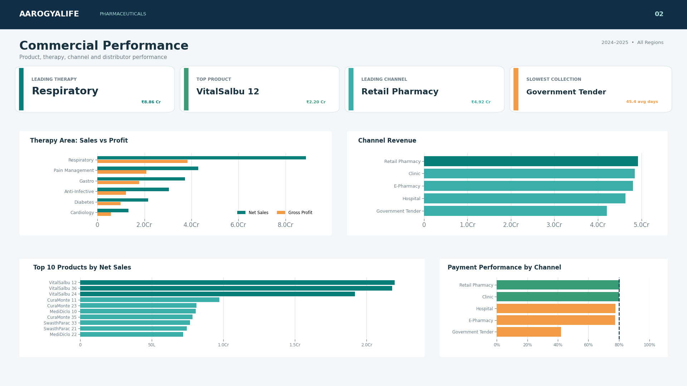
AAROGYALIFE
PHARMACEUTICALS
06
COMMERCIAL PERFORMANCE
Respiratory products led growth while collections varied by channel
₹8.86 Cr
Respiratory therapy sales
₹2.20 Cr
VitalSalbu 12 — top product
45.4 days
Government Tender average payment
Implication
Protect respiratory availability and tighten collection controls on slow-paying channels.
Synthetic portfolio case study • Python + MySQL + Power BI

Slide 7
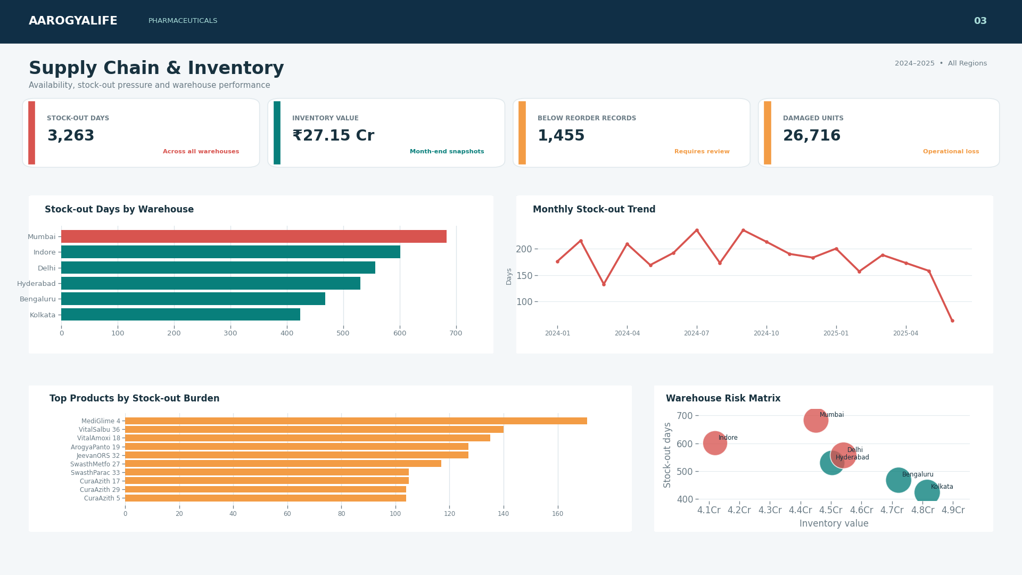
AAROGYALIFE
PHARMACEUTICALS
07
SUPPLY CHAIN
Stock-out pressure was concentrated enough to prioritise action
3,263
total stock-out days
683 days
Mumbai — highest warehouse burden
1,455
records below reorder level
Action
Reallocate fast-moving inventory and review reorder points before increasing stock broadly.
Synthetic portfolio case study • Python + MySQL + Power BI

Slide 8
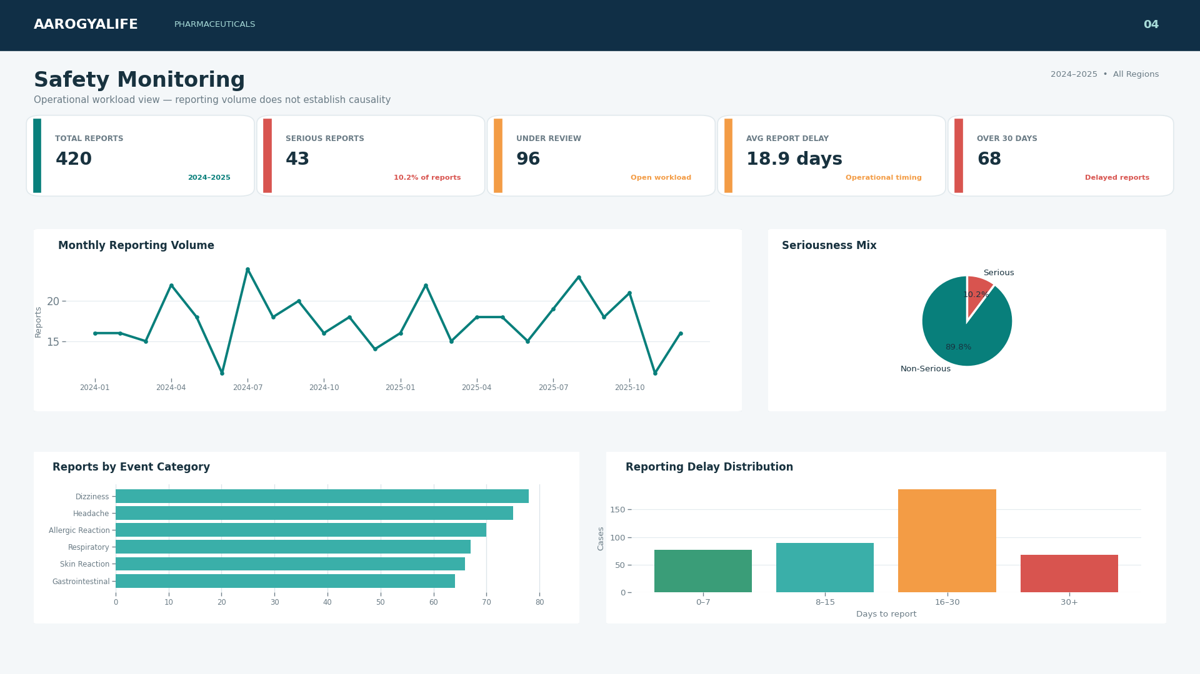
AAROGYALIFE
PHARMACEUTICALS
08
SAFETY OPERATIONS
Reporting workload required faster prioritisation—not clinical conclusions
420
total reports
43
serious reports
96
under review
18.9 days
average delay
Reporting volume ≠ incidence or causality
Synthetic portfolio case study • Python + MySQL + Power BI

Slide 9
AAROGYALIFE
PHARMACEUTICALS
09
RECOMMENDATIONS
Three focused actions convert the analysis into business value
01
02
03
Strengthen collections
Rebalance inventory
Prioritise safety workflow
Create channel and distributor payment scorecards; prioritise high-value overdue accounts.
Raise reorder points for fast-moving respiratory products and shift stock toward high-risk warehouses.
Route serious, delayed and under-review reports into a controlled operational queue.
EXPECTED OUTCOME
EXPECTED OUTCOME
EXPECTED OUTCOME
Improved cash conversion and lower receivable risk.
Fewer lost-sales days without blanket inventory growth.
Faster follow-up while preserving medical-review boundaries.
Decision principle
Grow where margin, service level and collections remain healthy.
Synthetic portfolio case study • Python + MySQL + Power BI

Slide 10
PROJECT OUTCOME
One connected view.
Four business decisions.
Synthetic portfolio case study
13K+
The project demonstrates how Python, MySQL and Power BI can turn disconnected pharmaceutical data into clear commercial, supply-chain and safety-operational priorities.
records analysed
4
Power BI report pages
01
Python & pandas
02
Relational modelling
03
SQL joins & CTEs
04
Window functions
05
DAX measures
06
Data storytelling
Tarun Yadav • Data Analyst Portfolio

