Slide 1
SMART PORTABLE PATIENT MONITORING DEVICE
Students:
SIVANAHUL R (ECE/II YEAR)
TARUN N (ECE/II YEAR)
YASHWANTHKUMAR R (ECE/II YEAR)
PRASAANTH G (ECE/II YEAR)

Slide 2
SMART PORTABLE PATIENT MONITORING DEVICE
Introduction
Existing solution
Proposed method
Block diagram of the invention
Circuit diagram of the invention
Conclusion

Slide 3
Introduction:
In recent days, the cardiovascular disease problem has been so high in the entire world.
A Holter monitor is a small, battery-powered medical device that measures your heart's function, such as heart rate and rhythm.
Holter monitoring is a continuous biomedical data test to record your heart's rate and heart rhythm for around 24 hours.
The Holter monitor device is also called ambulatory electrocardiography.
Monitoring the health conditions of a patient remotely needs a lot of devices to be connected with them and it is not affordable for a common person.

Slide 4
Existing solution:
The biomedical data of heart rate and ECG signals are proper. The system is very lightweight and low cost. We are storing biomedical data on an SD card as well as displaying it on an OLED display. Data stored in SD cards will help doctors to diagnose diseases of patients and OLED displays will give the current status of parameters to patients. This data can be sent on Blynk for real-time data access.
Class | Group A | Group B
Class 1 | 82 | 95
Class 2 | 76 | 88
Class 3 | 84 | 90

Slide 5
Proposed method:
The output of the ECG module is an analog signal. So, we can directly store ECG into an SD card and display it on OLED.
Pulse Oximeters are used to measure oxygen percentage in blood. The suggested quality-aware ECG telemetry system also saves energy consumption by broadcasting good ECG signals and placing IoT devices into sleep mode for poor ECG signals, according to real-time evaluation results.

Slide 6
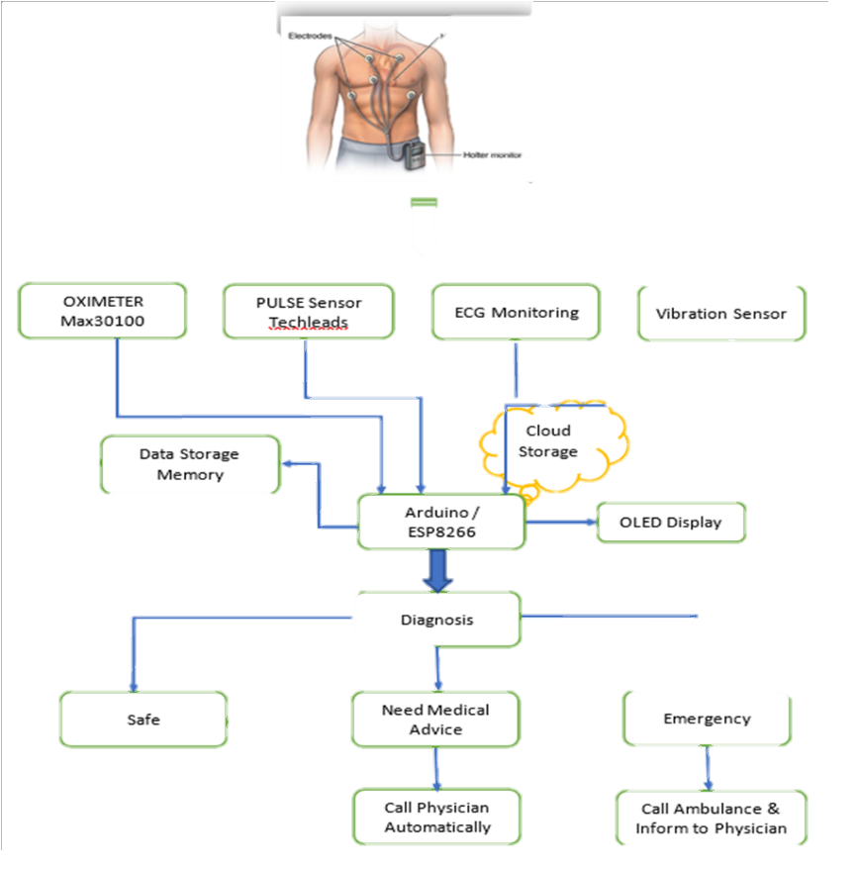

Slide 7
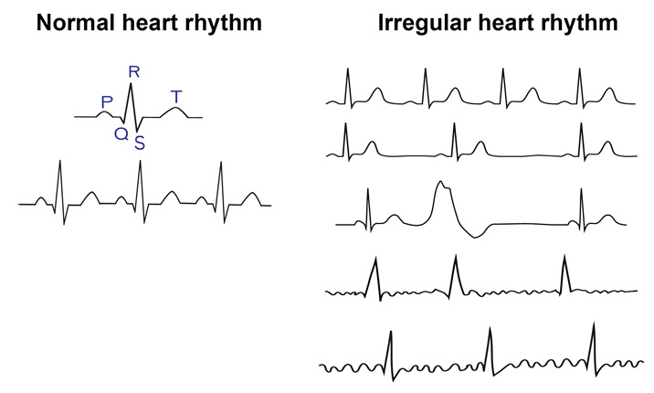

Slide 8
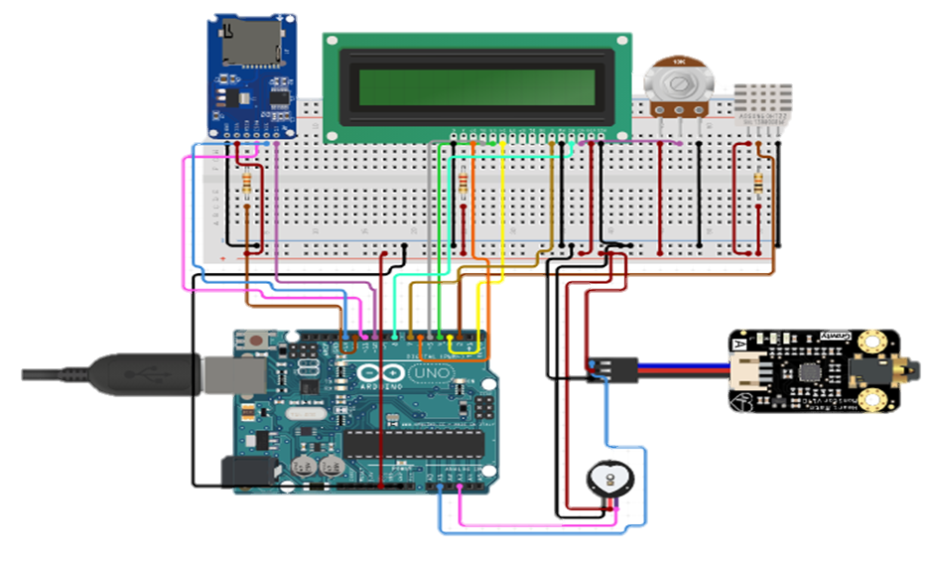
Circuit diagram of the invention:
ECG, Heart rate, and oxygen percentage present in the blood are the major parameters and are much important in the diagnosis process.
The system includes three modules to calculate heart rate, ECG signal, and oxygen percentage in blood. An Arduino microcontroller is used to acquire and process the information from the modules.
There are many different ways to calculate heart rate, and in this project, we built one algorithm which takes heartbeats for 15 sec and converts it to BPM.

Slide 9
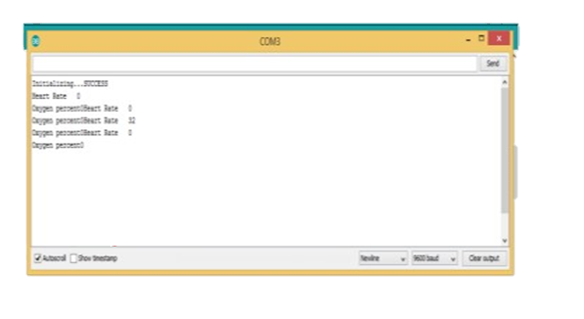
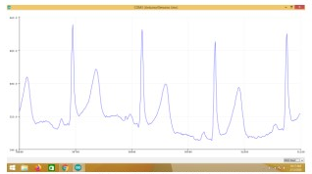
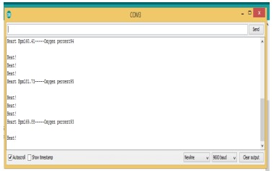
Result
Heart rate and Oximeter readings
Analog output of ECG sensor module
Output of pulse Oximeter

Slide 10
Conclusion:
The major parameters considered to make an innovative Holter monitor are heart rate, ECG signal, and oxygen percentage in blood.
The biomedical data of heart rate and ECG signals are proper.
The system is very lightweight and low costs as well as we are using predicament situations. We are storing biomedical data on an SD card as well as displaying it on an OLED display.
Data stored in SD cards will help our doctors to diagnose diseases of patients and OLED displays will give the current status of parameters to patients.

Slide 11
THANK YOU!!!

