Slide 1

Recovery Vault Protocol
Empowering Users: Fixing Web3's Biggest Challenge

Slide 2

Introduction
In the evolving landscape of Web3, the stakes are high, and user trust is paramount.
Let’s unveil a transformative solution addressing a critical flaw in digital wallets: secure password recovery.
Our Recovery Vault Protocol not only decentralizes this process but empowers users, making crypto ownership safer and more accessible.
Notes:
In the evolving landscape of Web3, the stakes are high, and user trust is paramount.
Let’s unveil a transformative solution addressing a critical flaw in digital wallets: secure password recovery.
Our Secret Recovery Protocol not only decentralizes this process but empowers users, making crypto ownership safer and more accessible.

Slide 3
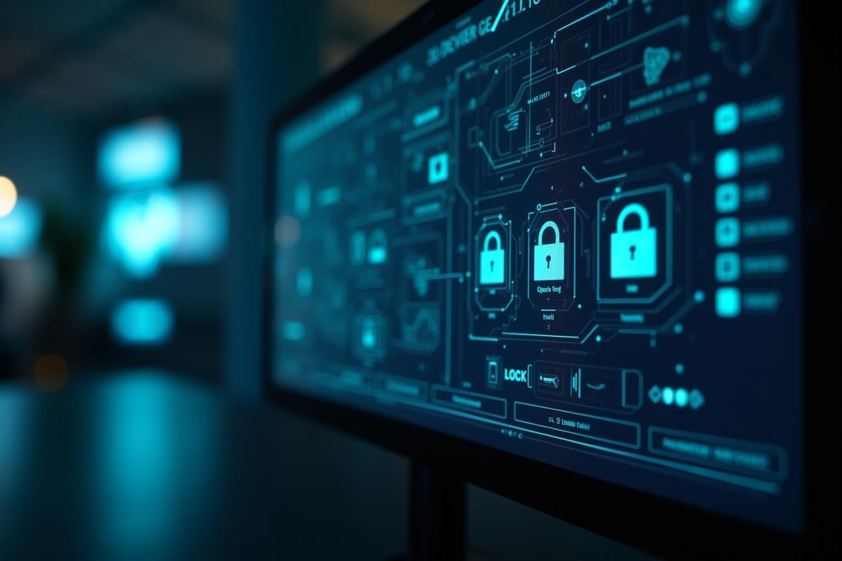
01
Problem Overview

Slide 4

Password recovery challenges
What to do if you forget your password?
Insurmountable challenges in recovering digital assets when passwords are forgotten.
The traditional reliance on centralized systems poses significant risks, leaving users vulnerable to hacks and irreversible losses.

Slide 5

Limitations -Centralized solutions
Existing solutions, like OTP systems, fall short in a decentralized world.
Centralized recovery options lead to increased vulnerabilities, as seen in email breaches that compromise user security.
We need a robust, decentralized recovery protocol.

Slide 6

Impact
The ramifications of losing access to crypto wallets are dire.
Users find themselves unable to recover their assets, leading to irretrievable losses.
Affects individual investors but also undermines confidence in the entire Web3 ecosystem. As we embrace a decentralized future, it is crucial to address these vulnerabilities to foster greater user trust and participation.

Slide 7

Solution: Recovery Vault Protocol
It redefines password recovery in Web3 by offering a trustless and decentralized solution.
By leveraging DKIM email signatures and ICP smart contracts, we provide a secure method that ensures users can regain access to their wallets without compromising their security.
This innovative approach places power back in the hands of users, revolutionizing how they interact with their assets.

Slide 8

How DKIM and ICP enhance security
Prevents email spoofing - only authenticated requests can initiate recovery processes.
Tamper-proof capabilities of ICP smart contracts - unparalleled security framework
By leveraging DKIM email signatures and ICP smart contracts, we provide a secure method that ensures users can regain access to their wallets without compromising their security.
This combination not only protects users but also ensures that they retain complete control over their recovery credentials—minimizing reliance on any third parties.

Slide 9

Benefits
Transitioning to a decentralized recovery system eliminates single points of failure inherent in traditional models.
Our solution emphasizes user ownership and security, enhancing accessibility while eliminating custodial risks.
We pave the way for a resilient and trustful environment for users to confidently manage their digital assets.

Slide 10

Questions?
Recovery Vault Protocol addresses a critical gap in Web3, enabling secure and user-centric recovery of digital assets.
We can create a future where users no longer fear losing access to their belongings.
Join us in championing this transformative solution and making the Web3 experience more secure and inclusive for everyone.

