Slide 1
WEEKLY MEAL PLANNER
& GROCERY GENERATOR
Java Mini Project Presentation
Branch: Computer Science & Information Technology (CS & IT)
Team Members:
1. Y. Tarun Kumar — 2620090136
2. E. Sharan Teja — 2620090134
Faculty Guide: Gopikrishna
CS & IT | Weekly Meal Planner & Grocery Generator | 1

Slide 2
1. Introduction
Java-based console application for planning meals across seven days.
Users select Breakfast, Lunch, or Dinner for each day.
The program adds the selected meal cost to an estimated weekly total.
It checks grocery availability and displays missing items to buy.
Uses core Java concepts such as Scanner, arrays, loops, switch, and if conditions.
CS & IT | Weekly Meal Planner & Grocery Generator | 2

Slide 3
2. Problem Statement
The Problem
Our Approach
Manual meal planning can be repetitive and easy to forget.
• Meals must be planned day by day.
• Grocery availability is checked separately.
• Cost has to be calculated manually.
• Missing items may be overlooked.
Create one simple Java program that:
• plans meals for all 7 days,
• calculates the estimated cost,
• checks Rice, Chicken, Vegetables and Oil,
• tells the user which missing items to buy.
CS & IT | Weekly Meal Planner & Grocery Generator | 3

Slide 4
3. Objectives
Plan meals for Monday to Sunday.
Provide three meal choices: Breakfast, Lunch and Dinner.
Calculate the total estimated meal cost automatically.
Check whether important grocery items are available.
Display a clear list of items that need to be purchased.
Demonstrate practical use of fundamental Java programming concepts.
CS & IT | Weekly Meal Planner & Grocery Generator | 4

Slide 5
4. Existing System
Manual Planning
Separate Grocery Check
Manual Costing
Meals are usually written in notes or on paper.
No automatic weekly repetition or validation.
Users check grocery items independently.
Missing items can be forgotten.
Meal prices are added separately.
This takes extra time and effort.
CS & IT | Weekly Meal Planner & Grocery Generator | 5

Slide 6
5. Proposed System
1
2
3
4
5
Select Day
Choose Meal
Add Cost
Check Groceries
Show Total
Result
A simple weekly meal plan + grocery availability check + estimated cost.
CS & IT | Weekly Meal Planner & Grocery Generator | 6

Slide 7
6. System Architecture
USER INPUT
MEAL SELECTION
COST CALCULATION
GROCERY CHECK
FINAL OUTPUT
Core Data
days[] stores the week • items[] stores grocery items • total stores estimated cost • choice selects the meal
CS & IT | Weekly Meal Planner & Grocery Generator | 7

Slide 8
7. Functionalities
7-Day Planner
Meal Selection
Processes Monday–Sunday using a while loop.
Switch statement offers 3 meal choices.
Cost Estimation
Grocery Check
Adds ₹40 / ₹120 / ₹100 based on selected meal.
Checks Rice, Chicken, Vegetables and Oil.
Missing Items
Final Output
If answer is “no”, prints Buy <item>.
Displays the estimated weekly cost.
CS & IT | Weekly Meal Planner & Grocery Generator | 8

Slide 9
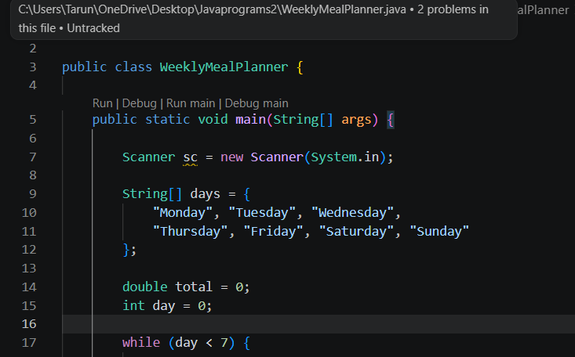
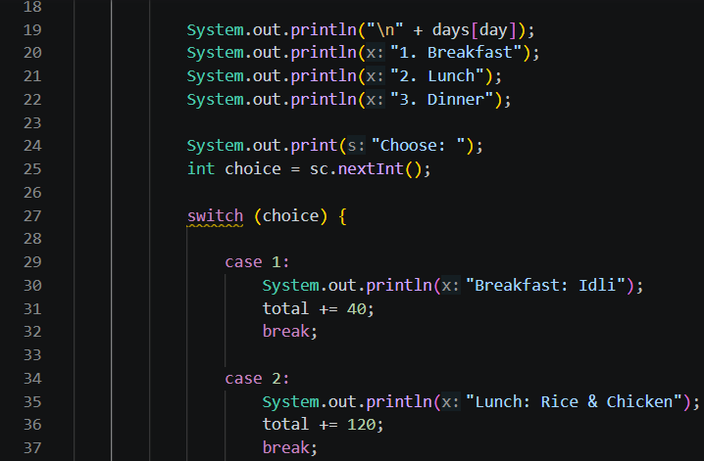
8. Implementation – Java Code Screenshots
Place your first two code screenshots in the marked areas.
PROGRAM SCREENSHOT 1
PROGRAM SCREENSHOT 2
CS & IT | Weekly Meal Planner & Grocery Generator | 9

Slide 10
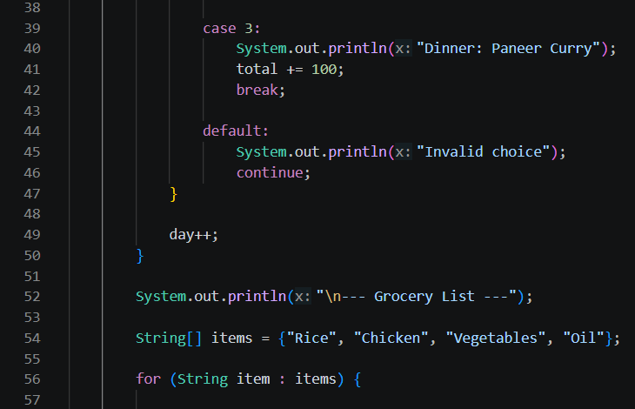
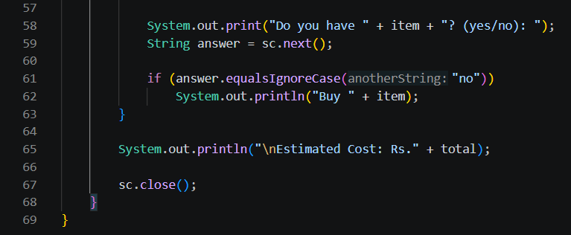
8. Implementation – Java Code Screenshots
Place your remaining two code screenshots in the marked areas.
PROGRAM SCREENSHOT 3
PROGRAM SCREENSHOT 4
CS & IT | Weekly Meal Planner & Grocery Generator | 10

Slide 11
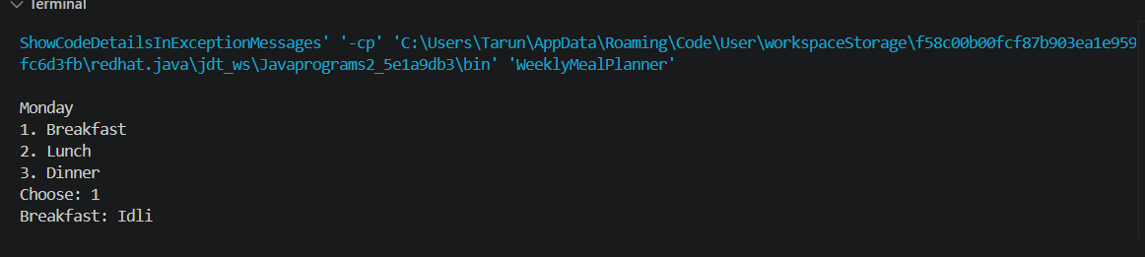
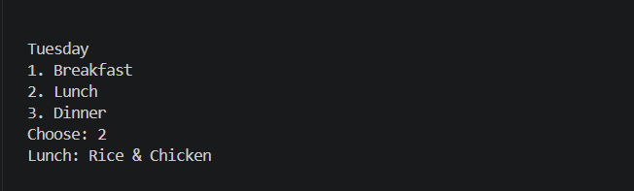
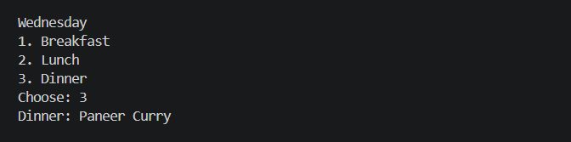
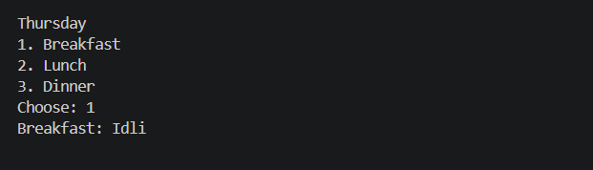
9. Output Screenshots
Output screenshots 1–4 • Replace the placeholders with your actual console outputs.
OUTPUT SCREENSHOT 1
OUTPUT SCREENSHOT 2
OUTPUT SCREENSHOT 3
OUTPUT SCREENSHOT 4
CS & IT | Weekly Meal Planner & Grocery Generator | 12

Slide 12
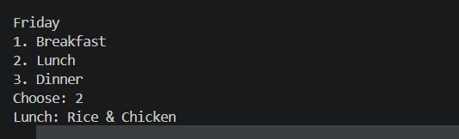
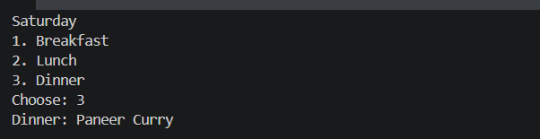
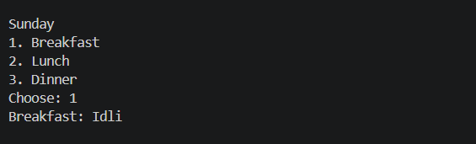
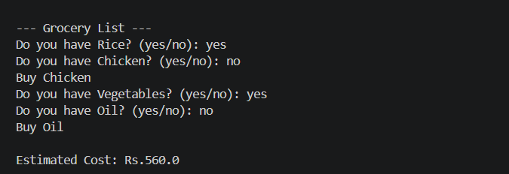
9. Output Screenshots
Output screenshots 5–8 • Replace the placeholders with your actual console outputs.
OUTPUT SCREENSHOT 5
OUTPUT SCREENSHOT 6
OUTPUT SCREENSHOT 7
OUTPUT SCREENSHOT 8
CS & IT | Weekly Meal Planner & Grocery Generator | 13

Slide 13
10. Future Scope
Add more meal choices and allow users to enter custom meals.
Store ingredient quantities and automatically combine repeated ingredients.
Add a graphical user interface using Java Swing or JavaFX.
Connect the application to a database for saved meal plans.
Add nutrition, calorie and monthly budget tracking.
Provide personalized meal recommendations.
CS & IT | Weekly Meal Planner & Grocery Generator | 14

Slide 14
11. Conclusion
Project Outcome
The Weekly Meal Planner & Grocery Generator provides a simple Java-based approach to weekly meal planning.
• Plans meals for seven days.
• Uses switch to select meals and calculates estimated cost.
• Checks grocery availability using a for-each loop and if condition.
• Displays missing items and the final estimated cost.
• Demonstrates practical use of fundamental Java programming concepts.
CS & IT | Weekly Meal Planner & Grocery Generator | 15

Slide 15
THANK YOU
Weekly Meal Planner & Grocery Generator
Questions & Answers
Y. Tarun Kumar • E. Sharan Teja
Faculty Guide: Gopikrishna | CS & IT
CS & IT | Weekly Meal Planner & Grocery Generator | 16

