Slide 1

Embedded I.O.T
Tarun Yadav
B.Tech CSE
180BTCCSE018

Slide 2
Smart Mining Safety
Monitoring System Using I.O.T
…
Title:-Smart Industrial Safety Monitoring System Using I.O.T

Slide 3
ABOUT Mining
The Key features and challanges of mining industry .
Economy
Employment
Challenges
Safety
Fatalities
Mining yields our economy a big capital and involves the use of the country's resources.
Mining uplifts the economy.and removes the problem of unemployment as it provide job to a large number of people.
It destroys our forest and leads to catastrophes and pollution and affects health of people.
Safety is one of the biggest issue in mining industry though fatility rate droped down to 60%-70% percent
Thousads of people lost their lives due to serveral issue like fall damage,intraction to toxic gas and not getting help on time

Slide 4

ABOUT Porject
The information about my project and how i tried to overcome some challenges in mining industry.
Smart Mining Safety monitoring System
By building this Real time project i tried to solve various safety challenges faced in mining industry to decrease or imporove the fatality rate as much as posible.
Providing 24/7 monitoring so that he/she can get a immediate help if required
Alert system for toxic gases in the surrounding
Motion monitoring system
And Heatbeat sensing system for real time checking of workers health.
DEPARTMENT
I.O.T

Slide 5
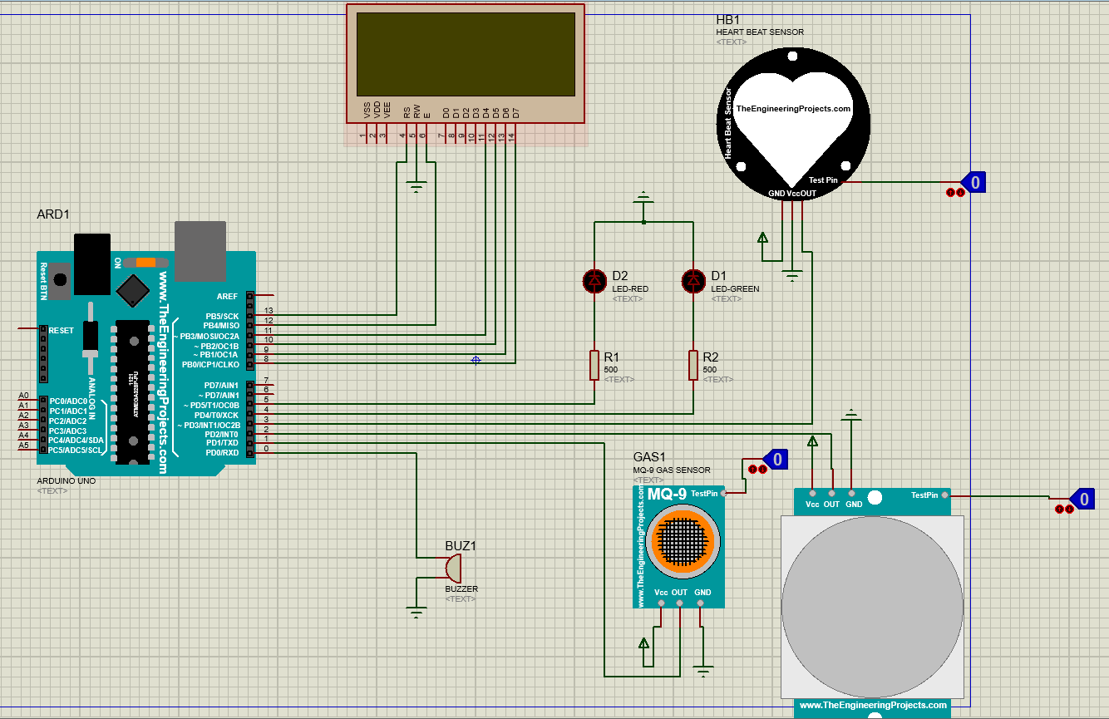
Circuit Diagram:-

Slide 6
Component Used
The future is before us and dynamic. Everything we do will affect it.
Micro-Controller Chip
Motion Sensor
Micro-controller chip is used as an embedded system to control all the component in the circuit and give the desired output.
Secondly under some circumstances like falling of roof or wall in mining field the motion sensor is used to send the information of worker
Gas Sensor
HeartBeat Sensor
Firstly Gas sensor (MQ-9) which is basically for sensing toxic gases in mining fields like CARBON MONO OXIDE and other flammable gases comes into action.
If worker been unconscious because of some reason then with the heartbeat sensor sending heartbeat reading to the person who is monitoring from away,
LED's and Buzzer
LCD Display
If it found a toxic and flammable gasses around then Green LED changes to RED for danger and if some cases worker is failed to notice LED Buzzer comes into play to alert the worker from toxic and flammable gases.
LCD is used to display all the sensor andother component readings and if he found some abnormal reading he can send emergency help as soon as possible from outside

Slide 7

Conclusion:-
The future is before us and dynamic. Everything we do will affect it.
Claims
Using this safety monitoring system we can save a lots of casualties which used to happen in day to day life of a mining industry by taking advantage of available technology .
Budget
Budget of whole project will be less than 12$ if we wish to built it.
Conclusion
A real time monitoring system is developed to provide clearer and more precise information about the workers working inside.
DESIGN
50%
CODING
30%
CONCEPTION
50%

Slide 8
THANK YOU

