Slide 1
Arrays
Lec-15-Part-A

Slide 2
CSE101-Lec#15(Part-A)
What are Arrays?
To declare an array
To initialize an array
Defining and Processing 1D array
To display address of the array
Basic program examples of 1D array

Slide 3

Introduction
Arrays
Collection of related data items of same data type.
Static entity – i.e. they remain the same size throughout program execution

Slide 4
Types
One Dimensional (e.g. int a[100],float b[10], char c[10])
Multidimensional(2D,3D….)(e.g. int a[5][5],float b[10][10],int c[5][5][5])
Note: As per syllabus we will be covering 1D and 2D arrays only..

Slide 5
1-D array
A single- dimensional or 1-D array consists of a fixed number of elements of the same data type organized as a single linear sequence.
The elements of a single dimensional array can be accessed by using a single subscript
Examples:
Array to store marks of all students of class in one subject
Array to store heights of all players in a team
Array to store prices of all products in a shopping mall

Slide 6
Defining(or Declaring) Arrays(1D)
When defining arrays, specify:
Name
Data Type of array
Number of elements
datatype arrayName[numberOfElements];
Examples:
int students[10];
float myArray[3284];
Defining multiple arrays of same data type
Format is similar to regular variables
Example:
int b[100], x[27];

Slide 7
Arrays[Memory representation]
An array is an ordered list of values
The entire array
has a single name
Each value has a numeric index
c[0] c[1] c[2] c[3] c[4] c[5] c[6] c[7] c[8] c[9]
c
79 87 94 82 67 98 87 81 74 91
An array of size N is indexed from zero to N-1
This array holds 10 values that are indexed from 0 to 9
Notes:
This will allocate 10*2 bytes of space in memory

Slide 8
Arrays(1D)-Accessing array elements
Name of array (Note that all elements of this array have the same name, c)
Array
Group of consecutive memory locations
Same name and data type
To refer to an element, specify:
Array name
Position number in square brackets([])
Format:
arrayname[position_number]
First element is always at position 0
Eg. n element array named c:
c[0], c[1]...c[n – 1]
c[0]
-45
c[1]
6
c[2]
0
c[3]
72
c[4]
3
c[5]
-89
c[6]
0
c[7]
62
c[8]
-3
c[9]
1
c[10]
6453
c[11]
78
Position number of the element within array c

Slide 9
Arrays(1D(-Accessing array elements
Array elements are like normal variables
c[0] = 3;/*stores 3 to c[0] element*/
scanf (“%d”, &c[1]);/*reads c[1] element*/
printf (“%d, %d”, c[0], c[1]); /*displays c[0] & c[1] element*/
The position number inside square brackets is called subscript/index.
Subscript must be integer or an integer expression
c[5 - 2] = 7; (i.e. c[3] = 7)

Slide 10
Initializing Arrays
Different ways of initializing ID Arrays
1) Initializing array at the point of declaration
int a[5]={1,2,3,4,5};
int a[]={1,2,3,4,5};//Here compiler will automatically depict the size:5
int a[5]={1,2,3};//Partial initialization[Remaining elements will be initialized to default values for integer, i.e. 0]
int a[5]={};//All elements will be initialized to zero
int a[5]={1};//First element is one and the remaining elements are default values for integer, i.e. 0

Slide 11
Initializing Arrays
2) Initializing array after taking input from the user
Array is same as the variable can prompt for value from the user at run time.
Array is a group of elements so we use for loop to get the values of every element instead of getting single value at a time.
Example: int array[5], i; // array of size 5
for(i=0;i<5;i++){// loop begins from 0 to 4
scanf(“%d”, &array[i]);
}

Slide 12
Polling Questions
If the size of the array is 100, then last index will be:
A. 100
B. 99
C. 98
D. 0

Slide 13
For the given array, int a={22,3,44,8,9}; what value will be coming for a[3]??
A. 22
B. 44
C. 9
D. 8

Slide 14
For the given array, int a[5]={}; what value will be coming for a[1]??
A.1
B. Garbage value
C.0
D.-1

Slide 15
Accessing (or Traversing) array elements after taking input from user
#include<stdio.h>
int main()
{
int a[100],n,i;
printf("\n Enter number of elements:");
scanf("%d",&n);
printf("\n Enter array elements:");
for(i=0;i<n;i++)
{
scanf("%d",&a[i]);//Reading array elements
}
printf("\n Entered array elements are:");
for(i=0;i<n;i++)
{
printf("\n%d",a[i]);//Printing array elements
}
return 0;
}

Slide 16
Printing base address of the array and address of any array element
#include<stdio.h>
int main()
{
int a[5]={1,2,3,4,5};
int i;
printf("\n Printing base address of the array:");
printf("\n%u %u %u",&a[0],a,&a);
printf("\n Printing addresses of all array elements:");
for(i=0;i<5;i++)
{
printf("\n%u",&a[i]);
}
return 0;
}

Slide 17
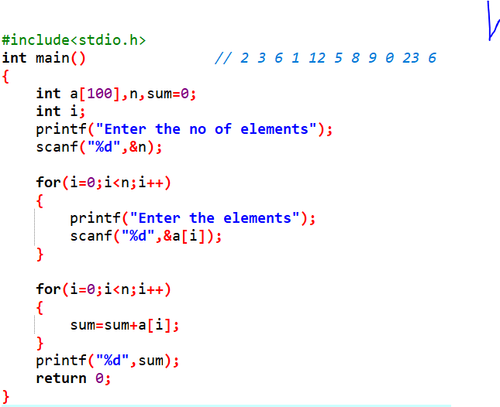

Slide 18
Program example-WAP to find the sum of all 1D array elements
#include<stdio.h>
int main()
{
int a[100],n,i,sum=0;
printf("\n Enter number of elements:");
scanf("%d",&n);
printf("\n Enter array elements:");
for(i=0;i<n;i++)
{
scanf("%d",&a[i]);
}
for(i=0;i<n;i++)
{
sum=sum+a[i];
}
printf("\n Sum of array elements is:%d",sum);
return 0;
}

Slide 19
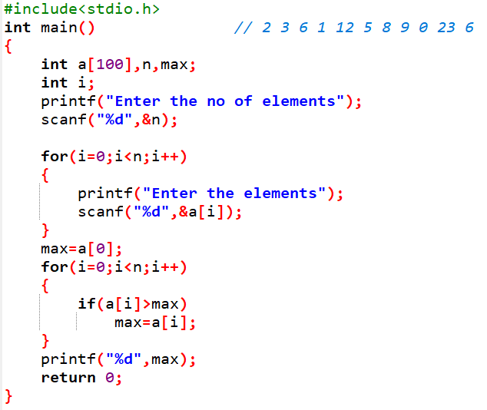

Slide 20
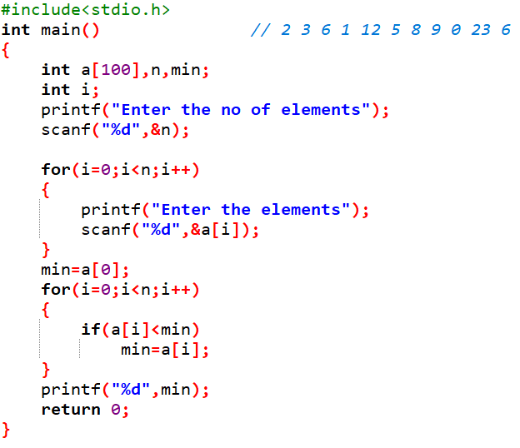

Slide 21
Program example-WAP to display the largest and smallest element from 1D array elements
#include<stdio.h>
int main()
{
int n,a[10],i,max,min;
printf("\n Enter number of elements:");
scanf("%d",&n);
for(i=0;i<n;i++)
{
scanf("%d",&a[i]);
}
min=a[0];
for(i=1;i<n;i++)
{
if(a[i]<min)
{
min=a[i];
}
}
max=a[0];
for(i=1;i<n;i++)
{
if(a[i]>max)
{
max=a[i];
}
}
printf("\nMaximum element is: %d",max);
printf("\nMinimum element is: %d",min);
return 0;
}

Slide 22
Polling Questions
What will be the output of following code?
#include<stdio.h>
int main()
{
int a[5],i;
for(i=0;i<5;i++)
{
a[i]=i;
}
printf("%d",a[2]);
return 0;
}
0
2
1
Garbage value

Slide 23
What will be the output of following code?
#include<stdio.h>
int main()
{
int a[5]={11,22,33,44,55};
a[2]=a[1];
a[3]=a[2];
a[4]=a[3];
printf("%d",a[4]);
return 0;
}
22
33
44
55

Slide 24
#include<stdio.h>
int main()
{
int a[5]={1,2,3,4,5};
int b[5];
int i;
for(i=0;i<5;i++)
{
b[i]=++a[i];
}
printf("%d",b[0]+b[3]);
return 0;
}
A. 5
B. 7
C. 4
D. 3

Slide 25
What will be the output of the following program?
#include<stdio.h>
int main()
{
int a[5] = {5, 1, 15, 20, 25};
int i=2;
printf("%d",a[++i]);
return 0;
}
A. 15
B. 20
C. 25
D. 5

Slide 26
What will be the output of the following program?
#include<stdio.h>
int main()
{
int a[5] = {5, 1, 15, 20, 25};
int i, j, m;
i = ++a[1];
j = a[1]++;
m = a[i++];
printf("%d %d %d",i,j,m);
return 0;
}
A. 3, 2, 15
B. 2, 3, 20
C. 2, 1, 15
D. 1, 2, 5

Slide 27
What is the output of C program.?
int main()
{
float marks[3] = {90.5, 92.5, 96.5};
int a=0;
while(a<3)
{
printf("%.2f,", marks[a]);
a++;
}
return 0;
}
A) 90.5 92.5 96.5
B) 90.50 92.50 96.50
C) 0.00 0.00 0.00
D) Compiler error

Slide 28
Programs for practice
WAP to count total number of odd array elements in the given 1D array
WAP to swap the largest and smallest elements in the given 1D array and display the updated array elements
WAP to replace all multiples of 5(array elements) with -1 and display the updated array on the screen
WAP to add elements of two 1D arrays and store the corresponding sums as array elements of third array. Display the content of third array on screen
WAP to count total number of prime array elements in the given 1D array

