Slide 1
CSE101-Lec#15(Part-B)
Multidimensional Arrays(2D Array)

Slide 2
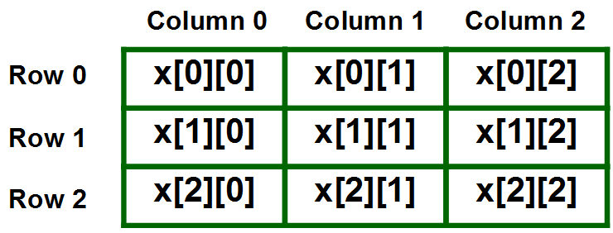
2D-Array
A two – dimensional array can be seen as a table with ‘x’ rows and ‘y’ columns where the row number ranges from 0 to (x-1) and column number ranges from 0 to (y-1). A two – dimensional array ‘x’ with 3 rows and 3 columns is shown below:
Examples:
Representing the marks of 60 students of class in 5 subjects, we can take a 2D array of row size:60 and column size:5
Representing the sales done by all(50) sales persons of a particular branch for all months(12), we can take a 2D array of row size:50 and column size:12

Slide 3
2D-Array
The basic form of declaring a two-dimensional array of size x, y:
Syntax:
data_type array_name[x][y];
data_type: Type of data to be stored. Valid C/C++ data type.
We can declare a two dimensional integer array say ‘x’ of size 10,20 as:
int x[10][20];
Elements in two-dimensional arrays are commonly referred by x[i][j] where i is the row number and ‘j’ is the column number

Slide 4
Also known as Multiple-Subscripted Arrays
Multiple subscripted arrays
Tables with rows and columns (m by n array)
Like matrices: specify row, then column
int a[rows][column];
Column 0 0
Column 1
Column 2
Column 3
Row 0
a[ 0 ][ 0 ]
a[ 0 ][ 1 ]
a[ 0 ][ 2 ]
a[ 0 ][ 3 ]
Row 1
a[ 1 ][ 0 ]
a[ 1 ][ 1 ]
a[ 1 ][ 2 ]
a[ 1 ][ 3 ]
Row 2
a[ 2 ][ 0 ]
a[ 2 ][ 1 ]
a[ 2 ][ 2 ]
a[ 2 ][ 3 ]
Column subscript
Array name
Row subscript

Slide 5
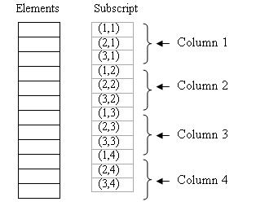
Memory representation of 2D-Array
A 2D array’s elements are stored in continuous memory locations. It can be represented in memory using any of the following two ways: 1. Column-Major Order 2. Row-Major Order 1. Column-Major Order: In this method the elements are stored column wise, i.e. m elements of first column are stored in first m locations, m elements of second column are stored in next m locations and so on. E.g. A 3 x 4 array will stored as below:

Slide 6
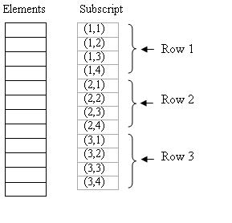
Memory representation of 2D-Array
2. Row-Major Order: In this method the elements are stored row wise, i.e. n elements of first row are stored in first n locations, n elements of second row are stored in next n locations and so on. E.g. A 3 x 4 array will stored as below:

Slide 7
Initialization
1) Initializing at the point of declaration:
int a[ 2 ][ 2 ] = { { 1, 2 }, { 3, 4 } };
Initializers grouped by row in braces
If not enough, unspecified elements set to zero
Int a[ 2 ][ 2 ] = { { 1 }, { 3, 4 } };
int a3[2][2]={1,2};//Remaining elements are zero
int a4[2][2]={0};//All elements are zero
1 2
3 4
1 0
3 4

Slide 8
Initialization
int a5[][2]={1,2,3};//It is possible to skip row size, if elements are initialized at the point of declaration
int a[2][]={1,2,3};//Not possible to skip column size[Error will come]
int a[][]={1,2,3};//Not possible to skip both row and column size[Error will come]

Slide 9
Initialization
2) Taking input from user
int a[3][3], i, j;
for(i=0; i<3; i++)
{ // for loop for rows
for(j=0; j<3;j++)
{ // for loop for columns
printf(“enter the value ofa[%d][%d]: ”, i, j);
scanf(“%d”, &a[i][j]);
} //end for columns
} //end for rows

Slide 10
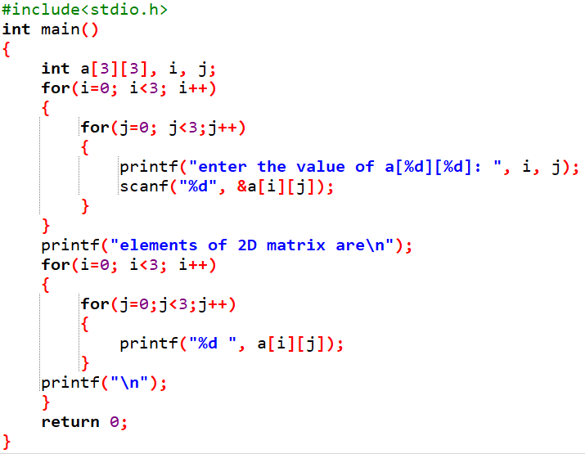
Accessing(or Traversing) 2D array elements after taking input from the user

Slide 11
enter the value of a[0][0] :1
enter the value of a[0][1] :2
enter the value of a[0][2] :3
enter the value of a[1][0] :4
enter the value of a[1][1] :5
enter the value of a[1][2] :6
enter the value of a[2][0] :7
enter the value of a[2][1] :8
enter the value of a[2][2] :9
Element of 2D matrix are:
2 3
5 6
7 8 9

Slide 12
Polling Questions
What will be the output of following code?
#include<stdio.h>
int main()
{
int a[][3]={1,2,3,4,5,6};
printf("%d",a[0][2]);
return 0;
}
A. 2
B. 3
C. 4
D. Compile time error

Slide 13
Which of the following is invalid initialization of 2D Array?
A. int a[][2]={1,2,3,4};
B. int a[2][2]={1,2,3,4};
C. int a[2][]={1,2,3,4};
D. int a[2][2]={};

Slide 14
What will be the output of following code?
#include<stdio.h>
int main()
{
int a[3][2]={{1,2},{3,4},{5,6}};
printf("%d",a[1][1]*a[2][1]);
return 0;
}
A. 24
B. 12
C. 8
D. 20

Slide 15
What will be the output of following code?
#include <stdio.h>
int main()
{
int a[2][3] = {1, 2, 3, 4, 5};
int i = 0, j = 0;
for (i = 0; i < 2; i++)
for (j = 0; j < 3; j++)
printf("%d ", a[i][j]);
return 0;
}
1 2 3 4 5
1 2 3 4 5 0
1 2 3 4 5 Garbage value
Compile time error

Slide 16
Matrix operations using 2D arrays
WAP to find the sum of two matrices
WAP to display the transpose of a matrix
WAP to find the sum of diagonal elements of a matrix
WAP to perform multiplication of 2 matrices and display the result

Slide 17
WAP to find the sum of two matrices
#include <stdio.h>
int main()
{
float a[3][3], b[3][3], c[3][3];
int i, j;
printf("Enter elements of 1st matrix\n");
for(i=0; i<3; i++)
{
for(j=0; j<3 ;j++)
{
printf("Enter a%d%d: ", i, j);
scanf("%f", &a[i][j]);
}
}
// Taking input using nested for loop
printf("Enter elements of 2nd matrix\n");
for(i=0; i<3; i++)
{
for(j=0; j<3; j++)
{
printf("Enter b%d%d: ", i, j);
scanf("%f", &b[i][j]);
}
}
// adding corresponding elements of two arrays
for(i=0; i<3; i++)
{
for(j=0; j<3; j++)
{
c[i][j] = a[i][j] + b[i][j];
}
}
// Displaying the sum
printf("\nSum Of Matrix:\n");
for(i=0; i<3; i++)
{
for(j=0; j<3; j++)
{
printf("%.1f\t", c[i][j]);
}
printf("\n");
}
return 0;
}

Slide 18
WAP to display the transpose of a matrix
#include <stdio.h>
int main()
{
int a[10][10], transpose[10][10], r, c, i, j;
printf("Enter rows and columns of matrix: ");
scanf("%d %d", &r, &c);
// Storing elements of the matrix
printf("\nEnter elements of matrix:\n");
for(i=0; i<r; i++)
{
for(j=0; j<c; j++)
{
printf("Enter element a%d%d: ",i, j);
scanf("%d", &a[i][j]);
}
}
// Displaying the matrix a[][] */
printf("\nEntered Matrix: \n");
for(i=0; i<r; i++)
{
for(j=0; j<c; j++)
{
printf("%d ", a[i][j]);
}
printf("\n\n");
}
// Finding the transpose of matrix a
for(i=0; i<r; i++)
{
for(j=0; j<c; j++)
{
transpose[i][j] = a[j][i];
}
}
// Displaying the transpose of matrix a
printf("\nTranspose of Matrix:\n");
for(i=0; i<r; i++)
{
for(j=0; j<c; j++)
{
printf("%d ",transpose[i][j]);
}
printf("\n\n");
}
return 0;
}

Slide 19
WAP to find the sum of diagonal elements of a matrix
#include<stdio.h>
int main()
{
int a[10][10],sum=0;
int i,j,m,n;
printf("Enter number of rows and column:");
scanf("%d%d",&m,&n);
printf("Enter Elements : ");
for(i=0;i<m;i++)
{
for(j=0;j<n;j++)
{
scanf("%d",&a[i][j]);
}
}
for(i=0;i<m;i++)
{
for(j=0;j<n;j++)
{
if(i==j)
{
sum=sum+a[i][j];
}
}
}
printf("Sum of Diagonal Elements = %d ",sum);
}

Slide 20
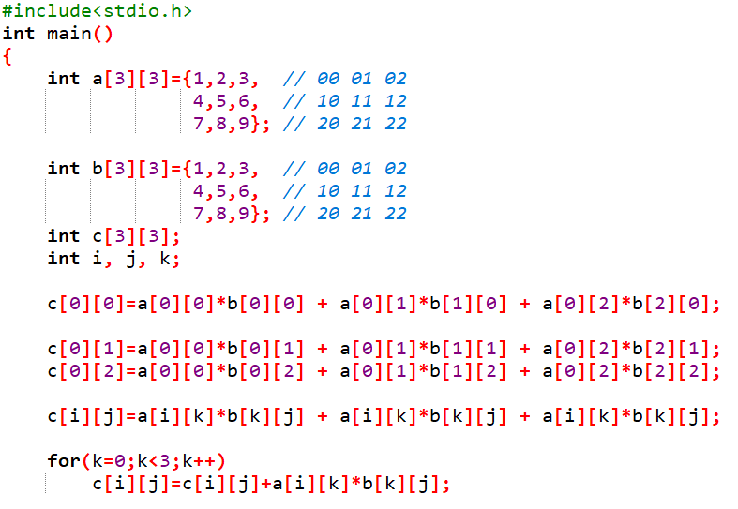

Slide 21
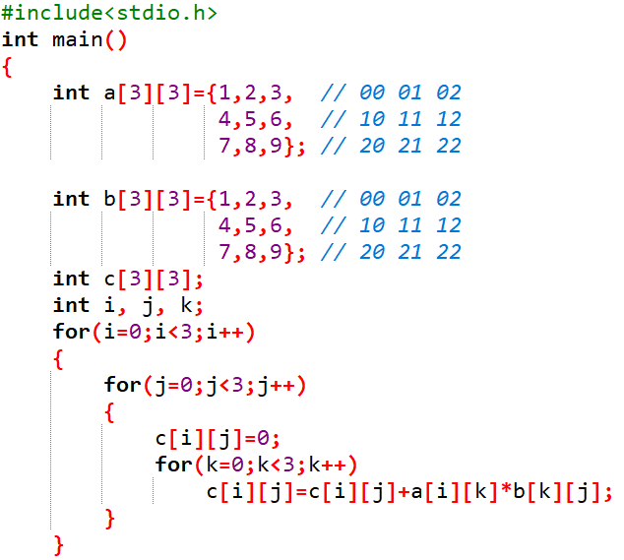
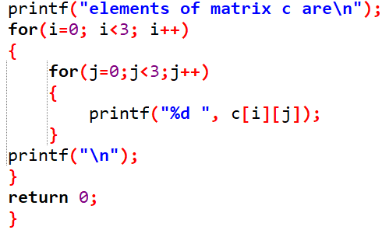

Slide 22
WAP to perform multiplication of 2 matrices and display the result
#include <stdio.h>
int main()
{
int a[10][10], b[10][10], result[10][10], r1, c1, r2, c2, i, j, k;
printf("Enter rows and column for first matrix: ");
scanf("%d %d", &r1, &c1);
printf("Enter rows and column for second matrix: ");
scanf("%d %d",&r2, &c2);
// Column of first matrix should be equal to column of second matrix and
while (c1 != r2)
{
printf("Error! No. of columns of first matrix not equal to no.of row of second.\n\n");
printf("Enter rows and column for first matrix: ");
scanf("%d %d", &r1, &c1);
printf("Enter rows and column for second matrix: ");
scanf("%d %d",&r2, &c2);
}
// Storing elements of first matrix.
printf("\nEnter elements of matrix 1:\n");
for(i=0; i<r1; i++)
{
for(j=0; j<c1; j++)
{
printf("Enter elements a%d%d: ",i,j);
scanf("%d", &a[i][j]);
}
}
// Storing elements of second matrix.
printf("\nEnter elements of matrix 2:\n");
for(i=0; i<r2; i++)
{
for(j=0; j<c2; j++)
{
printf("Enter elements b%d%d: ",i, j);
scanf("%d",&b[i][j]);
}
}
// Initializing all elements of result matrix to 0
for(i=0; i<r1; i++)
{
for(j=0; j<c2; j++)
{
result[i][j] = 0;
}
}
// Multiplying matrices a and b and
// storing result in result matrix
for(i=0; i<r1; i++)
{
for(j=0; j<c2; j++)
{
for(k=0; k<c1; k++)
{
result[i][j]+=a[i][k]*b[k][j];
}
}
}
// Displaying the result
printf("\nOutput Matrix:\n");
for(i=0; i<r1; i++)
{
for(j=0; j<c2; j++)
{
printf("%d ", result[i][j]);
}
printf("\n\n");
}
return 0;
}

Slide 23
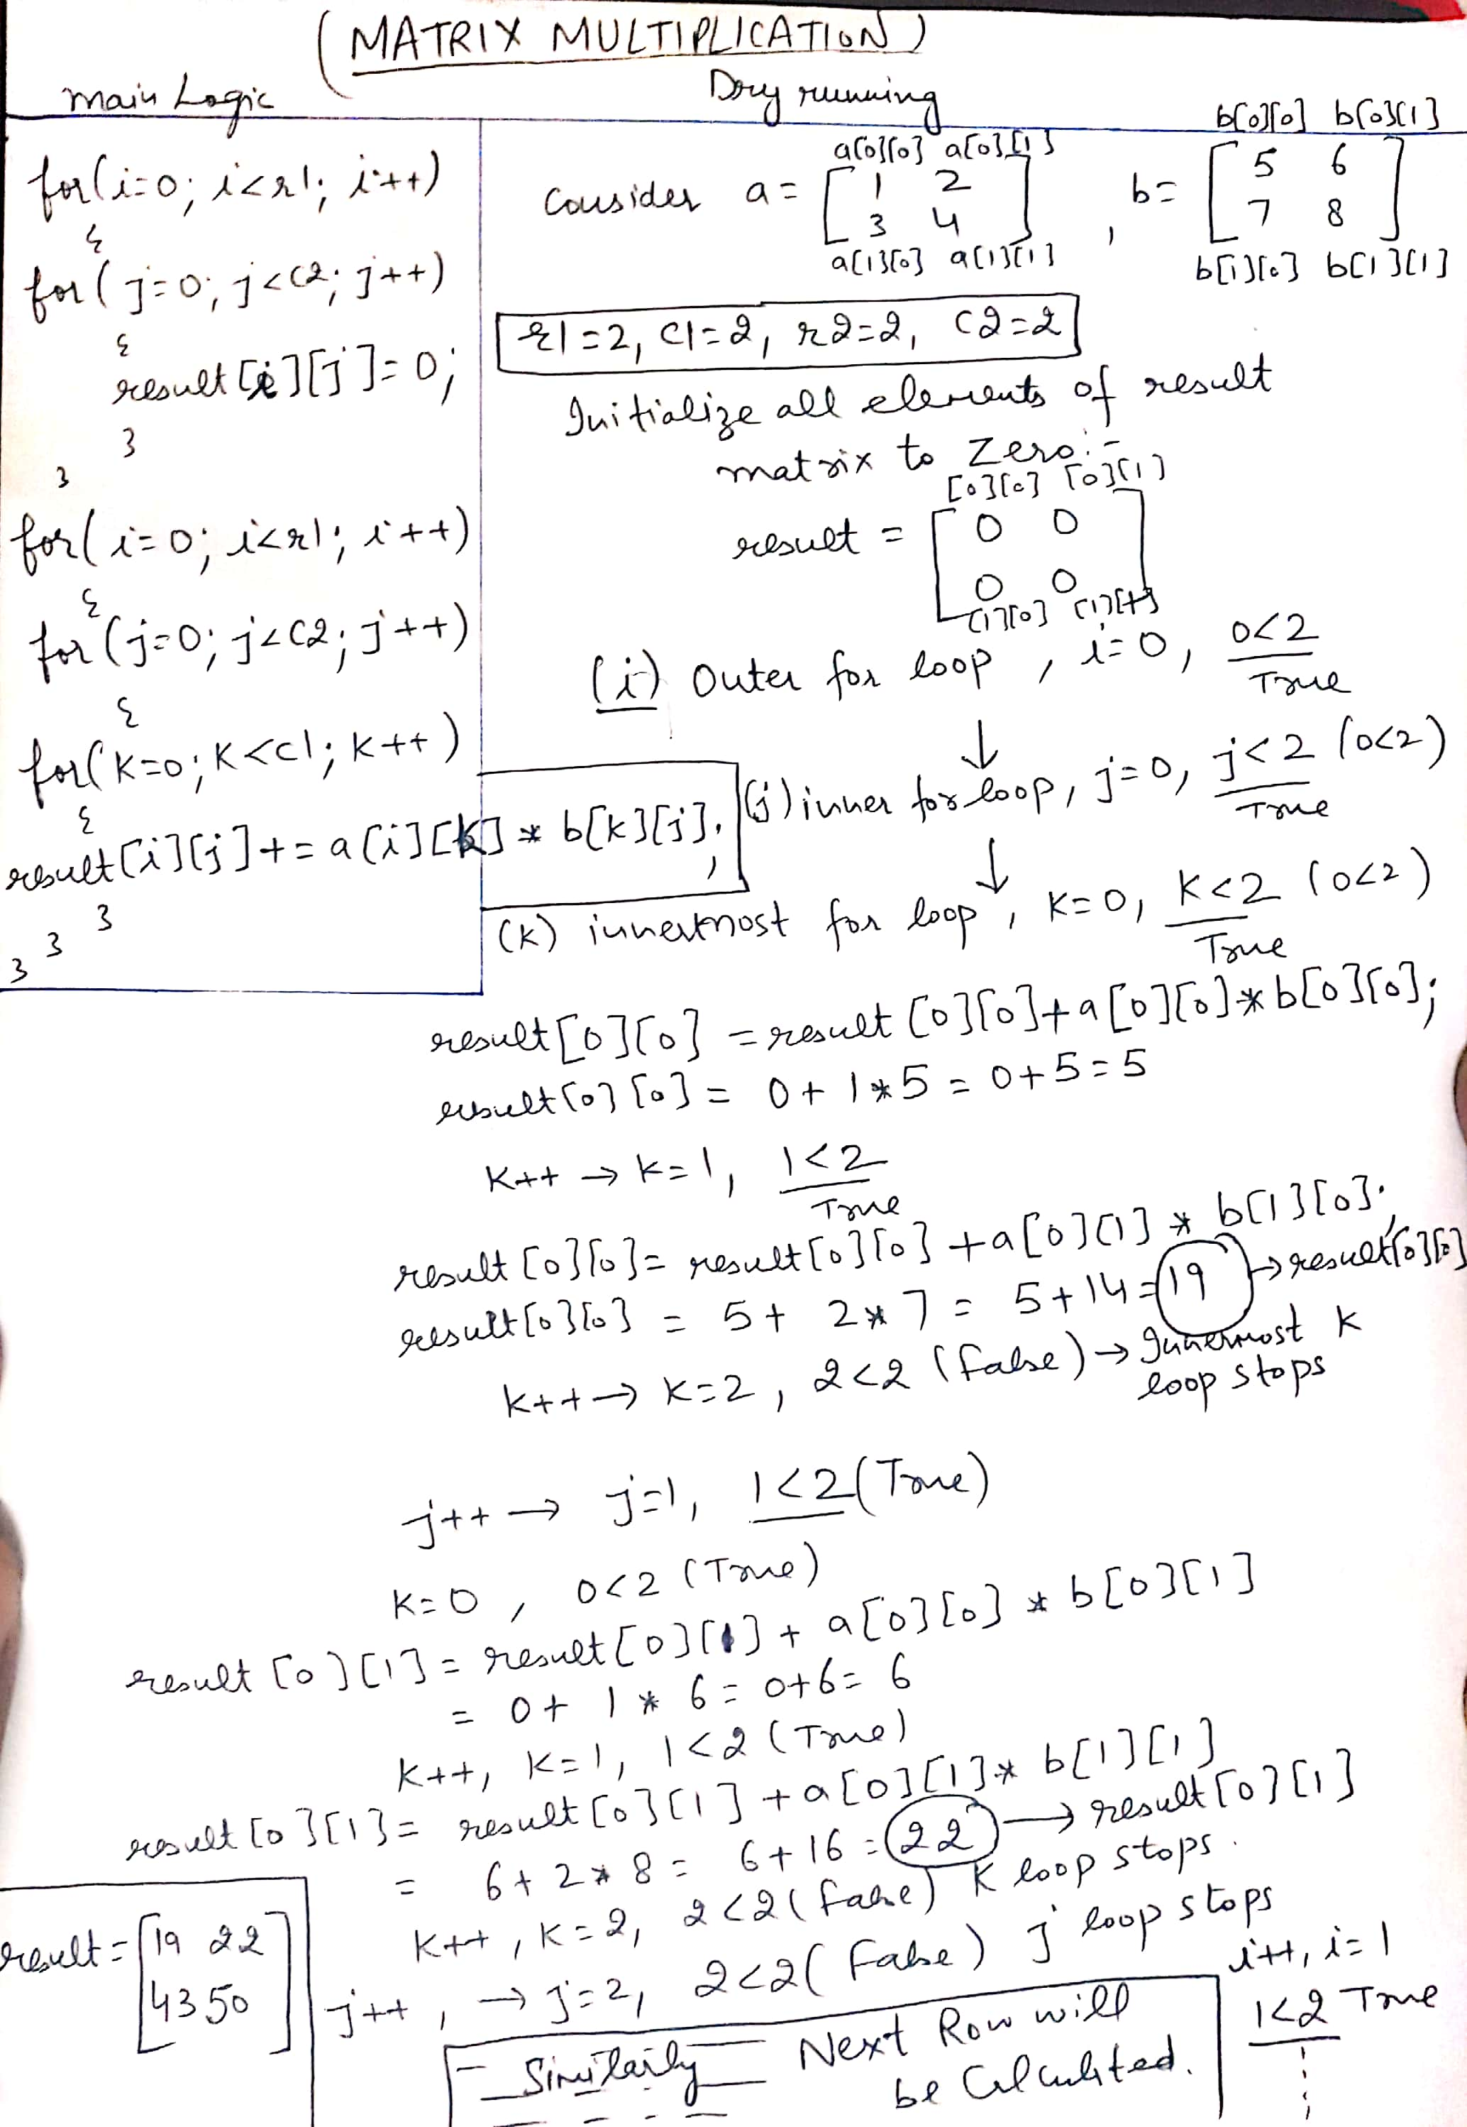
Dry running

Slide 24
Practice Questions
WAP to display the maximum sales done(monthly) from a particular branch in a year[Take input for number of sales persons and sales done in each month for each sales person]
WAP to display the minimum marks scored in each subject from a particular section[ Take input for marks of n no. of students in m no. of subjects from user]
WAP to display average marks scored by n no. of students of a section in their registered m no. of courses.[Inputs will be given by user]

