Slide 1

Blending Process
Presented To
Dr. Jayaram Valluru
Chemical Engineering, IIT-Ropar
Course Code: CH-303
Process Control
Presented by
Tarun Kumawat
2023CHB1085
Date: 29/11/2025

Slide 2
Blending Process
The blending process involves the uniform mixing of two or more substances without creating a chemical reaction to produce a final product with desired qualities, like gasoline or cosmetics.
In this system, two feed streams are combined in a well-mixed tank to produce an outlet stream with a controlled composition.
One feed stream is a mixture of two chemical species, while the other is pure component A.
The primary objective is to regulate the mass fraction of component A in the outlet by adjusting the flow rate of pure A, compensating for disturbances in the composition of the mixed feed.
Because streams can fluctuate in both composition and flow rate, maintaining a consistent product quality requires precise adjustment of the manipulated variables.
A core challenge is handling disturbances—especially changes in the inlet composition—by manipulating the flow rate of the pure component via a control valve.

Slide 3
Objective
Identify and classify all process variables, including controlled, manipulated, and disturbance variables.
Simulate the nonlinear dynamic model to determine the system's steady-state and dynamic response
Perform open-loop dynamic simulations and analyze the system’s response to step changes in the manipulated input. Determine the process gain and time constant.
Linearize the nonlinear model about the steady-state to develop a linear state-space model. Convert the linear state-space model into transfer function form for further control system analysis.
Perform stability analysis based on the poles and zeros of the derived transfer function, confirming the stability of the open-loop system.

Slide 4




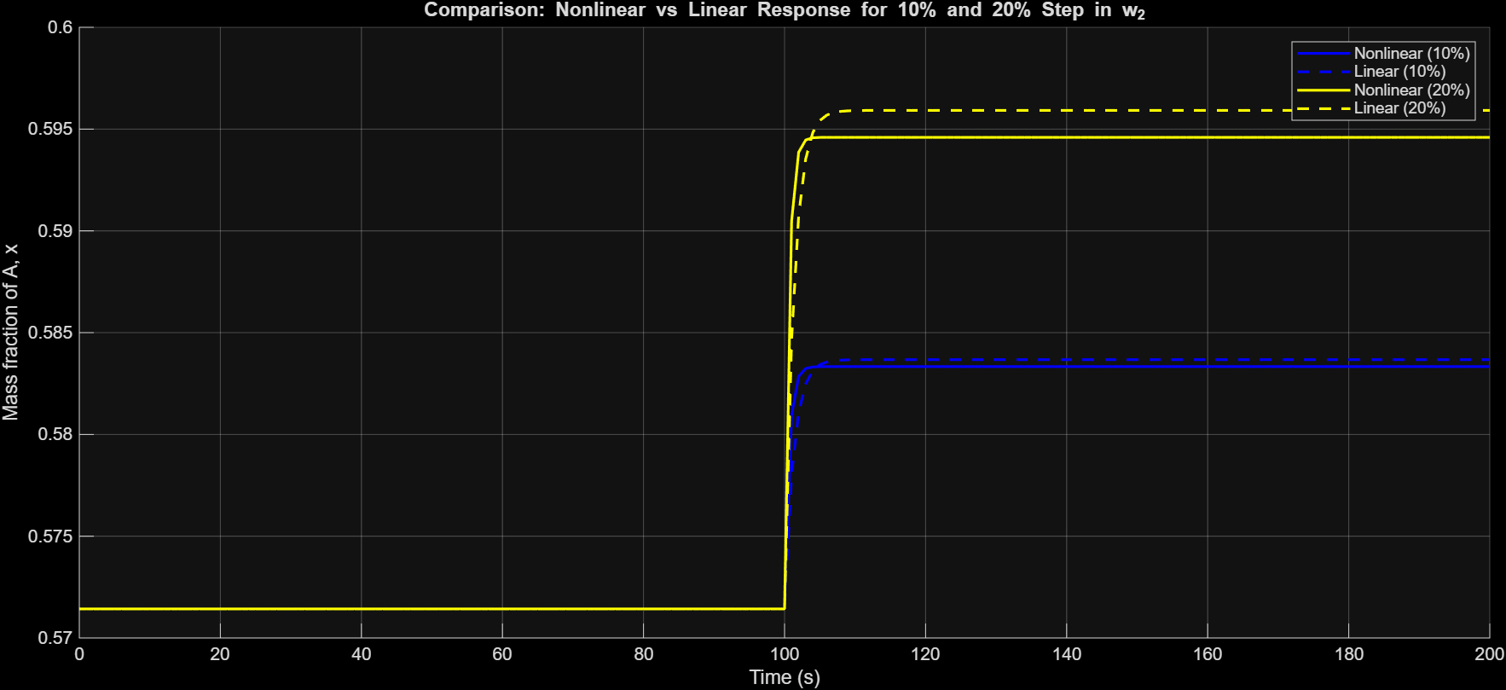





NonLinear v/s Linear Dynamic Model
0.5714
0.0006
1.29 min
Steady State Composition
Process Gain
time constant (τ)
Non-Linear Dynamic
Linearized Dynamic

Slide 5
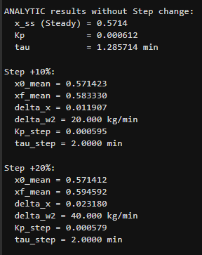
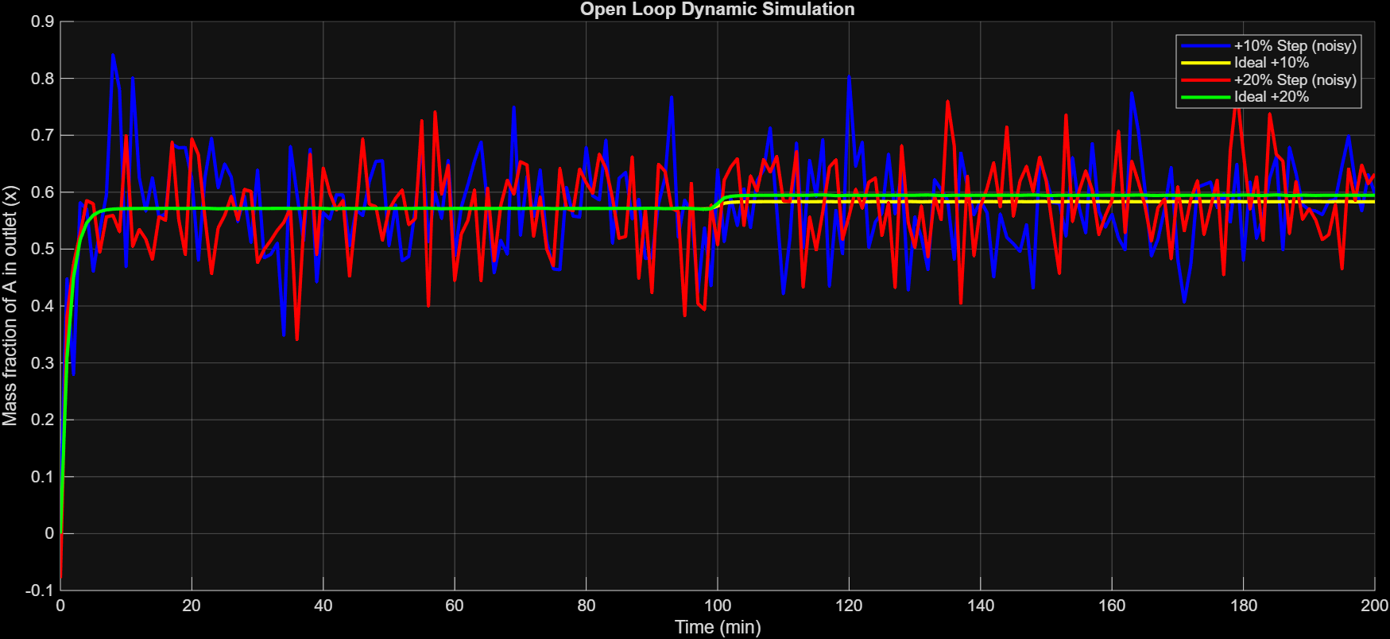
NonLinear v/s Linear Dynamic Model

Slide 6

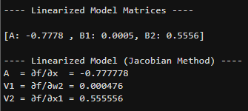
Linearized
The Jacobian method is a mathematical technique used to linearize nonlinear dynamic systems around an equilibrium or steady-state point.
f = dx/dt = (1/(rho*V))*(w1*(x1 - x) + w2*(x2 - x))
A = ∂(f)/∂x
B1 = ∂(f)/∂w2 (manipulated variable)
B2 = ∂(f)/∂x1 (disturbance variable)
A = -(w1 + w2)/(rho * V0);
V1 = (x2 - x0)/(rho * V0);
V2 = w1/(rho * V0);

Slide 7



Transfer
Function
The transfer function for the linearized blending process between the manipulated input flowrate (w2) , fraction composition (x1) and the controlled output composition (x) is:
Pole: The denominator root is at s=−0.7778.
Pole indicating infinite response or instability, and they determine a system's dynamic behavior and stability.
Poles with negative real components (left half) correspond to a stable system that will eventually settle.
Poles with positive real components (right half) indicate an unstable system that will grow without bound.
For system stability, all poles must be negative (left half-plane); zeros do not affect stability but do influence the output response and transient behavior.

Slide 8

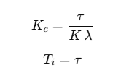



FOPTD
FOPTD with time delay
DS PI controller
λ (lambda) is the desired closed-loop time constant.
Smaller λ → faster response Larger λ → smoother, less aggressive controller
To convert PI → P:
Keep same proportional gain
Remove integral term

Slide 9
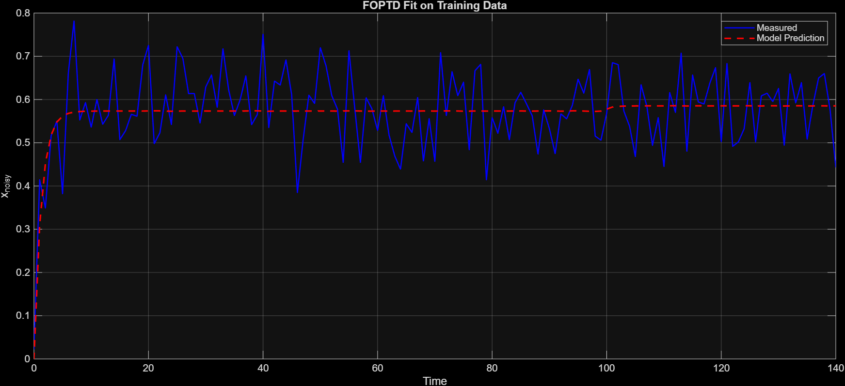

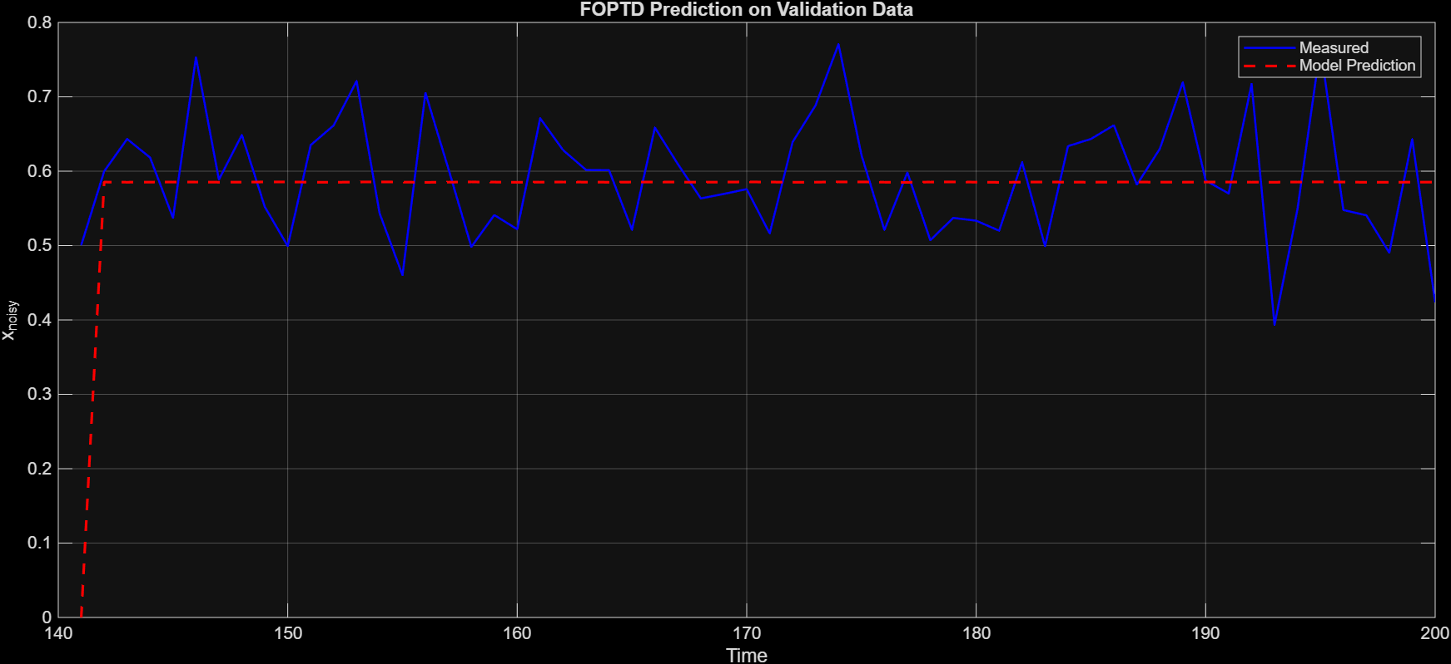
FOPTD

Slide 10


Close loop
e(t)=SP(t)−CV(t)
When you change SP, the error suddenly increases, so the controller output also changes.
For the P Controller
SP jumps → error jumps → proportional action also jumps.
P controller output = 𝐾 𝑐 ⋅ 𝑒​
CV never reaches SP.
For the PI Controller
SP jumps → error jumps → proportional action also jumps.
P controller output = 𝐾 𝑐 ⋅ 𝑒​ = 0
CV Slowly settles back to SP.

Slide 11
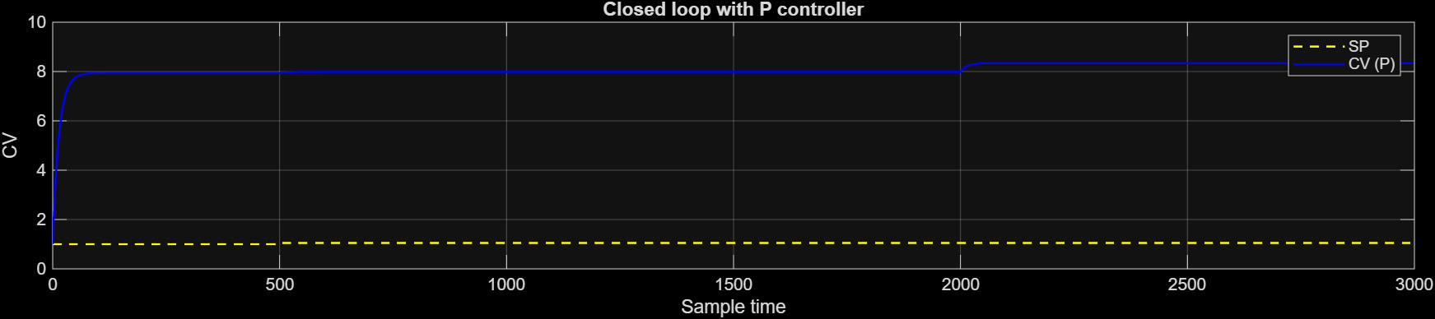
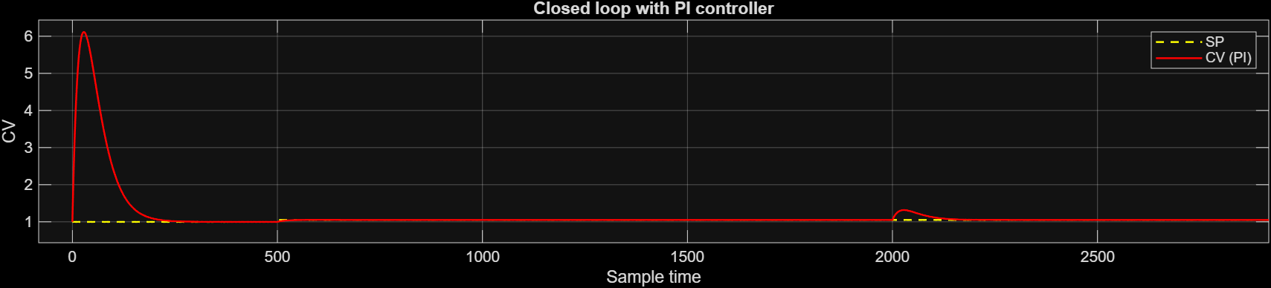
Close loop

Slide 12
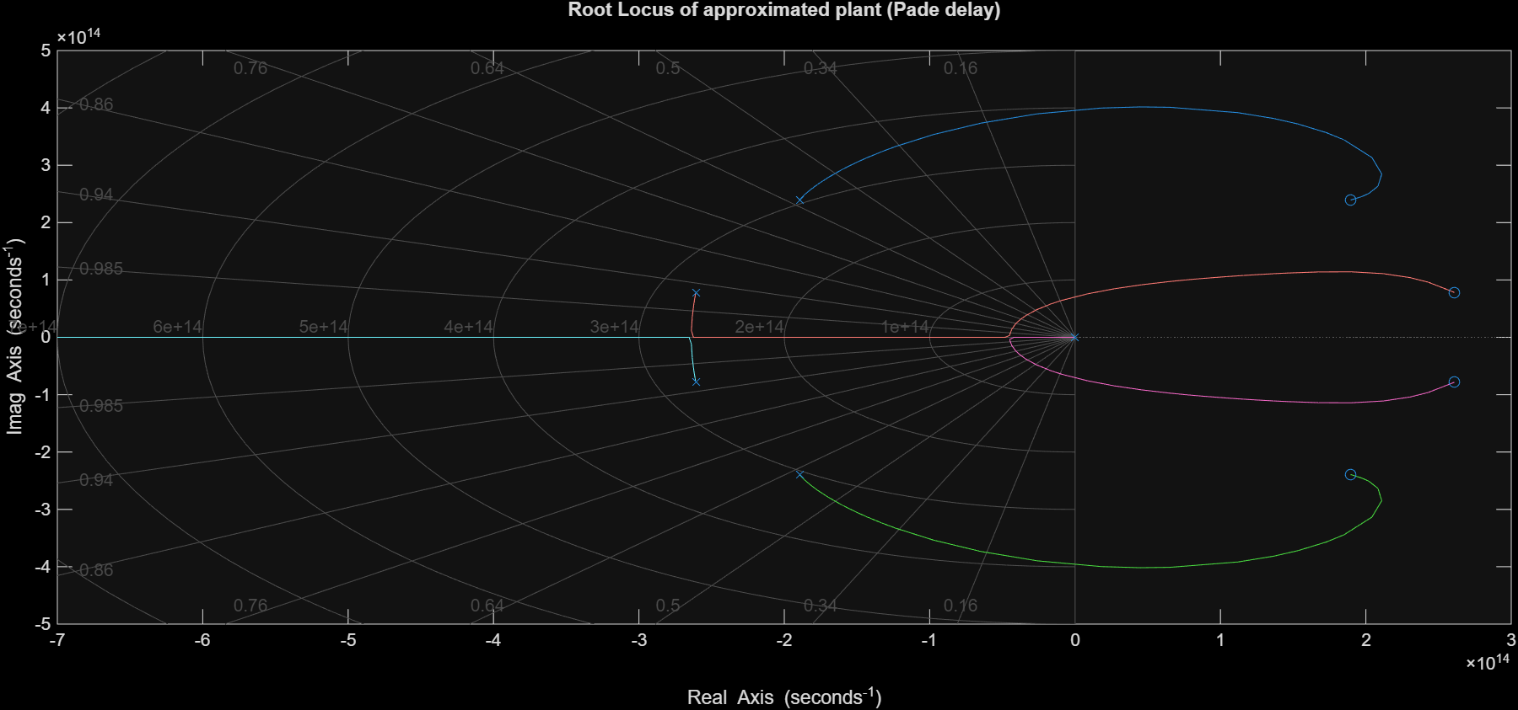
Root locus

