Slide 1
JDBC
Java has an API for working with databases, and this technology is known as JDBC. JDBC provides the developer with tools that allow clients to connect to databases, and send commands to the database.
JDBC API is an abstraction, and it uses a database specific code library to communicate with a particular database.

Slide 2
Seven Basic Steps in Using JDBC
1)Load the driver
2)Define the Connection URL
3)Establish the Connection
4)Create a Statement Object
5)Execute a Query
6)Process the results
7)close the Connection

Slide 3
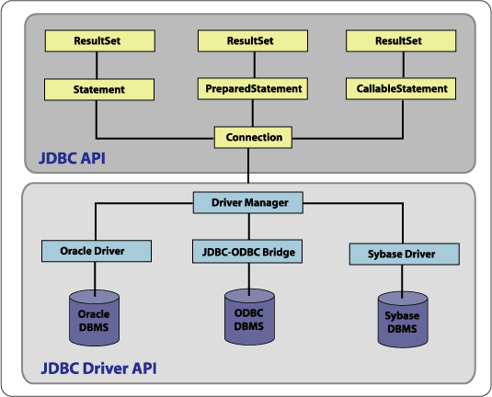

Slide 4
Class and Interfaces
DriverManager: This class manages a list of database drivers. Matches connection requests from the java application with the proper database driver.
Driver: This interface handles the communications with the database server.
Connection : This interface with all methods for contacting a database.
Statement : You use objects created from this interface to submit the SQL statements to the database.
ResultSet: These interface’s objects hold data retrieved from a database after you execute an SQL query using Statement objects. It acts as an iterator to allow you to move through its data.

Slide 5
Connecting to Databases
When making a database connection, your code does not need to open any sockets, or use any classes of the java.net package to make a connection to the database. All the connection details are handled primarily by a class in the database-specific library. This class is known as a Driver.
Your code simply tells a class known as the DriverManager that it needs a connection, and the DriverManager works with the driver to create a connection to the database that your code can use.

Slide 6
Drivers
Driver is a software which connects two dissimilar software components or software and hardware.
Java and database (say, Oracle) are two dissimilar software components. Java is a programming language used to develop software and Oracle is a database used to store data. Even the companies who developed them are different (Sun Microsystems and Oracle corporation; by the time JDBC was introduced, Java is not acquired by Oracle corporation). Now you feel the necessity of a driver. The driver here is called as JDBC driver. - types of drivers
1.Jdbc-Odbc Bridge driver
2.native api driver
3.Intermediate database access server
4.Pure java driver also called as thin driver .(This driver is very fast as it executes less code to communicate. For this reason, it is known as thin driver.

Slide 7
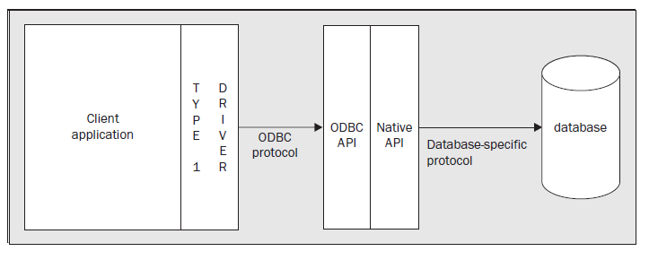
Type 1 Driver

Slide 8
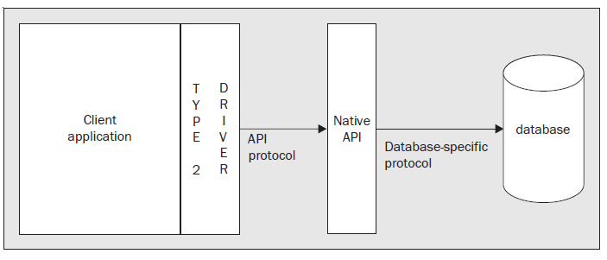
Type 2 Driver

Slide 9
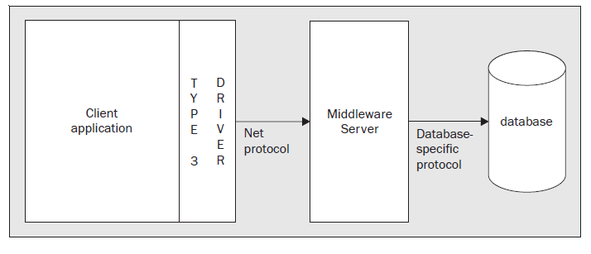
Type 3 Driver

Slide 10
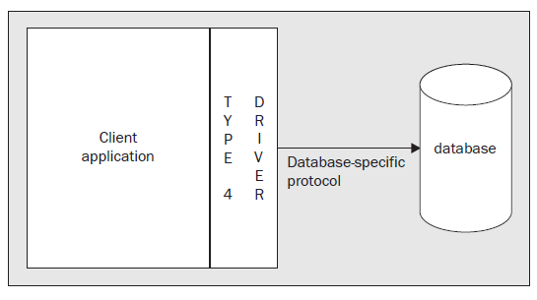
Type 4 Driver
This is the driver we are most likely using to connect to modern databases like Oracle, SQL Server, MySQL, SQLLite, and PostgreSQL. This driver is implemented in Java and directly speaks to the database using its native protocol.
This driver includes all database call in one JAR file, which makes it very easy to use.
Because of being lightweight, this is also known as a thin JDBC driver. Since this driver is also written in pure Java, it's portable across all platforms, which means you can use the same JAR file to connect to MySQL database even if your Java program is running on Windows, Linux, or Solaris.
.

Slide 11
The DriverManager Class
The driver manager maintains a reference to an instance of each driver class that is available.
❑ The driver manager needs to know which drivers are available.
❑ You need to provide a valid URL to the DriverManager class.
the JDBC URL provides a means to identify a resource (the database) that the client wishes to connect to.
The URL for each database will vary depending on the database and the driver. However, all URLs will have the general form
  jdbc:<subprotocol>:<subname>, with the <subprotocol> usually identifying the vendor and <subname> identifying the database and providing additional information needed to make the connection.

Slide 12
Can the constructor of a class be private?
class Singleton
{
private static Singleton single_instance = null;
public String s;
private Singleton()
{
s = "Hello I am a string part of Singleton class";
}
public static Singleton getInstance()
{
if (single_instance == null)
single_instance = new Singleton();
return single_instance;
}
}

Slide 13
Singleton class
class SingletonTest
{
public static void main(String args[])
{
Singleton x = Singleton.getInstance();
Singleton y = Singleton.getInstance();
Singleton z = Singleton.getInstance();
x.s = (x.s).toUpperCase();
System.out.println("String from x is " + x.s);
System.out.println("String from y is " + y.s);
System.out.println("String from z is " + z.s);
System.out.println("\n");
}
* Runtime class in java (Returns the runtime object associated with the current Java application.)

Slide 14
Connection.jsp
<%@ page import="java.sql.*" %>
<%! Connection conn=null;%>
<%try{ Class.forName("oracle.jdbc.driver.OracleDriver");
conn = DriverManager.getConnection("jdbc:oracle:thin:@localhost:1521:XE","system","system");
System.out.println("driver2 found");
} catch(Exception e){System.out.println("driver2 not found");}
%>

Slide 15
1. Loading a Driver
Before the DriverManager can provide connections, a driver class must be loaded by your application and registered with the DriverManager. There are various ways to accomplish this:
❑ You can load and register the class dynamically using Class.forName().
❑ You can let the system load and register the class automatically using a system property.
Using Class.forName()
try {
Class.forName("oracle.jdbc.driver.OracleDriver");
} catch (Exception e) {e.printStackTrace();}

Slide 16
2. Define the Connection URL
The DriverManager acts as a factory for Connection objects. The method used to get a Connection object is getConnection() and there are three overloaded forms of this method:
❑ getConnection(String url)
❑ getConnection(String url, String username, String password)
❑ getConnection(String url, Properties properties)
Create a Connection by Connection interface.
String url=jdbc:oracle:thin@
136.206.35.131:1521:DBName”, “username”, “password”;

Slide 17
3.Getting a Connection
Connection conn = DriverManager.getConnection(url);
Example for oracle
Connection conn = null;
conn = DriverManager.getConnection(“jdbc:oracle:thin@
136.206.35.131:1521:DBName”, “username”, “password”);

Slide 18
Java Database Connectivity with Oracle
Driver class: The driver class for the oracle database is oracle.jdbc.driver.OracleDriver.
Connection URL: The connection URL for the oracle10G database is jdbc:oracle:thin:@localhost:1521:xe where jdbc is the API, oracle is the database, thin is the driver, localhost is the server name on which oracle is running, we may also use IP address, 1521 is the port number and XE is the Oracle service name. You may get all these information from the C:\oraclexe\app\oracle\product\10.2.0\server\NETWORK\ADMIN\tnsnames.ora file.
Username: The default username for the oracle database is system.
Password: It is the password given by the user at the time of installing the oracle database.

Slide 19
4.Create a Statement to execute query
Create a sql Statement by Statement interface.
There are 3 types of statements
We use all these statement in executing sql queries
  1. Statement -normal stmt
  2. PreparedStatement-Precompiled Statement
  3. CallableStatement-call stored procedures.

Slide 20
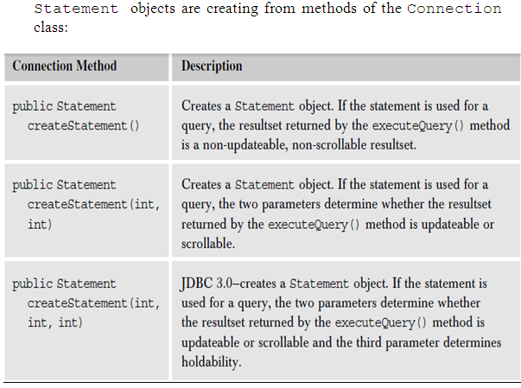
Statement from Connection Methods

Slide 21
Statement
Statement stmt = con.createStatement();
stmt.executeUpdate("INSERT INTO CUSTOMERS
(ID, SURNAME, FIRSTNAME, EMAIL, COUNTRY,
PHONE) VALUES (id, lastname, fname, email, country,
ph) ;
stmt.close();

Slide 22
Creating a Prepared Statement
Creating a PreparedStatement object is similar to creating a Statement object. One difference is that with a prepared statement, you need to tell the database what SQL you intend to execute. You pass the SQL in the creation method, rather than in the execute method. The methods to create a PreparedStatement object are as follows:

Slide 23
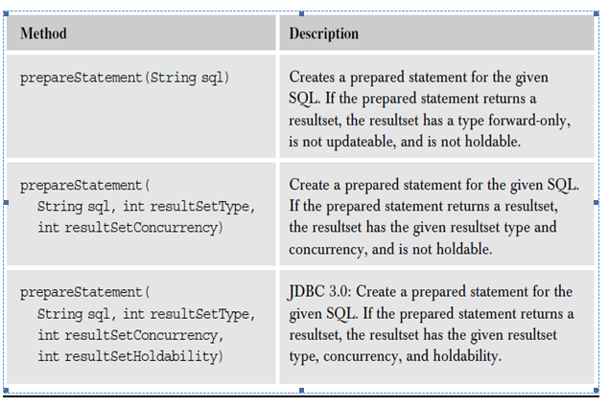
Prepared Statement from Connection methods

Slide 24
Prepared Statements
The first argument in each method is a SQL string. The SQL string can have placeholders (variables) that represent data that will be set at a later time. The placeholder is represented by the question mark symbol (?). Let’s take the SQL command presented above and change it so that it could be used as part of a prepared statement:
insert into COUNTRIES values (?, ?, ?)
Placeholders are referred to by their index in the SQL command. Placeholders are consecutively indexed starting with index 1 at the beginning of the SQL string. When the SQL in the prepared statement is sent to the database, the database compiles the SQL. Before you execute a prepared statement, you must set the placeholders with data. The driver sends the data to the database when the prepared statement is executed. Then, the database sets the variables with the data, and executes the SQL.
To set data setString(int index,String value)

Slide 25
Prepared Statements
PreparedStatement pstmt = con.prepareStatement ("INSERT INTO CUSTOMERS (ID, SURNAME, FIRSTNAME, EMAIL, COUNTRY, PHONE) VALUES (?,?,?,?,?,?)");
pstmt.setInt(1, 3054);
pstmt.setString(2, "Darcy");
pstmt.setString(3, "Simon");
pstmt.setString(4, "darcys@marconi.com");
pstmt.setString(5, "United States");
pstmt.setString(6, "+44 213 5553343");
pstmt.executeUpdate();

Slide 26
5.Execute a Query
Statement has three methods by which we execute and update the data.
1.executeQuery();//select statement
2.executeUpdate();//insert,delete,update

Slide 27
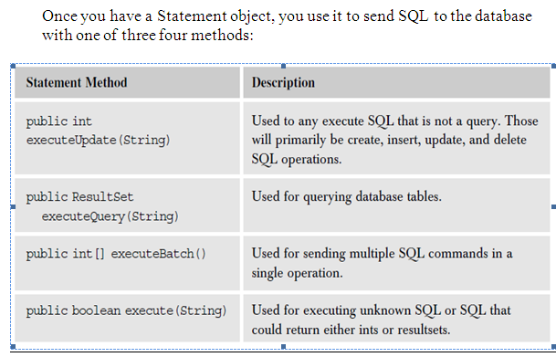
5.Execute a Query

Slide 28
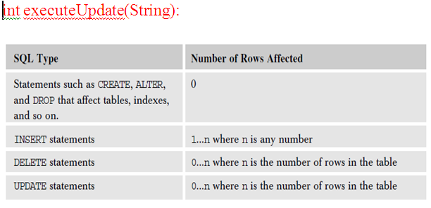
int executeUpdate(String):

Slide 29
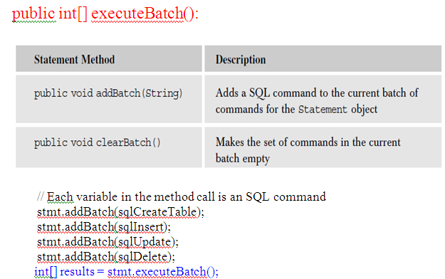
public int[] executeBatch():

Slide 30
public int[] executeBatch():
Since the executeBatch() methods returns an int array, the one type of SQL command that cannot be executed by batching is a SQL SELECT command, which returns a ResultSet object, not an int.

Slide 31
6.Process the Results
Resultsets
The ResultSet interface defines a number of methods that can be used for moving through the results returned. However, not all methods are available for every resultset. Here again are the three methods that create Statement objects:

Slide 32
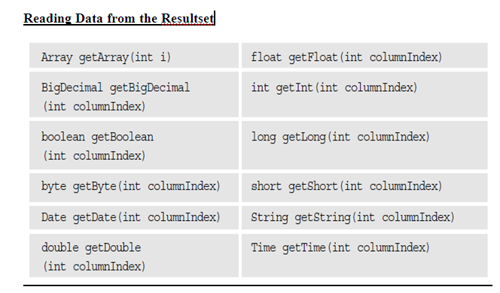
6.Process the Query Results

Slide 33
6. Process the Results
Statement stmt = con.createStatement();
ResultSet rs = stmt.executeQuery(“SELECT SURNAME FROM CUSTOMERS”);
while (rs.next()) {
System.out.println(“Surname=“ + rs.getString(“SURNAME”));//getString(“dbcolumnname”);
}

Slide 34
7. Close the Connection
if (rs != null) rs.close();
if (stmt != null) stmt.close();
if (con != null) con.close();

Slide 35
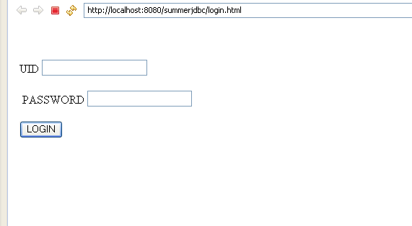
PROBLEM

Slide 36
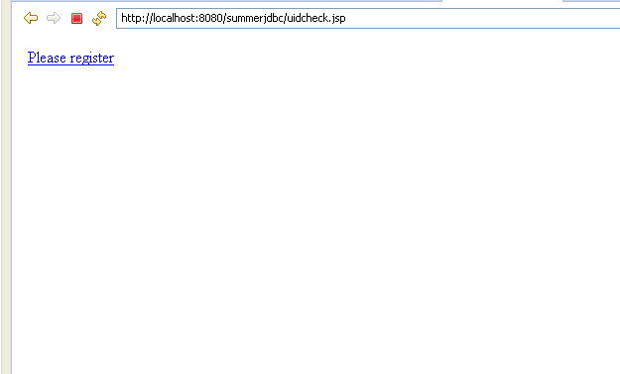
IF USER ID IS WRONG

Slide 37
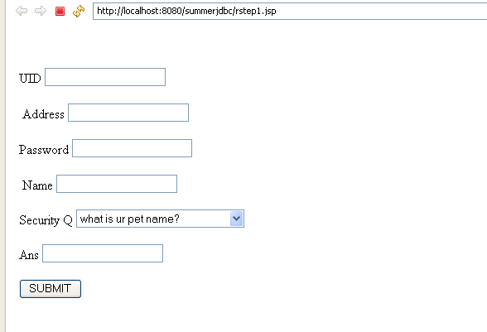
REGISTRATION

Slide 38
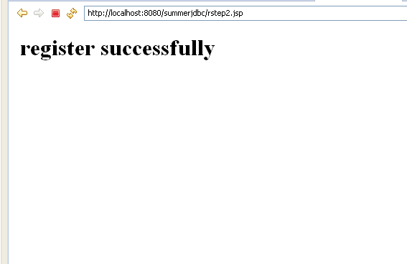
REGISTERED

Slide 39
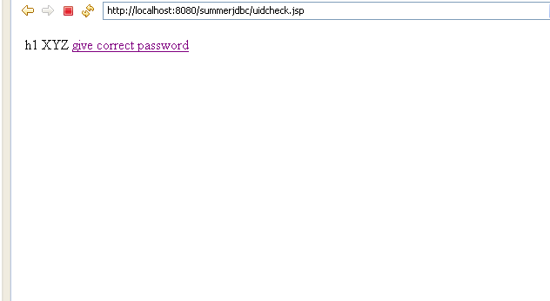
IF ID IS CORRECT PASSWORD IS WRONG

Slide 40
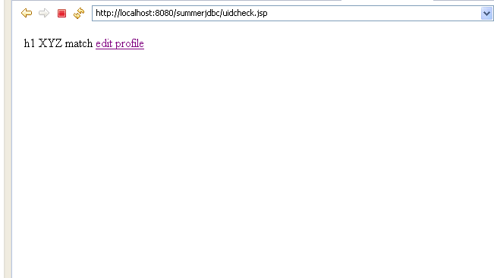
IF BOTH ARE CORRECT

Slide 41
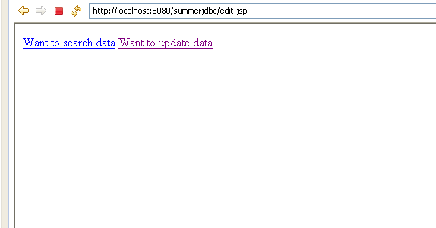
FROM EDIT PROFILE

Slide 42
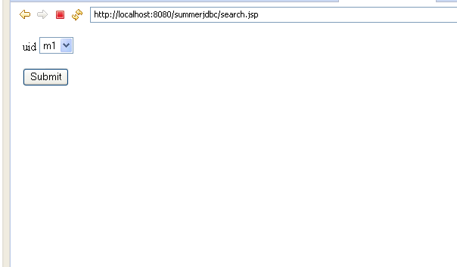
SEARCH ANY TABLE DATA

Slide 43
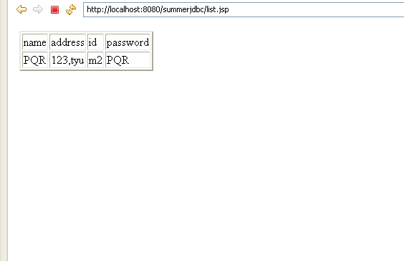
SEARCH RESULT

Slide 44
UPDATE OWN TABLE DATA

Slide 45
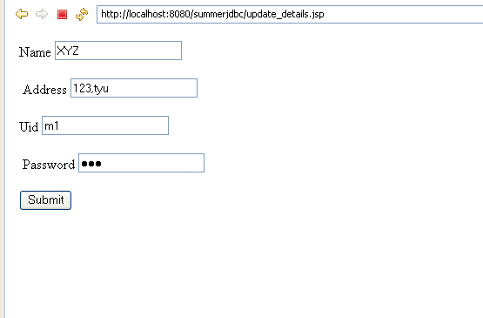
UPDATE FORM

Slide 46
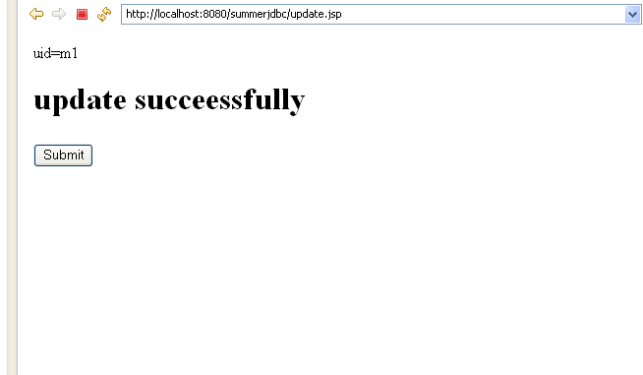

Slide 47
Summary
JDBC stands for Java Database Connectivity, which is a standard Java API for database-independent connectivity between a Java program and a wide range of databases.
Making a connection to a database
Creating SQL or MySQL statements
Executing that SQL or MySQL queries in the database
Viewing & Modifying the resulting records

