Slide 1
AI-Powered Validation Rule Generation
From Natural Language to Structured Validation Rules
POC using Local LLM Inference
Java • Spring Boot • Spring AI • Ollama • Qwen3 • PostgreSQL

Slide 2
Problem Statement & Objective
Problem Statement
Existing validation rules primarily support Primary and Secondary conditions
Complex business requirements can involve multiple conditions and logical combinations
Representing these requirements manually becomes difficult as complexity increases
Converting natural-language requirements into technical rule structures requires manual effort
Natural Language → 🤖 AI → Validation Rule
Objective
Convert natural-language requirements into structured validation rules
Support AND, OR and XOR combinations, including nested conditions
Reduce manual effort in rule creation
Validate and review the generated rule before it is added to the system
Goal
Simplify complex rule creation while keeping the process controlled and reviewable.

Slide 3
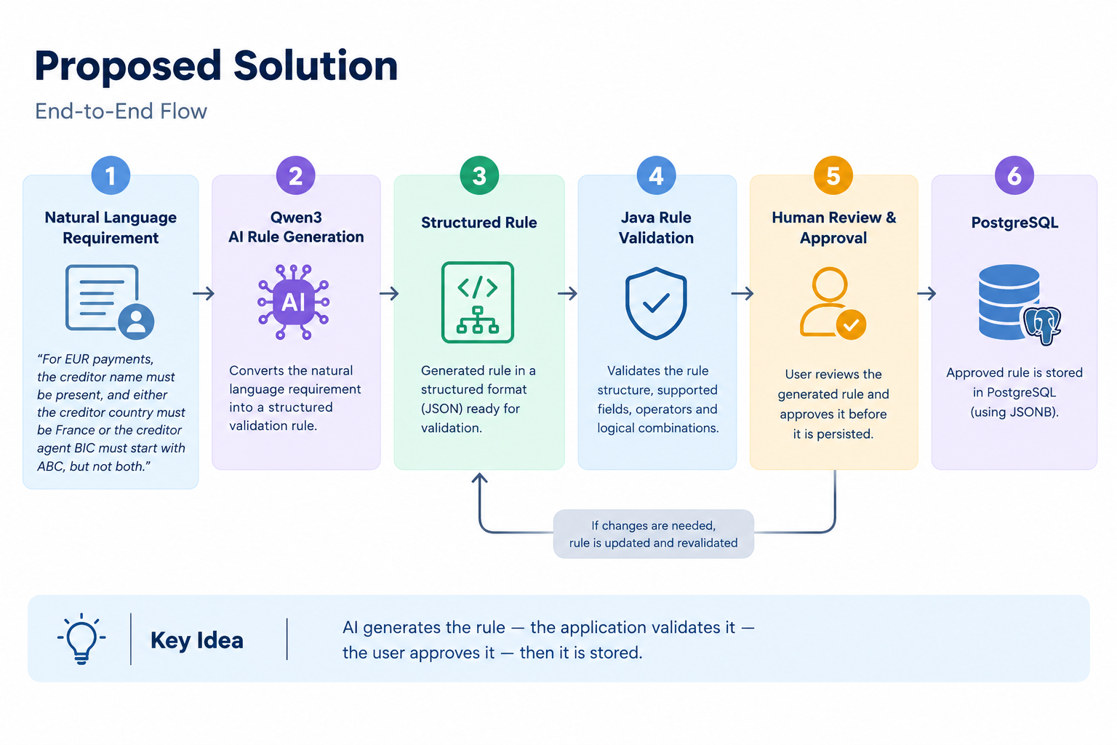

Slide 4
Complex Rule Example
Requirement:
  For EUR payments, the creditor name must be present, and either the creditor country must be France or the creditor agent BIC must start with ABC, but not both.
Structured representation:
AND
├── transactionCurrency == EUR
├── XOR
│ ├── creditor.postalAddress.country == FRA
│ └── creditorAgent.bic STARTS_WITH ABC
└── creditor.name PRESENT

Slide 5
Validation & Human Approval
Application Validation
The backend validates the AI-generated rule against:
• Supported fields
• Supported operators
• Logical structure
• Required values and conditions
Human Review & Approval
The generated rule is shown to the user before persistence.
The user can:
• Review the generated rule
• Regenerate if required
• Approve the rule
Only approved rules are stored.
AI-generated ≠ automatically published
AI-Powered Validation Rule Generation — POC

Slide 6
Technology Stack & Production Considerations
Frontend
React
Vite
CSS
Backend
Java
Spring Boot
REST / JPA / Hibernate
AI
Spring AI
Ollama
Qwen3 8B
Database
PostgreSQL
JSONB
POC Setup
• Qwen3 runs locally through Ollama
• Rule-generation requests do not need to be sent to a public external LLM API during local inference
• POC is optimized for demonstration, not production scale
Production Considerations
• company-managed GPU server/VM with an approved model and inference runtime, an internal AI platform/API, or an approved managed AI service.
• Review security, data residency, model governance and licensing
• Evaluate latency, concurrency, scalability, monitoring and availability
AI-Powered Validation Rule Generation — POC

