Slide 1

Sanjeevnam

Slide 2
Presentation Of
Project 2 [ CSE-410N]
Team Members
Tarun Kumar
2818063
Robin Bhutani
2818161
Tanuj
2818066

Slide 3
About Sanjeevnam :
The project aims at providing a completely free health predictor.
This project, we will develop a multiple disease predict system that can assist medical professionals in predicting disease status based on the clinical data of patients.
One Can check the vaccine slot in their nearby Vaccination Centre.
The system can be used by any type of users

Slide 4
Tools and Technology Used
Streamlit
Pandas
NumPy
Matplotlib
Sklearn
Linear Regression
Logistic Regression

Slide 5
Functionality | Description
1 | User Can Check the Vaccine Availability
2 | User Can Book The appointment with the concerned Doctor
3 | Parkinson Diseases Prediction
4 | Heart disease Prediction
5 | Diabetes Prediction
6 | Medical Insurance Cost Prediction
7 | Brain Tumour Detection
8 | Self-Assessment Test
Functionalities

Slide 6
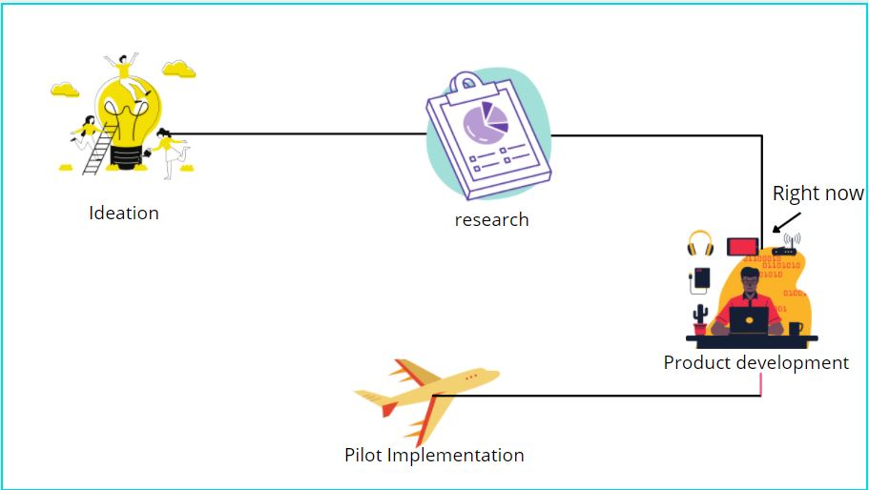

Slide 7
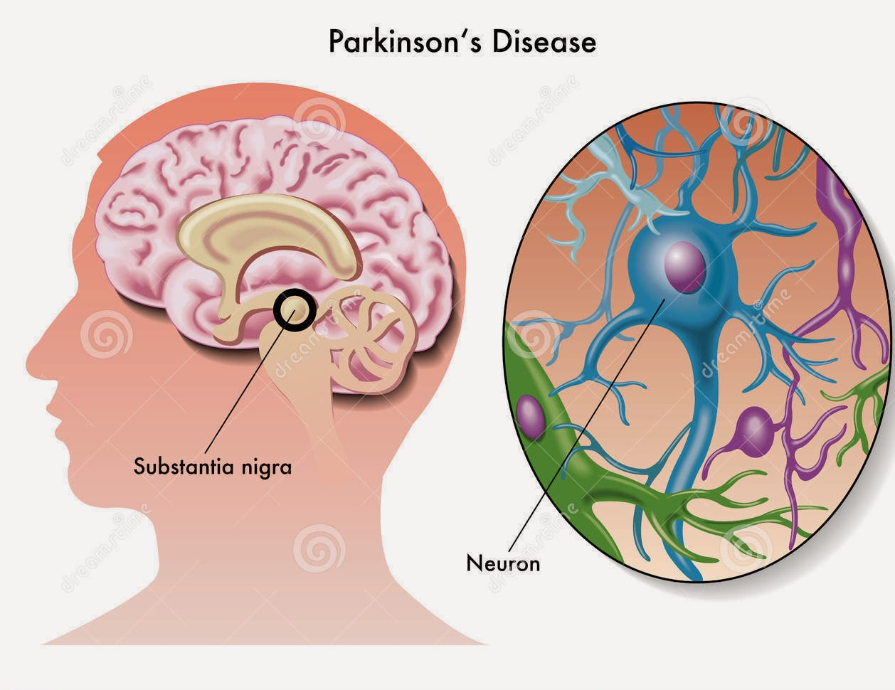
Parkinson Disease
Parkinson's disease is a neurodegenerative disease that develops because of the loss of dopamine, a neurotransmitter. PD is more common in the elderly population, causing changes in gait and posture that can increase the risk of falling and cause mobility problems. As a result, it influences everyday activities and lowers patient and family quality of life. Parkinson's disease is mainly a motor disorder. Inability to move freely, decreased, and sluggish movement, increased muscle tonus, and shaking movement in the resting posture are all symptoms of this movement disorder

Slide 8
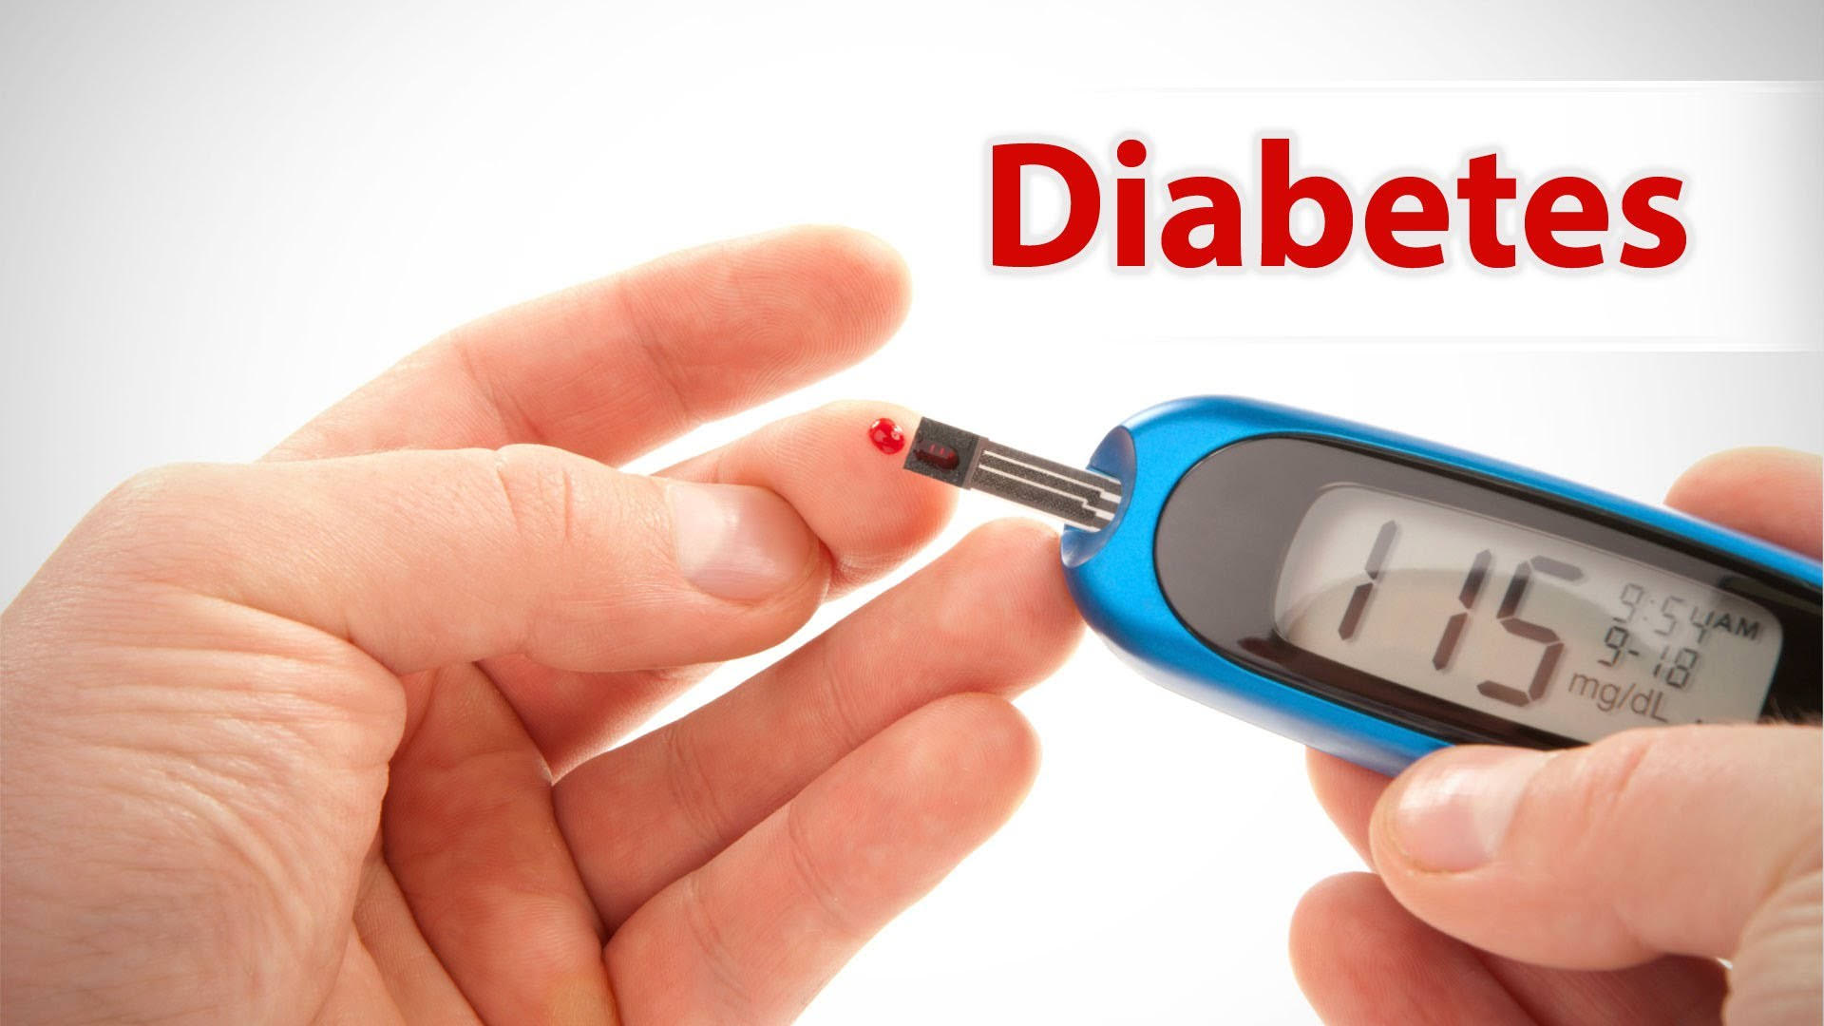
Diabetes
Diabetes is a disease that occurs when your blood glucose, also called blood sugar, is too high. Blood glucose is your main source of energy and comes from the food you eat. Insulin, a hormone made by the pancreas, helps glucose from food get into your cells to be used for energy. Sometimes your body doesn’t make enough—or any—insulin or doesn’t use insulin well. Glucose then stays in your blood and doesn’t reach your cells.
This Photo by Unknown Author is licensed under CC BY

Slide 9

Thank You

