Slide 1

Lecture 0 INT108:: PYTHON PROGRAMMING

Slide 2
Course Overview
3 | 0 | 2
L T P :
Credit: 4
Text Book:
1. FUNDAMENTALS OF PYTHON –FIRST PROGRAM by KENNETH A. LAMBERT, CENGAGE LEARNING
References Book:
1. PYTHON PROGRAMMING: USING PROBLEM SOLVING APPROACH by REEMA THAREJA, OXFORD UNIVERSITY PRESS

Slide 3
CA and ETP
CA
Programming Practice(Mandatory) 40 marks
Best 2 out of 3 Test Code -Based each of 30 marks
ETP
Programming Challenge

Slide 4
Marks Breakup
Marks Breakup:
Note :
20 Marks for programming practice, 15 marks for test code based.
Activity | Marks
Attendance | 5
Continuous Assessment (CA)* | 50(20+15+15)
End-Term Practical (ETP) | 45

Slide 5
Important information
Programming practice(Python Programming course ) . Student will complete it unit wise.
All code based test will be conducted on code tantra platform.
ETE will be conducted on code tantra platform.

Slide 6
Mandatory conditions for ca
First 50 percent of questions are mandatory to attempt in programming practice. After completion of first mandatory 50 % questions , remaining attempted questions marks will be awarded.

Slide 7
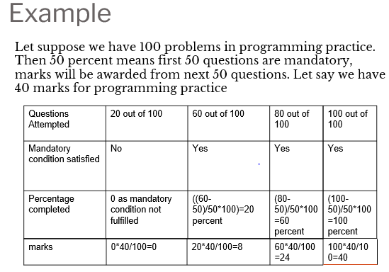

Slide 8
Mandatory conditions for ca
Programming practice marks will be awarded based upon performance in best 2 Code based test. There are total 3 code best test out of which best 2 will be considered.
Each Code based test will contain 10 MCQ questions each of 1 marks and 2 coding questions each of 10 marks.
Duration for code based test will be 1 hours

Slide 9
Performance in best 2 Code based test[x] | Weightage of programming practice
x>=81 percent | 100 percent marks of programming practice
71<=x<=80 | 70 percent marks of programming practice
51<=x<=70 | 50 percent marks of programming practice
30<=x<=50 | 30 percent marks of programming practice
X<30 | No marks will be awarded in programming practice

Slide 10
Code Based Test 1 (30) | Code Based Test 2 (30) | Code Based Test 3 (30) | Best 2 code based | Percentage | Programming Practice Question attempted | programming practice marks(out of 40)
24 | 16 | 21 | 45 | 45/60*100=75% | 100 | 40
30 | 30 | 20 | 60 | 60/60*100=100% | 80 | 24
15 | 30 | 15 | 45 | 45/60*100=75% | 80 | 24
30 | 30 | 10 | 60 | 60/60*100=100% | 40 | 0
21 | 10 | 21 | 42 | 42/60*100=70% | 90 | 32
Awarded marks based upon code based test( out of 40)
40*70/100=28
24*100/100=24
24*70/100=16.8
0
?
Again assume that there are 100 questions in programming practice and first 50 are mandatory to attempt, marks will be awarded on attempt of next 50 questions. Use the previous table(mentioned in slide 6 ) for programming practice marks calculation. Use table mentioned in slide 8 for Awarded marks based upon code based test

Slide 11
Answer
16

Slide 12
Star Course
Hands-on Practice: A good course which include interactive coding exercises to help you apply what you've learned.
This course is a short bite-sized courses that help students develop foundational-level knowledge and skills in Python language. Although the course is packed with high quality content that helps students further with their learning and earn credits.

Slide 13
Course Objectives
CO1 :: define the installation of python environment and basics of Python language
CO2 :: apply the condition and iteration statements for evaluating the appropriate alternates
CO3 :: apply to formulate Regular Expressions and use them for Pattern Matching encapsulation, polymorphism, and inheritance.
CO4 :: construct the core data structures like lists, dictionaries, tuples and sets in Python to store, process and sort the data
CO5 :: apply the concepts of Object-oriented programming as used in Python using encapsulation, polymorphism, and inheritance
CO6 :: apply the external modules for creating and writing data to excel files and inspect the file operations to navigate the file systems

Slide 14

Why languages?

Slide 15

COMPUTER IS SMART ?????
https://www.youtube.com/watch?v=lfuUiBanVDM

Slide 16
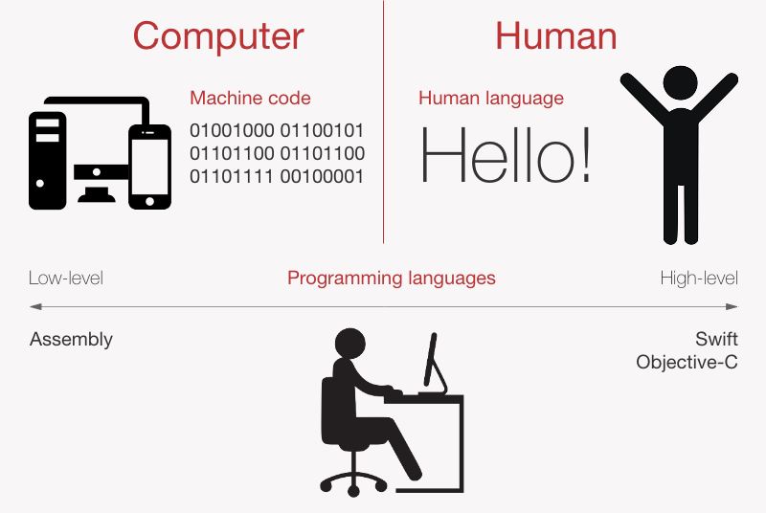
Computer Language vs. Human Language

Slide 17
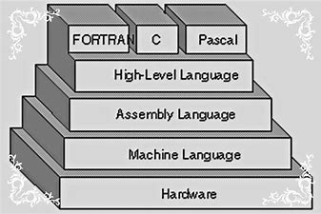
Different Computer Languages

Slide 18
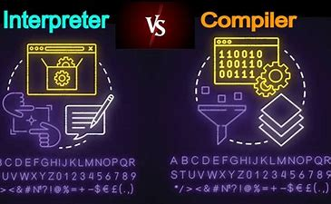
Compiler vs. Interpreter

Slide 19

Make language your Friend

Slide 20
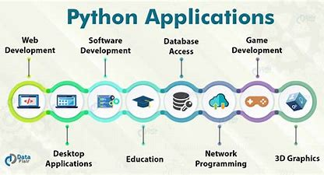

Slide 21
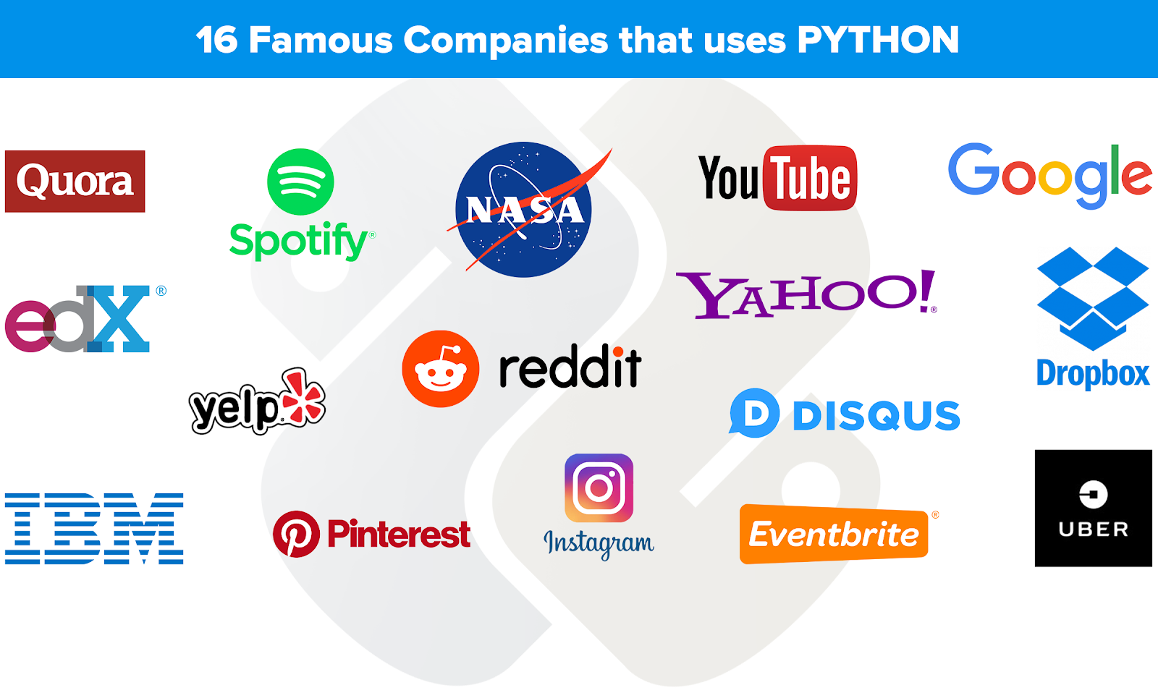

Slide 22

Overview of Unit 1

Slide 23
Unit 1
Setting up your Programming Environment : Python versions, Python on windows, running a ‘Hello World’ program
Variables, Expression and Statements: Naming and using variables, Avoiding Name Error when using variables, Values and types, variables, variables name and keywords, statements, operators and operand, order of operations, operations on string, composition and comments

Slide 24
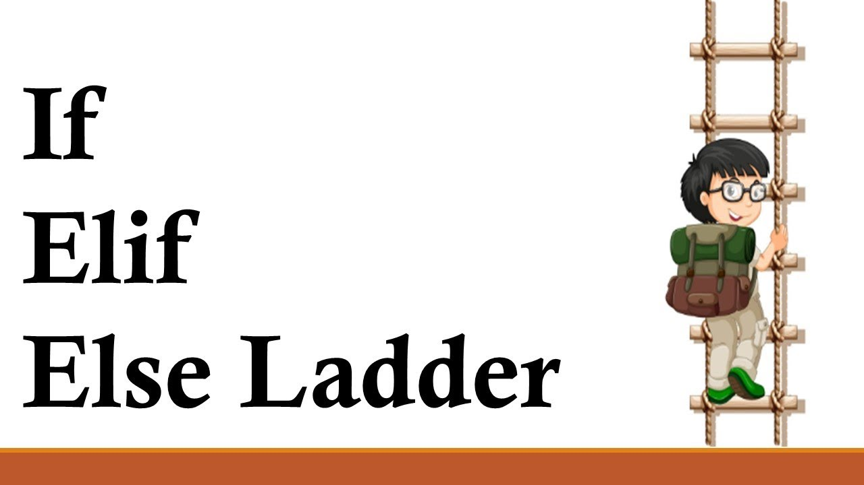
Overview of Unit 2

Slide 25
Unit 2
Conditional statements : modulus operator, Random numbers, Boolean expressions, logic operators, conditional, nested conditionals
Iterative statements : while statements, for loop statement, Nested for, Nested while, Random numbers in loops, encapsulation and generalization

Slide 26
Unit 3
Functions and recursion : function calls, type conversion and coercion, math functions, adding new function, parameters and argument, recursion and its use

Slide 27
Unit 4
String : string a compound data type, length, string traversal, string slices, comparison, find function, looping and counting
Lists : list values, length, membership, operations, slices, deletion, accessing elements, list and for loops, list parameters and nested list
Tuples and Dictionaries : mutability and tuples, tuple assignment, tuple as return values, dictionaries operations and methods, sparse matrices, aliasing and coping

Slide 28
Unit 5
Classes and objects : Creating classes, creating instance objects, accessing attributes
Object oriented programming terminology : Class Inheritance, Overriding Methods, Data Hiding, Function Overloading

Slide 29
Unit 6
Files and Exceptions : text files, writing variables, Reading from a file, writing to a file, directories, pickling, handling the zero Division error exception, using try-except blocks, The else block, Handling the File Not found error exception
Regular Expressions : Concept of regular expression, various types of regular expressions, using match function, Web Scraping by using Regular Expressions

Slide 30


