Slide 1
NLP (Natural language processing) Analysis of restaurant reviews

Slide 2
Natural language processing (NLP) is an area of computer science and artificial intelligence concerned with the interactions between computers and human (natural) languages, in particular how to program computers to process and analyse large amounts of natural language data. It is the branch of machine learning which is about analysing any text and handling predictive analysis.
GOAL
To develop a program using ‘Logistic Regression Model’ to find out whether given Restaurant review is positive or negative.

Slide 3
ABSTRACT:
The program is written in python. Each review from data set is labelled 1 for ‘positive’ and 0 for ‘negative’. Program uses 80:20 ratio of training samples vs test samples. Pre-processing is done which include tokenization using a python library NLTK and feature selection. Our goal is to classify whether the review is positive or negative using machine learning model, here Logistic Regression is used.
Prerequisite and setting up the environment
The prerequisites to follow this example are python version 3.7 and Spyder IDE. You can just install anaconda and it will get everything for you. Also, little bit of python and ML basics including text classification is required. We will be using scikit-learn (python) libraries for our example.
Scikit-learn is a free software machine learning library for Python programming language. Scikit-learn is largely written in Python, with some core algorithms written in Cython to achieve performance. Cython is a superset of the Python programming language, designed to give C-like performance with code that is written mostly in Python.

Slide 4
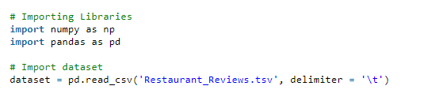
Steps Involved
Step 1:
Import dataset with setting delimiter as ‘\t’ as columns are separated as tab space. Reviews and their category(0 or 1) are not separated by any other symbol but with tab space as most of the other symbols are is the review (like $ for price, ….!, etc) and the algorithm might use them as delimiter, which will lead to strange behaviour (like errors, weird output) in output.

Slide 5
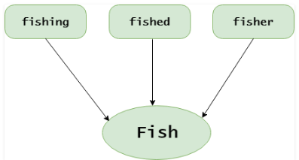
Step 2: Text Cleaning or Pre-processing
Remove Punctuations, Numbers: Punctuations, Numbers doesn’t help much in processing the given text, if included, they will just increase the size of bag of words that we will create as last step and decrease the efficiency of algorithm.
Stemming: Take roots of the word
Convert each word into its lower case: For example, it useless to have same words in different cases (eg : ‘good’ and ‘GOOD’).

Slide 6
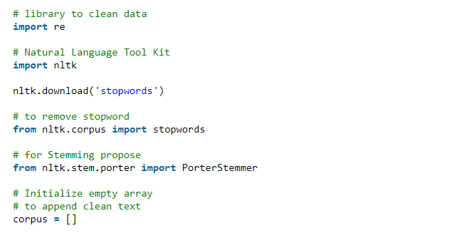

Slide 7
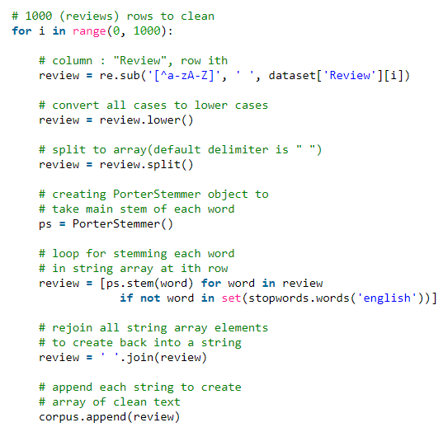

Slide 8
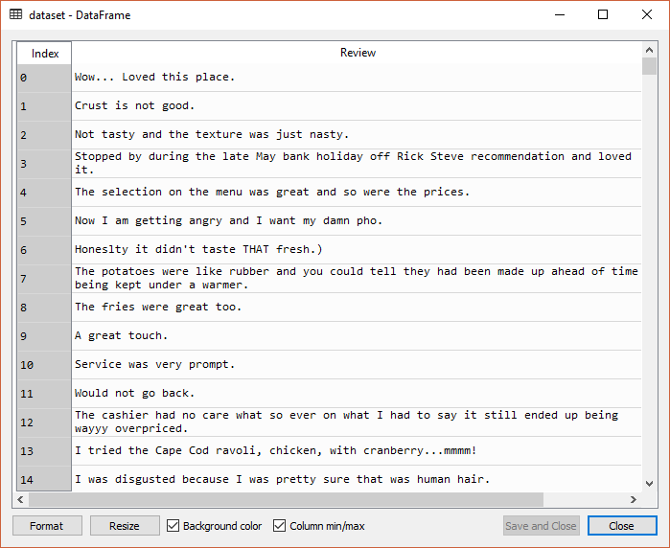
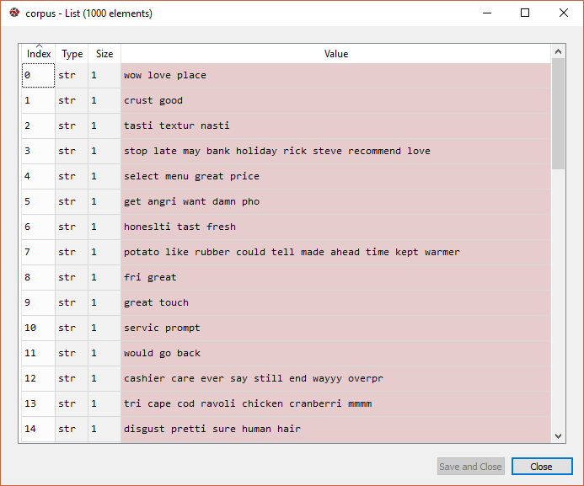
Before and after applying above code

Slide 9

Step 3: Tokenization, involves splitting sentences and words from the body of the text.
Step 4: Making the bag of words via sparse matrix
Take all the different words of reviews in the dataset without repeating of words.
One column for each word, therefore there are going to be many columns.
Rows are reviews
If word is there in row of dataset of reviews, then the count of word will be there in row of bag of words under the column of the word.
Step 5 : Splitting Corpus into Training and Test set.
For this we need class train_test_split from sklearn.cross_validation. Split can be made 70/30 or 80/20 or 85/15 or 75/25, here I choose 80/20 via “test_size”. x is the bag of words, y is 0 or 1 (positive or negative).

Slide 10

Step 6: Fitting a Predictive Model
Various Available models :
Naive Bayes Classifier
Linear Classifier
Support Vector Machine
Bagging Models
Shallow Neural Networks
Deep Neural Networks
Convolutional Neural Network (CNN)
Bidirectional RNN
Recurrent Convolutional Neural Network (RCNN)
Fit the model via .fit() method with attributes X_train and y_train

Slide 11
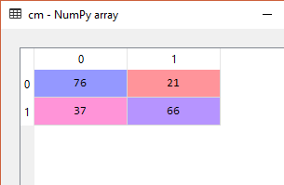
Step 7: Predicting Final Results via using .predict() method with attribute x_test
Step 8: To know the accuracy, confusion matrix is needed.
Note: Accuracy with Logistic Regression was 71%.(It may be different when performed experiment with different test size, here = 0.20).

Slide 12
THANK YOU

