Slide 1
Model Performance Summary
Comparison of Experiments

Slide 2
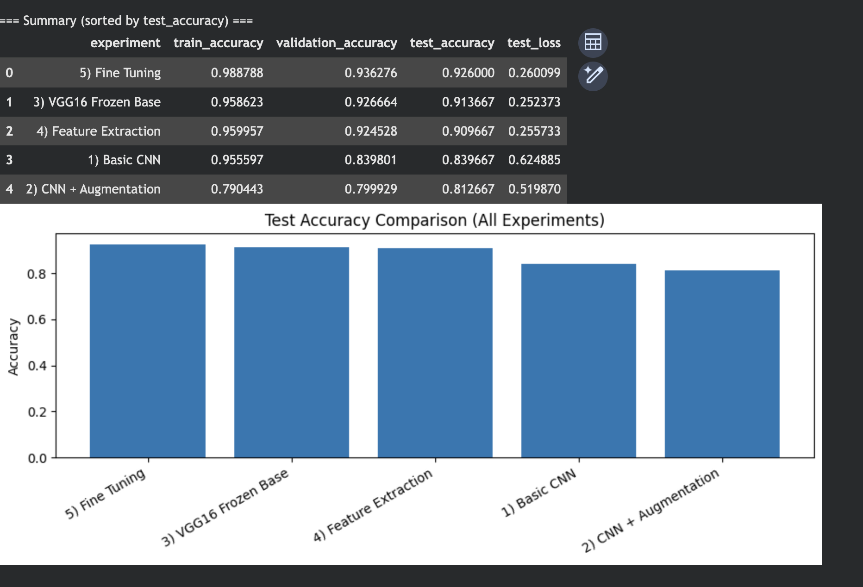

Slide 3
Key Insight
Insight: Fine Tuning worked best overall, achieving the highest test accuracy of 0.9234.

