Slide 1
Intelligent classification for rural Infrastructure projects
CAPSTONE PROJECT
Presented By:
Tarun Koneru
Vasavi College of Engineering (ECE Department)

Slide 2
OUTLINE
Problem Statement
Proposed System/Solution
System Development Approach (Technology Used)
Algorithm & Deployment
Result (Output Image)
Conclusion
Future Scope
References

Slide 3
Problem Statement
The Pradhan Mantri Gram Sadak Yojana (PMGSY) is a flagship rural development program in India, initiated to provide all-weather road connectivity to eligible unconnected habitations. Over the years, the program has evolved through different phases or schemes (PMGSY-I, PMGSY-II, RCPLWEA, etc.), each with potentially distinct objectives, funding mechanisms, and project specifications. For government bodies, infrastructure planners, and policy analysts, efficiently categorizing thousands of ongoing and completed projects is crucial for effective monitoring, transparent budget allocation, and assessing the long-term impact of these schemes. Manual classification is time-consuming, prone to errors, and scales poorly.

Slide 4
Proposed Solution
To effectively address the problem statement, I propose a solution that leverages Machine Learning algorithms to accurately classify each rural infrastructure construction project into its appropriate PMGSY_SCHEME category. While it is possible to develop the model entirely from scratch using open-source tools, this approach can be time-consuming and resource-intensive. Therefore, I opted to use the IBM Cloud platform, which offers an integrated environment for data preparation, model development, and deployment. The solution consists of the following components:
Data Collection:
The data required was obtained from the ‘AI Kosh’ website which is India's first large-scale non-personal data repository.
The dataset used is called ‘Pradhan Mantri Gram Sadak Yojna (PMGSY)’.
Data Preprocessing:
The dataset was cleaned using the ‘Data Refinery’ on IBM Cloud where I cleaned the data to handle outliers, missing values and inconsistencies.
Like removing the empty columns, making sure that all the columns have data with consistent data type and so on.

Slide 5
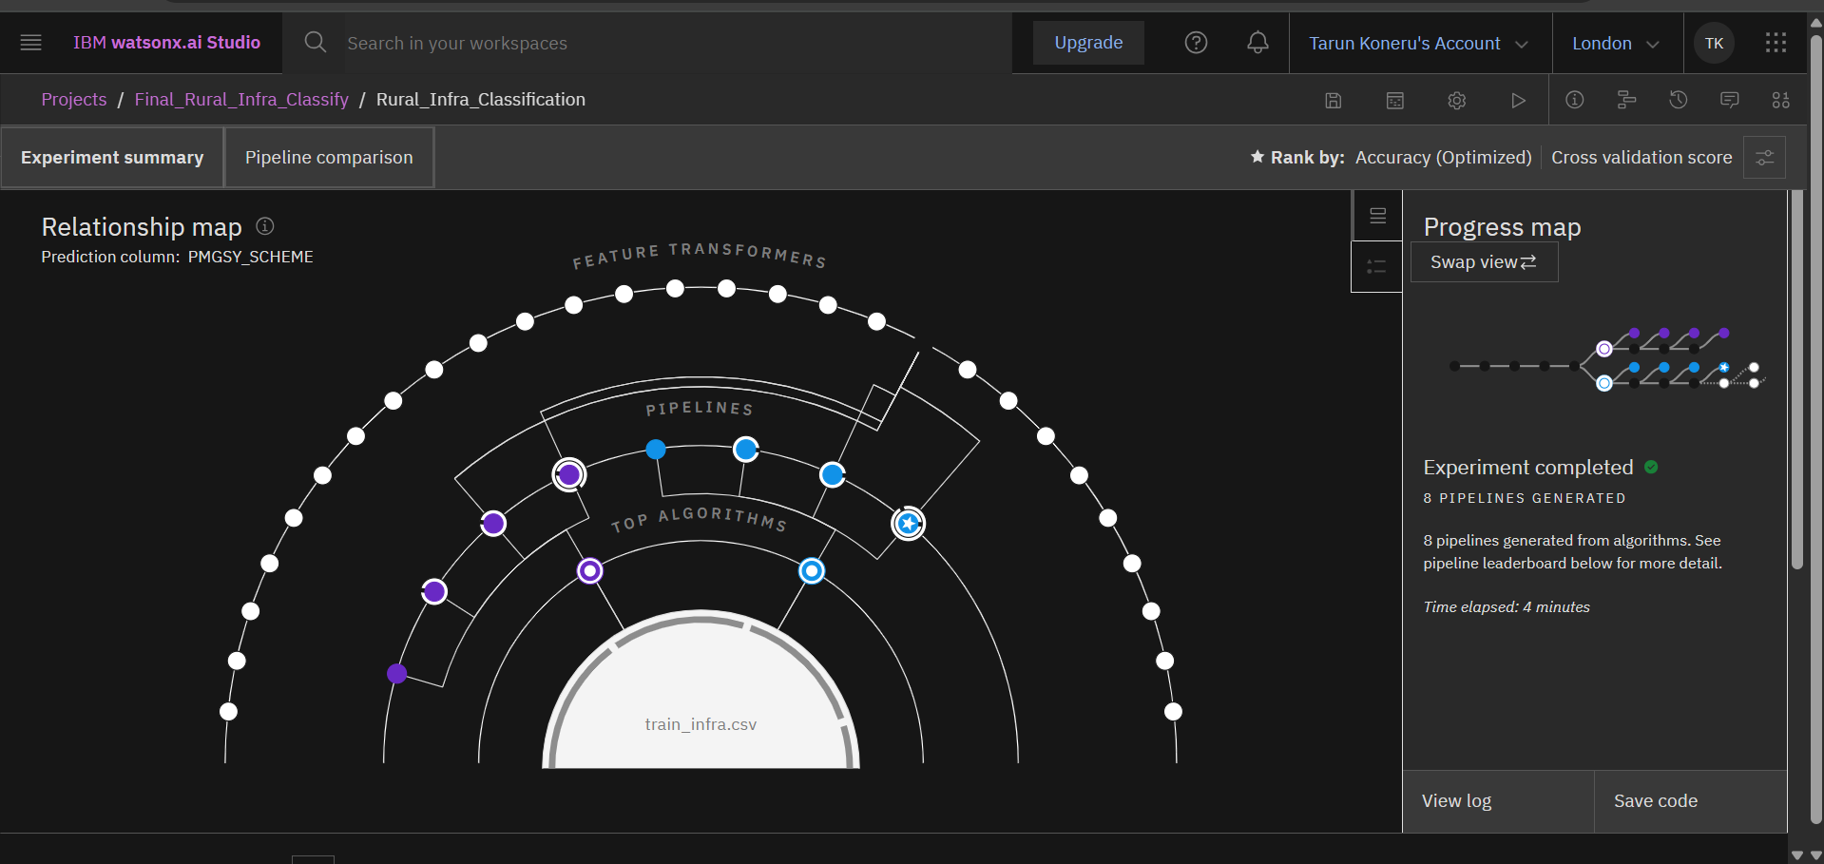
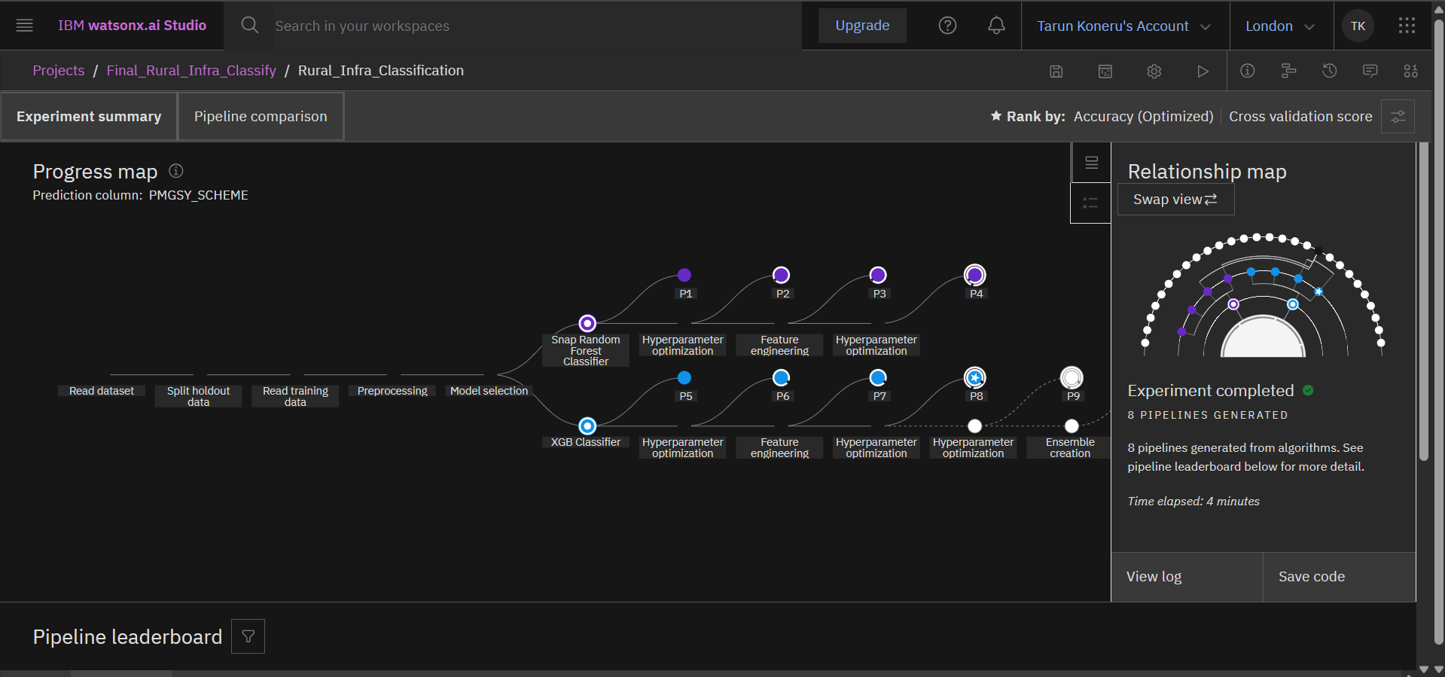
Proposed Solution
Building the Machine Learning Model:
Now that I have the cleaned data I proceeded with the next step which is building the ML model.
For this I used the watsonx.ai studio service available on IBM Cloud. This service allows us to build the ML models automatically.
For this we have to import the cleaned dataset and select the target column which has to be predicted. The Auto ML feature analyses the dataset, automates the selection of the proper classification algorithm and gives us a set of best ML pipelines.

Slide 6
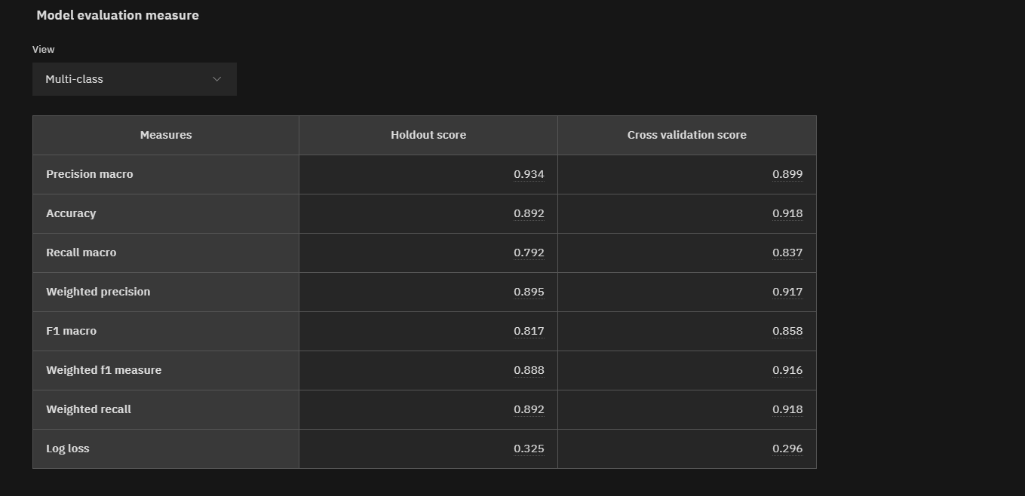
Proposed Solution
Evaluation:
Out of the select pipelines, pipeline-8 which uses an XG Boost Classifier with Feature Engineering and 2 Hyperparameter optimizations.
When compared with other pipelines’ performance metrics this pipeline was found to be more accurate.

Slide 7
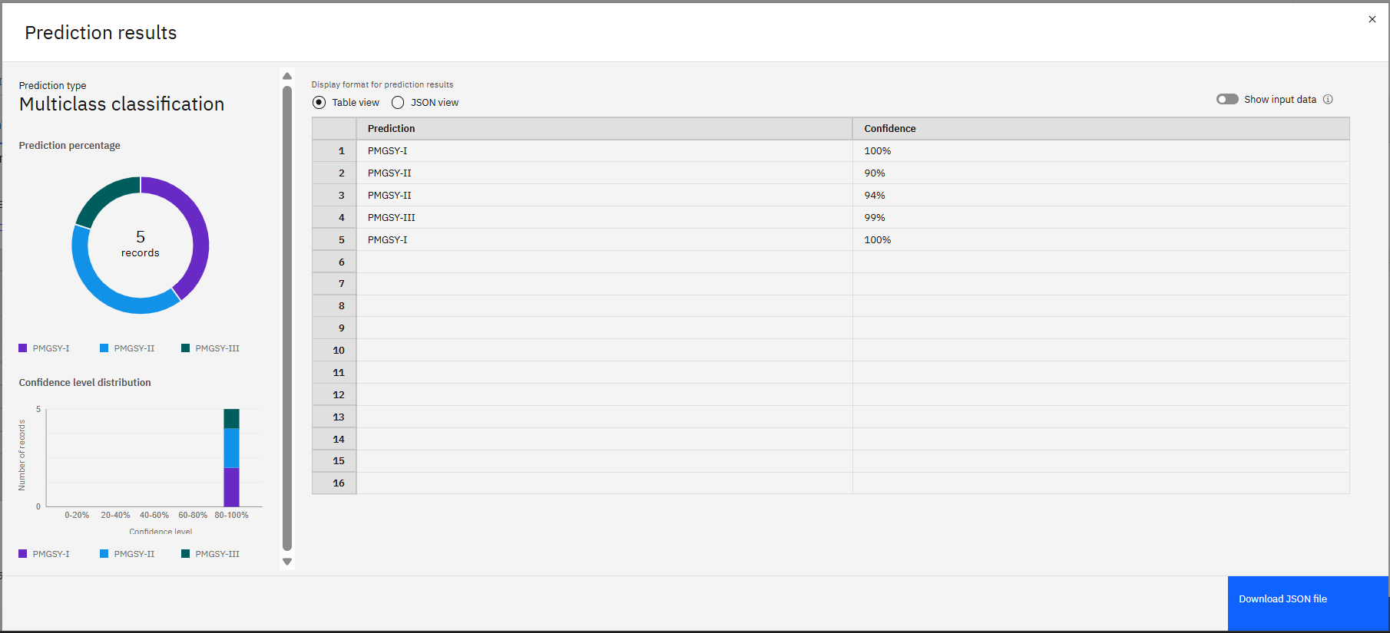
Proposed Solution
Obtained Results:
After saving the pipeline as an ML model and deploying it as a REST API, it was tested on IBM cloud using a sample dataset and the following results were obtained:

Slide 8
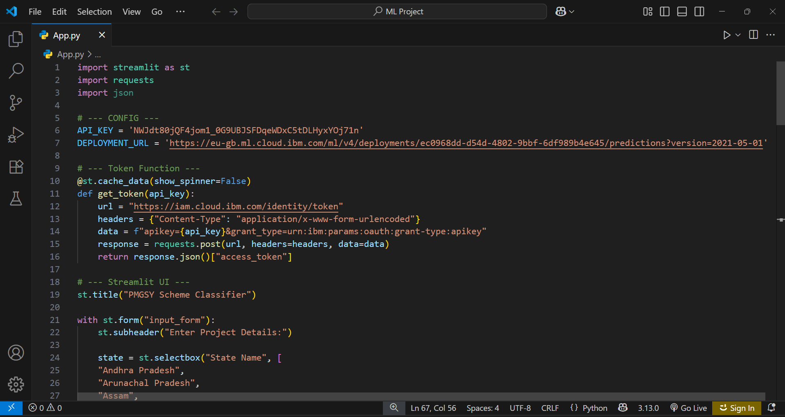
Proposed Solution
Creating a web app using streamlit:
After the model is tested, a simple yet effective UI is created using python’s streamlit library for entering the input data and get the predicted scheme.

Slide 9
System Approach
Hardware Requirements:
Laptop (with min 8GB RAM)
Software Requirements:
IBM Cloud
Watsonx.ai studio and runtime service
Cloud Object Storage
Streamlit Library (for web App UI)
VS code (to run streamlit python code)

Slide 10
Algorithm & Deployment
Algorithm Selection:
After the dataset was provided, the IBM AutoML selected XGB Classifier as the best-performing algorithm.
Gradient Boosting is a technique where new models (typically decision trees) are added sequentially to correct the errors made by the existing ensemble of models. Each new tree tries to fix the shortcomings of the previous trees.
The XGBoost classifier is an advanced implementation of the Gradient Boosting algorithm designed specifically for performance and speed. It is short for Extreme Gradient Boosting..
This model was chosen due to its high performance with structured data and robustness against overfitting through regularization.
Training of the model:
The training of the model was done in the following way:
The dataset was uploaded in the .csv format to the watsonx.ai studio under a new AutoML experiment. The target variable was selected was PMGSY_SCHEME.
The AutoML performed the data cleaning(handling the missing values and encoding), Model selection and train-test-validation splitting internally.
The training process included cross-validation to avoid overfitting, Evaluation of multiple pipelines and final model selection.

Slide 11
Algorithm & Deployment
Model Deployment:
For deploying of the model, I created a deployment space in the IBM Cloud.
In the deployment space, watsonx.ai runtime service and Cloud Object Storage were associated. The type of deployment selected was Online Deployment.
After the deployment is done, the API endpoint (both private and public) to send the JSON input data and bearer token are generated.
The API endpoint and the API key (created on watsonx.ai studio) can be used to use the deployed model outside the IBM Cloud (like a web app).
Accuracy and model evaluation:
The model performance was evaluated using:
Accuracy %: Percentage of correct predictions across all the classes.
F1-Score: Harmonic mean of precision and recall (used for class imbalance)
The accuracy of the model was found to be 91.8% and the F1-score was found to be 0.916.

Slide 12
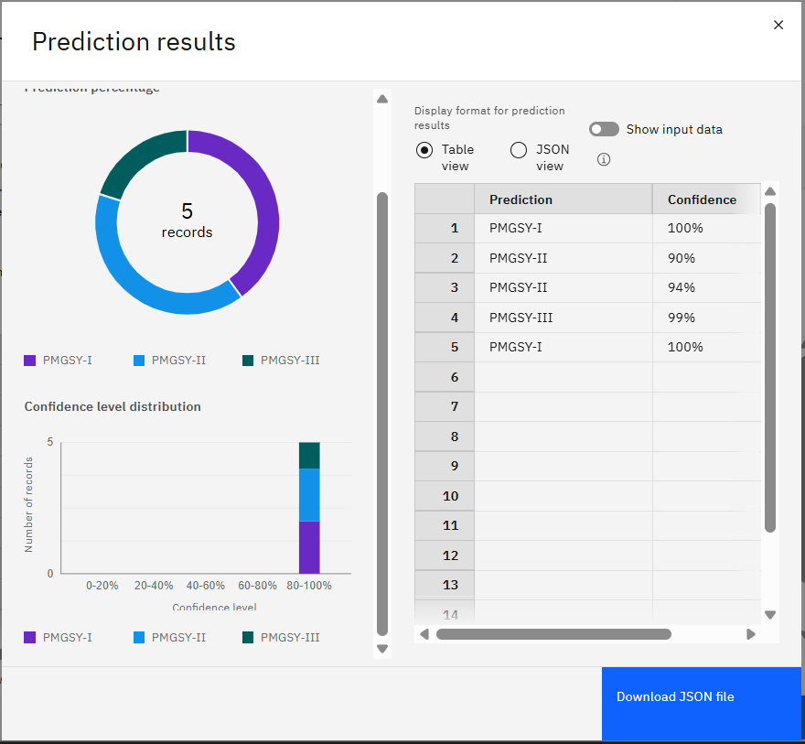
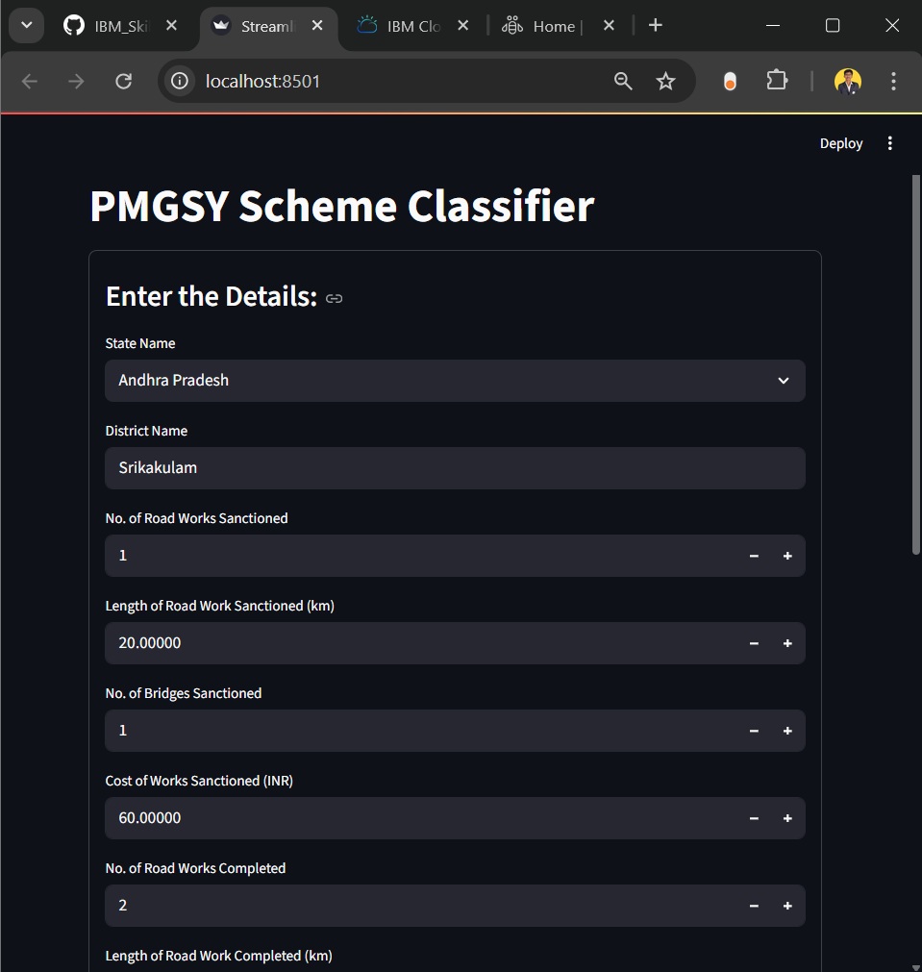
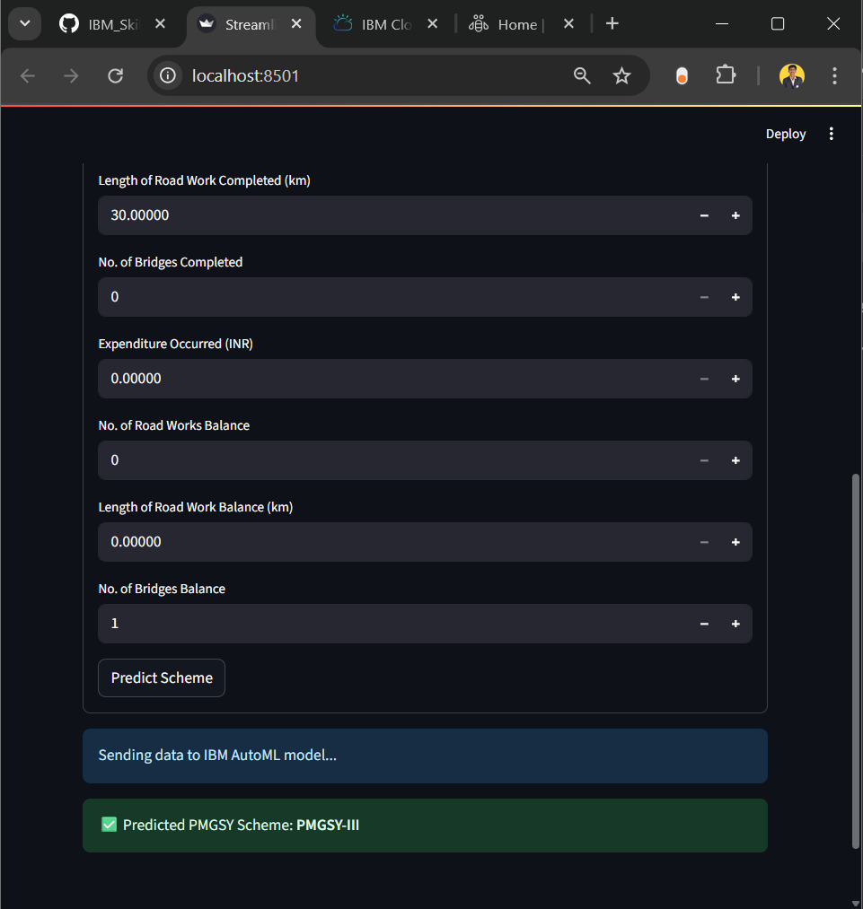
Result
After successfully finishing all the steps, the following results are obtained:

Slide 13
Conclusion
In conclusion, this project successfully demonstrated the use of IBM Cloud’s AutoAI capabilities to intelligently classify rural infrastructure projects under the Pradhan Mantri Gram Sadak Yojana (PMGSY) into their respective schemes. By leveraging the XGBoost classifier along with automated hyperparameter tuning and feature engineering, the model achieved high accuracy and efficiency in classification. The deployment of the trained model as a REST API on Watson Machine Learning further enabled seamless integration for real-time predictions, offering a scalable and reliable solution for aiding government bodies and infrastructure planners in project monitoring and decision-making.

Slide 14
Future scope
In the future, this project can be expanded to include additional data sources such as satellite imagery, geographic information system data, and on-ground progress reports to improve classification accuracy and support broader infrastructure analytics.
With further refinement and integration into government dashboards, it can contribute to transparent governance and data-driven policy-making.

Slide 15
References
IBM Cloud Docs – AutoAI: https://www.ibm.com/docs/en/cloud-paks/cp-data/4.7.x?topic=services-autoai
IBM Cloud Docs – Watson Machine Learning: https://www.ibm.com/docs/en/cloud-paks/cp-data/4.7.x?topic=ml-watson-machine-learning
Streamlit Docs: https://docs.streamlit.io/

Slide 16
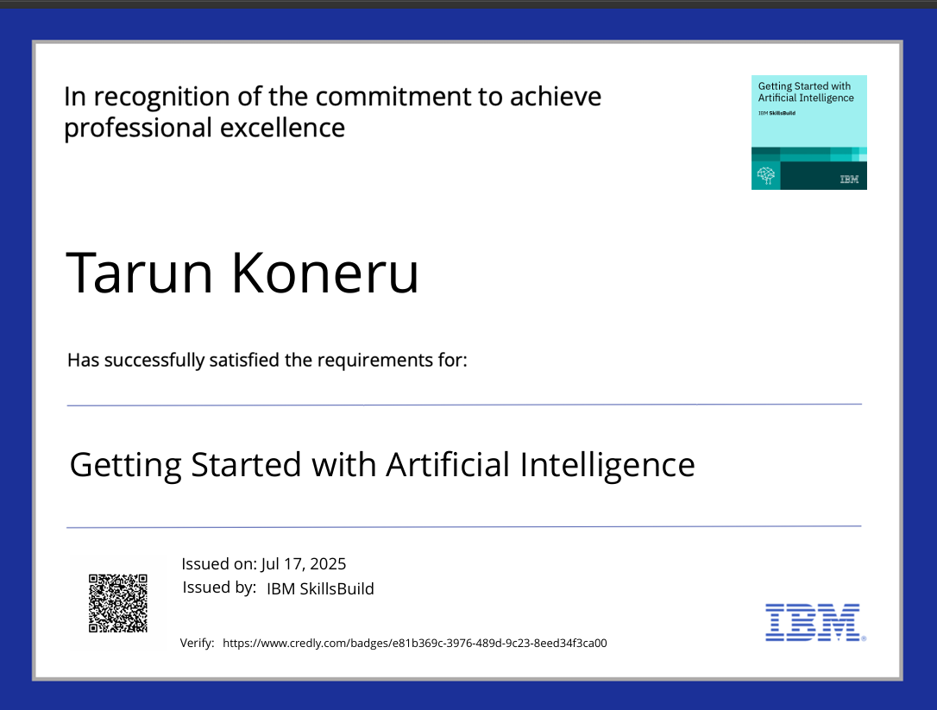
IBM Certifications

Slide 17

IBM Certifications

Slide 18
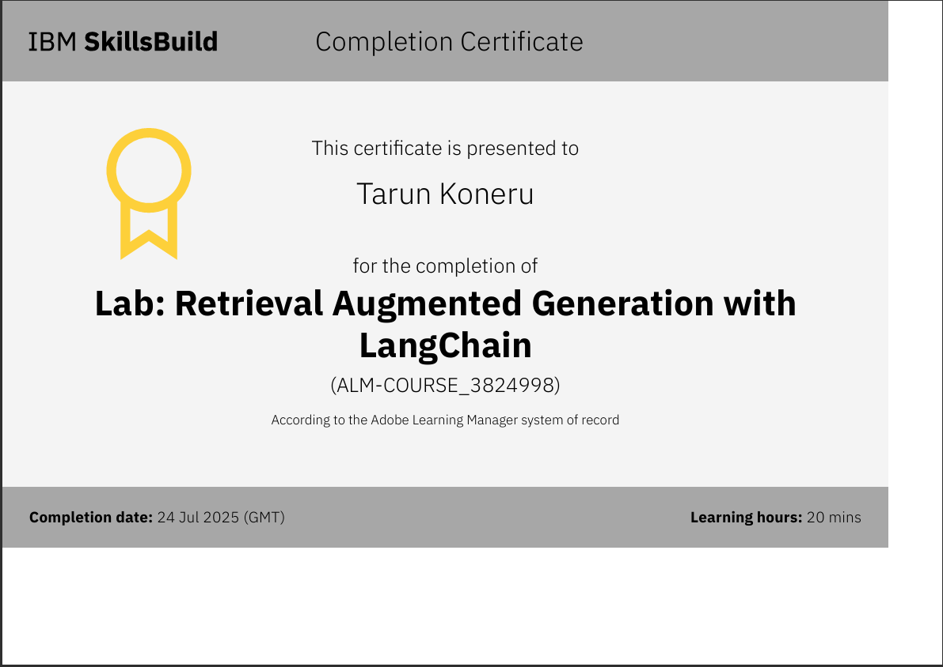
IBM Certifications

Slide 19
THANK YOU

