Slide 1


www.studymafia.org
Seminar
On
Wireless Electricity
Submitted To: Submitted By:
www.studymafia.org www.studymafia.org
Notes:
1
1

Slide 2
CONTENT
What is Wireless Electricity ?
History
Block diagram
Physics behind Wireless electricity
Witricity
Advantages
Disadvantages
Conclusion
Reference
Notes:
Beginning course details and/or books/materials needed for a class/project.

Slide 3
What is Wireless Electricity
Transmission of electrical energy from power source to an electrical load without using wires.
Different from cellular transmission of signals
Notes:
A schedule design for optional periods of time/objectives.

Slide 4
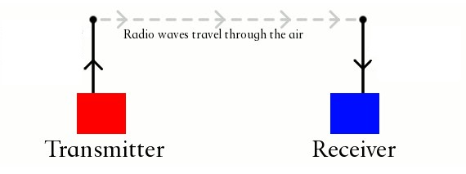
Cell transmission of signals - radio waves
Wireless mode of transmission - oscillating magnetic pulses.

Slide 5
Water – Current Analogy
Pumping of water through a host
The flow of water- current
Pressure – Voltage
Nozzle –Capacitive terminals

Slide 6
Tesla Coil
Similary, when current is passed through a small primary coil to a larger secondary coil
As a result, the voltage steps up tremendously.
This makes the Tesla Coil a Transformer.

Slide 7
Tesla Coil
The transmission distance was increased by using a receiving LC circuit ,tuned to resonance with the transmitter's LC circuit.
Using voltages of the order of 20 megavolts generated by an enormous coil,
He was able to light three incandescent lamps by resonant inductive coupling
Distance -100 feet (30 m).

Slide 8
Wardenclyffe Tower
Tesla began construction of a large high-voltage coil facility, the Wardenclyffe Tower
A prototype transmitter for a "World Wireless System"
To transmit power worldwide.
The facility was never completed, due to lack of funding

Slide 9
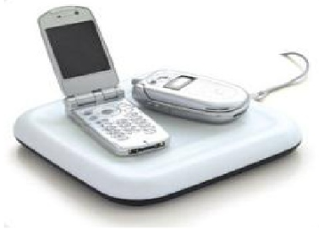
Wireless Electricity
Now-a-days there is a rapid increase of electronic goods like cell phones ,laptops ,I-pods etc., which rely on the chemical storage of energy by the battery which need to be recharged frequently As these are becoming daily needs to the present generation wireless energy transfer i.e, witricity would be useful for many applications as these things need mid range energy.

Slide 10
How it Works
Wireless Electricity uses the principle which involves the usage of inductively coupled objects with same resonant frequency.
The principle Electromagnetic Induction states that a coil generating magnetic field induces a current in another coil as it is being placed in the field of the former coil.
On the usage of resonance, the energy is well transferred between coils having same resonant frequency without any interruption.
Notes:
Relative vocabulary list.

Slide 11
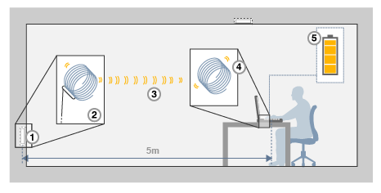
There are two copper coils arranged. One at the sender end and the other at the receiver end.
Power Supply
Transmitting Coil
Magnetic field
Receiving Coil
Status of Battery

Slide 12
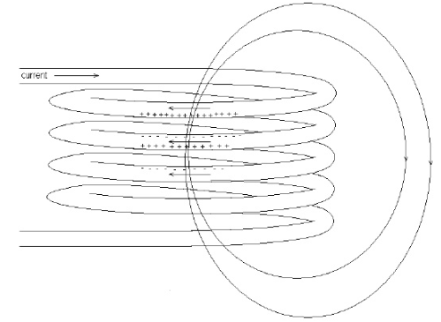
Primary Coil
When the power is switched on the first coil converts the electricity into magnetic field, which is oscillating at a particular frequency.

Slide 13
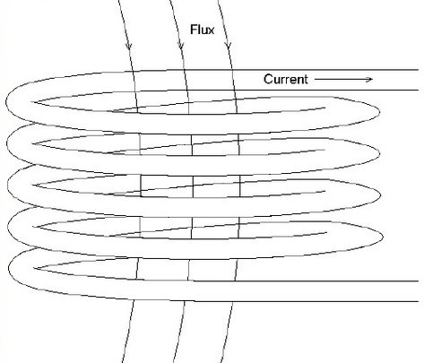
Secondary Coil
The second coil at the receiving end converts the oscillating magnetic field into electricity.
The surrounding environment remains unaffected.

Slide 14
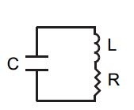
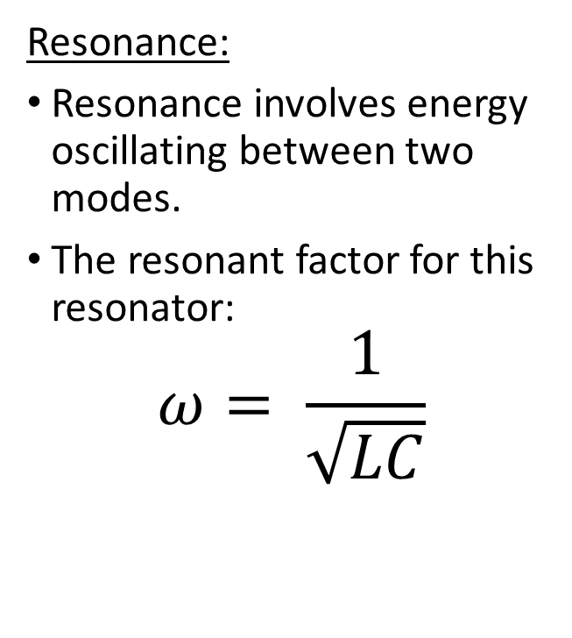
PHYSICS BEHIND WIRELESS TECHNOLOGY
Resonance:
Resonance involves energy oscillating between two modes.
The resonant factor for this resonator:
$$ω= \frac{1}{\sqrt{LC}}$$

Slide 15
PHYSICS BEHIND WIRELESS TECHNOLOGY
Two objects having similar resonance tend to exchange energy without causing any effects on the surrounding objects.
Notes:
A list of procedures and steps, or a lecture slide with media.

Slide 16
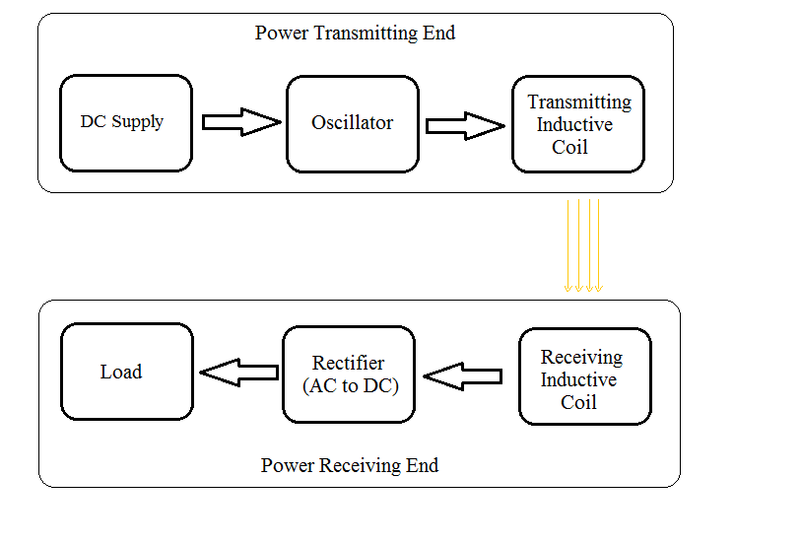
Basic block diagram

Slide 17
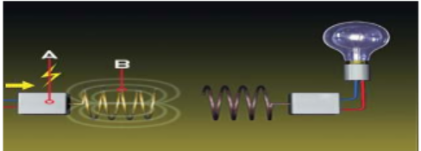
Sequence of flow of Power
Step 1
A circuit [A] attached to the wall socket converts the DC current to 2 megahertz and feeds it to the transmitting coil [B].
The oscillating current inside the transmitting coil causes the coil to emit a 2 -megahertz magnetic field

Slide 18
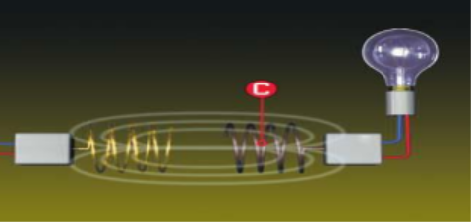
Continued…
Step 2
The receiving coil [C] is designed to resonate at the same frequency
Magnetic induction takes place.
Receiving coil picks up the energy of the first coil's magnetic field.

Slide 19
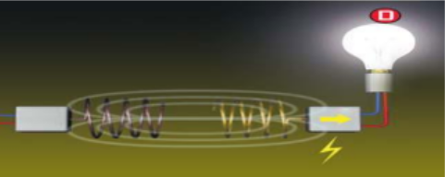
Continued…
Step 3
The energy of the oscillating magnetic field induces an electrical current in the receiving coil, lighting the bulb [D].

Slide 20
Applications
Totally replaces the wires
Electronic gadgets like laptops, mobiles, iPod etc. can be charged wirelessly
Charging is automatic, without human intervention

Slide 21
Advantages
It doesn’t require line of sight.
It doesn’t require batteries and power cables.
It doesn’t interfere with radio waves.
In this, wastage of power is in a small quantity.
It is highly efficient when compared with electromagnetic induction.
It is affordable.

Slide 22
Limitations
Size
Cost
Range and
Efficiency

Slide 23
Future of Wireless Electricity
Think of the revolutionary impact of the wireless phone. Now, imagine that same impact on power. The future is one where power can be completely untethered and can be installed anywhere, at a fraction of the cost. This will create a huge disruption to the monopoly held by power distributors.
Wireless smart control, or smart off-grid, is going to be what enables this big shift in the power industry. Big Data, advanced analytics, and soon, artificial intelligence (AI), will also have a material impact on performance and

Slide 24
Conclusion
Non-radioactive mode of energy transfer.
Magnetic fields interact very weakly with biological organisms—people and animals and are scientifically regarded to be safe.
It can transfer the power through walls and any metal obstacles.
Transmission efficiency is maximum over short range of distance (mm).
Wireless Electricity technology is based on sharply resonant strong coupling.
It is able to transfer power efficiently even when the distances between the power source and capture device are several times the size of the devices themselves
Notes:
Example graph/chart.

Slide 25
References
www.google.com
www.wikipedia.com
www.studymafia.org

Slide 26
THANKS

