Slide 1
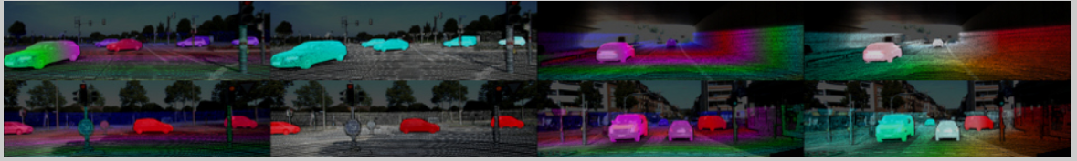
MatXtract: GPU Performance Analysis on NVIDIA RTX 5060
Tarun Malepati
Indiana University • High Performance Computing (B649)
CUDA-Based Sparse Matrix Benchmarking on Ada Lovelace (SM89)
github.com/TarunMalepati99/MatXtractt

Slide 2
Hardware, Build Environment & Dataset
Hardware Platform
GPU: NVIDIA RTX 5060 Laptop (SM120, Blackwell) — Lenovo Legion
3072 CUDA cores • 8 GB GDDR7 • 288 GB/s BW
CPU: Intel Core i7-13700H • 16 GB DDR5 RAM
Build Configurations
build-baseline Unprofiled reference (sm_89)
build-5060 --use_fast_math, -O3, line-info
build-5060-ninja Ninja generator, VS Code integration

Slide 3
Hardware, Build Environment & Dataset
Matrix Name | Rows | Cols | Non-zeros (NNZ) | Description
ash85 | 85 | 85 | 523 | Holland survey matrix (Symmetric pattern)
bcsstk14 | 1,806 | 1,806 | 63,454 | Stiffness matrix - Roof of Omni Coliseum, Atlanta
cnr-2000 | 325,557 | 325,557 | 3,216,152 | Web crawl of Italian CNR domain
com-Amazon | 334,863 | 334,863 | 1,851,744 | Amazon product co-purchasing network
com-Youtube | 1,134,890 | 1,134,890 | 2,987,624 | Youtube online social network
poisson3Da | 13,514 | 13,514 | 352,762 | 3D Poisson problem (FEMLAB)
web-Stanford | 281,903 | 281,903 | 2,312,497 | Stanford University web graph (2002)
west0479 | 479 | 479 | 1,888 | 8 stage column section (Chemical Engineering)

Slide 4
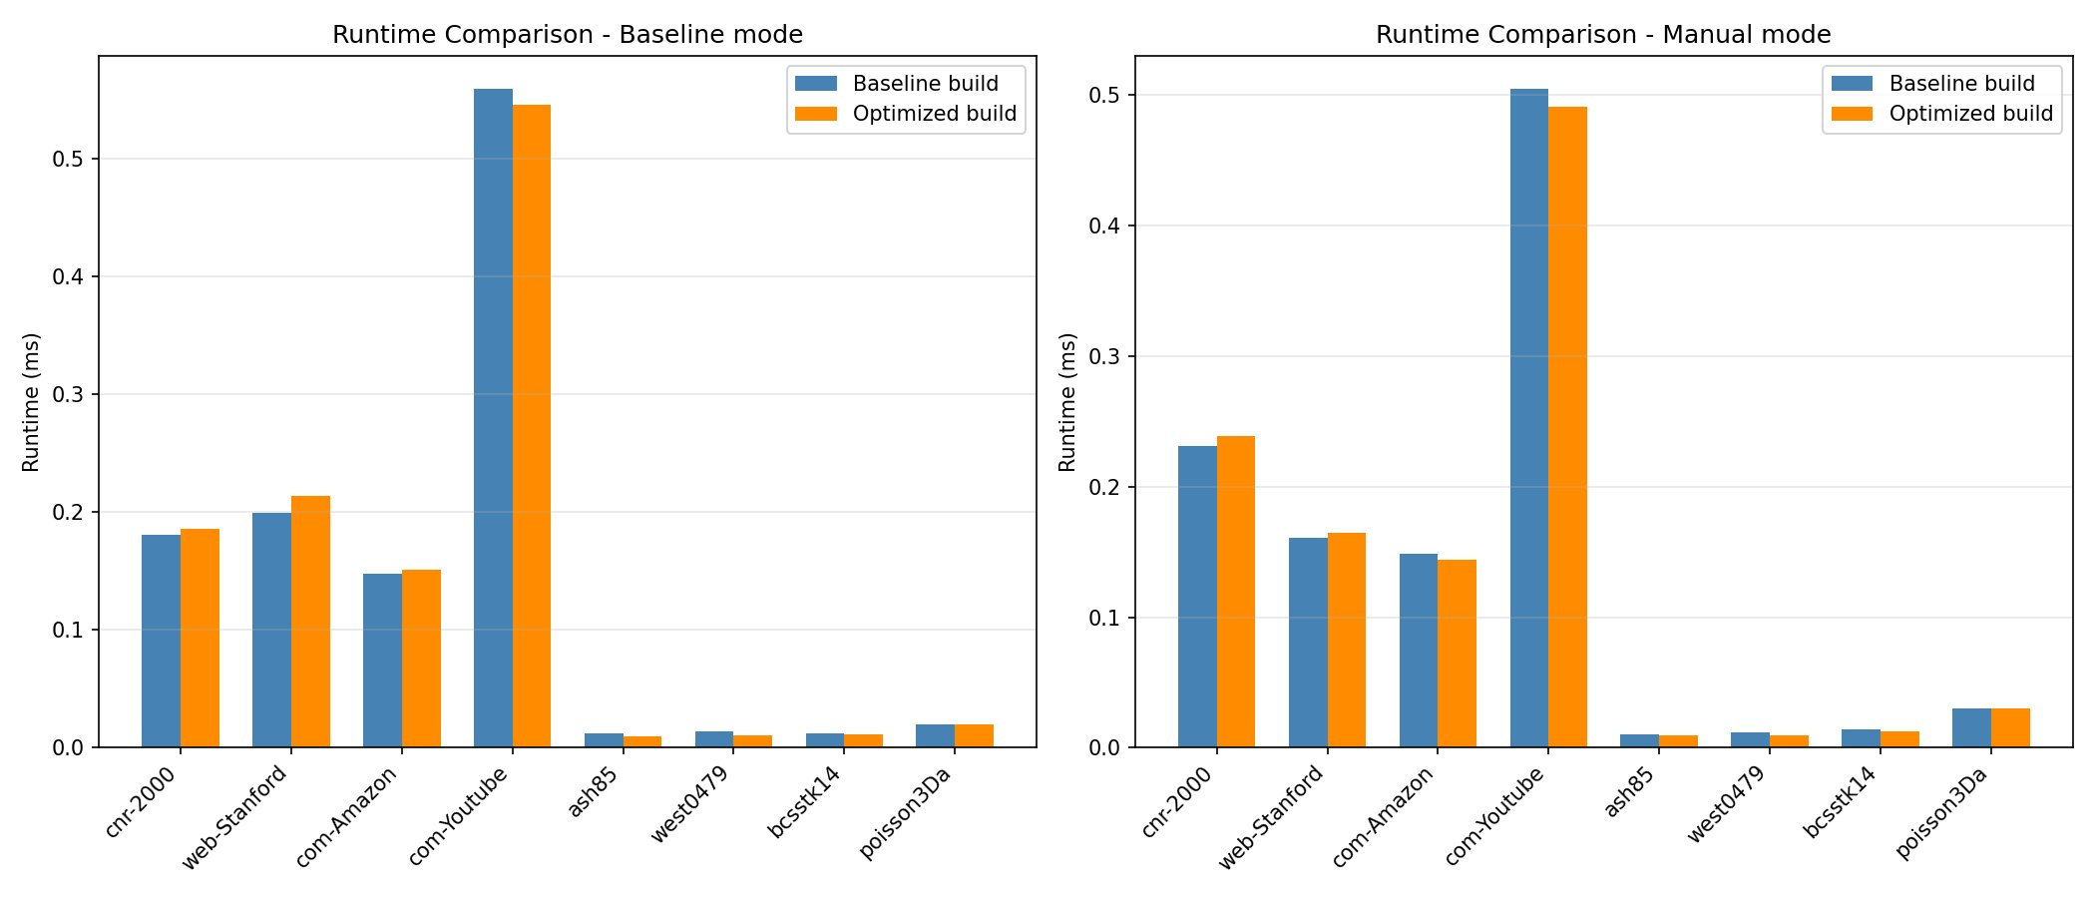
Runtime Comparison

Slide 5
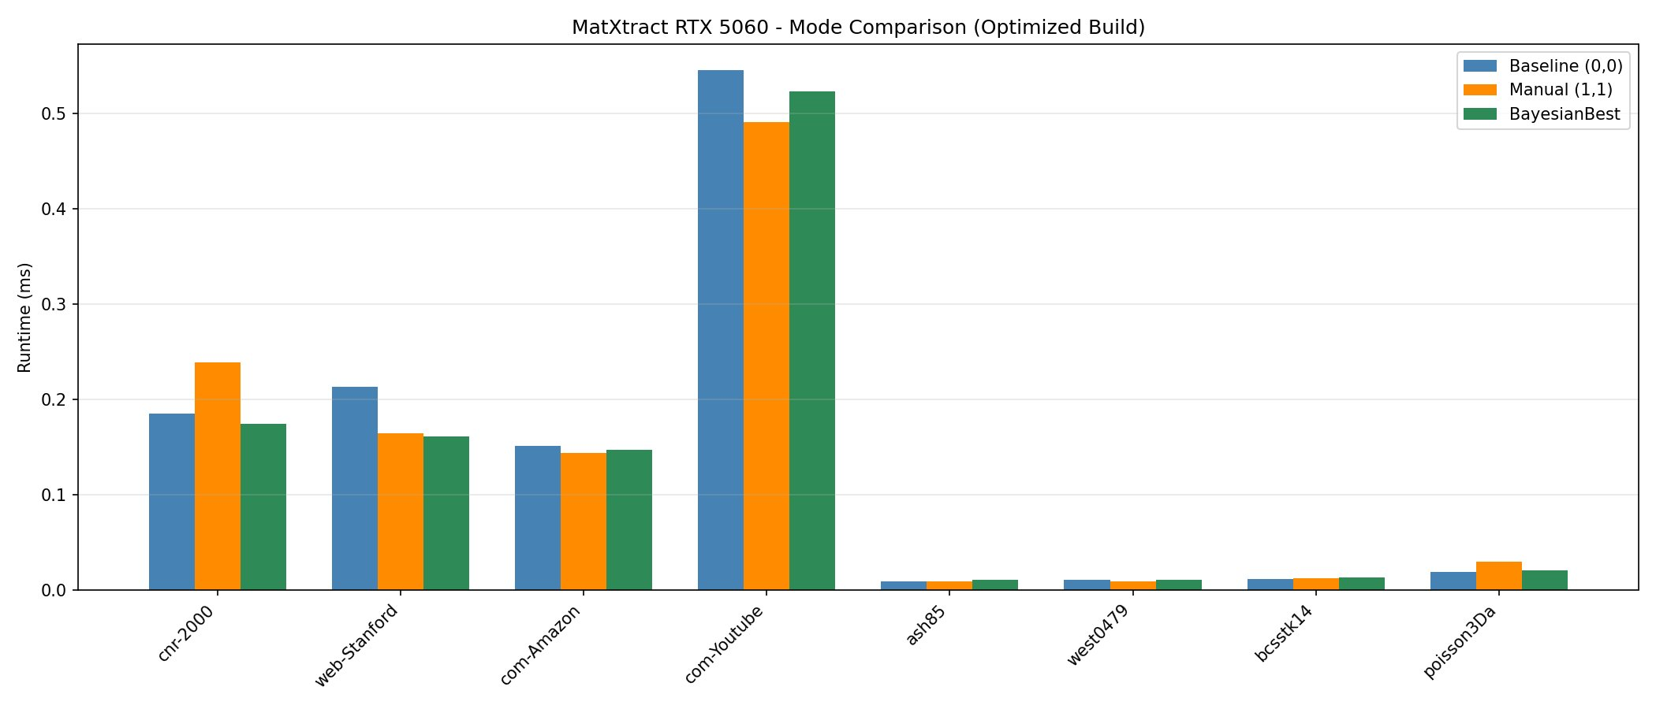
RTX 5060 — Mode Comparison
Baseline
The Baseline (or cuSPARSE) mode is the "out-of-the-box" reference using standard, un-tuned CUDA kernels that rely on NVIDIA’s pre-optimized libraries for general-purpose execution.
Manual
The Manual mode uses fixed, human-defined heuristics (such as forced blocking or specific tiling sizes) applied uniformly across all datasets regardless of their unique sparsity patterns.
Bayesian
The Bayesian (cruxBO) mode uses machine learning to perform a per-matrix search, automatically identifying the specific hyperparameters (like col_frac or hot_frac) that minimize latency for that exact matrix structure.

Slide 6
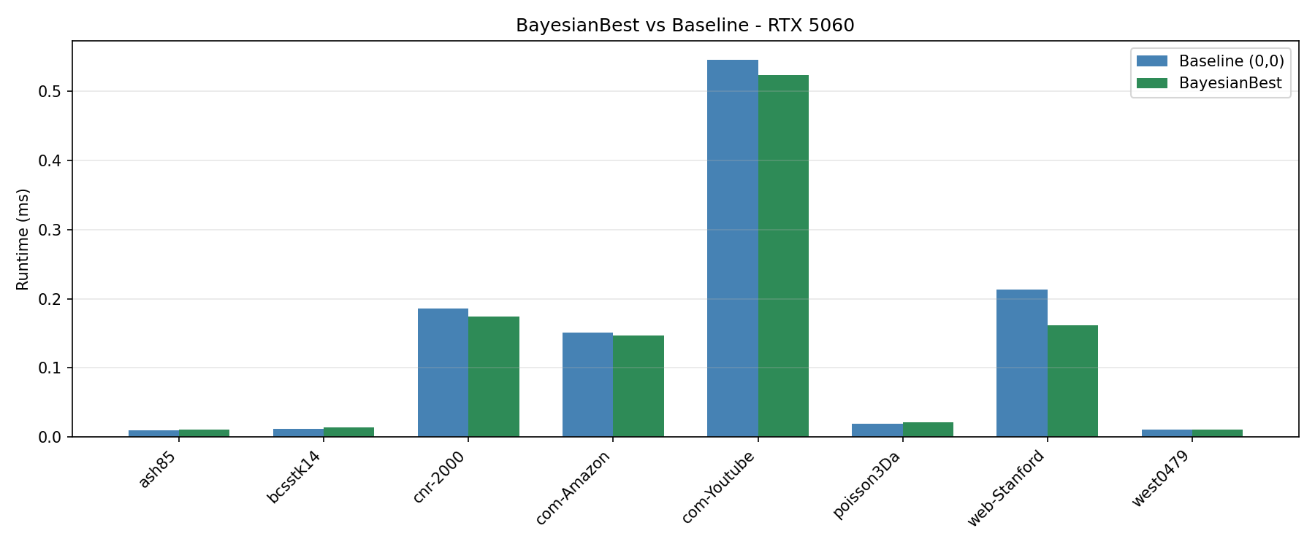
Bayesian vs Baseline

Slide 7
Benchmark Results: Runtime by Mode & Matrix
Per-Matrix Runtime (ms) by Mode
*
Matrix Name | Baseline (ms) | Optimized (ms) | Speedup | Status
ash85 | 0.0122 | 0.0094 | 1.29x | GAIN
bcsstk14 | 0.0125 | 0.0114 | 1.10x | GAIN
cnr-2000 | 0.1807 | 0.1857 | 0.97x | REG
com-Amazon | 0.1479 | 0.1511 | 0.98x | REG
com-Youtube | 0.5594 | 0.5456 | 1.03x | GAIN
poisson3Da | 0.0194 | 0.0194 | 1.00x | REG
web-Stanford | 0.1993 | 0.1528 | 1.30x | GAIN
west0479 | 0.0134 | 0.0111 | 1.21x | GAIN
The web-Stanford matrix saw the most significant improvement with a 1.30x speedup, dropping from 0.1993 ms to 0.1528 ms.
Small, irregular matrices like ash85 and west0479 achieved gains of 1.29x and 1.21x respectively, as the optimized build reduced instruction overhead on the SM120 architecture.
Large datasets like cnr-2000 and com-Amazon experienced regressions (0.97x and 0.98x), likely due to optimization flags disrupting memory coalescing on the 288 GB/s bandwidth interface.

Slide 8
Speedup Analysis, Findings & Future Work
Speedup Summary (Baseline vs. Optimized)
Metric Value
Mean speedup 1.020x
Median speedup 1.014x
Cases > 1.0 (faster) 11 / 20 (55%)
Best speedup 1.430x (west0479/cruxBO)
Largest regression 0.453x (poisson3Da/cruxBO)
Nsight Systems traces 20 / 20 (100%)
Key findings
Baseline performed worse on irregular matrices because its un-tuned kernels do not account for specific sparsity patterns like column density or "hot" data regions.
Bayesian (cruxBO) beat the baseline by using machine learning to find the exact Col Frac and Hot Frac values that optimize memory access for a specific matrix structure.
Local PC testing on the RTX 5060 provided "bare-metal" performance results with low latency, whereas cloud execution would likely offer higher HBM (High Bandwidth Memory) bandwidth

